Slide 1
Intelligent Speed Monitoring and Alert System for Traffic Management

Slide 2
Objective
Tracking cars and detect their speed.
If a car speed crosses a certain threshold then mark it as violation of speed and capture that frame.
Automatic number plate recognition.
Send mail to concern authority with attachment of captured frame along with the vehicle number.

Slide 3
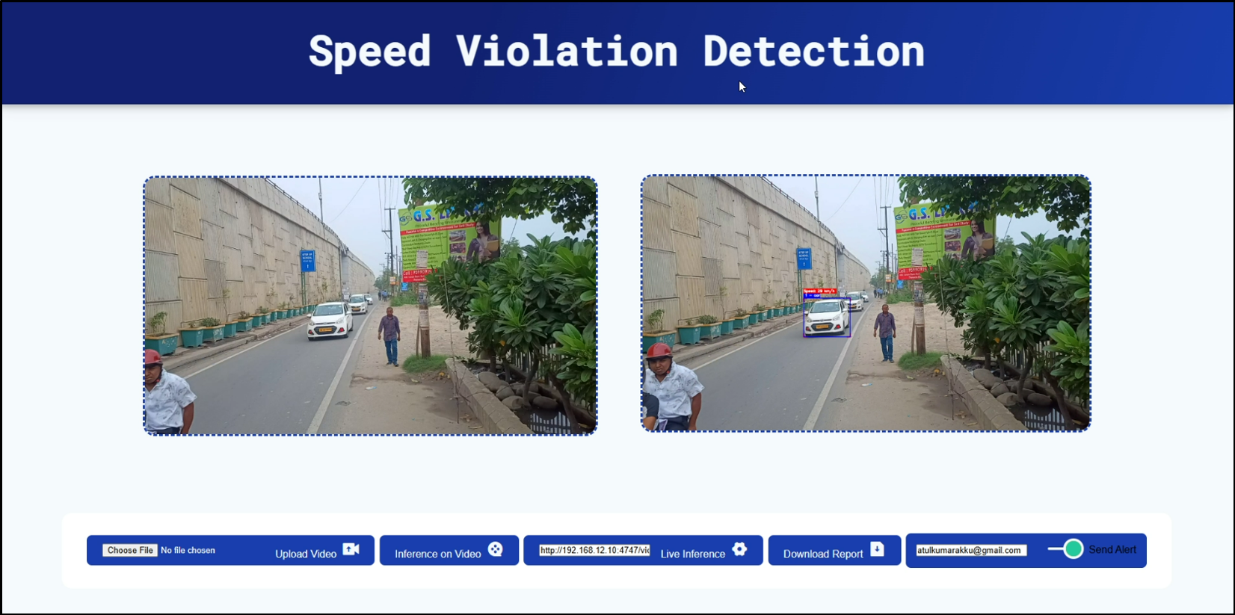
Screen Shot

Slide 4
Technologies
Object Detection - Yolo V9
Object Tracking - DeepSORT
ANPR - EasyOCR
Alert System - GmailAPI
GUI - Flask
Deployment
Software - Containerization
Hardware - NVIDIA DGX A100

Slide 5
Object Detection vs Object Tracking
Object Detection
Object Tracking
Object detection identifies “what and where”.
Identifies and locates objects in individual frames.
Works frame by frame without maintaining object identity.
Example: Detecting a car in a single frame.
Applications: Autonomous vehicles, surveillance, and image recognition.
Object tracking focuses on “where it moves”.
Continuously follows detected objects across multiple frames.
Maintains object identity over time.
Example: Following a car’s movement across frames in a video.
Applications: Traffic monitoring, sports analytics, and motion capture.

