Slide 1

cobweb
AN ONLINE IDE TO WORK WITH HTML,CSS AND JAVASCRIPT

Slide 2

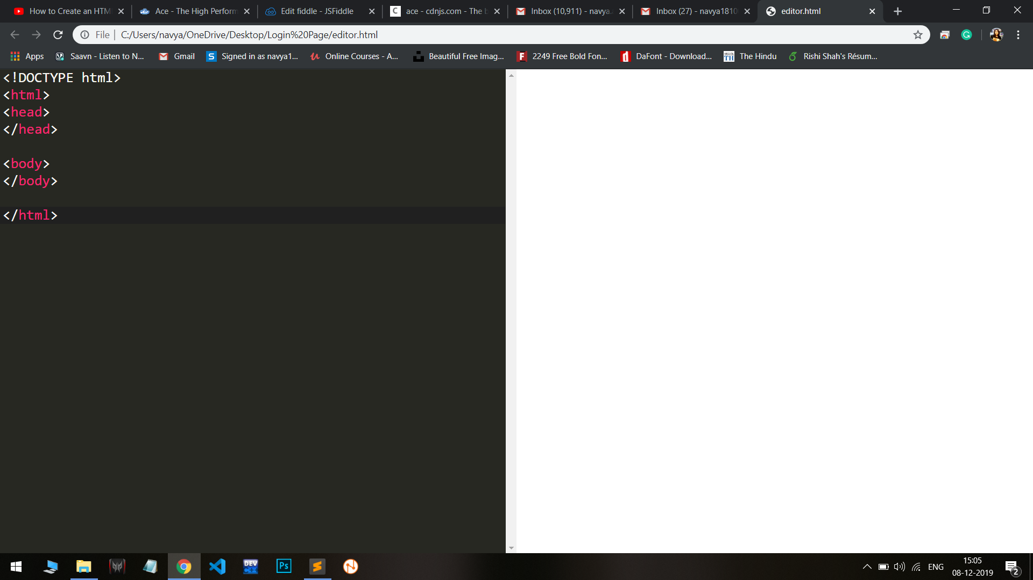
introduction
AN INTEGRATED DEVELOPMENT ENVIRONMENT (IDE) IS A SOFTWARE APPLICATION THAT PROVIDES COMPREHENSIVE FACILITIES TO COMPUTER PROGRAMMERS FOR SOFTWARE DEVELOPMENT. IT IS A PROGRAMMING ENVIRONMENT THAT HAS BEEN PACKAGED AS AN APPLICATION, TYPICALLY CONSISTING OF A CODE EDITOR, A COMPILER, A DEBUGGER, AND A GRAPHICAL USER INTERFACE (GUI) BUILDER. AN IDE NORMALLY CONSISTS OF AT LEAST A SOURCE CODE EDITOR, BUILD AUTOMATION TOOLS AND A DEBUGGER.

Slide 3
ABSTRACT
This website is an ide for writing html, CSS and JavaScript codes and getting a preview for the written codes. The users can save their codes and upload on the website, if they wish to. other users will also be able to access these codes, and can edit these codes as well if granted access by the developer of that project. We will use html and css in the frontend and Django Framework in the backend to develop this website. The webpage will help students learn and explore web development , improve their sense of design as well as generate new ideas by looking at existing codes.

Slide 4

Technology USED
Javascript
HTML
CSS

Slide 5
HTML
AN ONLINE IDE TO WORK W Hypertext markup language (HTML) is the standard markup language for documents designed to be displayed in a web browser. It can be assisted by technologies such as cascading style sheets (CSS) and scripting languages such as JavaScript.
WEB browsers receive html documents from a web server or from local storage and render the documents into multimedia web pages. Html describes the structure of a web page semantically and originally included clues for the appearance of the document.

Slide 6
JAVASCRIPT
JavaScript id s lightweight, interpreted, object-orientated language with first-class functions, and is best known as the scripting language for web pages, but it's used in many non-browser environments as well. It is a prototype-based, multi-paradigm scripting language that is dynamic and supports object-oriented, imperative and functional programming styles.

Slide 7
CSS
Cascading style sheets, fondly referred to as css, is a simple design language intended to simplify the process of making web paged presentable. It handles the look and feel part of a web page. Using CSS, you can control the color of the text, the style of fonts, the spacing between paragraphs, how columns are sized and laid out, what background images or colors are used, layout designs, variations in display for different devices and screen sizes as well as a variety of other effects.

Slide 8
System design
LOGIN
COBWEB
CODE/OUTPUT
SIGNUP

Slide 9
This is the homepage for the website.
COBWEB
Search
SIGN UP
Start Coding
HTML
JS
CSS

Slide 10
When "Start Coding" is clicked , this page opens.
COBWEB
LOGIN PAGE
Username
Password
LOG IN
If not a member, Sign Up

Slide 11
When "Sign Up" from homepage and login page is clicked, this page opens.
COBWEB
SIGNUP PAGE
Name
Username
Password
Email
SIGN UP

Slide 12
When "Log In" from Login page and "Sign up" from Signup page is clicked, this window opens.
COBWEB
Code..
Output

Slide 13


Experimental prototype

Slide 14

Limitations:
CANNOT AUTOMATICALLY FIX EROORS, STILL NEED KNOWLEDGE TO CODE EFFICIENTLY.
Text prediction is not provided.

Slide 15
REFERENCES
https://www.youtube.com/watch?v=jEeYPFFmMcs
https://www.w3schools.com/php/func_mysqli_connect.asp
https://www.youtube.com/watch?v=arqv2YVp_3E
https://codepen.io/picked-pens?cursor=ZD0xJm89MCZwPTEmdj01NzY5Mg==

Slide 16

Thank You!
Manya rampuria (18100030)
Navya Agrawal (18100036)
VIdhi sharma (18100058)

