Slide 1
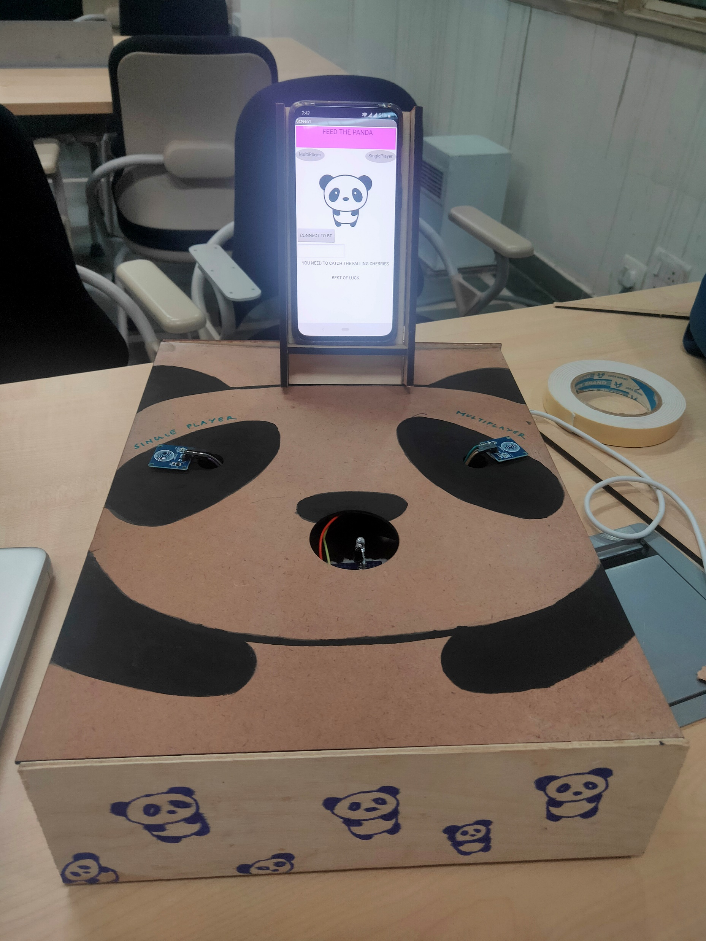
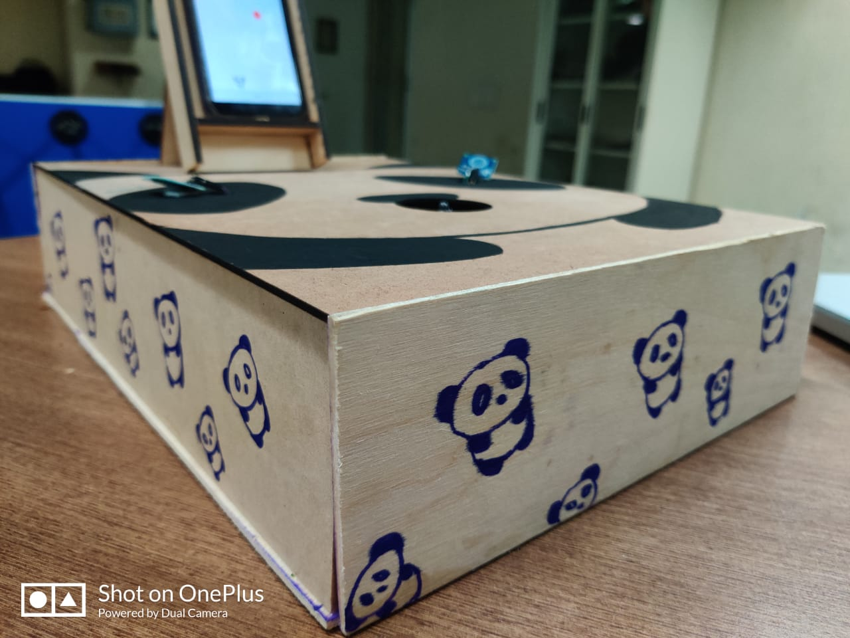
FEED THE PANDA
IN THIS GAME YOU NEED TO CATCH THE FALLING CHERRIES .
THE GAME IS DESIGNED FOR BOTH MULTIPLAYER AND SINGLEPLAYER.
INSTRUCTIONS –
TOUCH THE LEFT SENSOR TO PLAY SINGLEPLAYER GAME
TOUCH THE RIGHT SENSOR TO PLAY MULTIPLAYER GAME
BLOCK THE IR SENSOR TO MOVE THE PANDA RIGHT ELSE IT WILL GO LEFT
IN MULTIPLAYER GAME , THE PLAYER WHO CATCHES MORE CHERRIES WINS

Slide 2
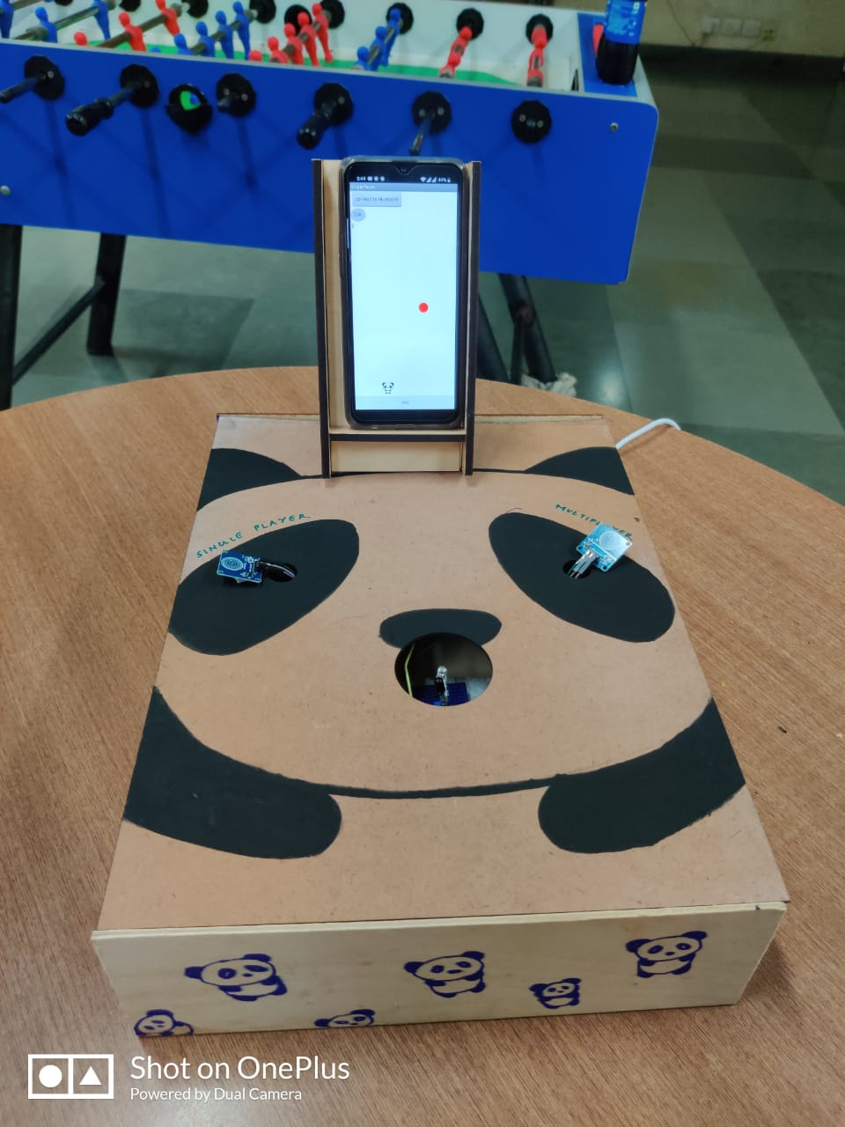
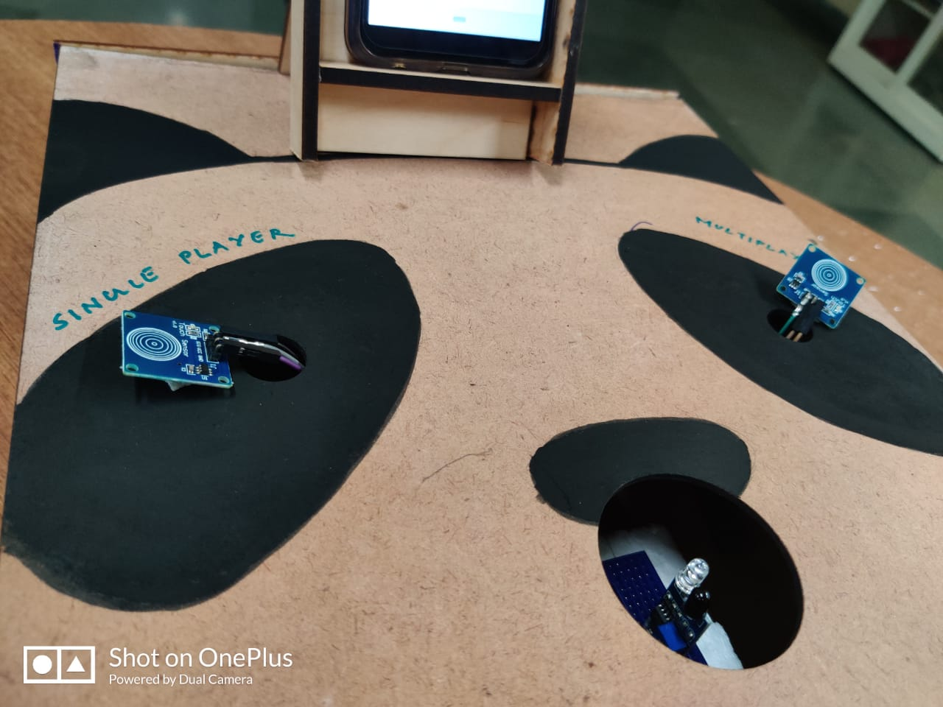
DESIGN
THIS GAME IS DESIGNED USING MIT APP INVENTOR. THESE COMPONENTS ARE USED
TO CONTROL THE GAME –
ARDUINO – CREATES INTERACTIVE ENVIRONMENT
IR SENSOR – CONTROLS THE MOVEMENT OF PANDA
TOUCH SENSOR – CONTROLS THE SELECTION OF MULTIPLAYER AND SINGLEPLAYER
BLUETOOTH CLIENT – USED TO CONNECT THE ARDUINO WITH THE MIT APP INVENTOR

Slide 3

DESIGNED BY
DOLLY SIDAR 2019304
SIRAJ ANSARI 2019176
VIDHI SHARMA 2019286

