Slide 1
AOES
(Advanced Onion Encryption Standard)
Mentor: Prof. Manish Gupta

Slide 2
01
04
Introduction
Software Implementation
Problem
Formulation
02
05
Security Analysis
Conclusion
03
06
AOES

Slide 3
01. Introduction

Slide 4


User Concern
Is my transaction info safe
with me?

Slide 5

Financial cryptography
Financial Cryptography Ensures the protection of transaction with various mechanisms and algorithms.

Slide 6
02. Problem Formulation

Slide 7
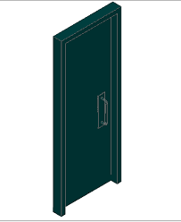

What is the problem?
Transaction Information

Slide 8

When the transaction info is protected by only one lock i.e. One Encryption method,
It is easy for hacker to unlock the only door i.e.Decrypt and get all the transaction info.

Slide 9


Solution Approach:
Decryption
Key
Multiple Doors

Slide 10


Solution Approach:
Decryption
Key

Slide 11

Solution Approach:
Decryption
Key

Slide 12

When the key of encrypted transaction info is protected by multiple locks i.e. multiple Encryption methods,
The hacker will practically not be able to find out the encryption key because it is hidden under multiple level encryption.

Slide 13
Mental Model

Slide 14


Mental model
Encryption:
Original
Key
Encrypted
Key
Encryption
round_1
Encryption
round_2
Encryption
round_n
Decryption:
Encrypted
Key
Original
Key
Decryption round_n
Decryption
round_(n-1)
Decryption
round_1

Slide 15
Major Disadvantages of these techniques and
How our cryptosystem overcomes them!
AES
DES
RSA
AES is fast and secure but key must be delivered safely with the encrypted data.
We encrypted the key using 3DES(Symmetric) and RSA(Asymmetric).
Moreover we also used custom padding to hide the key among the data bits.
Slower than AES
Now, 3DES would be slow for the whole data stream.
But if we use it on just a few blocks, it would not affect the performance and also provide security.
We will use DES only on the key.
Complex and slow
Key management
It will only be used on key so there is no issue of time complexity
Key will be safely transferred using the custom padding technique.

Slide 16
03. AOES
(Advanced Onion Encryption Standard)

Slide 17
AOES (Advanced Onion Encryption Standard)
This cryptosystem is mainly designed to overcome the drawbacks of currently used classic methods.
Naming has been done on the basis of the onion analogy, i.e. there are many layers of an onion and digging through each of them is hard (almost impossible).
Main goal is to make it impossible for cryptanalyst to crack the system, make it faster for the users and easy to send bits-data without fear of data theft.

Slide 18
Custom Padding
128 Bits
1
7 bits
120 bits
Parity Bit
Data bits
Addressing Bits

Slide 19
Custom Padding
1 bit for Parity check (Padding there or not)
7 bits to be considered as an integer k (Binary to int).
120 bits are data bits (real+random).
First bit is Parity check bit:
0 - No padding is done i.e. all 120 bits are real data bits.
1 - Padding is done and some of 120 bits are real and rest are randomly generated.
If Parity check bit is 1 :
If k<120, then k bits out of 120 are real and rest are randomly generated.
If k≥120, then the given block is a key-block.

Slide 20
AES for data using Key K
AES decryption of data
2DES & RSA on Key K
Decryption of the Key
Custom padding
Collecting data
ENCRYPTION LAYERS
DECRYPTION LAYERS
Simple AES Encryption of plain
data stream.
Then the AES key is used to decrypt the data (cipher) stream into plain/initial data stream.
The key k (used in AES) is encrypted using DES and RSA.
The main AES (cipher) key is decrypted using 3DES and RSA keys.
The final encrypted data is converted into bit-stream using custom padding scheme to hide keys in the stream itself
Separating keys and data stream from the padded bit-stream

Slide 21
AOES Encryption (Step-wise)
Simple AES encryption of plain data using key k1..
Encrypting the key k1(AES key) using 3DES.
Encrypting it further using RSA (an asymmetric encryption method).
Generating corresponding bit-stream (using custom padding technique) that consists of these following things:AES encrypted data, AES key(encrypted), 3DES key and RSA key.

Slide 22
Key Encryption Algorithm
128 bit key(k1)
64 bit
64 bit
3DES Encryption
64 bit
64 bit
128 bit key
RSA Encryption
k

Slide 23
Step 4: Generation of Bit-stream
It can be done in following sub-steps:
Firstly the Cipher-text from step 1 can be divided into blocks using the Custom Padding scheme.
Keys are stored in form of blocks.
They are sent in a random order to the receiver which is nearly impossible to crack without knowing the perfect method.

Slide 24
Step 4: Generation of Bit-stream
Now, we will generate a bit stream which includes k2(3DES key) , k3(RSA key) , k(final encrypted key) and the cipher-text which we got in step 1.
k2
k3
k
Resultant Cipher Text
Key Blocks
m1
m2
. . . . . .
mn
Cipher Data blocks

Slide 25
Key Expansion:
For each 128-bit key -two blocks of 64 bits will be generated and that will be secured in following way:
128 bit key
64 bit
64 bit
Padding algorithm applied to each 64 bit block
1 bit
7 bits
120 bits
Parity check bit which determines whether the block is padded.
In which 64 bits of keys is hidden and the address of the hidden key can be known from 7 addressing bits.
Addressing bits

Slide 26
Step 4: Generation of Bit-stream
Forming a key-block:
In the key-blocks, we will set the Parity-check bit as 1 and the addressing bits as a value
Here, x>=120, which will act as an indication that the block is a key-block.
Note: We will have 8 blocks numbered 120 to 127 for storing keys in this cryptosystem.Hence total of 120*8=960 bits can be stored as keys for AOES cryptosystem.

Slide 27
AOES Decryption (Step-wise)
Analyze the padded bit stream and then separate the keys - RSA key,3DES key,Final key as well as the data stream.
Decrypt the Final key by using the RSA encryption key.
Decrypt the resultant key-gained in step 2 using 3DES key-this decryption will gives us the real key of AES.
Now,Decrypt the data stream i.e. cyphered text using the obtained key.

Slide 28
Step 1: Dissecting the padded bit stream
The algorithm for dissecting is as follows:
For each block chain, firstly we will check whether it is a data block or a key-block.
If it is a data block then according to the padding scheme, add the real bit-data to the main cipher text stream.
In this way the cipher text of AES could be regenerated.
During the process of iterating through the bit-stream, collect all the key blocks and then decide.

Slide 29
Step 1: Dissecting the padded bit stream
k2
k3
k
Key Blocks
m1
m2
. . . . . .
mn
Cipher Data blocks
k3
k2
k
Cipher Text

Slide 30
Key Decryption Algorithm
k
RSA Decryption
128 bit key
64 bit
64 bit
3DES Decryption
64 bit
64 bit
128 bit key(k1)

Slide 31
04. Software Implementation

Slide 32
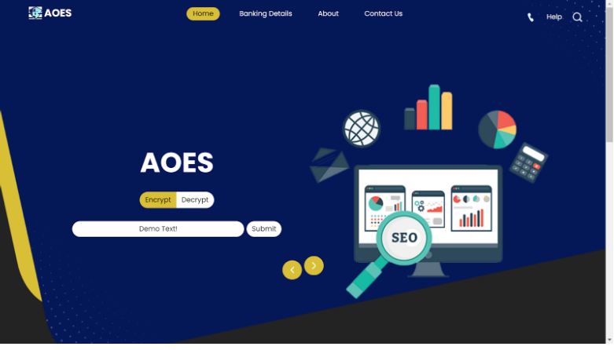

Slide 33
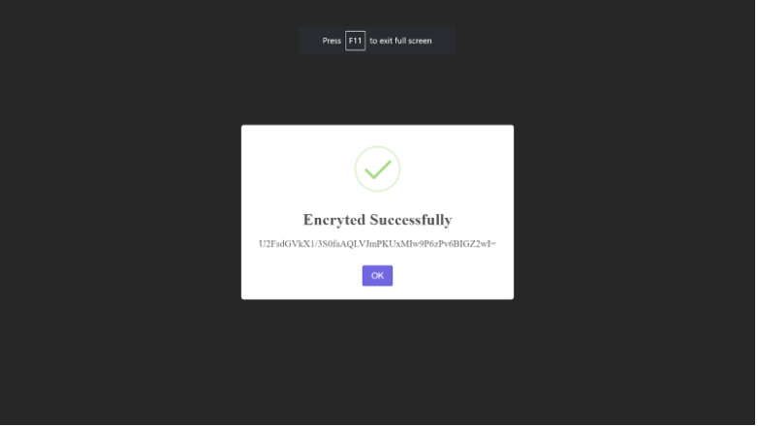

Slide 34
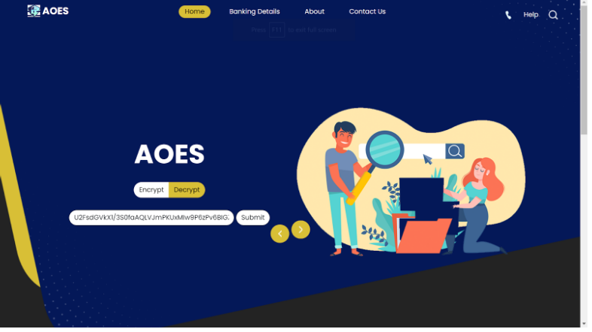

Slide 35
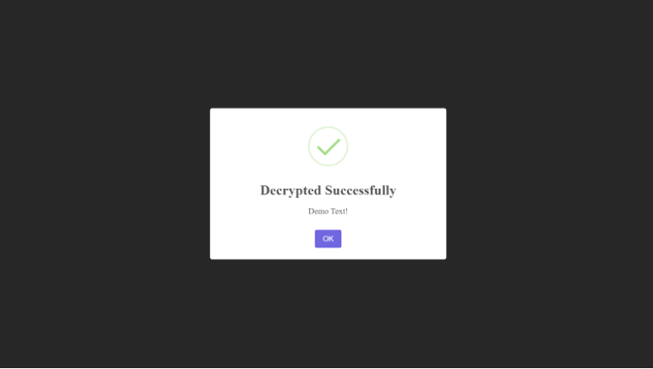

Slide 36
Security Analysis for Different methods used

Slide 37
Security Using RSA
RSA encryption is a deterministic encryption algorithm.
An attacker can easily launch a chosen plaintext attack against the cryptosystem. Since we are using custom padding(random components within actual data and key block) this issue is solved.
RSA is further secured because of two mathematical problems:
i) The problem of factoring large numbers ii) the RSA problem.

Slide 38
Security Using 3DES
By 3DES algorithm it would require greater effort which is 3 times as compared to the classic one.
Classical algorithm
requires 2⁵⁶ attempts
to find the correct key

Slide 39
Security using AES
Effectiveness of cryptographic technique against brute force attack
Exhaustively testing each potential key combination require billions of years to crack AES
Time Security

Slide 40
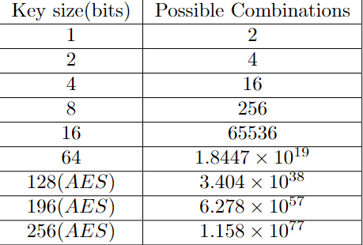
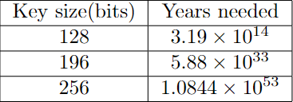
Time Security
Estimated Years to break AES
Maximum Key Combination

Slide 41
Security using AES
Avalanche effect
A cryptosystem has the avalanche property if the output changes dramatically (about half of the output) after flipping or changing just a single bit in plaintext or in the secret key.
Cryptanalysts are able to determine the plaintext by examining the Ciphertext in cases where a cipher does not exhibit a desired level of avalanche effect.

Slide 42
05. Security Analysis for AOES

Slide 43
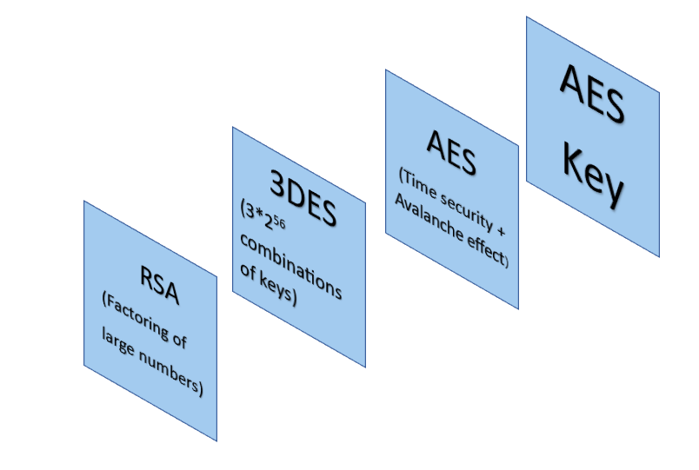

Slide 44
06. Conclusion

Slide 45
Advantages of AOES
AOES is faster and more secure than DES and RSA.
AOES is more secure than AES, DES and RSA as multiple keys and multiple levels will make it hard to crack without any hints.
It encrypts the key using an asymmetric method of encryption i.e. RSA, and hence provides extra security while sending data.
The padding scheme is custom and some parts of bits are randomly generated and the cryptanalyst would not be able to figure out which are the real data bits.

Slide 46
Drawbacks of AOES
AOES padding scheme is unique and strong but if the scheme leaks, then the security may be threatened because it would be easy for cryptanalyst to find the keys.
Secure but Costly. Wastage of bandwidth by sending too many randomly generated bits.
AOES is merely an integration of a few methods and a complex algorithm to implement.

Slide 47
Group Members
Vatsal Sutariya(202001027) (Group Leader)
Vidhi Ahir(202001195)

