Slide 1
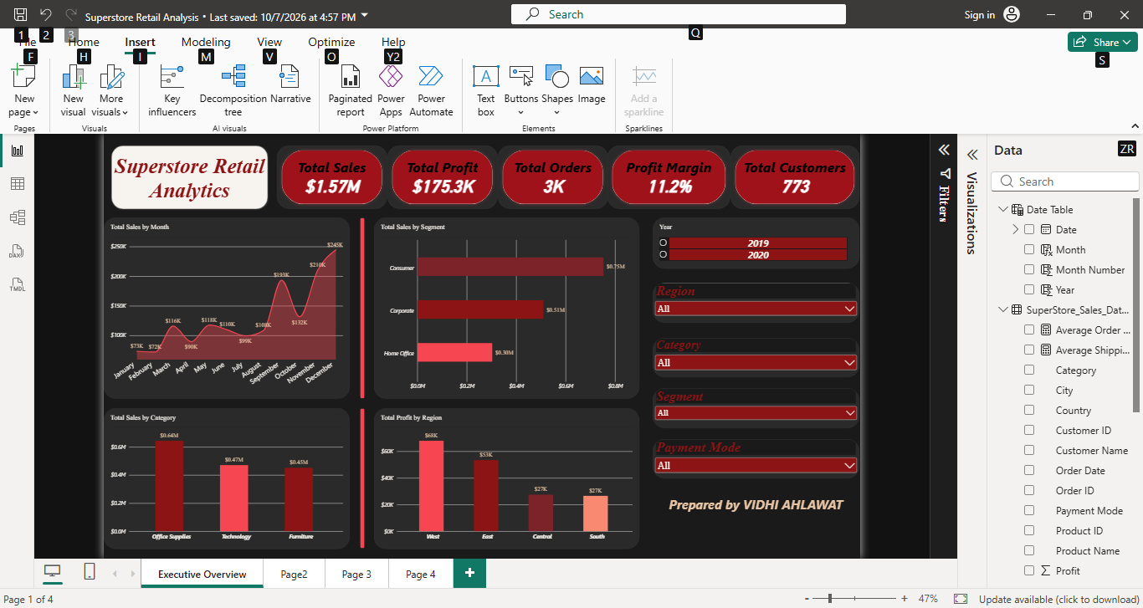
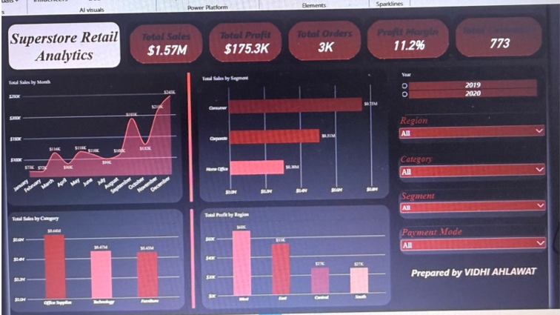
Retail
Analytics
SUPERSTORE
A four-page interactive Power BI dashboard
Sales • Products • Customers • Operations
01
02
03
04
Sales
Products
Customers
Operations
Prepared by: Vidhi Ahlawat
Notes:
Introduce the project and explain that it is an interactive Power BI report with four analytical pages.

Slide 2




Project Objective
PROJECT OVERVIEW
Turning retail transaction data into a clear view of business performance
The goal of this project is to explore sales, profitability, product performance, customer behaviour and operational patterns through an interactive Power BI report.
Measure performance
Find patterns
Explore operations
Support decisions
Track sales, profit, orders, customers and margin.
Compare categories, regions, customer segments and time periods.
Review shipping modes, payment modes and shipping-time patterns.
Use filters and visuals to investigate performance.
Notes:
Explain that the objective is to turn transaction data into a clear view of performance and operational patterns.

Slide 3


Dataset Overview
PROJECT OVERVIEW
Superstore sales transactions covering 2019–2020
TIME PERIOD
Key fields used
2019–2020
Order Date and Ship Date
Category, Sub-Category and Product Name
Customer Name, Segment, Region, State and City
Sales, Profit, Quantity, Ship Mode and Payment Mode
order dates
Data fields
Orders, customers, products, dates, shipping, sales and profit
Core measures created in Power BI
Data preparation
Total Sales
Total Profit
Total Orders
Total Customers
Removed unusable helper columns and the all-NA Returns column; retained date fields.
Total Quantity
Profit Margin
Average Order Value
Average Shipping Days
Notes:
Describe the dataset fields and the main data preparation steps. Measures were created in Power BI for reusable calculations.

Slide 4
Executive Sales Overview
DASHBOARD 1 OF 4
A high-level snapshot of business performance
What this page shows
Sales, profit, orders, margin and customer KPIs
Monthly sales trend
Sales by segment and category
Profit by region
Dropdown filters for year, region, category, segment and payment mode
Notes:
Walk through the Executive Sales Overview: KPIs first, then monthly trend and category/segment/region visuals. Mention the slicers.

Slide 5
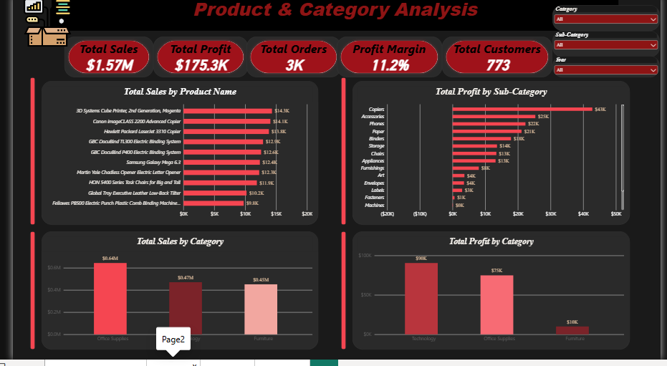
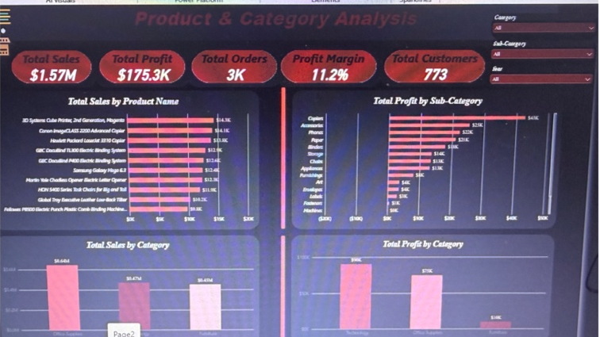

Product & Category Analysis
DASHBOARD 2 OF 4
Comparing category performance and identifying leading products
What this page shows
Sales and profit KPI cards
Sales by category
Profit by category and sub-category
Top 10 products by sales
Filters for category, sub-category and year
Notes:
Explain how the product page compares sales and profit and ranks the top 10 products.

Slide 6
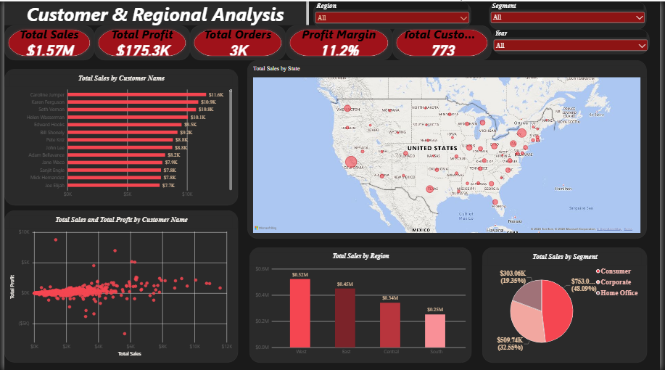
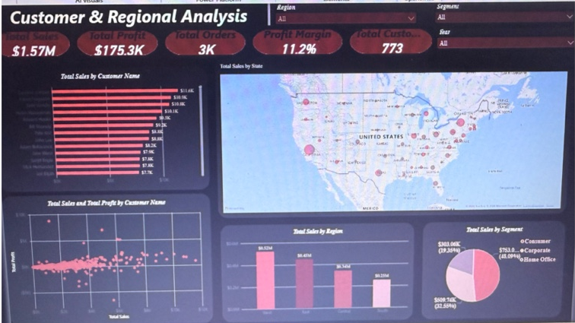

Customer & Regional Analysis
DASHBOARD 3 OF 4
Exploring customer value and geographic patterns
What this page shows
Sales by customer segment
Customer sales versus profit scatter plot
Top 10 customers by sales
Sales by state map and sales by region
Filters for region, segment and year
Notes:
Explain how the customer page combines segment mix, customer-level sales/profit, top customers and geography.

Slide 7
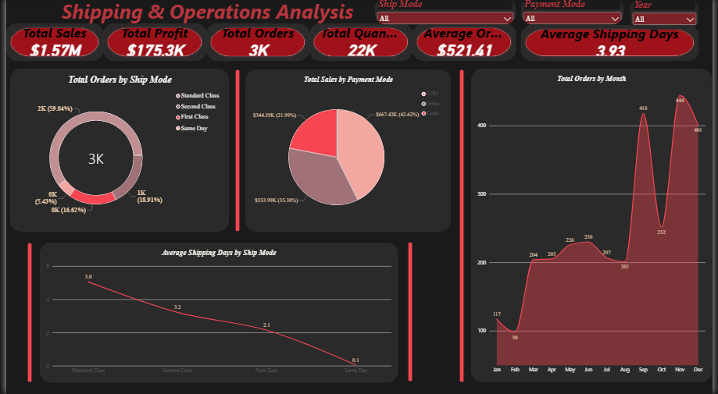
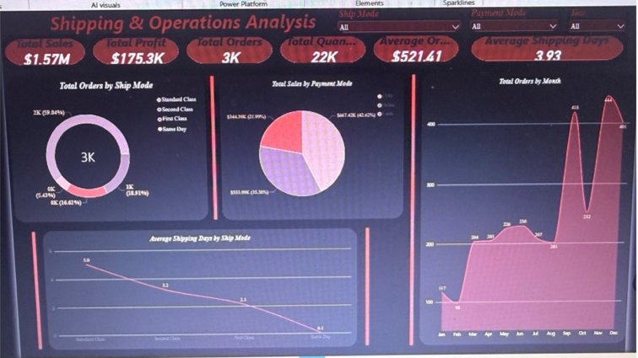

Shipping & Operations Analysis
DASHBOARD 4 OF 4
Reviewing shipping choices, payment mix and order patterns
What this page shows
Orders by ship mode
Sales by payment mode
Average shipping-time KPI and comparison by ship mode
Monthly order trend
Filters for ship mode, payment mode and year
Notes:
Explain how the operations page compares shipping modes, payment modes and monthly order volume. Average shipping days is based on Order Date to Ship Date.

Slide 8




Key Insights to Investigate
WHAT TO LOOK FOR
Use the report to validate patterns rather than relying on a single headline number
Revenue & profitability
Product performance
Customer & region
Compare sales and profit together; high revenue does not always mean high profit.
Look for categories and sub-categories that contribute strongly—or weakly—to profit.
Identify high-value customers and compare sales across regions and states.
Shipping patterns
Payment mix
Compare average order-to-ship time across shipping modes.
Check which payment modes contribute the largest share of sales.
Notes:
Use this slide to discuss patterns you would investigate. Avoid stating a specific finding unless you have confirmed it in the live report.

Slide 9
Recommendations
Potential next steps suggested by the types of analysis in the dashboard
1
Review low-profit sub-categories and investigate pricing, discounting and cost drivers.
2
Use the Top 10 product and customer views to understand where sales are concentrated.
3
Compare regional performance before deciding where to focus marketing or inventory.
4
Monitor order-to-ship time across shipping modes and investigate unusually long delays.
5
Use the slicers to compare years, segments, regions and payment methods before drawing conclusions.
Notes:
Explain that recommendations should be based on the detailed values and comparisons revealed by the report.

Slide 10
Conclusion
WRAP-UP
A single report for exploring retail performance from multiple angles
This Power BI project brings together sales, product, customer, regional and operational views in one interactive report.
Thank you
The four dashboards provide a foundation for asking better business questions, spotting patterns and supporting data-informed decisions.
SALES
PRODUCTS
CUSTOMERS
OPERATIONS
Notes:
Summarize the value of bringing the four views together and invite questions.

