Slide 1
SPORTS ACADEMY
MANAGEMENT SYSTEM
Project Presentation
Presented by: Vidhi Sukhlecha
MSc Semester IV • Computer Science
Shri Jain Kanya P.G. Mahavidhyalaya, Bikaner
Session 2025–26

Slide 2
About Me
My academic and project introduction
Vidhi Sukhlecha
College & University
My Contribution
MSc Semester IV Computer Science Project: Sports Academy Management System I worked on the web interface, PHP backend and MySQL database integration.
Shri Jain Kanya P.G. Mahavidhyalaya, Bikaner Maharaja Ganga Singh University, Bikaner Session 2025–26
• Interface screens • PHP coding • MySQL database • Student management • Coach management • Slots & fees • Edit / delete operations
Sports Academy Management System • Vidhi Sukhlecha • 2

Slide 3
Project Overview
Purpose of the Sports Academy Management System
• Web-based application for managing academy information.
• Main focus: admin-side management.
• Connects HTML/CSS/JavaScript pages with PHP and MySQL.
• Manages students, coaches, sports, time slots and fee records.
• The report follows SDLC stages including planning, analysis, design, coding and testing.
Admin Control
Central place to manage academy records.
Database
Structured storage using MySQL.
Web Interface
Forms, tables and dashboard screens.
Sports Academy Management System • Vidhi Sukhlecha • 3

Slide 4
Main Objectives
• Provide a simple admin interface.
• Maintain complete student information.
• Maintain coach information and experience.
• Manage sports and time slots.
• Track student fee records.
• Allow records to be edited or deleted.
• Display total and available seats for slots.
• Demonstrate frontend + backend + database integration.
Sports Academy Management System • Vidhi Sukhlecha • 4

Slide 5
Technology Stack
Frontend, backend and database technologies
HTML
CSS
JavaScript
PHP
Page structure, forms, tables and content.
Layout, styling, forms, tables and responsive design.
Client-side interaction and interface behavior.
Server-side processing, sessions and database operations.
MySQL
MySQLi
Relational database for academy records.
PHP connection to the sports_academy database.
Sports Academy Management System • Vidhi Sukhlecha • 5

Slide 6
Admin Modules & Workflow
How I would explain the system during the presentation
1. Login
Admin enters email/phone and password.
2. Dashboard
Admin reaches the main control screen.
3. Students
View, edit, delete and deposit fees.
4. Coaches
View, edit and delete coach records.
5. Slots
View sports, timings and seat availability.
6. Sports
Navigate Basketball, Cricket, Running, Badminton and Karate.
Sports Academy Management System • Vidhi Sukhlecha • 6

Slide 7
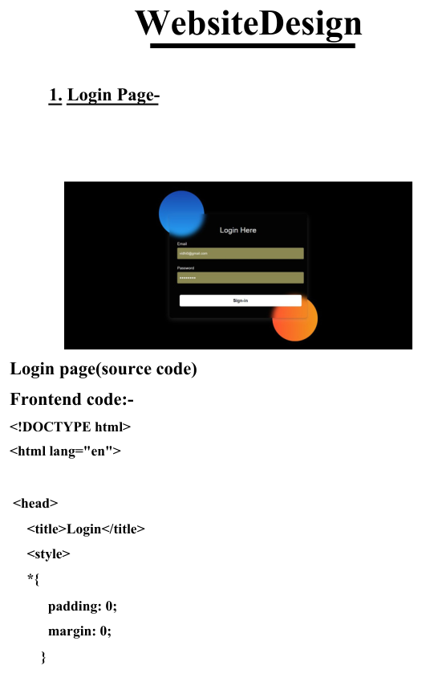
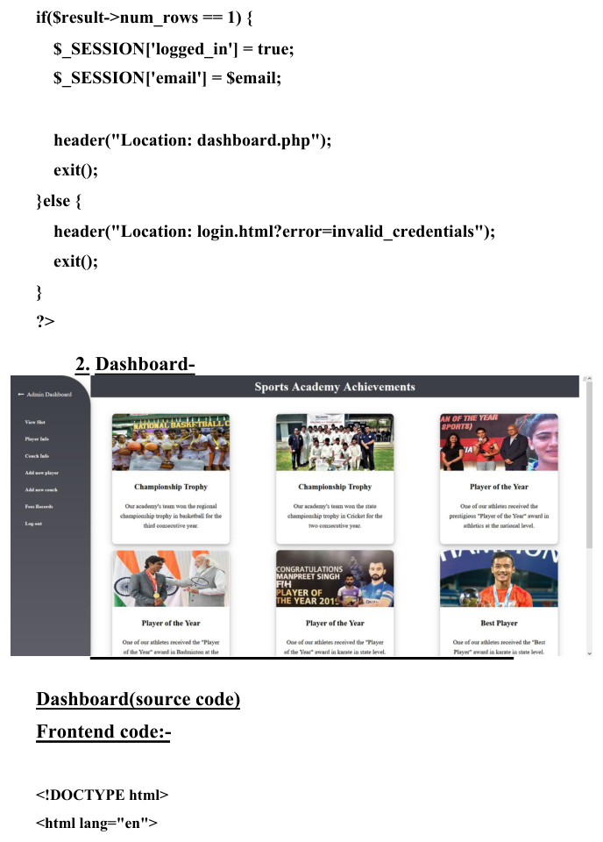
Login & Dashboard
Important screens from the project
Login page • Report page 23
Dashboard • Report page 28
Sports Academy Management System • Vidhi Sukhlecha • 7

Slide 8
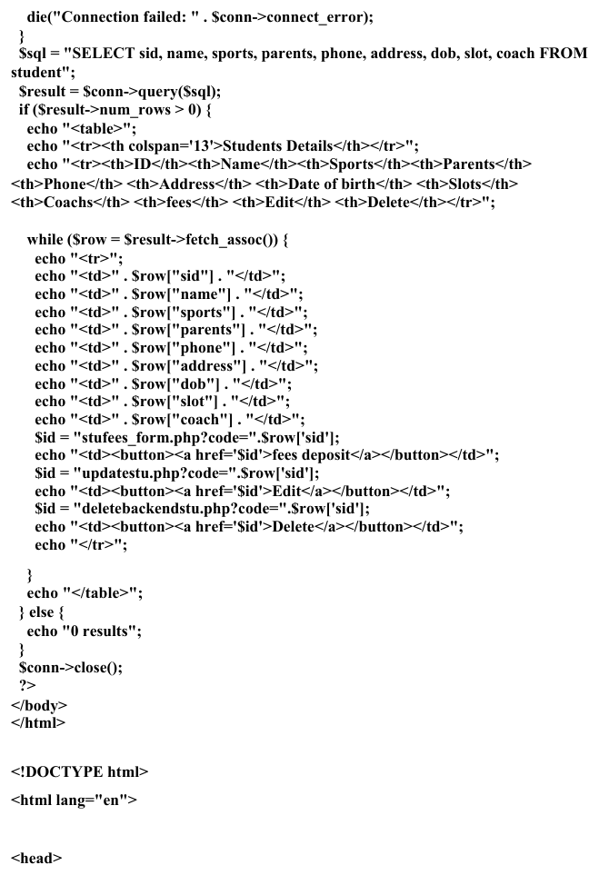
Student Management
Admin can maintain student records
• Student ID and name
• Sport, parents and phone
• Address and date of birth
• Assigned slot and coach
• Fee deposit action
• Edit and delete actions
Student details • Report page 37
Sports Academy Management System • Vidhi Sukhlecha • 8

Slide 9
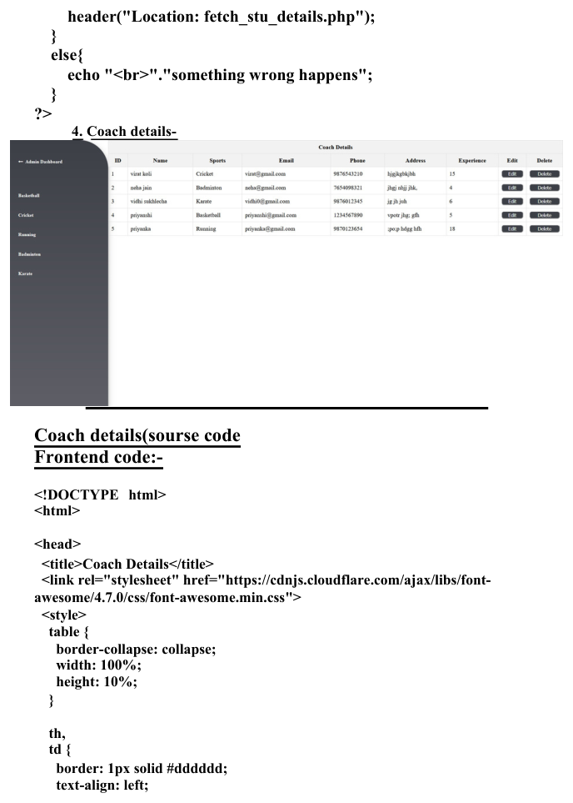
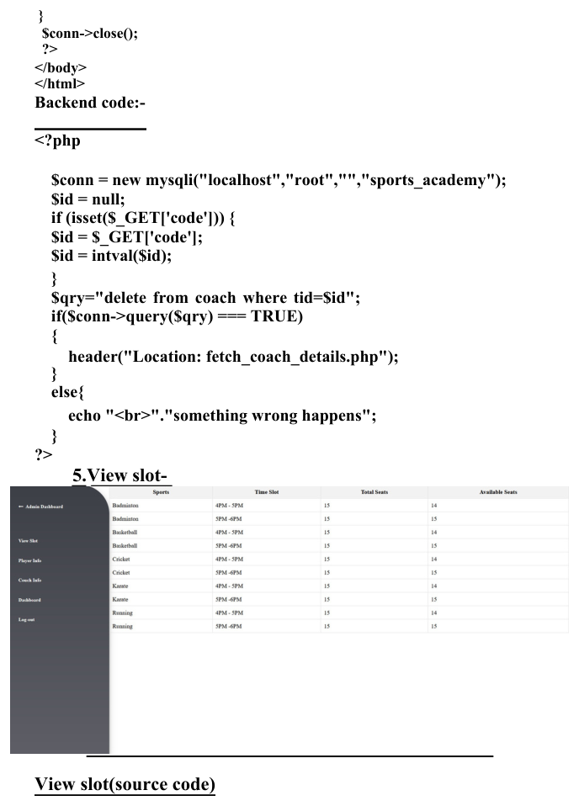
Coach & Slot Management
Managing coaches, sports and capacity
Coach details • Report page 42
View slot • Report page 47
Sports Academy Management System • Vidhi Sukhlecha • 9

Slide 10
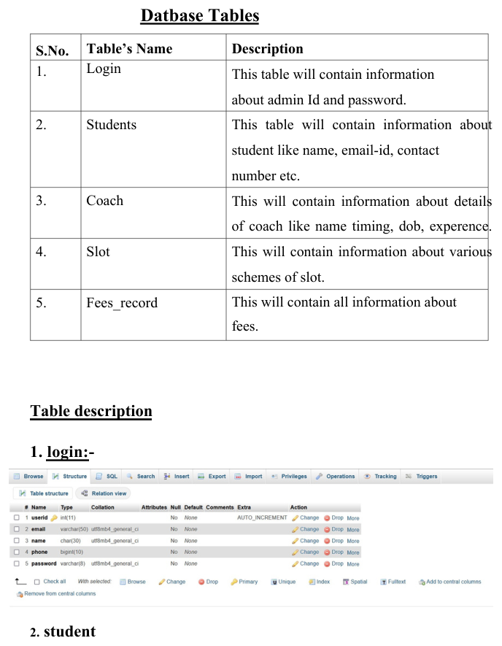
Database Design
Main tables used by the application
Login
Admin login information.
Students
Student details, sport, slot and coach.
Coach
Coach name, sport, contact and experience.
Slot
Sports, timings and seat availability.
Fees_record
Fee-related information.
Database tables • Report page 21
Sports Academy Management System • Vidhi Sukhlecha • 10

Slide 11
Coding & Backend
How the screens communicate with the database
• PHP connects to MySQL using MySQLi.
• Database name used in the code: sports_academy.
• SELECT queries retrieve student and coach data.
• UPDATE queries modify existing records.
• DELETE queries remove selected records.
• PHP sessions maintain login state.
• HTML forms send data to PHP backend files.
• Slot availability is calculated from the number of students in each sport and slot.
Student Flow
Form / request → PHP → MySQL → HTML table
Update Flow
Edit form → PHP backend → UPDATE query
Slot Flow
Count students → calculate available seats
Sports Academy Management System • Vidhi Sukhlecha • 11

Slide 12
Key Features
What the admin system provides
• Admin login and session handling
• Dashboard
• Student management
• Coach management
• Sports navigation
• Time-slot display
• Seat availability
• Fee deposit action
• Edit and delete records
• MySQL database integration
• Clean web forms and tables
• PHP backend processing
• SQL-based data retrieval
• CRUD-style operations
• Responsive interface elements
• Separate pages for sports
• Structured database tables
• Practical database-driven application
Sports Academy Management System • Vidhi Sukhlecha • 12

Slide 13
Conclusion
What I learned and what I can explain in viva
• I learned how a complete database-driven web application works.
• I worked with frontend design, PHP backend logic and MySQL.
• I understood how forms, SQL queries and database records connect.
• I gained practical experience with student, coach, slot and fee management.
• The project demonstrates my practical skills in web development and database management.
THANK YOU • QUESTIONS?
Sports Academy Management System • Vidhi Sukhlecha • 13

