Slide 1
ONLINE RETAIL II — SALES ANALYSIS
Data Analyst Assessment | VirtuBox Infotech
UCI Online Retail II dataset

Slide 2
Business Problem & Methodology
Business problem: understand revenue performance, product and market concentration, customer value, and cancellation/return patterns.
Dataset: UCI Online Retail II — transactional retail data covering December 2009 to December 2010 (December 2010 is partial).
Cleaning: removed exact duplicates; removed rows with missing Description and zero Price; excluded negative-price bad-debt adjustments from sales analysis.
Analysis-ready sales data: positive prices, non-zero quantities, revenue calculated as Quantity × Price.
Anonymous transactions were retained for overall sales analysis but excluded from customer-level analysis.

Slide 3
Key Findings
Net revenue
£9.64M
Positive sales
£10.27M
Top-10 customer share
16.68%
UK revenue share
~86%
Revenue accelerated strongly in September–November 2010, with November the highest full month at ~£1.42M.
The UK dominates revenue; international markets are much smaller individually.
Revenue is not extremely concentrated among the largest customers: the top 10 contribute 16.68% of customer-attributed revenue.

Slide 4
Product & Cancellation Deep Dive
REGENCY CAKESTAND 3 TIER is the #1 product by net revenue at ~£162.9K.
It also has the highest product-related cancellation value among the leading products at about -£7.0K.
Among top-selling products, its cancellation-value rate is about 4.14%, higher than the other major sellers reviewed.
Important interpretation: negative-quantity transactions include cancellations and operational adjustments, so they should not be treated as confirmed product defects.

Slide 5
Recommendations & Measurement
1. Investigate Regency Cakestand 3 Tier cancellations — owner: Product/Operations. Review order, fulfillment and cancellation reasons; track cancellation-value rate.
2. Protect the UK core while expanding selected international markets — owner: Commercial/Marketing. Prioritize EIRE, Netherlands, Germany and France; track monthly revenue and repeat sales.
3. Strengthen customer retention and cross-sell — owner: CRM/Marketing. Segment known customers by revenue/value and target high-value customers; track repeat purchase rate and customer revenue.

Slide 6
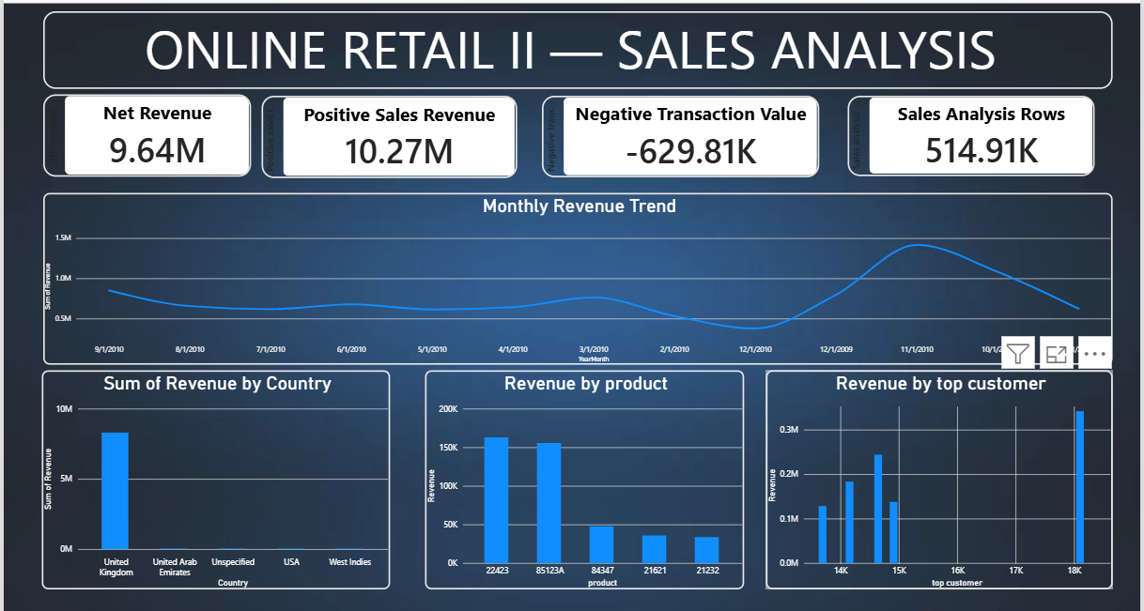
Dashboard, Limitations & Next Steps
Dashboard: KPI summary, monthly revenue trend, country revenue, product revenue and top-customer revenue.
Limitations: customer ID is missing for ~20.8% of cleaned rows; this limits customer-level conclusions.
Negative transactions combine product cancellations/returns and operational/financial adjustments.
December 2010 is partial, so it should not be compared directly with complete months.
Next step: reproduce the dashboard in Google Looker Studio as required by the assessment.

