Slide 1
BIA-678 – Big Data Technologies Spark Sherlock: Catching Fraudsters Faster than They Swipe!
Group Members:
Pooja Pande (20035197)
Vidhi Palan (20031836)
Pratik Kale (20036601)

Slide 2
Table of Contents
Problem Statement
Dataset Overview
Data Dictionary
Data Pre-processing
Solution Approach
Modeling Steps
Performance Metrics
Scaling Strategies
Expected Outcomes

Slide 3
Problem Statement
Problem:
Financial fraud in mobile money transactions is rapidly increasing.
High volume and velocity of transactions make fraud detection challenging.
Traditional approaches struggle to scale and lack real-time responsiveness.
Objective:
Develop a scalable, real-time fraud detection model using big data technology (PySpark).
Improve detection accuracy to minimize financial losses.

Slide 4

Dataset Overview
Dataset:
Synthetic Mobile Money Transaction Dataset
Source:
Synthetic data created by a wise guy with reference to African Real Money Transactions( )
Format & Size:
CSV file format
Size = ~ 6.3 million rows
Domain:
Financial services, specifically mobile money transactions.

Slide 5
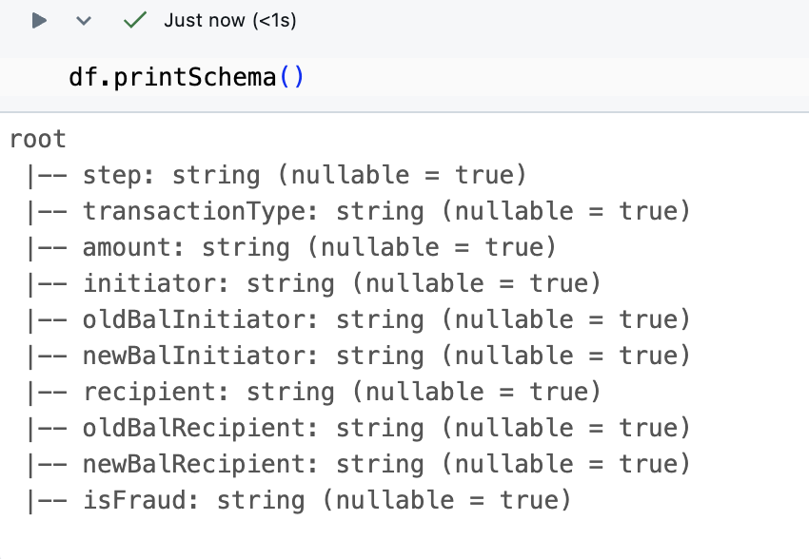
Data Dictionary
Key Columns:
Transaction Type (e.g., deposit, withdrawal, payment)
Initiator
Amount
Sender and Receiver IDs
Sender/Receiver Balance Before and After Transaction
Transaction Type Is Fraud (target variable)
Target Variable:
Binary (0: Genuine transaction, 1: Fraudulent transaction)

Slide 6
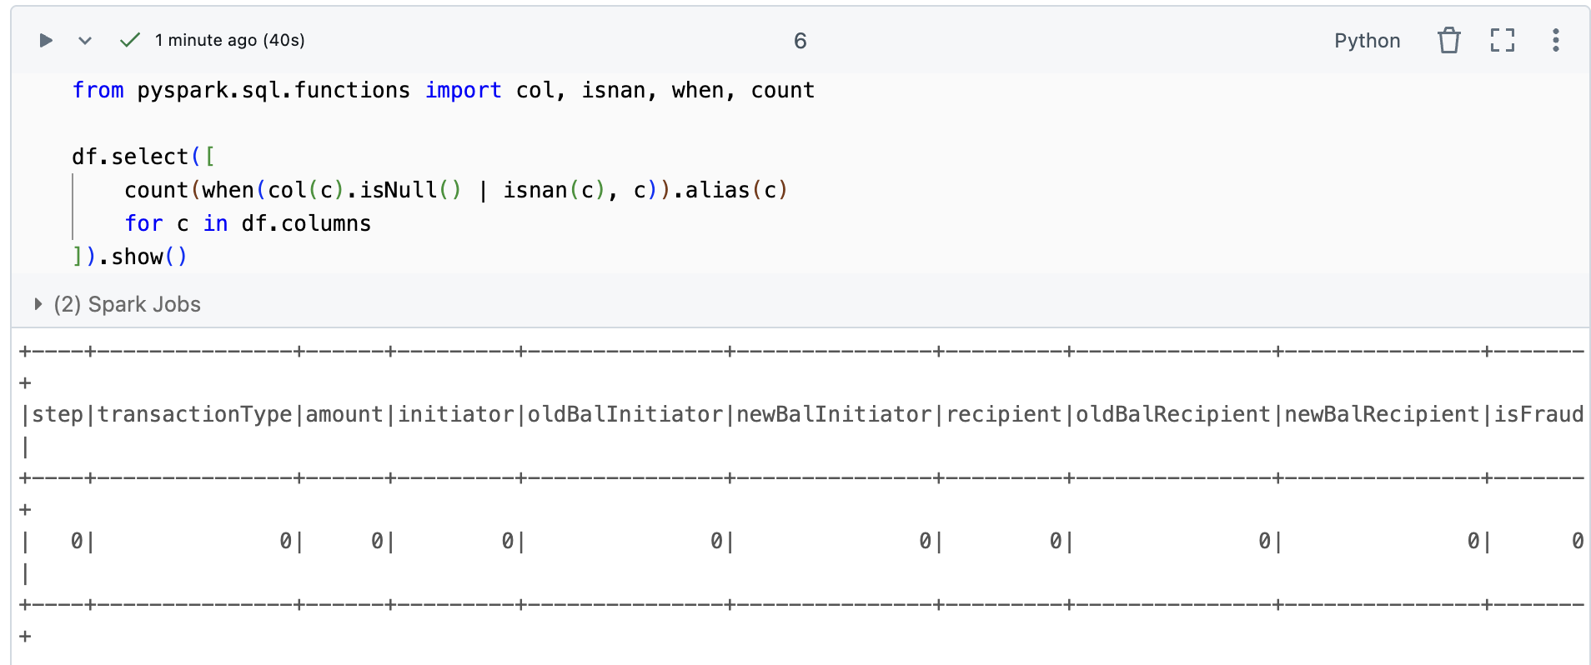
Data Pre-processing
Data Cleaning & Transformation:
Dropping irrelevant columns (Transaction ID, Date)
Converting categorical variables to numerical indices (StringIndexer)
Feature Engineering:
Created "Amount-to-Balance Ratio" to highlight anomalies.
Handling Missing Values:
Initial dataset inspection for missing values.
Appropriate handling strategies (imputation/removal).

Slide 7
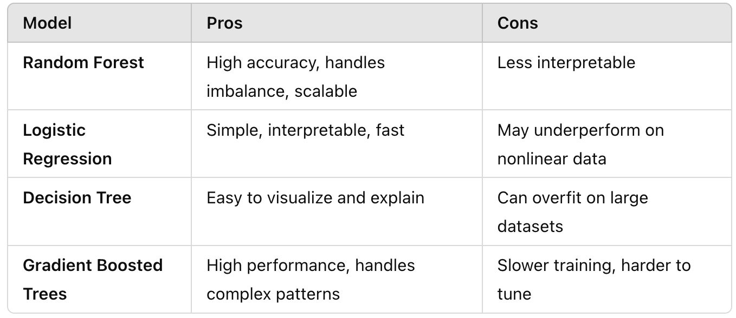
Solution Approach
Modeling Algorithm:
Random Forest Classifier
Reason for Choosing Random Forest:
Robustness to outliers
Handles imbalanced datasets effectively
Parallelizable, making it suitable for big data scenarios
Alternatives Considered:
Logistic Regression
Decision Trees
Gradient Boosted Trees

Slide 8
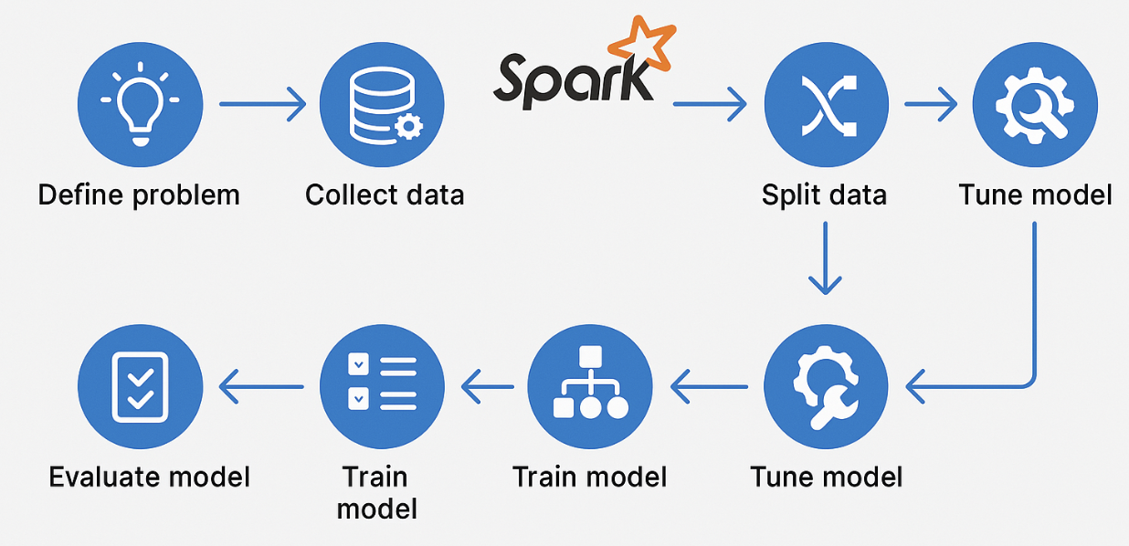
Modeling Steps
Feature Selection:
Transaction amount, sender/receiver balances, derived ratio, transaction type.
Hyperparameter Tuning:
Number of Trees: 100 initially
Future scope for detailed tuning
(max-depth, feature subset strategy)
Train-Test Split:
80% Training, 20% Testing

Slide 9
Performance Metrics
Primary Metric:
F1-score
Reason for Choosing F1-score:
Balances precision (false alarms) and recall (missed fraud)
Effective for imbalanced fraud detection scenarios
Other Metrics Considered:
Accuracy, Precision, Recall, ROC-AUC, PR-AUC (not primary due to imbalance and interpretation concerns)

Slide 10
Scaling Strategies
Data Scaling:
Initial experiments with smaller subsets (10%, 25%, 50%, 75%) before processing full dataset
Measure execution time and scalability trends
Cluster Scaling:
Initially test on smaller clusters (single-node)
Progressively scale out to multi-node clusters (2, 4, 6+ nodes)
Demonstrate execution time reduction with cluster scaling

Slide 11
Expected Outcomes
Scalable fraud detection pipeline capable of real-time analysis
Improved detection performance
Clearly demonstrated scalability with increased data and cluster sizes

Slide 12
Thank You!

