Slide 1
Covid Management System
Group ID:- 33
By:-
Nishant Koradia (202118009)
Dhairya Lakhani (202118012)
Kandarp Parmar (202118027)
Vidhi Shah (202118037)

Slide 2
Project Description
For the last two years covid-19 is wreaking havoc in over 200 countries and millions of people are getting affected by it. In India, as cases started to increase there was trepidation in people and bungling of resources in hospitals.
Considering the situation, Our project aims to smooth out some processes related to finding a hospital, finding a laboratory, booking an appointment with a doctor, and getting a hospital bed if needed.
User can get information about various services available at a hospital, various staff details. Also, our project helps in smoothing out the process of discharge.

Slide 3
Project Scope
For instance, if the User is getting any symptoms of covid then he/she can consult a doctor nearest to him/her in the area.
If symptoms are considerable then a Consulting doctor can prescribe for getting tested. So, the user can search for the laboratory in that area.
After getting tested if the user gets a report positive then he can again consult the doctor for asking to be home quarantined or getting admitted to a hospital.
If the user is suggested for getting admitted to a hospital, then the user can search for the hospital nearby his/her location according to the budget by looking at the average cost of a hospital and availability of beds for treatment.

Slide 4
Entity Relationship Diagram
In Entity-Relationship Model database is represented as a collection of entities and their relationship instances.
ER Diagram

Slide 5
Relational Schema
A Relational Schema is a set of relational tables and associated items that are related to one another.
Schema Diagram

Slide 6
Functional Dependencies & Normalization
Functional Dependency is a relationship that exists between two attributes.
Normalization is the process of organizing the data in a database and is used to minimize the redundancy from a relation or a set of relations.
Functional Dependencies and Normalization

Slide 7
Data Definition Language & Data Manipulation Language
Data Definition Language (DDL) is a standard for commands that define the different structures in a database.
DDL Script
Data Manipulation Language is used for adding, deleting and modifying data in a database.
DML Script

Slide 8
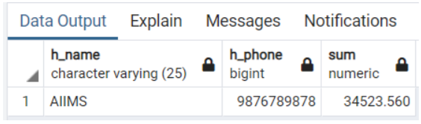
Query 1:- List hospital name and contact number having lowest total cost among all the private hospitals.
SQL Query:-
SELECT h_name,h_phone,SUM(total_cost) FROM hos_info NATURAL JOIN payment_details WHERE h_type='Private' GROUP BY h_name,h_phone,total_cost ORDER BY total_cost asc LIMIT 1;
Relational Algebra:-
Output:-

Slide 9
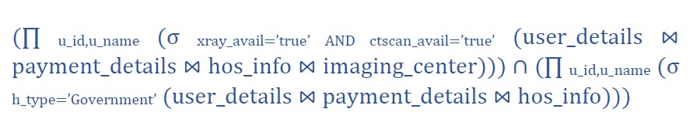
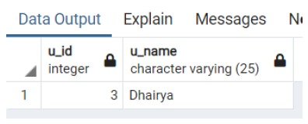
Query 2:- List ID and name of patient who availed both xray and ctscan from Government hospitals
SQL Query:-
SELECT u_id, u_name FROM user_details NATURAL JOIN payment_details NATURAL JOIN hos_info NATURAL JOIN imaging_center WHERE xray_avail='true' AND ctscan_avail='true' INTERSECT SELECT u_id, u_name FROM user_details NATURAL JOIN payment_details NATURAL JOIN hos_info WHERE h_type='Government’;
Relational Algebra:-
Output:-

Slide 10
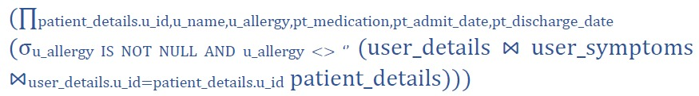
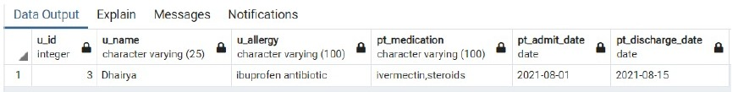
Query 3:- List ID, name of patient who is suffering from any allergy and recovered from Covid. Also display patient medication, admit date and discharge date for the same.
SQL Query:-
SELECT patient_details.u_id, u_name, u_allergy, pt_medication, pt_admit_date, pt_discharge_date FROM user_details NATURAL JOIN user_symptoms INNER JOIN patient_details ON user_details.u_id=patient_details.u_id WHERE u_allergy IS NOT NULL AND u_allergy <> ‘’;
Relational Algebra:-
Output:-

Slide 11

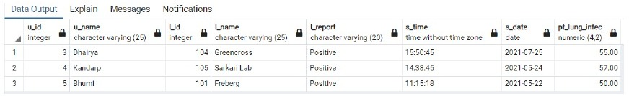
Query 4:- List of the patients that are tested positive and have lung infection more than 25% in order to get admitted to the hospital.
SQL Query:-
SELECT u_id, u_name, l_id, l_name, l_report, s_time, s_date, pt_lung_infec FROM patient_details NATURAL JOIN user_details NATURAL JOIN l_testing NATURAL JOIN lab_info WHERE l_report='Positive' AND pt_lung_infec>25;
Relational Algebra:-
Output:-

Slide 12
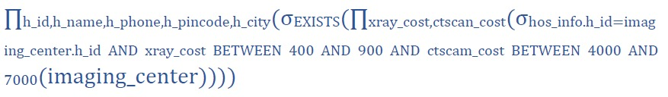
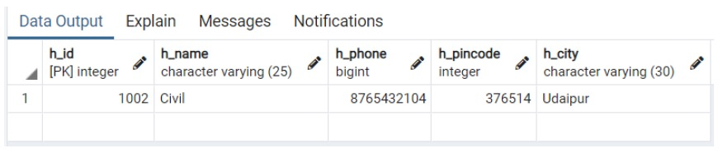
Query 5:- List the details of hospitals having Cost of an X-ray between 400 to 900 and a CT scan cost also between 4000 to 7000.
SQL Query:-
SELECT h_id, h_name, h_phone, h_pincode, h_city FROM hos_info WHERE EXISTS (SELECT xray_cost, ctscan_cost FROM imaging_center WHERE hos_info.h_id = imaging_center.h_id AND xray_cost BETWEEN 400 AND 900 AND ctscan_cost BETWEEN 4000 AND 7000);
Relational Algebra:-
Output:-

Slide 13
More Queries:-
More queries from the database are:-
More Queries

Slide 14
Conclusion:-
Taking into consideration all the mentioned details in the description we have created a user-friendly interface for users to easily fulfil their needs and to clarify their doubts. It automates numerous daily operations and enables streamlined functioning to desist mismanagement.
Through this project, we got to know that how different entities should be connected for the easy functioning of the whole system.
We are providing the facility to the users for easy searching of the laboratory in their areas if they get any of the symptoms.
Details of hospitals available in their area, beds available in that hospitals, and also details of the doctors who are working there are provided to the user for better information.
Medications of the hospital and also the approximate cost of treatment are easily known to the user.
Records of the patient’s history, allergies, and transactions are safeguarded with the hospital for further references.
We have created this system as a great opportunity to establish a distinct, efficient, and fast-delivering healthcare model. Implementation of this covid management system is sharing an easy way to store all the kinds of records, provide coordination and user communication, improve day-to-day operations, and clarification of doubts. This project covers the needs of the users, doctors, and hospital authorities by simplifying their interactions.

Slide 15


