Slide 1
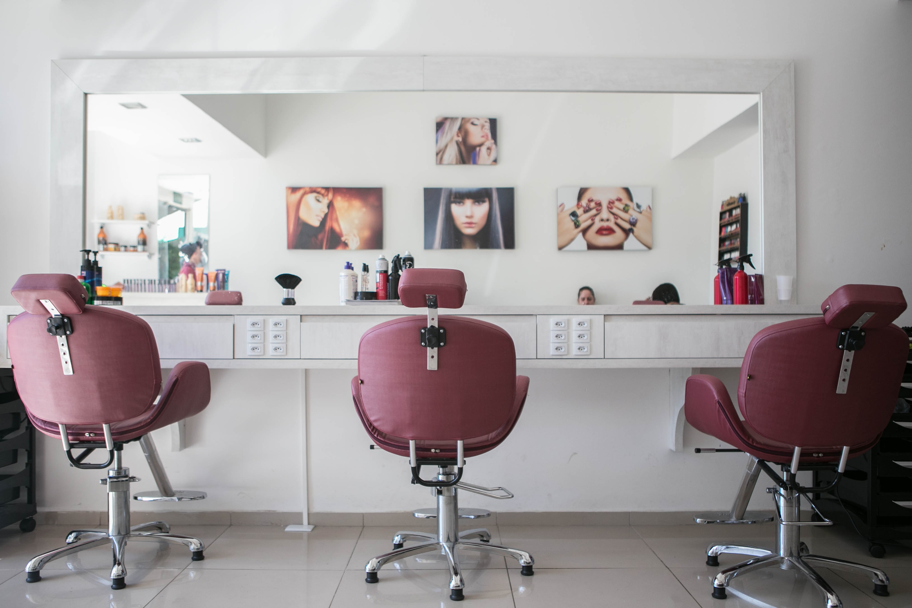
FIND AND BOOK SALON
GROUP NO: 1
Internal Guide:
Miss. Nithya Nadar
External Guide:
Mr. Ronald Macwan
18BCA100 Hunny Shah
18BCA126 Vidhi Shah
18BCA151 Hansika Asthana

Slide 2
1. Company Profile
2. Project Definition
3. Requirement Gathering
4. Existing System
CONTENTS
5. Proposed System
6. Tools And Technology Used
7. Data Flow Diagrams
8. Entity Relationship Diagram
9. Data Dictionary

Slide 3

COMPANY PROFILE
About Company:
Unicorn Technolabs is a Website and Mobile App Development Company, located in Ahmedabad.
The company is known for Internet Website Developers, Computer Software Developers, Internet Website Designers, Mobile Application Developers and much more.
This establishment acts as a one-stop destination servicing customers both local and international.
Organization/Company Details:
Company Name : Unicorn Technolabs
Contact No. : (+91) 7818075214
Address : K16- Krishna Center,
Mithakhali Six Road,
Navrangpura, Ahmedabad
E-mail Address : info@unicorntechnolabs.com
Website : http://unicorntechnolabs.com
Group 1 | Find and Book Salon

Slide 4
PROJECT DEFINITION
The Find and Book Salon is a web-based Salon management Application with appointment and scheduling functionality.
The aim is to develop an online software which connects users and multiple salon owners in an online community allowing users to browse salons and their services.
Subscribing to this software, the salon owners can manage online bookings which provides a new way to their business. Also, this software increases efficiency and service quality for the users by giving ratings to Salons.
The website has mainly four types of user groups: Salon owner, Users, Visitors and Website administrator.
Group 1 | Find and Book Salon

Slide 5
REQUIREMENT GATHERING
Admin should be able to login and manage account efficiently.
Salon Owner will create account and subscribe to customized membership plans managed by Admin.
Salon Owner should be able to manage services and offers.
Users should be able to create their own account and search salon & salon services.
Users will book the appointments according to the slots available and these appointments will be managed by the Salon Owners.
After using the salon services, Users will rate the salons which will be visible to Salon Owners and other Users.
Users should be able to bookmark a particular salon for future use.
There should be limited access given to Visitors for searching salon and salon services without login or creating their account.
Group 1 | Find and Book Salon

Slide 6
EXISTING SYSTEM
Currently, there is no such system where user can search and view multiple salons and their details.
Online customers are only able to search salon by name through search engines, not through other criteria.
In the existing system, there is limited options to book/cancel online appointment.
User is not able to understand the service quality of a salon through search engines, and they are dependent on their personal experiences of using the salon services for the first time.
Group 1 | Find and Book Salon

Slide 7




PROPOSED SYSTEM
ENTITIES
ADMIN
SALON OWNER
USER
VISITOR
Group 1 | Find and Book Salon

Slide 8
ENTITIES
ADMIN
Admin can Register and Login.
Admin can manage accounts of User and Salon Owner.
Admin can manage membership plans.
Admin can manage services details.
Admin can manage the details of Salon Owner and then approve the account.
Group 1 | Find and Book Salon

Slide 9
ENTITIES
SALON OWNER
Salon Owner can register and create an account of their own.
When the Owner will register, the details will go to Admin, and once the account gets verified by the Admin, the Owner can use it.
Salon Owner can subscribe the membership by choosing a particular membership plan.
Salon Owner can update or edit all the services and photos regarding their salon.
Salon Owner can provide offers.
Owner can view, approve and cancel appointments according to their schedule and can also view User account details.
Owner can see the Ratings given by the users.
Group 1 | Find and Book Salon

Slide 10
ENTITIES
USER
User has to register/login to use the features provided other than viewing details and services of a salon.
User can search for the salons according to the services.
User can book/cancel appointment in a particular slot available.
User can check which salon is suitable according to their requirements and preferences.
User can also give Ratings to the salons.
User can bookmark the salon for future use.
Group 1 | Find and Book Salon

Slide 11
ENTITIES
VISITOR
Visitor can search for the salons according to the services.
Visitor can view the salon details, offers and services that are provided by Salon.
Group 1 | Find and Book Salon

Slide 12






TOOLS AND TECHNOLOGY USED
Front End:
IDE:
PHP 7.3
Apache NetBeans IDE 12.0
Back End:
Others:
MySQL 5.0
Edraw Max
Server:
Apache
MS Office 2019
Group 1 | Find and Book Salon

Slide 13
Level 0
Level 1
DATA FLOW DIAGRAMS
Level 2.2
Level 2.3
LEVEL 0
(CONTEXT LEVEL)
Level 2.4
Level 2.5
Level 2.6
Level 2.7
Level 2.9

Slide 14
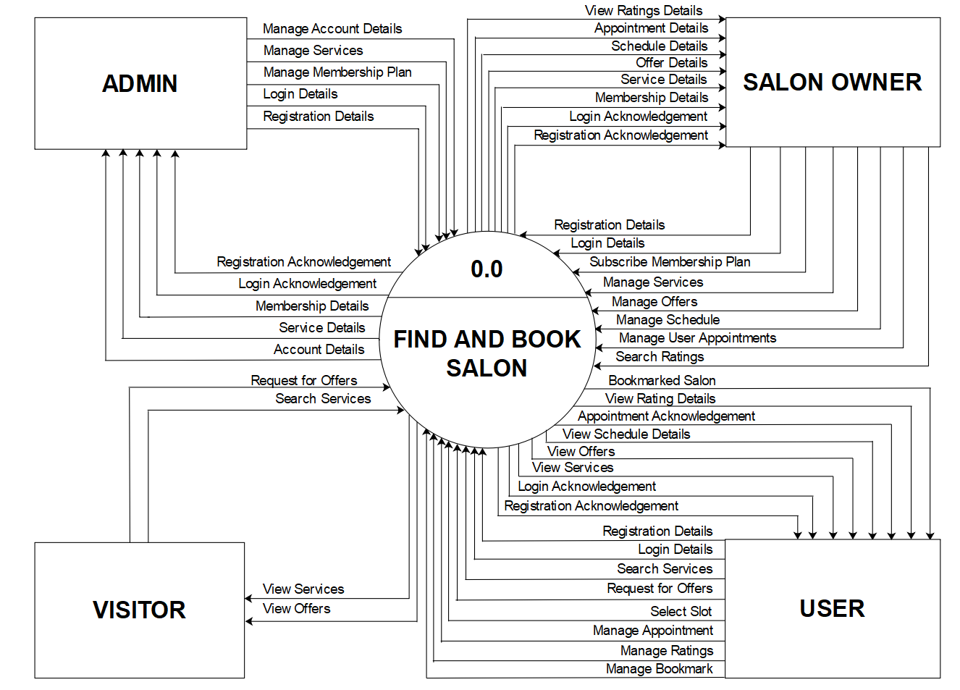

Slide 15
Level 0
Level 1
DATA FLOW DIAGRAMS
Level 2.2
Level 2.3
LEVEL 1
Level 2.4
Level 2.5
Level 2.6
Level 2.7
Level 2.9

Slide 16
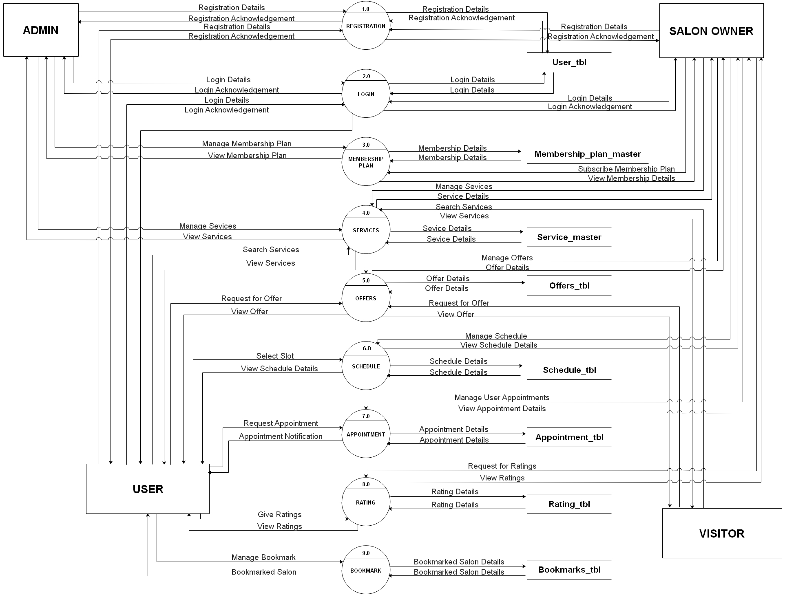

Slide 17
Level 0
Level 1
DATA FLOW DIAGRAMS
Level 2.2
Level 2.3
LEVEL 2.2
Level 2.4
Level 2.5
Level 2.6
Level 2.7
Level 2.9

Slide 18
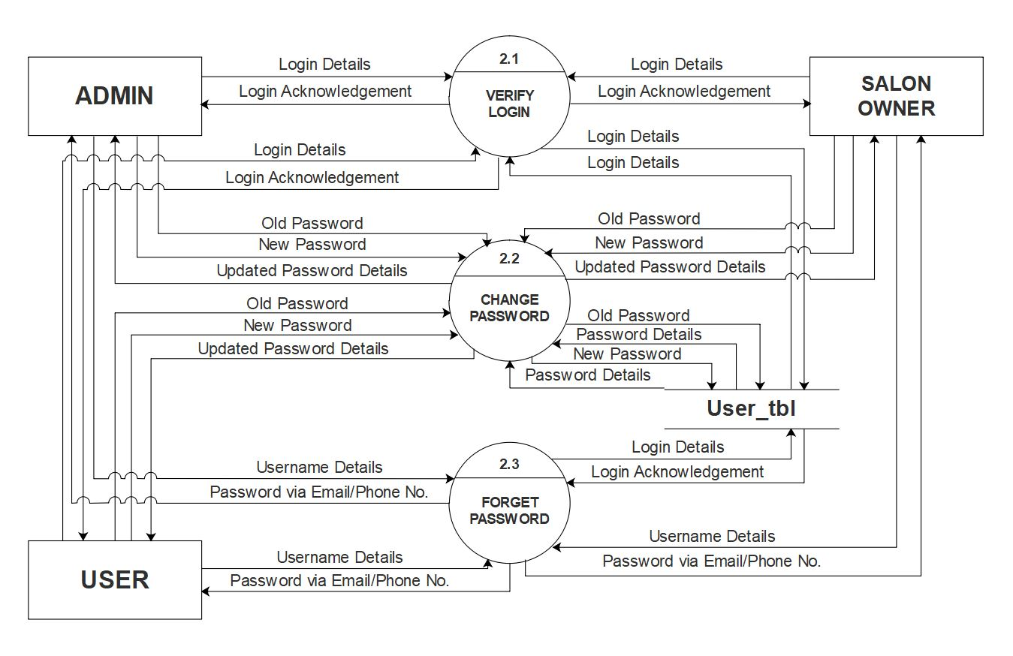

Slide 19
Level 0
Level 1
DATA FLOW DIAGRAMS
Level 2.2
Level 2.3
LEVEL 2.3
Level 2.4
Level 2.5
Level 2.6
Level 2.7
Level 2.9

Slide 20
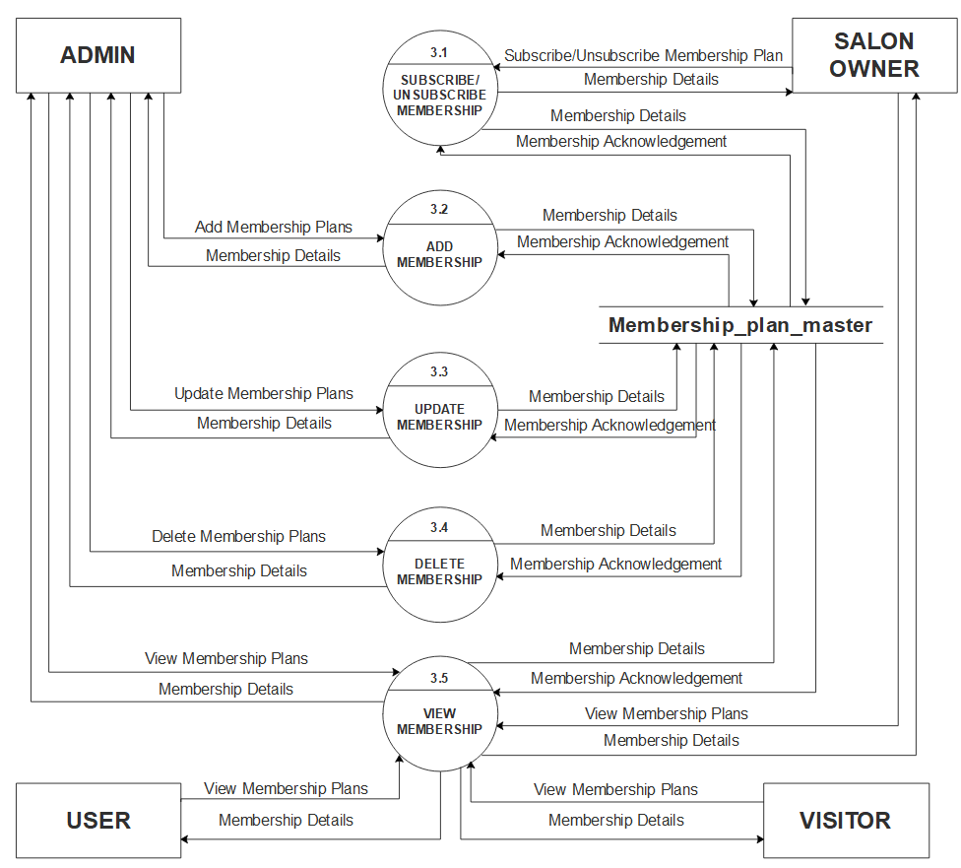

Slide 21
Level 0
Level 1
DATA FLOW DIAGRAMS
Level 2.2
Level 2.3
LEVEL 2.4
Level 2.4
Level 2.5
Level 2.6
Level 2.7
Level 2.9

Slide 22
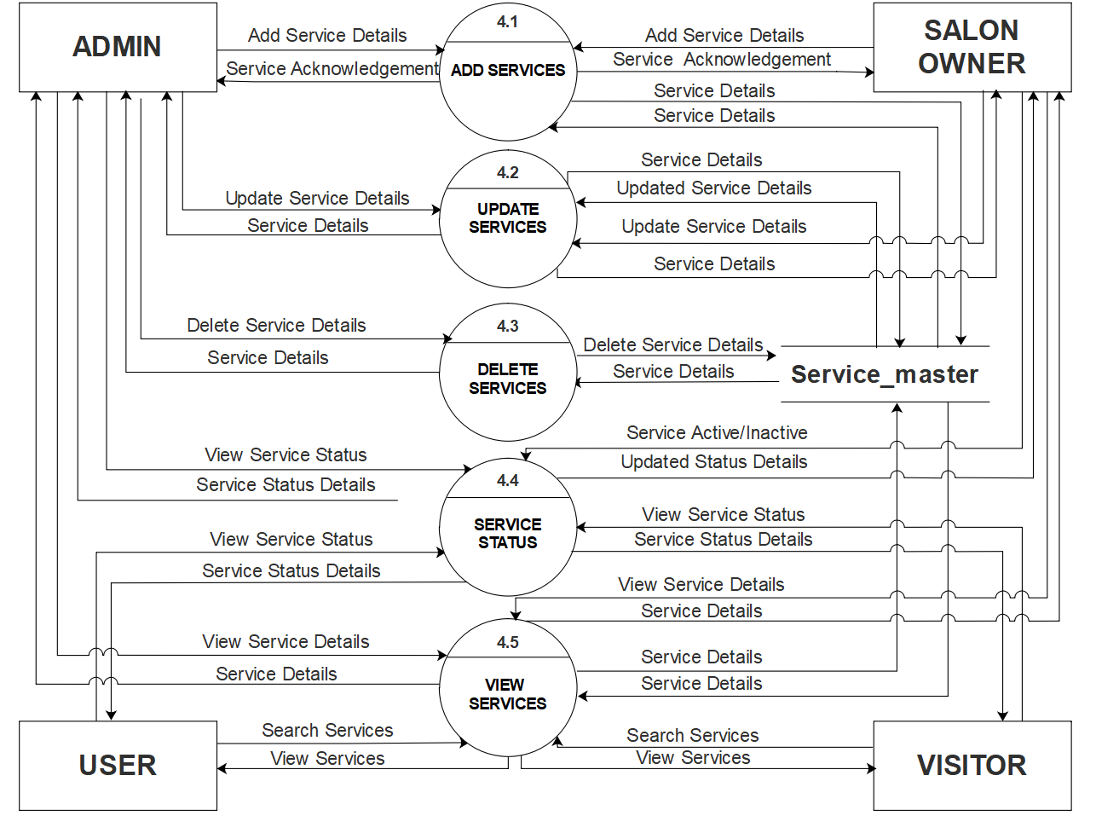

Slide 23
Level 0
Level 1
DATA FLOW DIAGRAMS
Level 2.2
Level 2.3
LEVEL 2.5
Level 2.4
Level 2.5
Level 2.6
Level 2.7
Level 2.9

Slide 24
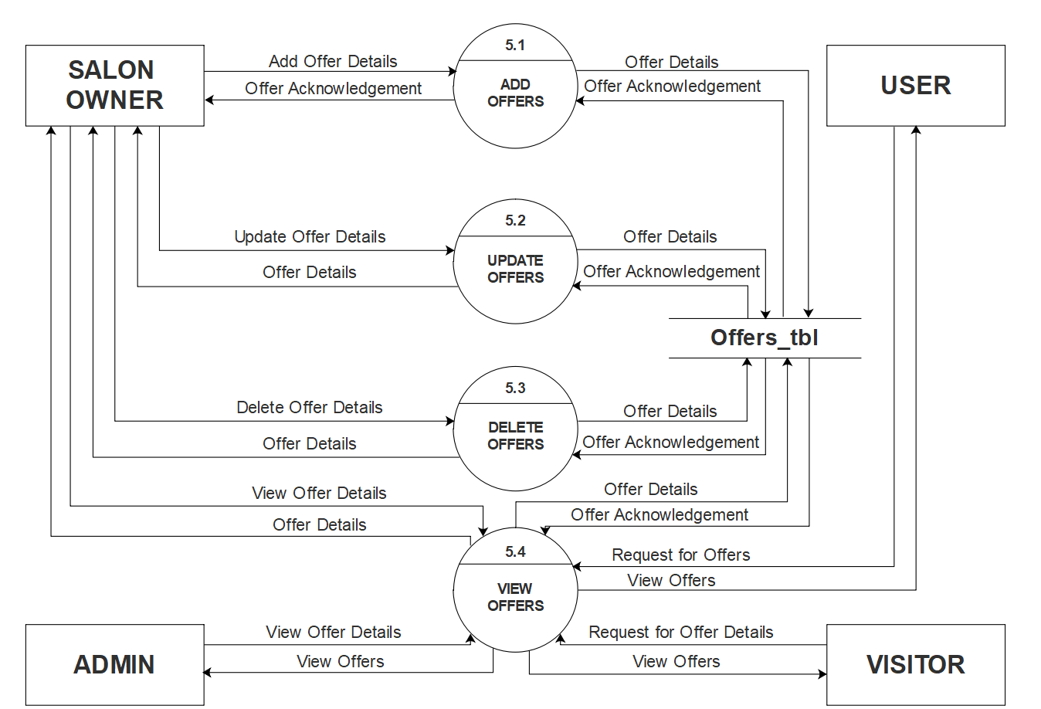

Slide 25
Level 0
Level 1
DATA FLOW DIAGRAMS
Level 2.2
Level 2.3
LEVEL 2.6
Level 2.4
Level 2.5
Level 2.6
Level 2.7
Level 2.9

Slide 26
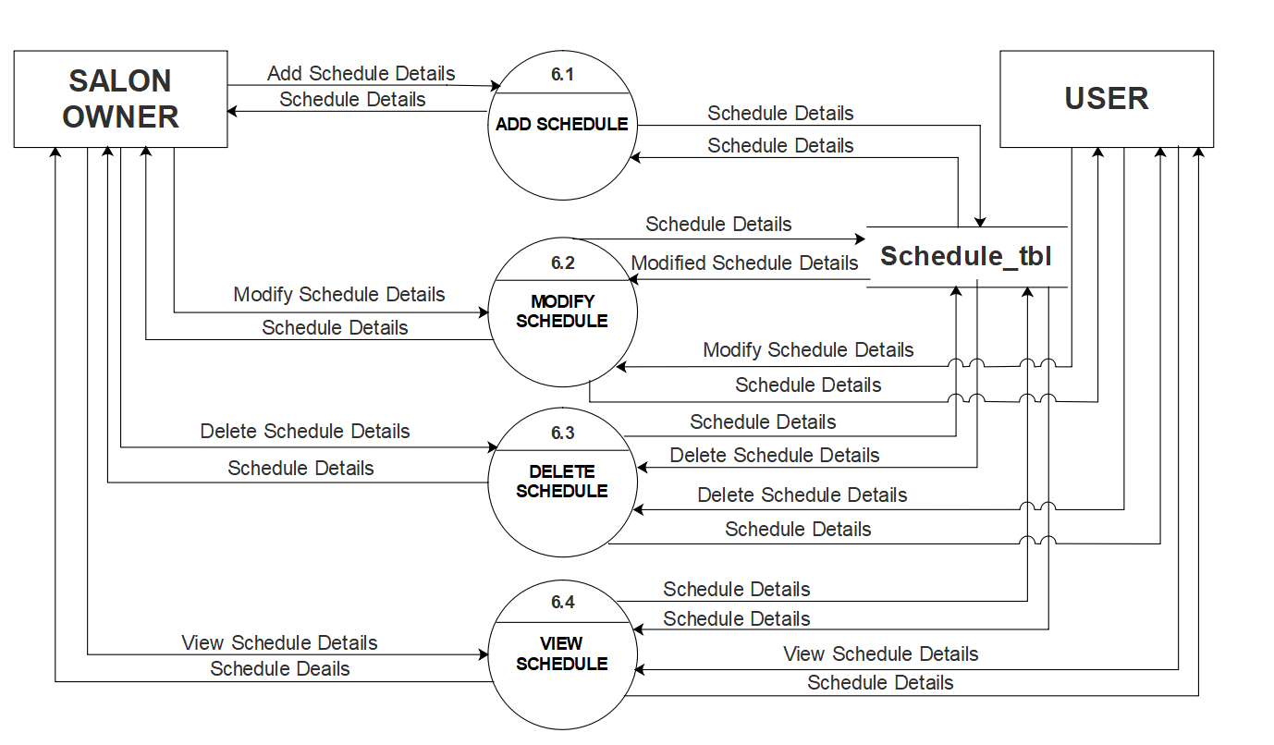

Slide 27
Level 0
Level 1
DATA FLOW DIAGRAMS
Level 2.2
Level 2.3
LEVEL 2.7
Level 2.4
Level 2.5
Level 2.6
Level 2.7
Level 2.9

Slide 28
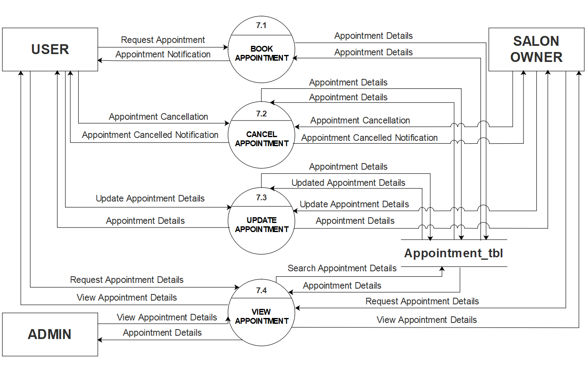

Slide 29
Level 0
Level 1
DATA FLOW DIAGRAMS
Level 2.2
Level 2.3
LEVEL 2.9
Level 2.4
Level 2.5
Level 2.6
Level 2.7
Level 2.9

Slide 30
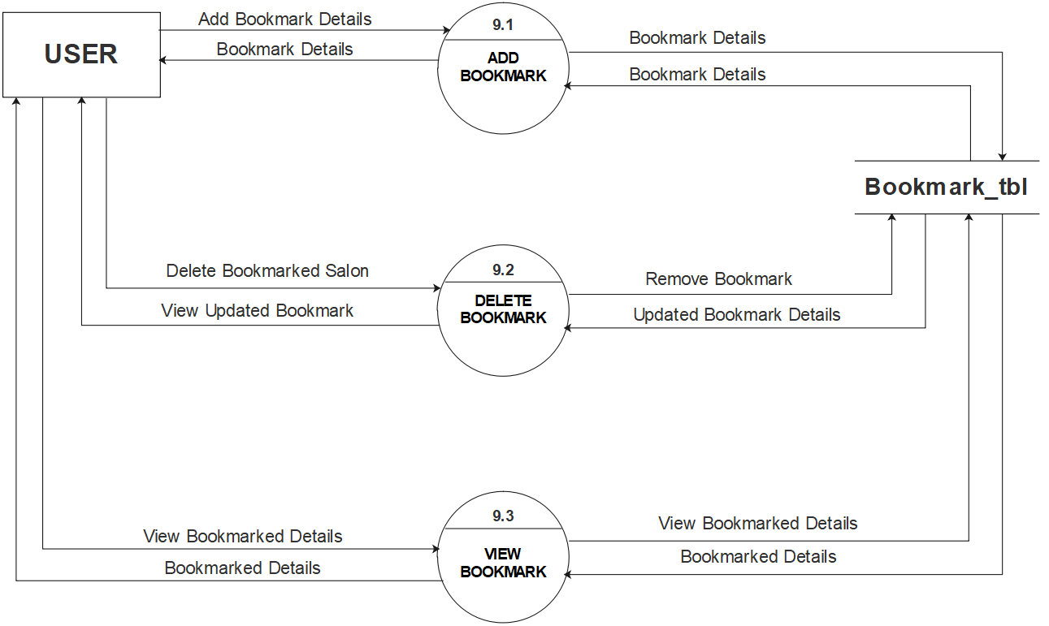

Slide 31
ENTITY RELATIONSHIP DIAGRAM (ERD)

Slide 32
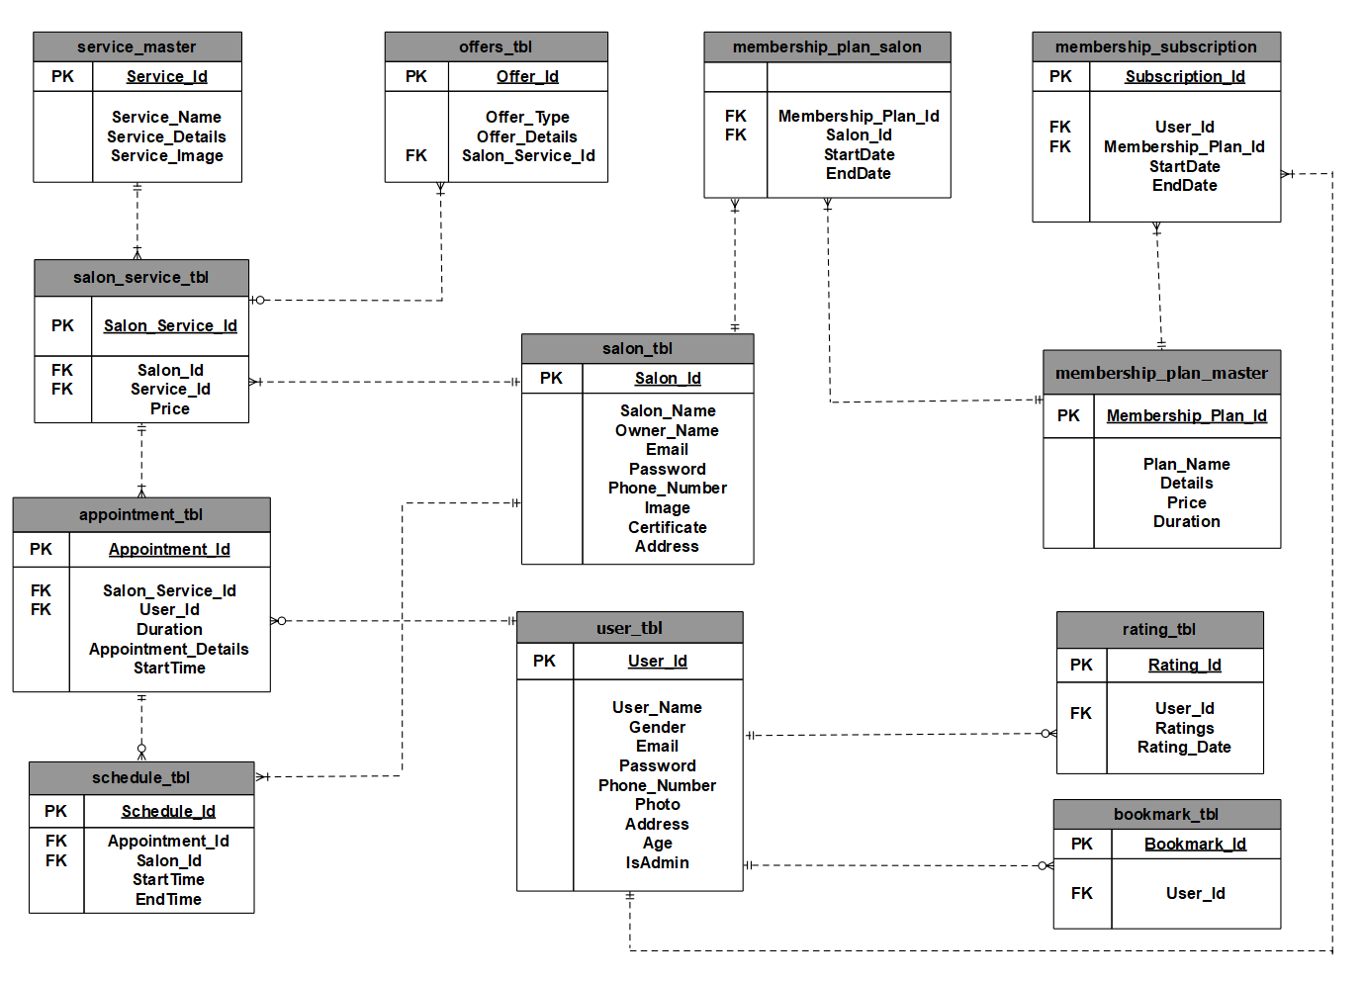

Slide 33
User_tbl
Salon_tbl
Membership_plan_master
Membership_plan_salon
Membership_subscription
DATA DICTIONARY
Service_master
Salon_service_tbl
Offers_tbl
Schedule_tbl
Appointment_tbl
Rating_tbl
Bookmarks_tbl

Slide 34
User_tbl TABLE
Description : It will store the details about user.
Field Name | Data Type | Size | Constraint | Description
User_Id | Integer | 5 | Primary Key | It stores the User Id of admin/user
User_Name | Varchar | 30 | Not Null | It stores the name of the user
Gender | Varchar | 3 | Not Null | It stores the gender of the user
Email | Varchar | 25 | Unique | It stores the email id of the user
Password | Varchar | 10 | Not Null | It stores password of the user
Phone _Number | Integer | 10 | - | It stores phone number of the user
Photo | Varchar | 50 | - | It stores path of the user’s picture
Address | Varchar | 150 | - | It stores address of the user
Age | Integer | 3 | Not Null | It stores the age of the user
IsAdmin | Boolean |  | Not Null | It will store if User is admin or User True is Admin and False is User
Group 1 | Find and Book Salon

Slide 35
Salon_tbl TABLE
Description : It will store the salon details.
Field Name | Data Type | Size | Constraint | Description
Salon_Id | Integer | 5 | Primary Key | It stores id of salon
Salon_Name | Varchar | 30 | Not Null | It stores name of the salon
Owner_Name | Varchar | 30 | Not Null | It stores name of the salon owner
Email | Varchar | 25 | Unique | It stores the email id of the salon
Password | Varchar | 10 | Not Null | It stores password of the salon
Phone _Number | Integer | 10 | Not Null | It stores phone number of the salon
Image | Varchar | 50 | Not Null | It stores path of the salon’s picture
Certificate | Varchar | 50 |  | It stores path of the salon owner certificate
Address | Varchar | 150 | Not Null | It stores address of the salon
Group 1 | Find and Book Salon

Slide 36
Membership_plan_master TABLE
Description : It will store the details about membership Plans.
Field Name | Data Type | Size | Constraint | Description
Membership_Plan_Id | Integer | 5 | Primary Key | It stores id of the membership plan
Plan_Name | Varchar | 30 |  | It stores name of the membership plan
Details | Text |  | Not Null | It stores details regarding membership plan
Price | Decimal | (7,2) | Not Null | It stores the price of a membership plan
Duration | Text |  | Not Null | It stores the duration of membership plan
Group 1 | Find and Book Salon

Slide 37
Membership_plan_salon TABLE
Description : It will store details of membership subscribed by salon owner.
Field Name | Data Type | Size | Constraint | Description
Salon_Id | Integer | 5 | Foreign Key | It stores Salon_Id of salon_tbl
Membership_Plan_Id | Integer | 5 | Foreign Key | It stores Membership_Plan_Id of membership_plan_master
StartDate | Date |  | Not Null | It stores subscription start date
EndDate | Date |  | Not Null | It stores subscription expiry date
Group 1 | Find and Book Salon

Slide 38
Membership_subscription TABLE
Description : It will store details of user subscribed membership.
Field Name | Data Type | Size | Constraint | Description
Subscription_Id | Integer | 5 | Primary Key | It stores subscription id
User_Id | Integer | 5 | Foreign Key | It stores User_Id of User_tbl
Membership_Plan_Id | Integer | 5 | Foreign Key | It stores Membership_Plan_Id of membership_plan_master
StartDate | Date |  | Not Null | It stores subscription start date
EndDate | Date |  | Not Null | It stores subscription expiry date
Group 1 | Find and Book Salon

Slide 39
Service_master TABLE
Description : It will store the details about services.
Field Name | Data Type | Size | Constraint | Description
Service_Id | Integer | 5 | Primary Key | It stores the id of a service
Service_Name | Varchar | 15 | Not Null | It stores name of a service provided by a salon (e.g. Haircut, Waxing, Massage, so on..)
Service_Details | Text |  | Not Null | It stores details regarding a service
Service_Image | Varchar | 50 | Not Null | It stores the path of a service’s image
Group 1 | Find and Book Salon

Slide 40
Salon_service_tbl TABLE
Description : It will store the details salon services.
Field Name | Data Type | Size | Constraint | Description
Salon_Service_Id | Integer | 5 | Primary Key | It stores the id of a salon service
Salon_Id | Integer | 5 | Foreign Key | It stores Salon_Id from Salon_tbl
Service_Id | Integer | 5 | Foreign Key | It stores Service_Id from Service_master
Price | Decimal | (7,2) | Not Null | It stores the price of a services
Group 1 | Find and Book Salon

Slide 41
Offers_tbl TABLE
Description : It will store the details of the offers.
Field Name | Data Type | Size | Constraint | Description
Offer_Id | Integer | 5 | Primary Key | It stores the offer id
Offer_Type | Text |  | Not Null | It stores the type of an offer (e.g. Seasonal Offer/Festive Offer/etc..)
Offer_Details | Text |  | Not Null | It stores the details regarding an offer
Salon_Service_Id | Integer | 5 | Foreign Key | It stores Salon_Service_Id from Salon_service_tbl
Group 1 | Find and Book Salon

Slide 42
Schedule_tbl TABLE
Description : It will store the schedule details.
Field Name | Data Type | Size | Constraint | Description
Schedule_Id | Integer | 5 | Primary Key | It stores the id of schedule
Appointment_Id | Integer | 5 | Foreign Key | It stores Appointment_id from Appointment_tbl
Salon_Id | Integer | 5 | Foreign Key | It stores Salon_Id from Salon_tbl
StartTime | Date/Time |  | Not Null | It stores start time of schedule
EndTime | Date/Time |  | Not Null | It stores end time of schedule
Group 1 | Find and Book Salon

Slide 43
Appointment_tbl TABLE
Description : It will store the appointment details.
Field Name | Data Type | Size | Constraint | Description
Appointment_Id | Integer | 5 | Primary Key | It stores the appointment id
Salon_Service_Id | Integer | 5 | Foreign Key | It stores Salon_Service_Id from Salon_Service_tbl
User_Id | Integer | 5 | Foreign Key | It stores User_Id from User_tbl
Duration | Text |  | Not Null | It stores the duration of appointment
Appointment_Details | Text |  | Not Null | It stores the details regarding an appointment
StartTime | Date/Time |  | Not Null | It stores appointment start time
Group 1 | Find and Book Salon

Slide 44
Rating_tbl TABLE
Description : It will store the details of Rating.
Field Name | Data Type | Size | Constraint | Description
Rating_Id | Integer | 5 | Primary Key | It stores the rating id
User_Id | Integer | 5 | Foreign Key | It stores User_Id from User_tbl
Ratings | Integer | 2 | Not Null | It stores the ratings given by a user to a salon (e.g. 1/2/3/4/5)
Rating_Date | Date |  | Not Null | It stores the date of the rating given
Group 1 | Find and Book Salon

Slide 45
Bookmarks_tbl TABLE
Description : It will store the details of the Bookmark.
Field Name | Data Type | Size | Constraint | Description
Bookmark_Id | Integer | 5 | Primary Key | It stores the bookmark id
User_Id | Integer | 5 | Foreign Key | It stores User_Id from User_tbl
Group 1 | Find and Book Salon

Slide 46
THANK YOU!
GROUP NO: 1
Internal Guide:
Miss. Nithya Nadar
External Guide:
Mr. Ronald Macwan
18BCA100 Hunny Shah
18BCA126 Vidhi Shah
18BCA151 Hansika Asthana

