Slide 1
CNN-Based Road Sign Classification
Project Summary and Results
Vidhu Govind
DA/DS NOVEMBER FN

Slide 2
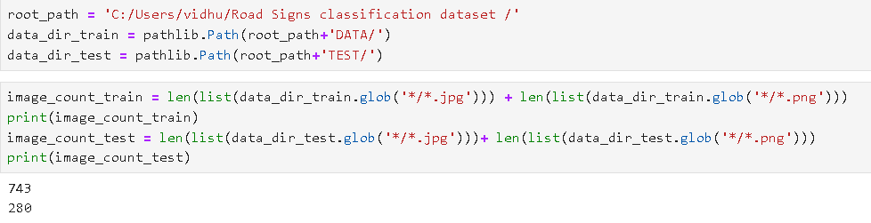
1. Dataset Overview
30 road sign classes
Images resized to 180x180 pixels
Labels from CSV file
Split: 70% Train, 15% Val, 15% Test

Slide 3
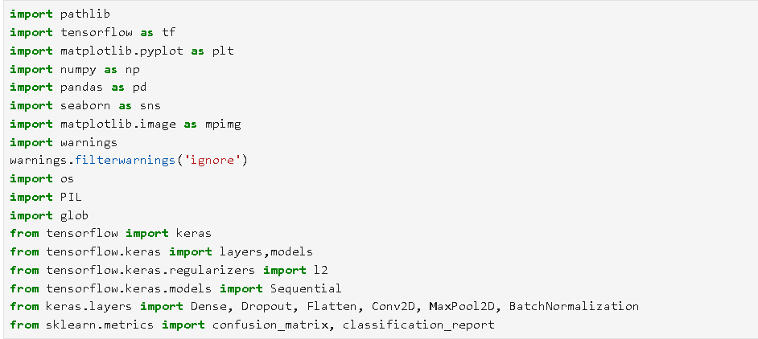
Libraries Used

Slide 4
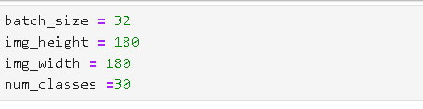
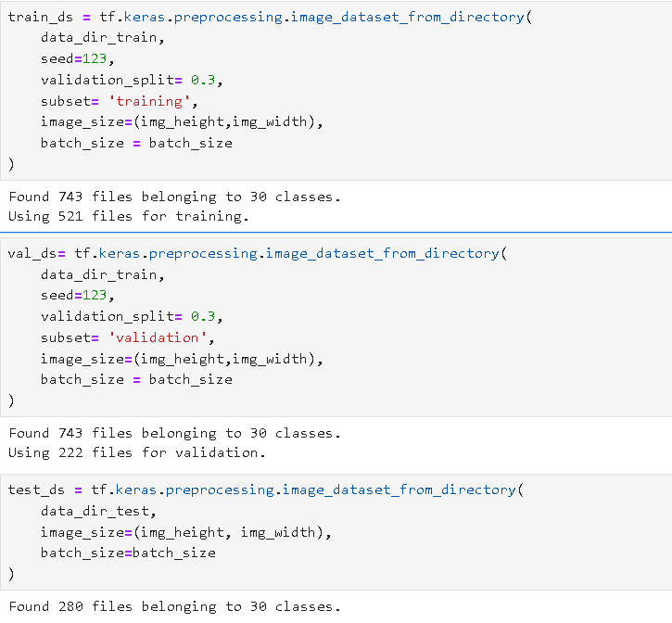
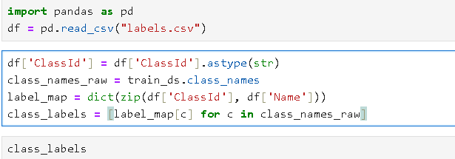
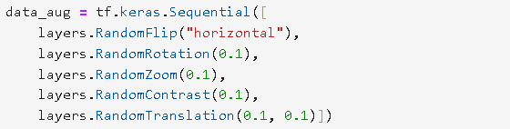
2. Data Preprocessing & Augmentation

Slide 5
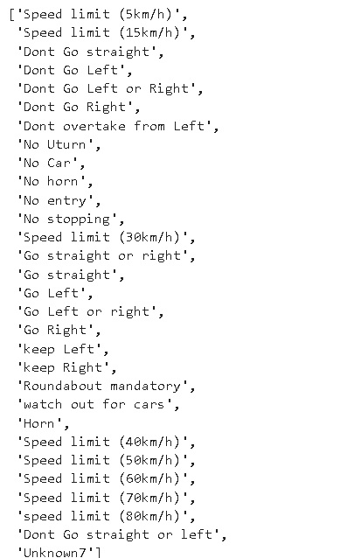
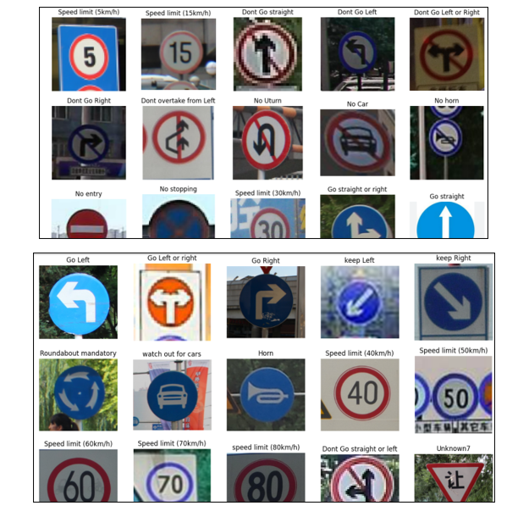
Data Understanding

Slide 6
3. CNN Architecture Design
- 5 Convolutional Layers with Dropout
- MaxPooling after each Conv layer
- Fully Connected Layers: 2 Dense + Output
- L2 Regularization on first Dense layer
- Activation: ReLU (hidden), Softmax (output)

Slide 7
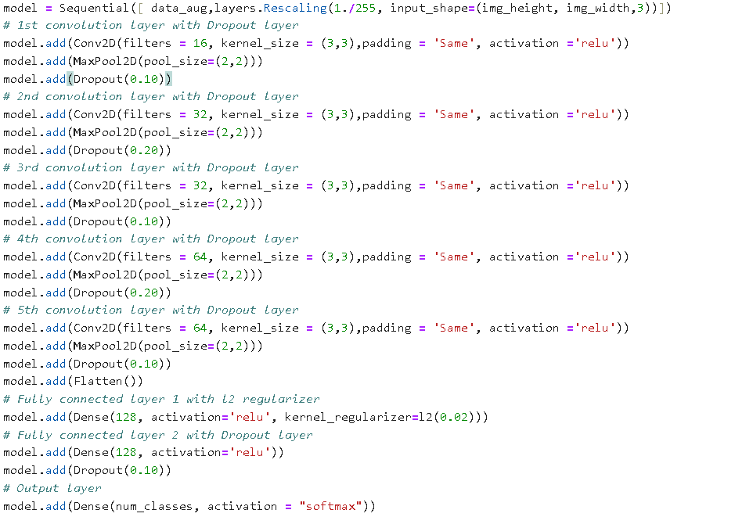

Slide 8
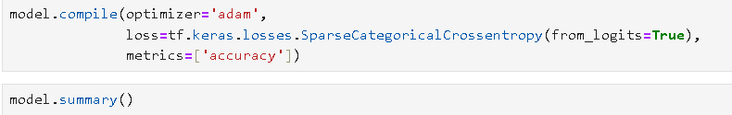
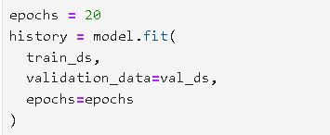
4. Model Compilation & Training
- Optimizer: Adam
- Loss: Sparse Categorical Crossentropy
- Metrics: Accuracy
- EarlyStopping and Checkpoints used
- Trained with augmented data

Slide 9
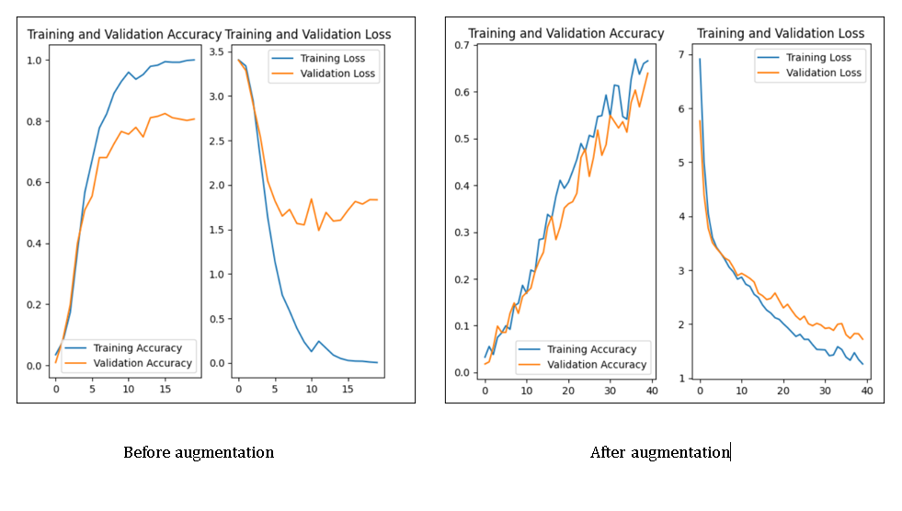
Training –Validation Plots

Slide 10
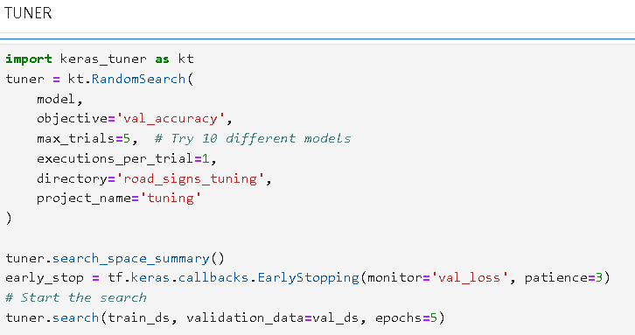
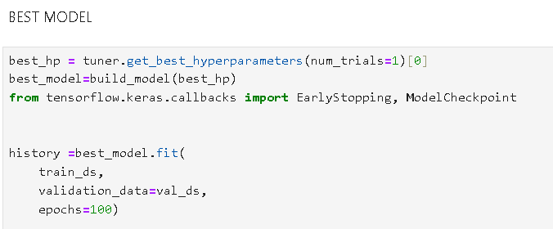
5. Hyperparameter Tuning
- Used Keras Tuner (RandomSearch)

Slide 11
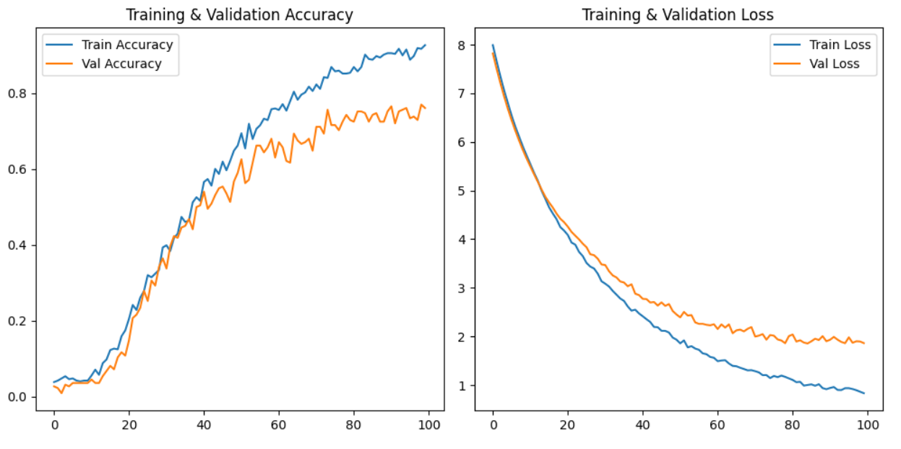
Tunning Results

Slide 12
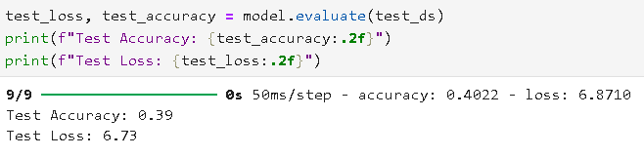
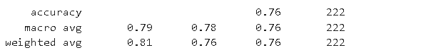
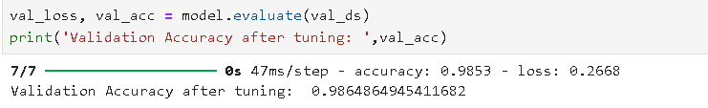
6. Evaluation & Testing

Slide 13
9. Conclusion & Insights
- Data augmentation and tuning greatly improved accuracy
- Model generalizes well on unseen images
- Improve class balance when synthetic data is added

Slide 14
10. Thank You
Questions and Discussions

