Slide 1
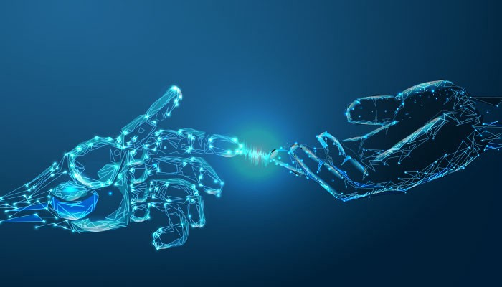
Identification of User Query on Stack Overflow Using Semantic Search
→CODE BLOODED

Slide 2


WHAT IS STACK OVERFLOW
Stack Overflow is a platform where students and professionals post queries and answer questions about programming. The answers are upvoted based on its usefulness to the community. Users can also use Stack Overflow to advance their careers.

Slide 3

USE OF STACKOVER FLOW
Post Questions and Answer Questions:
It has enabled knowledgeable users to thrive on the platform.
Hire programmers and get hired:
Stack Overflow talent enables employers to look for talented developers for their companies and projects

Slide 4

AGENDA
Identification of User Query on Stack Overflow Using Semantic Search
The problem statement aims at building a solution that helps to find the right answers that are relevant to the developer issues on Stack Overflow.

Slide 5

EXPECTED OUTPUT
To identify most relevant questions to a query [text similarity]
Identify the matching tags and pick top relevant questions from stack overflow.
To identify top k solutions of the problem.

Slide 6

APPROACH
IMPORTATION OF STACKOVERFLOW LIBRARY:
The web browser module provides a high-level interface to allow displaying Web-based documents to users. Under most circumstances, simply calling the open() function from this module will do the right thing.

Slide 7

APPROACH
2. CLEANING OF DATA :
Data cleansing or data cleaning is the process of detecting and correcting (or removing) corrupt or inaccurate records from a record set, table, or database and refers to identifying incomplete, incorrect, inaccurate or irrelevant parts of the data and then replacing, modifying, or deleting the dirty or coarse data

Slide 8

APPROACH
3. PREPROCESSING:
Data preprocessing is a data mining technique that involves transforming raw data into an understandable format.
we use removing of stopwords.
We use removing of punctuation.
Converting the data into binary array.

Slide 9
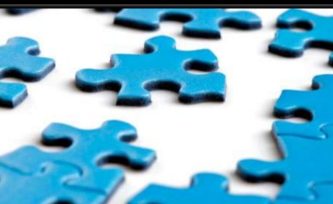
APPROACH
4. TOKENIZATION: Tokenization is the act of breaking up a sequence of strings into pieces such as words, keywords, phrases, symbols and other elements called tokens. Tokens can be individual words, phrases or even whole sentences. In the process of tokenization, some characters like punctuation marks are discarded. The tokens become the input for another process like parsing and text mining

Slide 10
APPROACH
5. TOP.GEOMETRY:
This function is used for display the UI window size
6. pack():This geometry manager organizes widgets in blocks before placing them in the parent widget.
7. SITE.fetch():to fetch the data

Slide 11
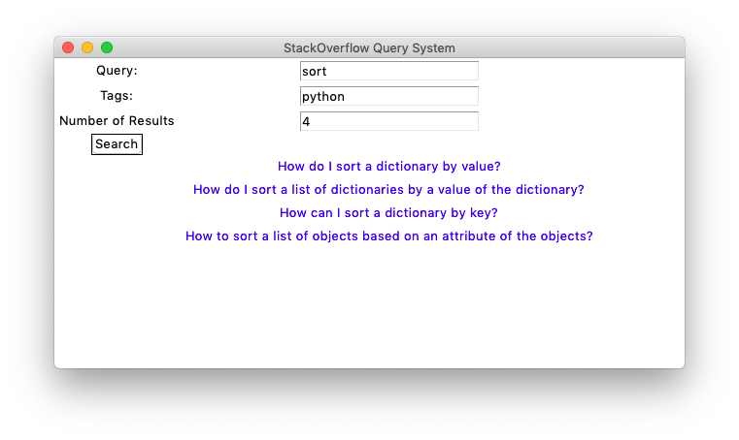
UI
Tkinter is a Python binding to the Tk GUI toolkit. It is the standard Python interface to the Tk GUI toolkit, and is Python's de facto standard GUI.

Slide 12

CONCLUSION
The solution should have a mechanism to identify relevant questions on stack overflow with tags and top k relevant answers that should be provided to the user. So that he can understand the concept clearly and try to get his queries resolved more effectively and efficiently.

Slide 13

THANK YOU
CODE BLOODED
VIDHUR K
SAI SARAN GODA
SREE SRUSHITHA DIDDI
V. NAGA PREETHI
S.SUBHASH

