Slide 1


Global Trade Analysis using Tableau SEWP ZG628T DISSERTATION
Submitted by:-Vidhya Shankar Goel
Bits ID:- 2018HW70409

Slide 2
Contents
Overview of the project
Data Description
Data Preparation
Learning
Work in Tableau Public: Challenges and Steps taken
Insights
References

Slide 3
Overview of the project
The objective of the project was to create innovative and interactive Tableau dashboards that focus on potential commodities, countries, year, trade amount and quantity.
The client wanted to launch a new business unit, focusing on global trade and logistics, majorly in the countries such as USA, Canada and Australia
The dataset provided by the client contained 59090 observations of 10 variables.
The client insisted the data to be cleaned using Excel or R. The Dataset contained missing values and was cleaned using the R programming language.
Tableau dashboards were created from the cleaned dataset.

Slide 4
Data Description
Variable | Description
Country or Area | There were three countries – Australia, Canada, and the USA
Year | The Year variable ranged from 1988 to 2016
Commodity Code | The commodity code was unique for each commodity. Example: 10111 for Horses, live pure bred
Commodity | The commodity variable contained various trade commodities that belonged to each of the 12 categories.
Flow | This indicates flow of trade. They are Export, Import, Re-Import, and Re-Export.
Trade USD | The trade value in US Dollars
Weight | The total weight of the traded commodity in Kgs
Quantity Name | Quantity name of the traded commodity
Quantity | The total quantity of the traded commodity
Category | There were 12 unique categories in the data.

Slide 5


Data Preparation
The data was cleaned using the R programming language. The variable names were edited for better reading.
Upon exploring the dataset, it was found that the weight and the quantity variable contained missing values. Additionally, there were “0” values in these variables. This didn’t account for the Trade amount values in the data. Some instances were observed:
Weight | Quantity
NA | NA
NA | 0
0 | NA
0 | 0
Value | NA
NA | Value

Slide 6
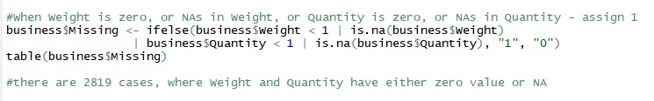
Data Preparation - continued
To eliminate such instances, an if-else condition was implemented.
The impact of the missing information was assessed using the filter function from the dplyr package. The assessment was made for each country and flow of trade.
Per business perspective, such losses cannot be ignored. Weight and Quantity are important variables that determine the trade value. Hence, the reason for such missing info has to be investigated. For this project, I have eliminated all such instances. The cleaned dataset was then imported to Tableau Public for visualization.
Country | Total Trade Value (in billions of US Dollars) - Loss
Australia | $ 13.5 billion
Canada | $ 32.5 billion
USA | $ 36.9 billion

Slide 7
Market Size -sheet1
Action: Select the Flow of trade and set the range for Year to observe the insights described below.
The comparison is based on demand i.e. Quantity.
Insight:
1) From 1988 to 2016, the USA has been the largest exporter, importer, and re-exporter of commodities. Whereas Canada has been the largest re-importer of commodities.
2) The USA has never re-imported commodities throughout these years.
Additional findings are described in the worksheet - 'Trade Market Analysis'.

Slide 8
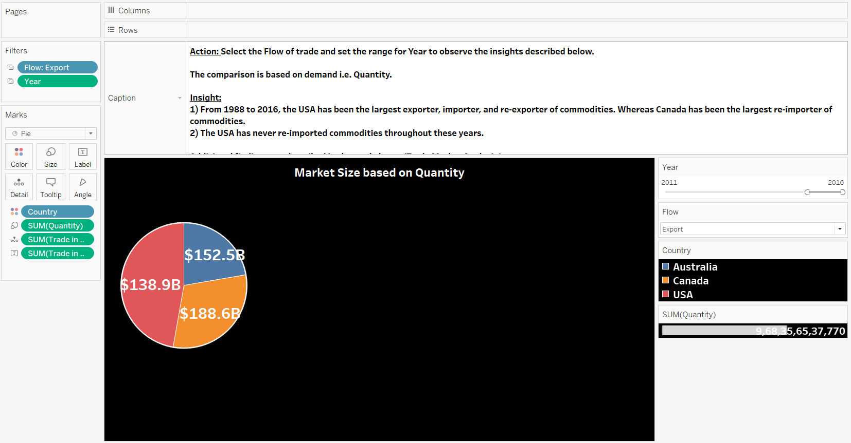

Slide 9
Trade Market Analysis- Sheet 2
Action: Select the Flow of trade and set the range for Year to observe the insights described below.
Insights:
The data collected from 1988 to 2016 indicates:
1) Australia hasn't re-exported commodities since the year 2000.
2) Canada began re-exporting commodities from the year 2000.
3) In the year 2016, Canada was the largest re-exporter of commodities.
4) The USA has been dominant in export, import and re-export of commodities from 1988 to 2016.
5) The USA has never re-imported commodities.
6) Canada dominates the re-import trade business.

Slide 10
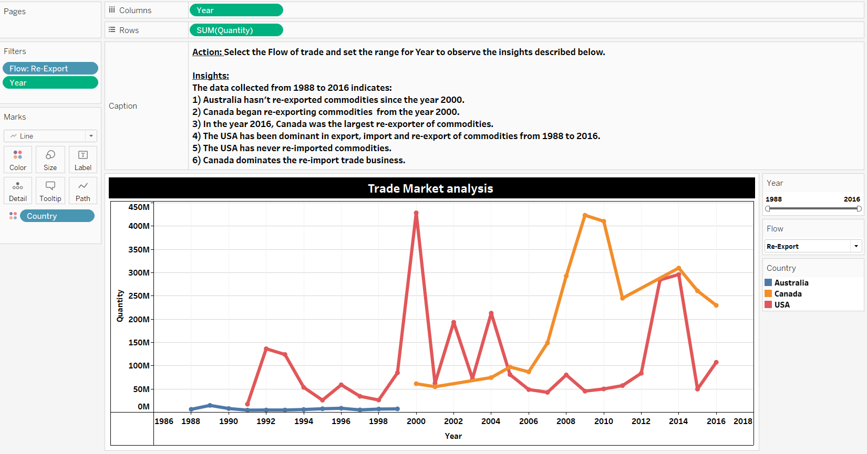

Slide 11
Total Trade Value – Sheet 3
Action:
Select Country and Flow of trade from the filter tab. Set the range of Year as desired.
Insights:
1) The map displays the selected country and its total trade value based on the selected trade flow - export, import, re-export, or re-import.
Note:
The Flow filter for the USA will not show Re-import, as there is no re-import activity in the country from the given data. Similarly, Australia will not show Re-export, as the re-export activity in Australia stopped since 1999.

Slide 12
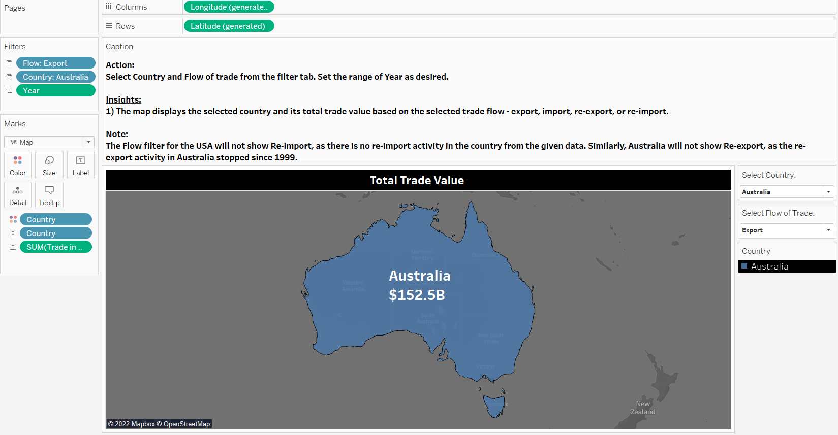

Slide 13
Top Categories based on Quantity- Sheet4
Action: Select the Country and the Flow of trade from the filter tabs. Adjust the Year range as desired.
Observation:
1) There are 12 categories in the given data. Each category has a list commodities. I have analyzed the commodities in the dashboard - 'GLOBAL TRADE ANALYSIS - 2'
2) The trade value in billions of US Dollars has been labeled for each category.
Insights:
1) Per the country and the flow of trade, we can observe the ranking of categories based on demand i.e. Quantity. Example: When we select Australia and Export from the filter tabs, we can observe the top categories.

Slide 14
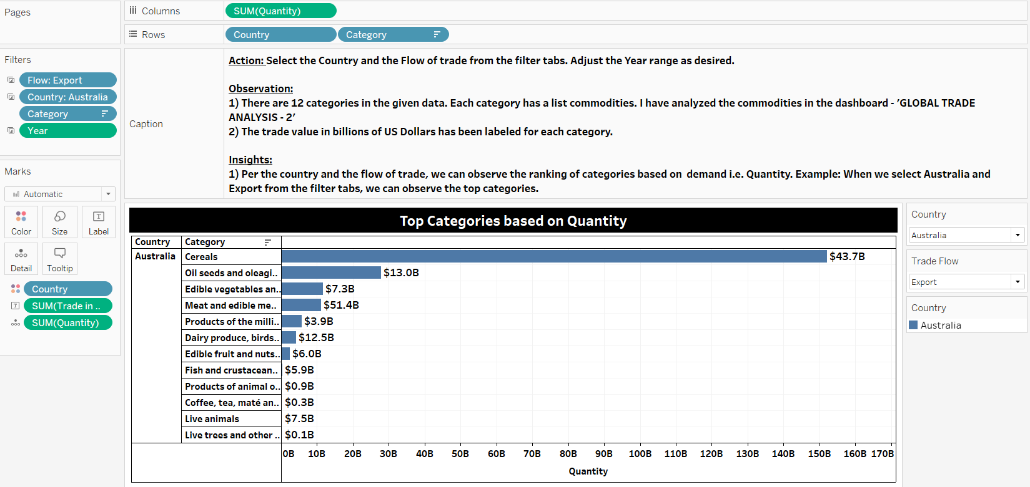

Slide 15
Trade Balance- Sheet 5
Action: Select the Country and the Flow of trade from the filter tabs. Adjust the Year range as desired.
Observation: The Trade balance has been calculated by subtracting the total import value from the total export value. It measures the country's net income earned on international assets. If the Trade Balance is positive, then it is called Trade Surplus, while a negative value is called Trade Deficit. Most countries regard Trade Deficit as unfavorable. This indicates the country imports commodities more than it exports them. However, a trade surplus may not be in the country's best interests.
Insight:
1) The Trade Balance has been positive for the three countries throughout the years 1988 - 2016, indicating Trade Surplus.

Slide 16
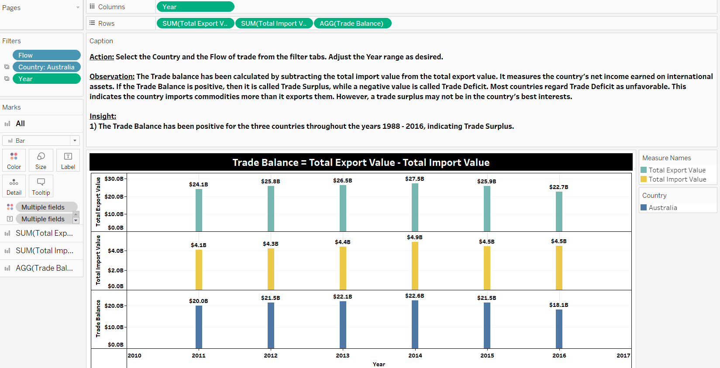

Slide 17
Trade Balance Analysis – Sheet 6
Action: Select the Country and adjust the range of Year to observe the overall Trade Balance for those years.
Observation: We can observe the ranking of Countries by their Trade Balance.
Insight:
1) The Ranking is in this order - Australia > USA > Canada for the years 1988-2016. While, for the years 2012 - 2016 the ranking is as follows - Australia > Canada > USA. Considering 2016 alone, the ranking is the same as the previous setting (2012 - 2016).
2) Trade Surplus countries may not be suitable for Import business, as countries tend to levy higher import duty on commodities. This is done so that domestic goods are consumed more than foreign goods by their people.

Slide 18
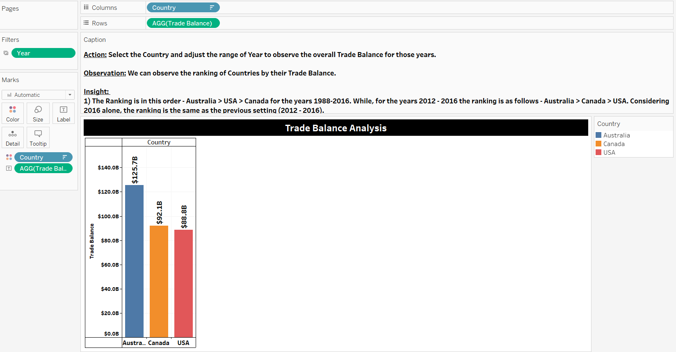

Slide 19
Top Commodities based on Trade Value- Sheet 7
Action: Select the Country and the Flow of trade from the filter tabs. Adjust the Year range as desired.
Observation: Each Category has a list of commodities. The chart shows the top commodities based on its demand i.e Quantity for the selected Flow of trade.
Insights:
1) Selecting the country and a flow of trade for the range of years, will show the top commodities based on the traded Quantity. Example: Selecting Canada and Export from their filter tabs, and setting the year from 1988 to 2016, will show that Wheat except durum wheat as the largest exported commodity. The total trade value for this commodity during those years is labeled on the chart.
2) We can perform the same action for other countries and observe the top commodities.

Slide 20
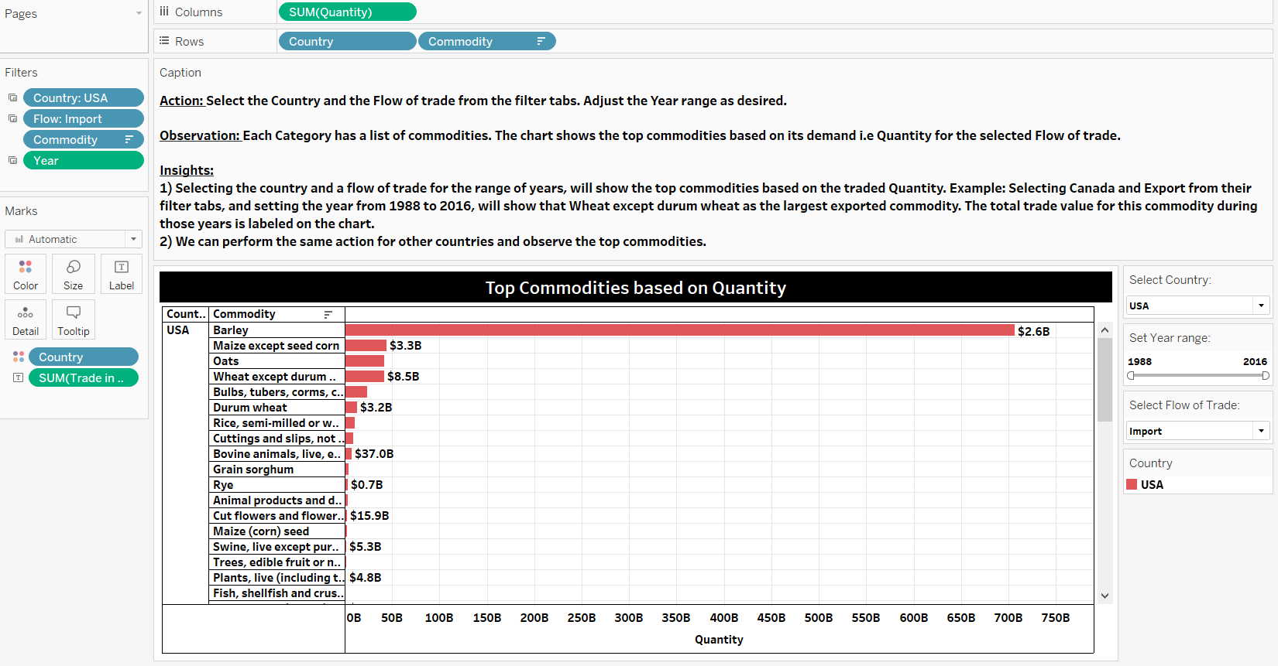

Slide 21
Unit Price of the Commodity over the years (1988 to 2016) – Sheet 8
Action: Select a country, a flow of trade , and a commodity from their respective filter tabs and observe the commodity's unit price for that country and flow of trade during a period.
Observation: The Unit price equals Trade Value / Quantity. The chart shows the unit prices for the commodity during the set period of years. The Unit price varies for each country and the flow of trade.
Insight:
1) Information on Unit prices can be seen for the selected country, flow of trade and commodity.
For Example: If we are interested in knowing the unit price for a top export commodity, we must select the commodity from the commodity filter. The line chart is color coded based on Country.
2) We can use forcasting techniques to find out future unit prices of the commodity.

Slide 22
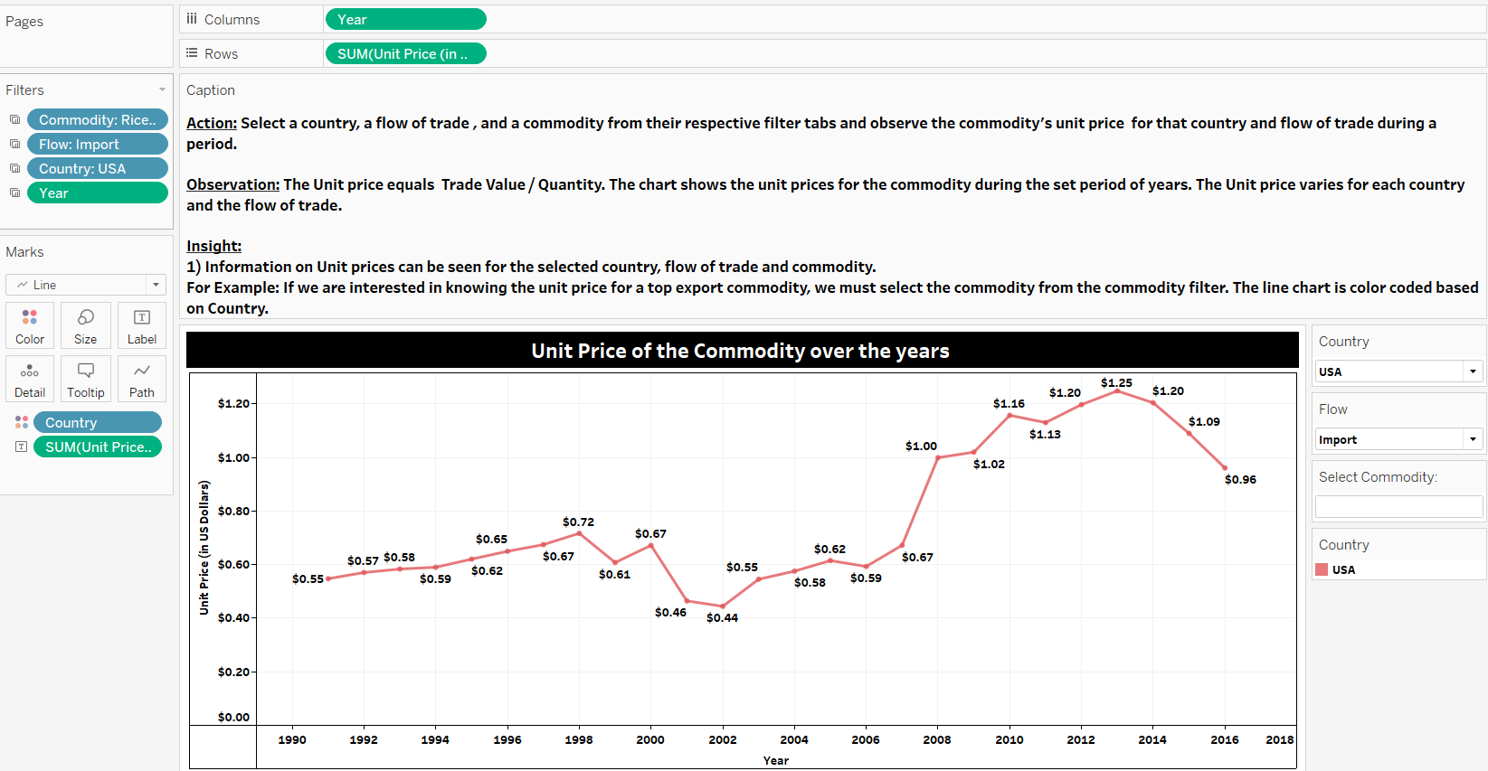

Slide 23
Demand for the Commodity over the years (1988 to 2016) – Sheet 9
Action: Select a country, a flow of trade , and a commodity from their respective filter tabs and observe the commodity's demand for that country and flow of trade during a period.
Observation: The chart shows the demand for the commodity during the set period of years. The Unit price for that commodity are labeled in the chart. Additionally, the total trade value (USD in billions) for that commodity has been included in the detail.
Insight:
1) The fluctuation in the line chart indicates the quantity of a commodity exported, imported, re-exported, or re-imported for a country during a period.
2) Information on Unit prices can be seen for the selected country, flow of trade and commodity.
For Example: If we are interested in knowing the unit price for a top export commodity, we must select the commodity from the commodity filter. The line chart is color coded based on Country.

Slide 24
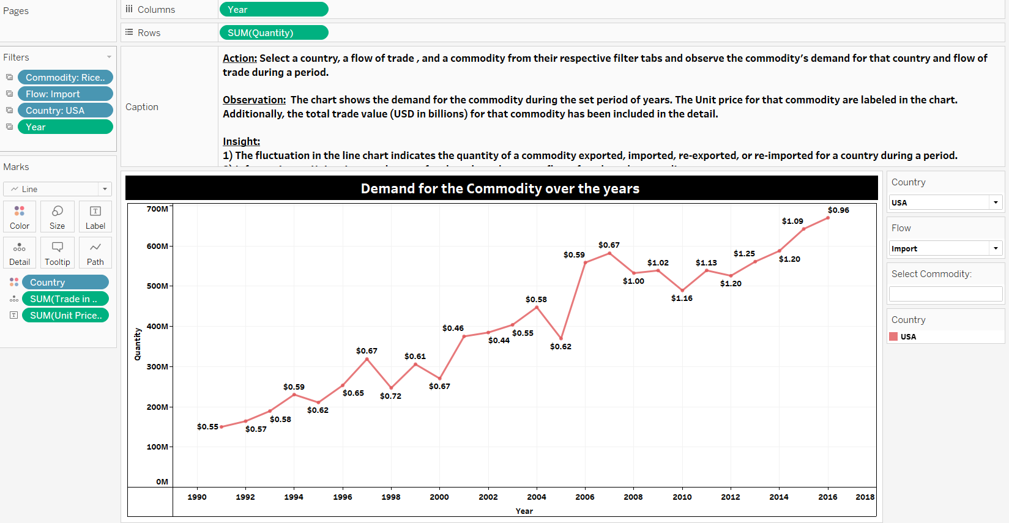

Slide 25
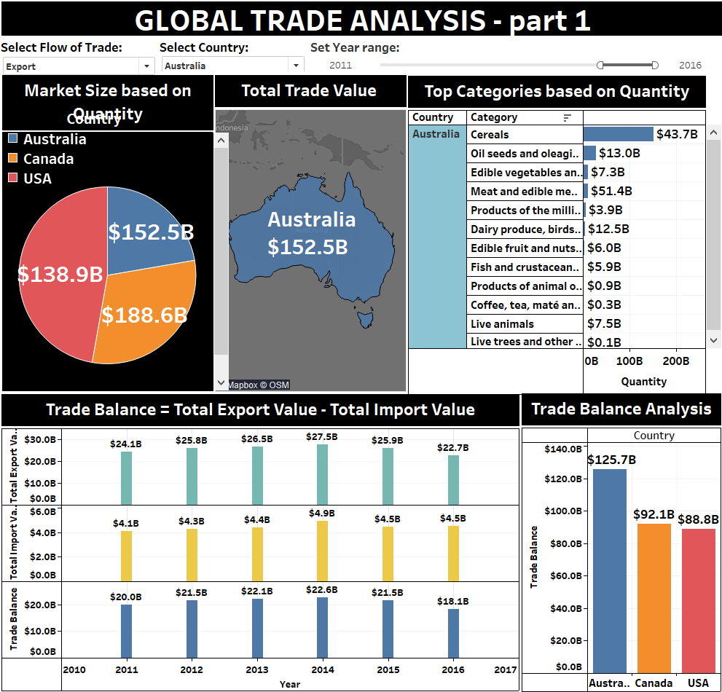
GLOBAL TRADE ANALYSIS - 1

Slide 26
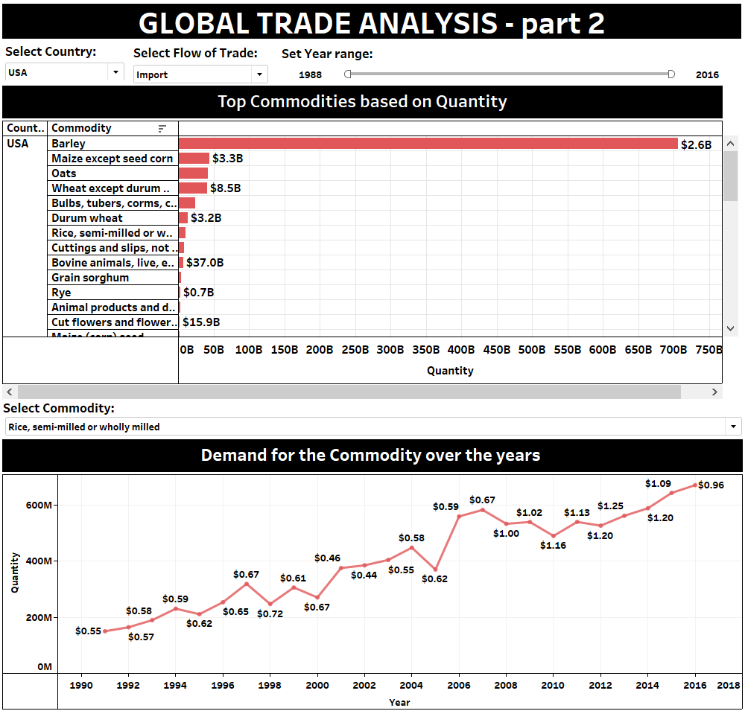
GLOBAL TRADE ANALYSIS - 2

Slide 27
Learning
Important trade concepts like Export, Import, Re-export, Re-import, Trade Balance, Trade Surplus, Trade Deficit , Trade Protectionism, Tax and Excise duty were learnt during this project.
Observed current trends in the trade markets. Example: The US President Trump’s declaration of Make in USA. He insists to levy higher duties on imports. This was due to America having a trade deficit with major Asian countries like India and China. I also came to realize about the India trade environment. What India imports the most and exports the most. With which countries India runs a trade surplus and trade deficit. Prime Minister Modi’s Make in India initiative.
Read the news on important trade related activities. Example: Recently, there was news about setting up Harley Davidson motorcycle stores in India. PM Modi assured Trump of dropping the import duty from 75 % to 50 %. However, Trump mocked India by saying it wasn’t doing America a favour. From reading such issues, I got a bigger picture of how trade affects the relation between countries.
I also read a gist of how to set up an import/ export business from the book – “Building an Import Export Business” by Kenneth D.Weiss.

Slide 28
Work in Tableau Public: Challenges and Steps Taken
Challenges | Steps Taken
Technical issue: Lost older project workbooks while working in Tableau Public. There was also occurrence of failure in saving the workbook to the website. | I discovered that Tableau Public required saving the workbook every five minutes, and learnt how to troubleshoot the failure occurring during saving. It required the user to sign out from the application and then sign in.
The Trade USD variable from the data did not have a currency format by default. Example: $ 123.4 B , where the suffix B stands for billions. | I wanted to observe my data in the currency format, where values should have a prefix of a dollar sign and the suffix “B”. I learnt about Tableau’s Default number format option which allows the user to assign a custom currency format.
Calculating the Trade Balance as it was important concept in understanding the trade environment for the given countries. | From the Internet, I learnt how to calculate the Trade Balance. Trade Balance = Total Export Value – Total Import Value. A calculated field was created for Total Export Value, Total Import Value and Trade Balance. The type of trade balance was identified and countries were ranked based on their trade balance value.
Calculating Unit price of a commodity. This is to understand the variation in unit price of a commodity for a range of years. This will assist the client in making an informed decision for choosing any of the potential commodities. | A calculated field was created for Unit price of a commodity. The formula for Unit price is Trade USD divided by Quantity.

Slide 29
Insights
After importing the data in Tableau, and studying the data visually, I was able to derive the following insights:
Note: The table shows insight from each of the worksheets featured in the Tableau dashboards
From 1988 to 2016, the USA has been the largest exporter, importer, and re-exporter of commodities. Whereas Canada has been the largest re-importer of commodities.
The USA has never re-imported commodities throughout these years.
Australia hasn't re-exported commodities since the year 2000.
Canada began re-exporting commodities from the year 2000.
In the year 2016, Canada was the largest re-exporter of commodities.
Canada dominates the re-import trade business.
Top categories were identified for each country.
Trade Balance was calculated and analysed. It was observed that all the countries had Trade Surplus from 1988 to 2016. The countries were ranked based on this observation. It is believed that a Trade Surplus country isn’t suitable for import business.
Top Commodities were identified based on their quantity traded via export, import, re-export, and re-import.
After identifying the potential commodities, we can observe it’s quantity and unit price over the past years. It was observed that unit prices differed for each country. Further, we can use forecasting technique to get an estimate of the unit prices for the years ahead.

Slide 30
References
“Building an Import/ Export Business” by Kenneth D.Weiss.
Harley-Davidson: Trump says 'getting nothing' after India reduces tariffs on motorcycles (https://timesofindia.indiatimes.com/business/india-business/harley-davidson-trump-says-getting-nothing-after-india-reduces-tariffs-on-motorcycles/articleshow/63090599.cms)
Balance Of Trade – BOT (https://www.investopedia.com/terms/b/bot.asp)
Balance of Trade, How to Calculate, and Favorable Versus Unfavorable (https://www.thebalance.com/balance-of-trade-definition-favorable-vs-unfavorable-3306261)
How to Start an Import/Export Business (https://www.entrepreneur.com/article/41846)
Importing into Canada (http://www.international.gc.ca/controls-controles/about-a_propos/impor/canada.aspx?lang=eng)
How to Export (http://www.indiantradeportal.in/vs.jsp?lang=0&id=0,25,44)

Slide 31
Thank You ☺

