Slide 1

Student Admission System
Developed By:-
Vidhya Shankar (Developer)
Himalay Dwivedi (Tester)
Mohammad Haris(Architect designer)

Slide 2
Objective of the student Admission System
Purpose: Streamline the admissions process for Humber College by automating data collection, GPA calculation, and report generation.
01
Goals: Enhance efficiency, accuracy, and insights in admissions management.
02
Significance: Improve operational efficiency, data integrity, and stakeholder satisfaction.
03
Alignment: Aligned with Humber College's goals of innovation and excellence in student services.
04
Outcomes: Expectations include reduced processing time, enhanced data accuracy, and better decision-making capabilities.
05

Slide 3
Overview of the Code
Description:
Python program utilizing tkinter library for GUI.
Modular design for ease of maintenance and scalability.
Features:
Password validation: Ensures data security and user authentication.
Data collection: Streamlines input of student information.
GPA calculation: Automates computation based on entered grades.
School assignment: Determines school placement based on GPA ranges.
Report generation: Produces comprehensive reports for analysis and decision-making.
Advantages:
User-friendly interface for seamless interaction.
Efficient processing reduces administrative burden.
Customizable to adapt to changing needs of Humber College.

Slide 4
Password Security
Enhanced Security Measures:
Stringent password criteria ensure robust password strength:
10+ characters
Uppercase letters
Numbers
Special characters
Limited Login Attempts:
Mitigate brute-force attacks and unauthorized access
Maximum attempts: 3
Clear error messages guide users and prevent account lockouts.
Error Handling and User Guidance:
Informative error messages for password entry:
Guides users on criteria for validation.
Graceful error handling ensures smooth user experience.

Slide 5
Efficient Data Collection
User Input for Number of Students:
Admin prompted to specify the number of students to process.
Validates input to ensure it falls within a reasonable range (1-50).
Student Names Input:
Admin enters names for each student.
Criteria enforced for student names:
Alphabetic characters only.
Title case format (e.g., "John").
Clears any leading or trailing whitespace.
Benefits:
Ensures consistency and accuracy in student data.
Prevents input errors and maintains data integrity.
Grades Capture for All Subjects:
Admin records grades for each student across multiple subjects.
Validates grades to ensure accuracy and reliability.
Conditions for grade entry:
Grade must be within the range of 0 to 100.
Minimum passing grade threshold of 40.
Comprehensive Error Handling:
Provides informative error messages for incorrect inputs.
Guides users through the data entry process to ensure compliance with criteria.
Enhances user experience by gracefully handling input errors within the application.

Slide 6
GPA Calculation
GPA Calculation Process:
Utilizes a weighted average method to calculate GPA for each student.
Incorporates grades obtained in individual subjects and their corresponding credit hours.
Formula: GPA =∑(Grade × Credit Hours)Total Credit Hours GPA= Total Credit Hours∑(Grade×Credit Hours)
Grade Validation:
Validates each grade entry to ensure it falls within the valid range of 0 to 100.
Implements a minimum passing grade threshold of 40% to maintain academic standards.
Provides clear error messages for invalid grades, guiding admins to correct their input.

Slide 7
College Selection Criteria
Engineering College:
Requires a GPA between 90 and 100 for admission.
Attracts students with exceptional performance in subjects like Math and Science.
Business School:
Accepts students with GPAs ranging from 80 to 89.
Emphasizes proficiency in subjects like Economics and Finance.
Law School:
Considers students with GPAs between 70 and 79.
Values competence in subjects like History and Political Science.
Not Accepted:
Students with GPAs below 70 are ineligible for admission to any college.
Encouraged to improve academic performance before reapplying.

Slide 8
Final Report Overview
Report 1: Student - College Allocation:
Provides a detailed breakdown of students and their allocated colleges based on GPA.
Data includes student names and their respective colleges.
Filter Criteria: Ensures only eligible students with valid GPAs are included, maintaining accuracy.
Report 2: College Acceptance Statistics:
Offers statistics on the number of students accepted into each college.
Helps in resource planning and allocation for each college.
Filter Criteria: Filters out invalid entries and ensures accurate acceptance counts.
Report 3: Rejected Applicants:
Lists students who were not accepted into any college.
Helps identify areas for improvement in the admissions process.
Filter Criteria: Filters out ineligible students and ensures only rejected applicants are listed.
Report 4: Percentage of Acceptance:
Displays the percentage of students accepted in each college.
Aids in evaluating the effectiveness of college acceptance criteria.
Filter Criteria: Filters out ineligible students and ensures accurate percentage calculations.

Slide 9
Benefits of Comprehensive Reports
Decision Making:
Provides admins with critical data for informed decision-making in student admissions and resource allocation.
Helps identify trends and patterns to optimize admissions strategies.
Resource Planning:
Facilitates resource allocation based on college acceptance statistics, ensuring efficient distribution of resources.
Helps colleges prepare for incoming student cohorts and adjust staffing levels accordingly.
Efficiency Enhancement:
Saves time and reduces manual effort by automating the generation of comprehensive reports.
Enables admins to access critical data with a click of a button, streamlining decision-making processes.
Performance Evaluation:
Allows admins to evaluate the effectiveness of admission processes and identify areas for improvement.
Provides insights into college acceptance rates and helps refine admission criteria for future cycles.
Versatile Use Cases:
Academic planning
Budget allocation
Marketing and outreach strategies
Institutional research and accreditation processes
Student counseling and support services

Slide 10

Code Demonstration

Slide 11
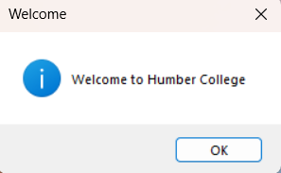
Welcome Page

Slide 12
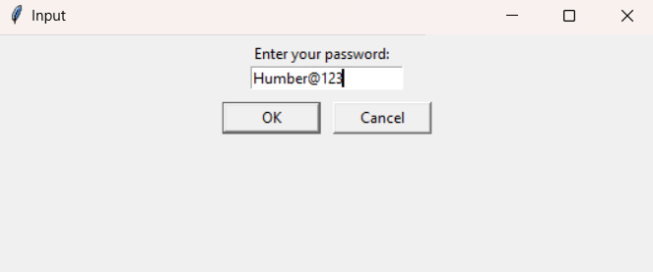
Password Page

Slide 13
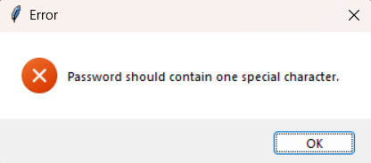
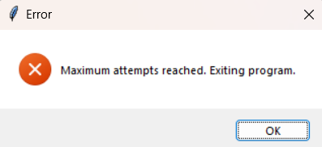
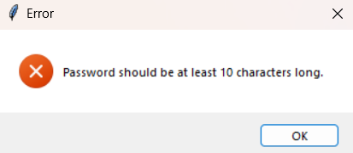
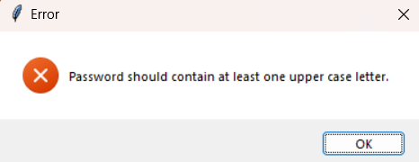
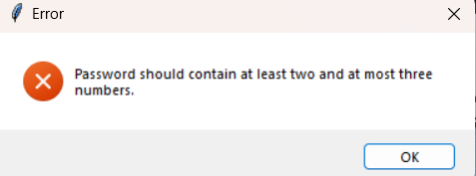
Password Type of error handling
Password
Criteria
Max Attempt

Slide 14
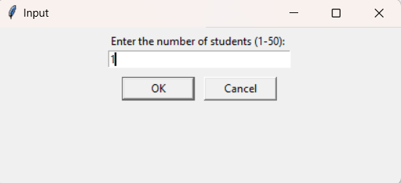
ValidATE Number of Students

Slide 15
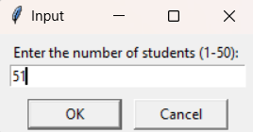
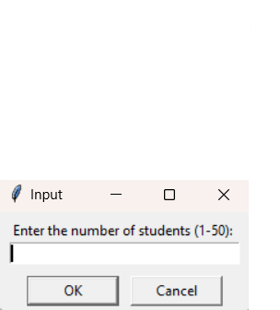
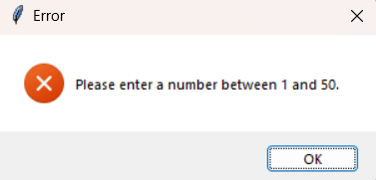
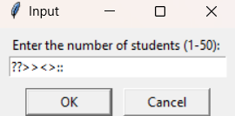
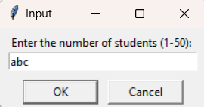
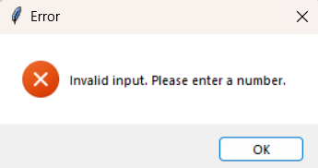
Error Handling in Number of Students

Slide 16
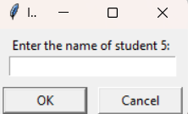
Enter Student Names

Slide 17
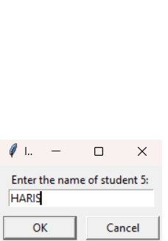
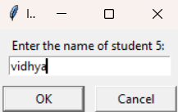
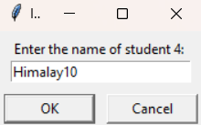
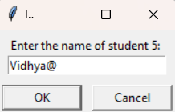
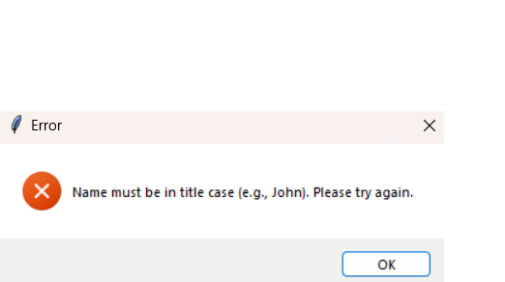
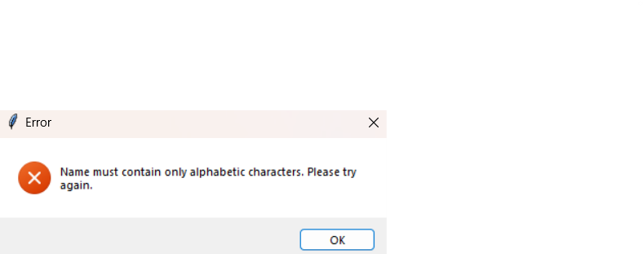
Validate Student Names
Title Case
Only Character Accepted

Slide 18
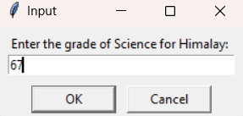
Grades Entry

Slide 19
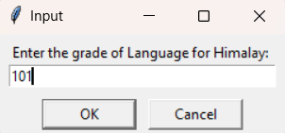
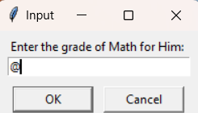
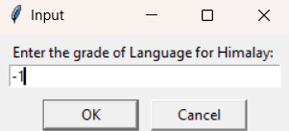
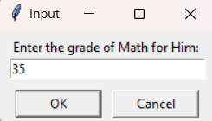
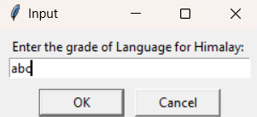
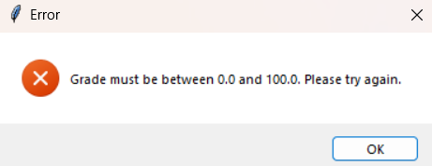
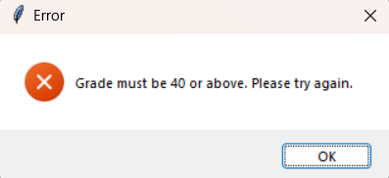
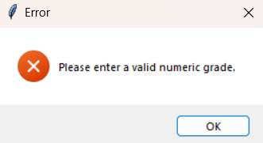
Valid Student Grades Entry

Slide 20
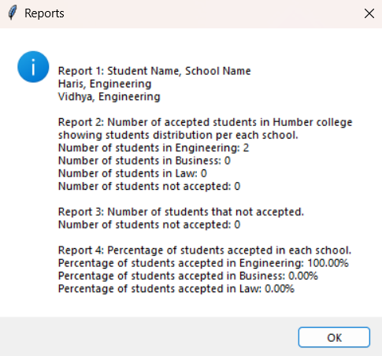
Report Generation

Slide 21

Thank YOU

