Slide 1

Lending Club Case Study
Team
- Vijay Bhaskar
- Vidhyadhar Pandit

Slide 2
TOC
Problem statement
Assumptions
Approach
Insights
Recommendation and conclusion

Slide 3
Problem statement
Objective of case study is to understand the driving factors (or driver variables) behind loan default i.e. the variables which are strong indicators of default

Slide 4
Assumptions
<need to add>

Slide 5
Approach
Step 1: Data Understanding
Total number of Rows - 39717
Total number of Columns – 111
Conclusion
There are many columns with null values for all the rows. Hence we need data cleaning

Slide 6
Approach
Step 2: Data Cleaning – Strategy
Columns having high percentage of missing values, directly discard those column from the analysis
Columns having missing values under acceptable range we prefer to impute them(replace with some values)
For numerical columns we prefer to use mean or median (Median is preferred)
Median is not affected with the outliers
For categorical column we refer to use mode
If we have very less missing values in any column in that case you can drop rows as well
For a target variable - if there are missing values, drop the row
Removing columns which has all values as null
Drop columns where same value is present in all or most of the rows
Conclusion
<need to add>

Slide 7
Approach
Step 3: Data Analysis
Identify Categorical and Numeric variables
Univariate Analysis
Categorical columns
Numeric Columns
Bivariate Analysis
Categorical columns
Numeric Columns
Conclusion
<need to add>

Slide 8
Insights
Recommendation and conclusion

Slide 9
Insights
Insight1: At higher loan amounts the percent of charged off loans over total loans increased by 5 percentage points i.e. one in every five loans charged off
Insight2: At higher interest rates, charged off loans as a percentage of total loans doubled when compared to overall range of data. Three loans in every ten loans charged off, meaning there is correlation between higher interest rate and loan getting charged off
Insight3: When the interest rate is very low, the percent of charged off loans is way to less when compared to the overall range. This means when the interest rate is very low, very few loans gets charged off
Insight4: When the loan term is 60 months, 25% of the total loans got charged off
Insight5: As the grade of loan moves from A to G, the percentage of charged off loans keeps increasing. While only 6% of the grade A loans ended up in charged off, in grade G over 33% of the loans are charged off
Insight6: In the F5 subgrade, almost 48% of the loans resulted in charged off loans. In these subgrades F5,G3,G2,F4,G5,G1 the charged off loans percentage is very high(more than 33%. At least One in every three loans got charged off)
Insight7: Lending for the purpose of small business turned out to be risky. More than 27% of the total loans resulted in charged off, this is way more than the average of 16%
Insight8: The percentage of charged off loans is around 15% in most cases except DC-7% and NV-22.5%
Insight9: When there is one pubrec, the percent of charged off loans is high when compared to average. The other sample sizes are very small, so not considering them.
Insight10: When there is one pub_rec, bankruptcy, the percent of charged off loans is high when compared to average. The other sample sizes are very small, so not considering them

Slide 10
Insight 1
At higher loan amounts the percent of charged off loans over total loans increased by 5 percentage points i.e. one in every five loans charged off

Slide 11
Insight 2
At higher interest rates, charged off loans as a percentage of total loans doubled when compared to overall range of data. Three loans in every ten loans charged off, meaning there is correlation between higher interest rate and loan getting charged off

Slide 12
Insight 3
When the interest rate is very low, the percent of charged off loans is way to less when compared to the overall range. This means when the interest rate is very low, very few loans gets charged off

Slide 13
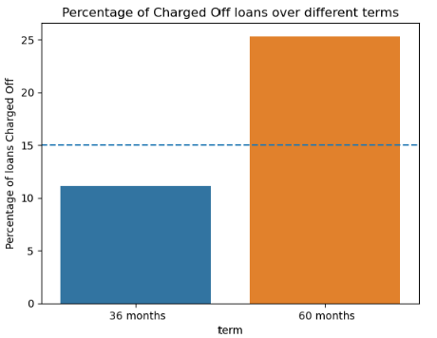
Insight 4
When the loan term is 60 months, 25% of the total loans got charged off

Slide 14
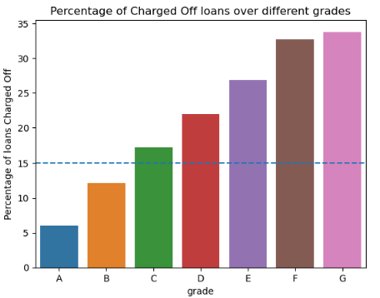
Insight 5
As the grade of loan moves from A to G, the percentage of charged off loans keeps increasing. While only 6% of the grade A loans ended up in charged off, in grade G over 33% of the loans are charged off

Slide 15
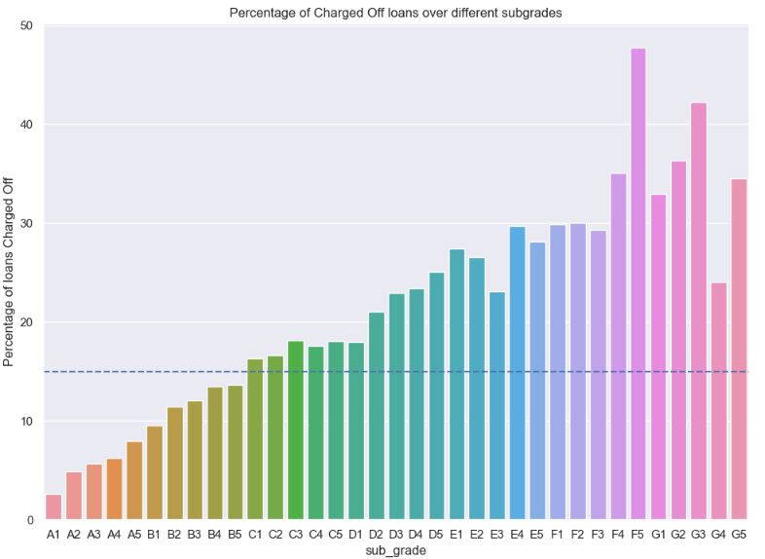
Insight 6
In the F5 subgrade, almost 48% of the loans resulted in charged off loans. In these subgrades F5,G3,G2,F4,G5,G1 the charged off loans percentage is very high(more than 33%. At least One in every three loans got charged off)

Slide 16
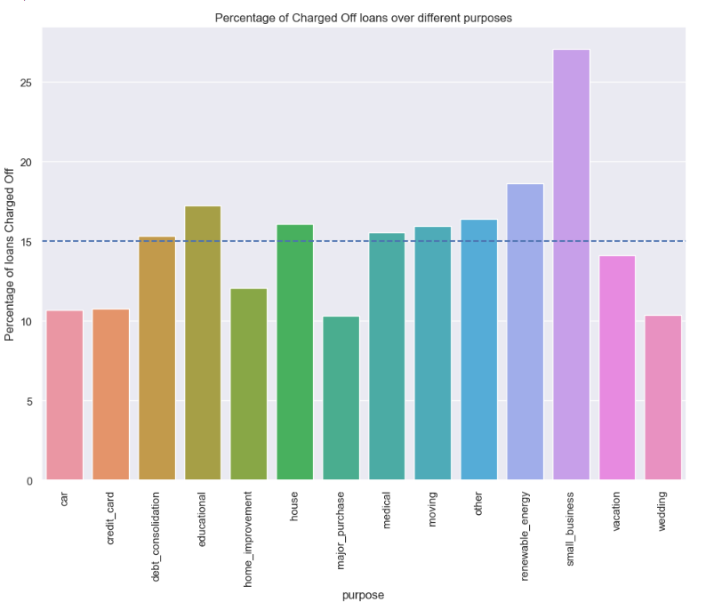
Insight 7
Lending for the purpose of small business turned out to be risky. More than 27% of the total loans resulted in charged off, this is way more than the average of 16%

Slide 17
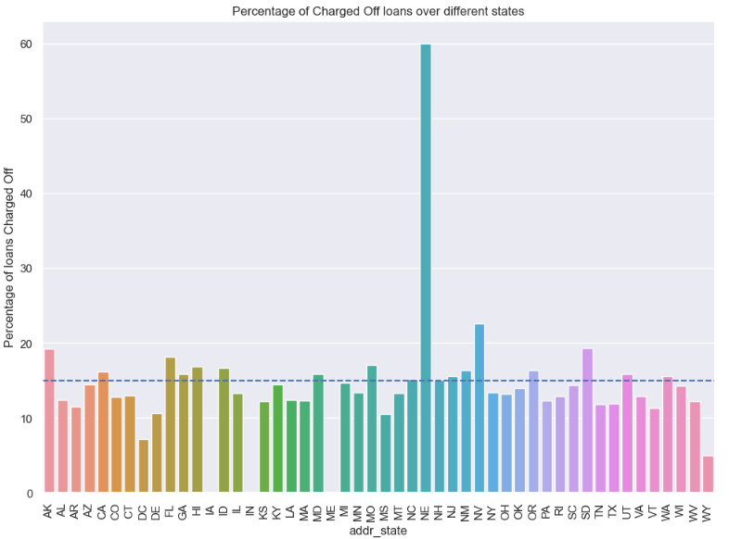
Insight 8
The percentage of charged off loans is around 15% in most cases except DC-7% and NV-22.5%

Slide 18
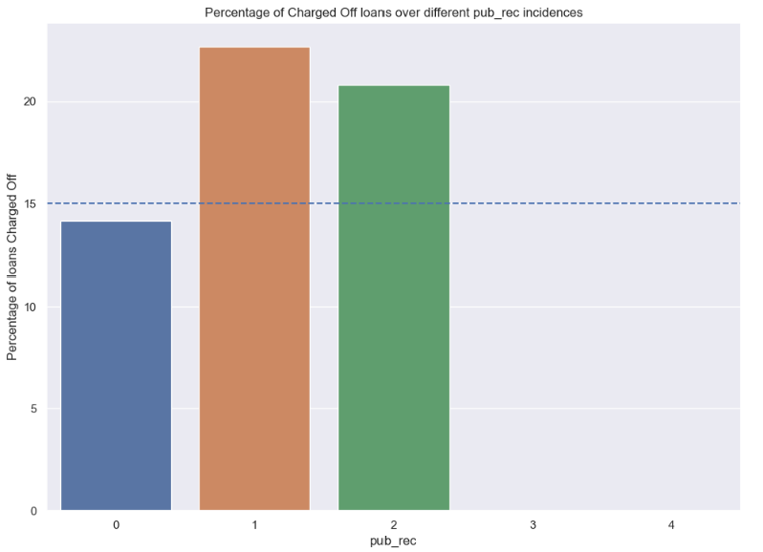
Insight 9
When there is one pubrec, the percent of charged off loans is high when compared to average

Slide 19
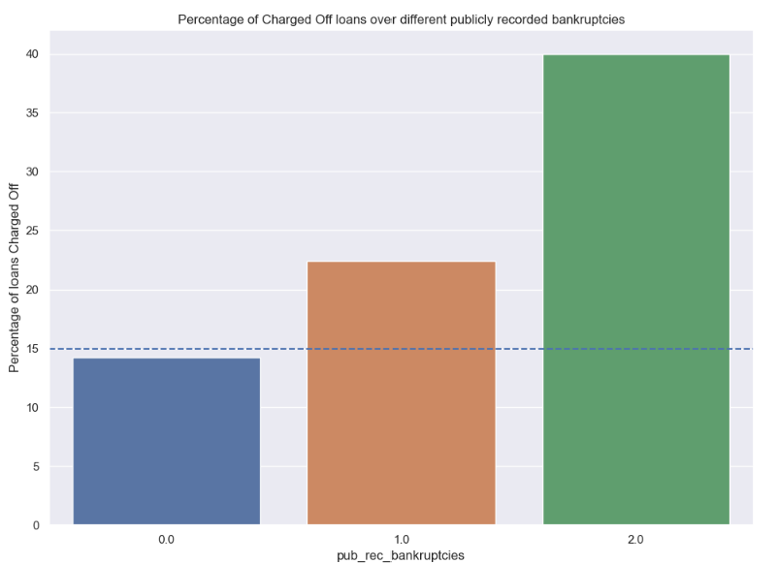
Insight 10
When there is one pub_rec, bankruptcy, the percent of charged off loans is high when compared to average

