Slide 1

Lending Club Case Study
Team
- Vijay Bhaskar
- Vidhyadhar Pandit

Slide 2
Table of Contents
Problem statement
Assumptions
Approach
Insights
Recommendation and conclusion

Slide 3
Problem statement
Objective of case study is to understand the driving factors (or driver variables) behind loan default i.e. the variables which are strong indicators of default

Slide 4
Assumptions
The analysis is done only for loan status that has values Fully Paid and Charged Off. The data that has loan status value "current" is removed from the dataset

Slide 5
Approach
Step 1: Data Understanding
Total number of Rows - 39717
Total number of Columns – 111
Conclusion: There are many columns with null values for all the rows. Hence we need data cleaning

Slide 6
Approach
Step 2: Data Cleaning – Strategy
Columns having high percentage of missing values, directly discard those column from the analysis
Columns having missing values under acceptable range we prefer to impute them(replace with some values)
For numerical columns we prefer to use mean or median (Median is preferred)
Median is not affected with the outliers
For categorical column we refer to use mode
If we have very less missing values in any column in that case you can drop rows as well
For a target variable - if there are missing values, drop the row
Removing columns which has all values as null
Drop columns where same value is present in all or most of the rows

Slide 7
Approach
Step 3: Data Analysis
: For performing the analysis, the percentage of charged off loans in the overall dataset is taken as the baseline and data in various segments is compared against this baseline to find out the strong indicators of default
Identify Categorical and Numeric variables
Univariate Analysis
Categorical columns
Numeric Columns
Bivariate Analysis
Categorical columns
Numeric Columns

Slide 8
Insights
Recommendation and conclusion

Slide 9
Relationship between loan amount and charged off loans
The analysis is done for the data beyond 90th percentile of loan amount.
In this dataset, it is observed that the percentage of charged off loans increased by 5 percentage points. While the percentage of charged off loans in the overall dataset is 15%, the same in higher loan amount dataset is 20%
Observation:
Higher the loan amount, higher are the chances for the loan getting charged off

Slide 10
Relationship between interest rate and charged off loans
When the analysis is done for the dataset beyond 90th percentile of the interest rate, it is observed that the percentage of the charged off loans in the total loans in this dataset is 30%. This is double when compared to the percentage of charged off loans in the overall dataset(15%) indicating that at higher interest rate there is high chance of loan getting charged off.
Similarly, when the analysis is done for the data below the 10th percentile of interest rate, it is observed that the percentage of the charged off loans in the total loans in this dataset is 4%. This is very less when compared to the percentage of charged off loans in the overall dataset(15%) indicating that, at lower interest rate there is high chance of loan getting fully paid.
Observation:
Higher the interest rate, the higher are the chances for the loan getting chargedoff

Slide 11
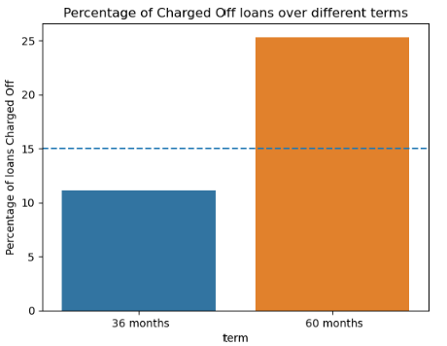
Loan term and Charged Off loans
When the loan term is 60 months, 25% of the loans in this dataset got charged off. This is higher than the overall average of 15%
When the loan term is 36 months, only 11% of the loans in this dataset got charged off. This is lower than the overall average of 15%
Observation:
Lending for longer term has high chances for loan getting charged off

Slide 12
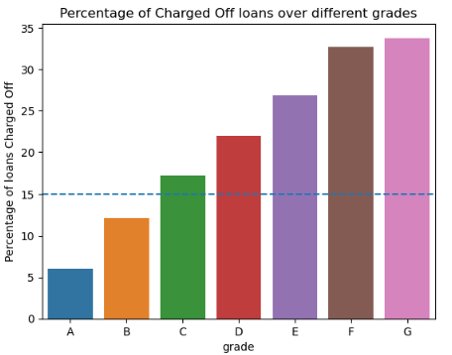
Loan Grade and Charged Off loans
As the grade of loan moves from A to G, the percentage of charged off loans keeps increasing. While only 6% of the grade A loans ended up in charged off, in grade G over 33% of the loans are charged off
Observation:
The higher the grade of the loan(E,F,G), the higher are the chances of loan getting charged off. It is advised to give loans with grades (A,B,C) to minimize the credit loss.

Slide 13
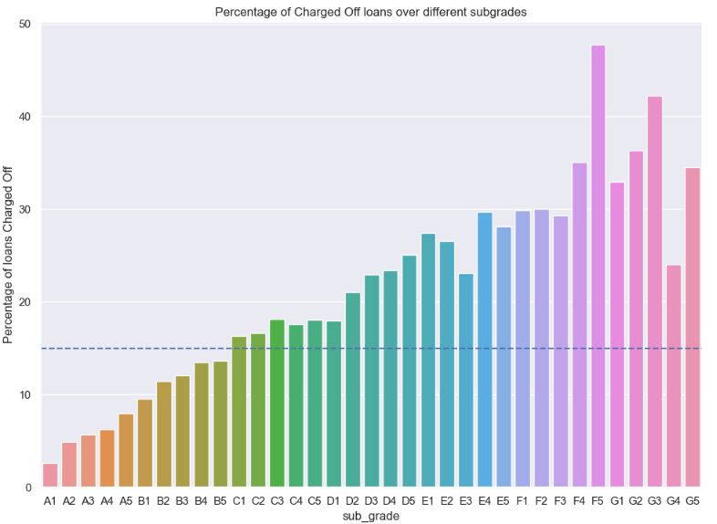
Loan sub grade and Charged Off loans
In the F5 subgrade, almost 48% of the loans resulted in charged off loans. In these subgrades F5,G3,G2,F4,G5,G1 the charged off loans percentage is very high(more than 33%. At least One in every three loans got charged off)
Observation:
The loans in subgrades of E,F,G have higher chances of default

Slide 14
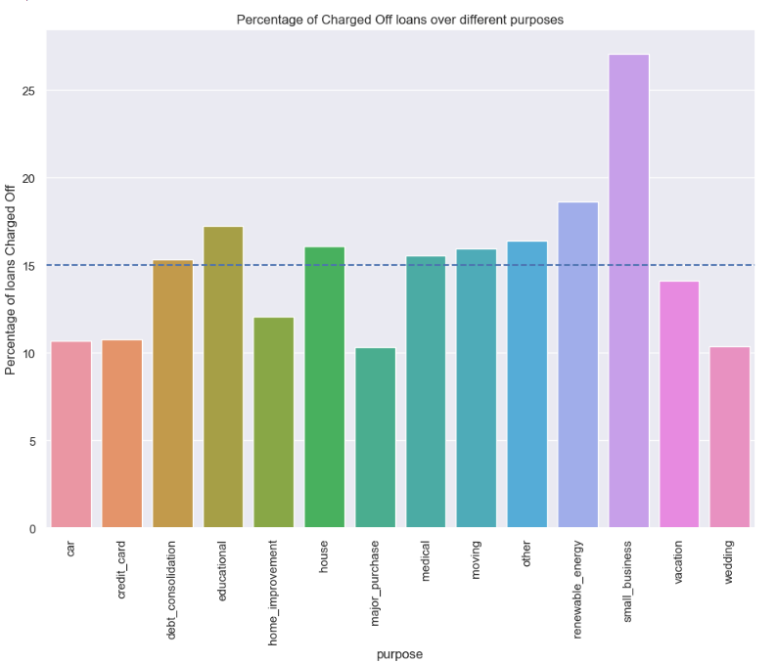
Purpose of the loan and Charged Off loans
Observation: Lending to small businesses is risky when compared to loans for other purposes
Send message
Checking who can access file
10:00PM
Lending for the purpose of small business turned out to be risky. More than 27% of the total loans resulted in charged off, this is way more than the average of 16%
Observation:
Lending to small businesses is risky when compared to loans for other purposes

Slide 15
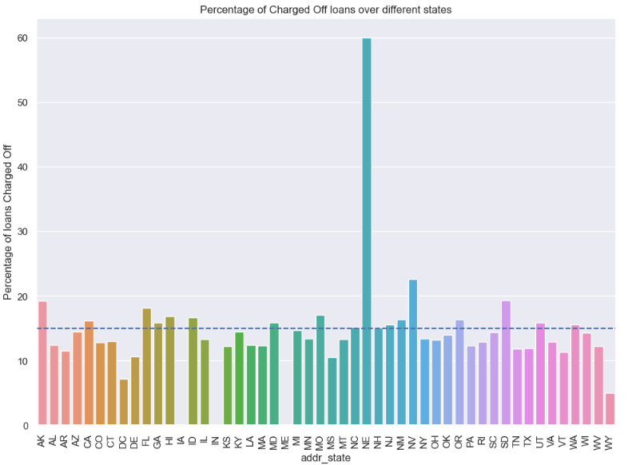
Charged Off loans across states
In the state of DC, the percentage of charged off loans is only 7% when compared to national average of 15%
In the state of NV, it is 22.5%,this is higher than the national average of 15%.
In the state of NE, it is 60% way higher than the national average.
Observation:
For the loans in the states of NE and NV,the chances of loan getting charged off is higher.

Slide 16
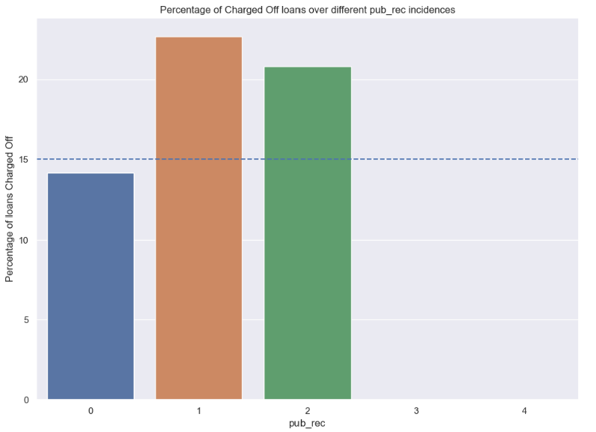
Charged Off loans when there are derogatory public records
When there are derogatory public records against a loan applicant, there is a higher chance of loan getting defaulted

Slide 17
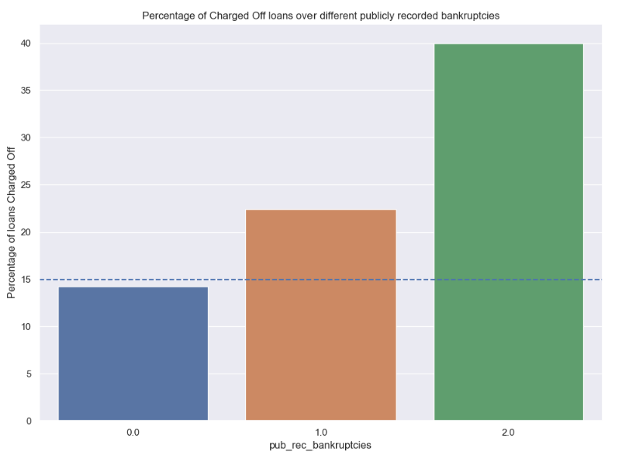
Charged Off loans when there are publicly recorded bankruptcies
When there are publicly recorded bankruptcies against a loan applicant, there is a higher chance of loan getting defaulted

