Slide 1
ALY 6040 - Data Mining Applications
Final Project Presentation
USA Accidents Dataset
29 June 2022
Team 10
Perumal Kabali
Priyanga Sreeram
Vidhya Lakshmi Vaithilingam Palanimurugan

Slide 2
Real-world Problem - Solved with Big-data
High casualty and injuries are observed
Road crashes costs $230.6 billion per year for the government or an average of $820 per person
Accidents has different severities
Need to reduce accidents
Hotspot locations needs to be identified
Aim to find the most important factors that determine the severity of an accident
Notes:
In the USA, over 37,000 people die in road crashes each year, and 2.35 million are injured or disabled.
Road crashes cost the U.S. $230.6 billion per year or an average of $820 per person.
The severity of accidents can be predicted based on the weather conditions, time, location, traffic information, etc.
Reducing traffic accidents is an important public safety challenge
Accidents can be reduced by identifying accident hotspot locations.
Using our analysis, we plan to find out the most important factors that determine the severity of an accident.

Slide 3
Dataset Selection - Reason
The USA accident dataset - March 2016 to December 2021
Taken from Kaggle with the title - US Accidents
2.8 million records
47 features – with different data types
Sub-setting data due to computational requirements
Data of interest – Accidents in the New England
Notes:
The USA accident dataset is a countrywide traffic accident dataset collected between March 2016 and December 2021 across 49 states of the United States.
It consists of 2.8 million records of car accidents from
It is collected from Kaggle under the title US Accidents.
The data set has 47 variables with 16 categorical variables, 13 Boolean variables, 15 numerical variables, 2 Date Time stamps, and 1 string. Out of the 47 variables, 12 of them are traffic attributes, 9 of them are location attributes, 11 of them are weather attributes, and 13 of them are point of interest (POI) attributes. This study will be a subset of the US-Accidents dataset occurred in New England region of the United States comprising the states of Maine, Vermont, New Hampshire, Massachusetts, Connecticut and Rhode Island.

Slide 4
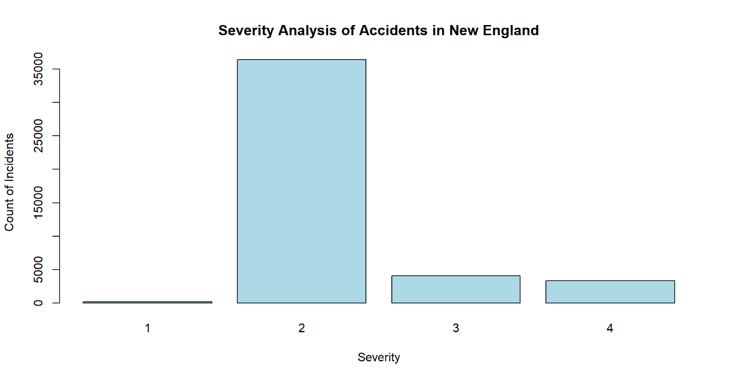
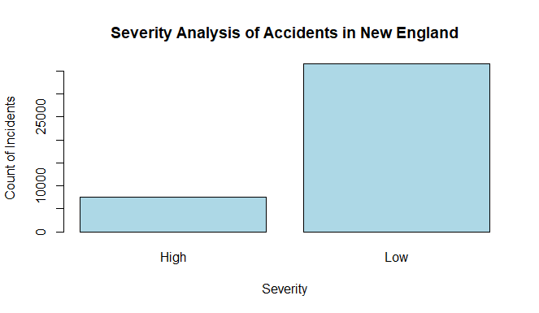
Exploratory Data Analysis – Target Variable

Slide 5
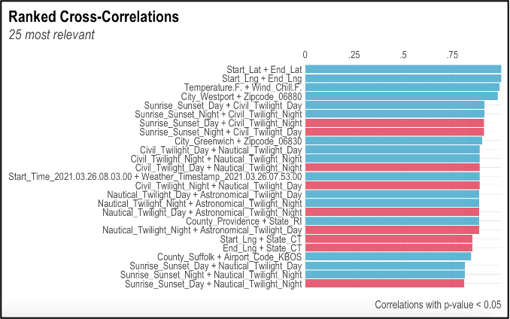
Exploratory Data Analysis – Explanatory Variables

Slide 6
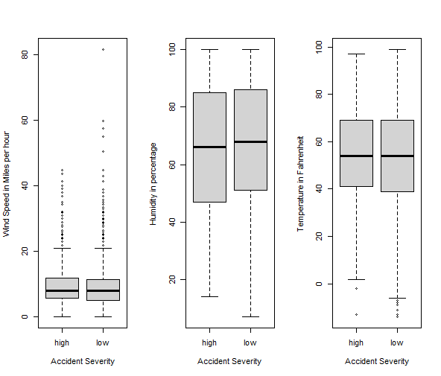
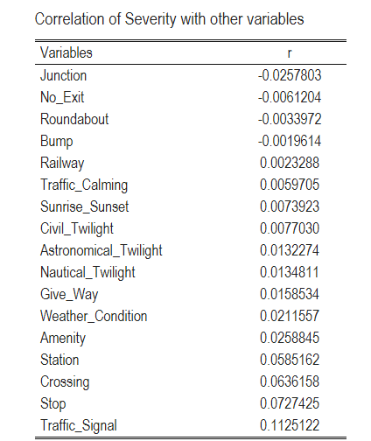
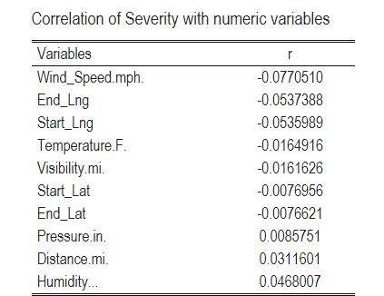
Exploratory Data Analysis - Correlation

Slide 7
Data Modelling Techniques Used
Decision tree
Classifies the data points by checking the information gain at each node
Predictor variables - Distance, Start Latitude and Side of the road
The accuracy is 84.42% with many Type-1 and few Type-2 errors
Gradient Boost Method
Uses cross-validation training control method
The accuracy is 85% with huge misclassification errors
Low kappa value (0.23)

Slide 8
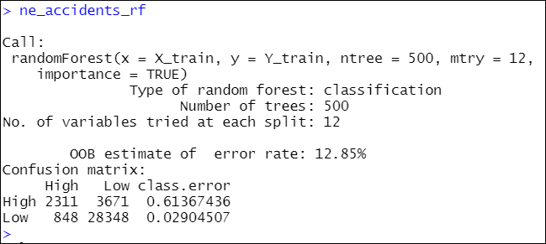
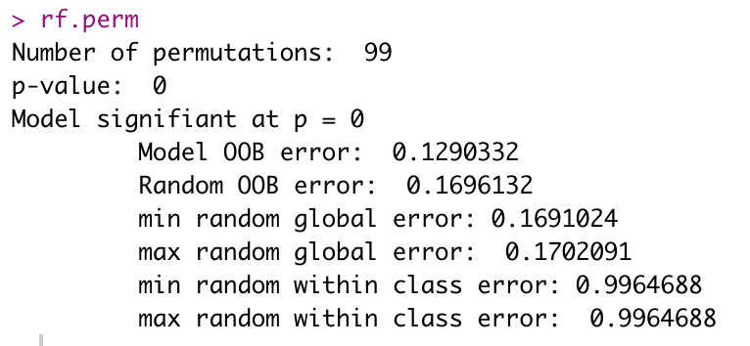
Methodology Used to Analyze the Data
Random Forest model
Ensemble of decision trees
Eliminates high variance by adding randomness to the model.
88% accuracy with testing data
Model’s Significance test
Model’s Output

Slide 9
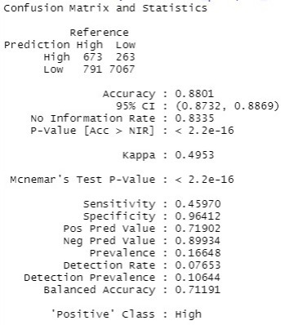
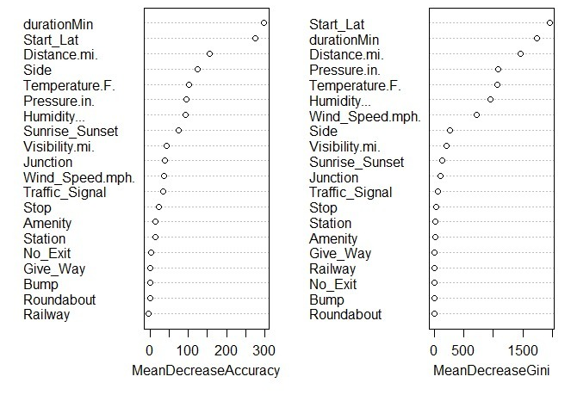
Results of the Analysis
Confusion Matrix
Variables of Importance

Slide 10
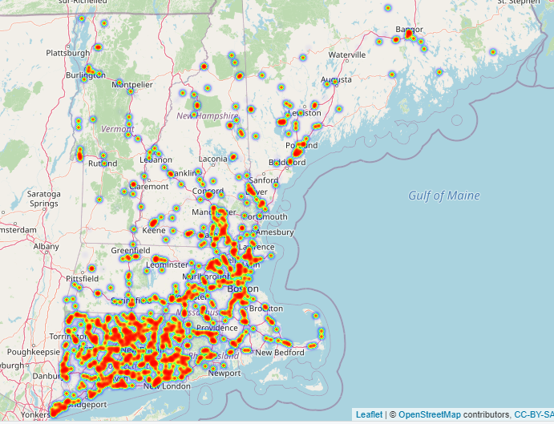
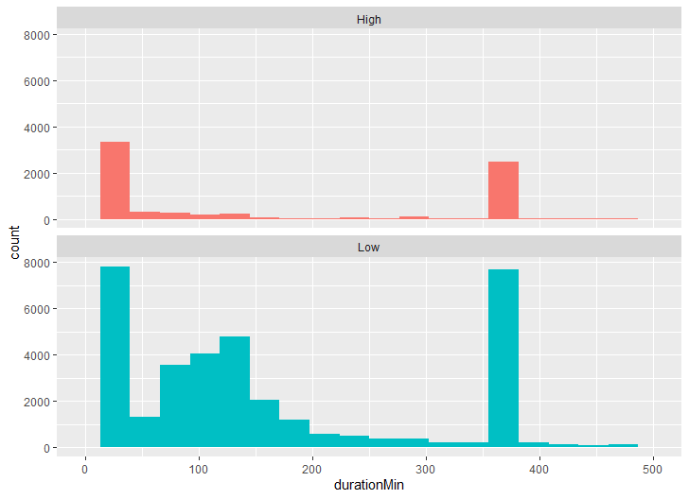
Interpretation of High Influence Variables
Hotspot Locations of Accidents
Duration of Accidents vs Severity

Slide 11
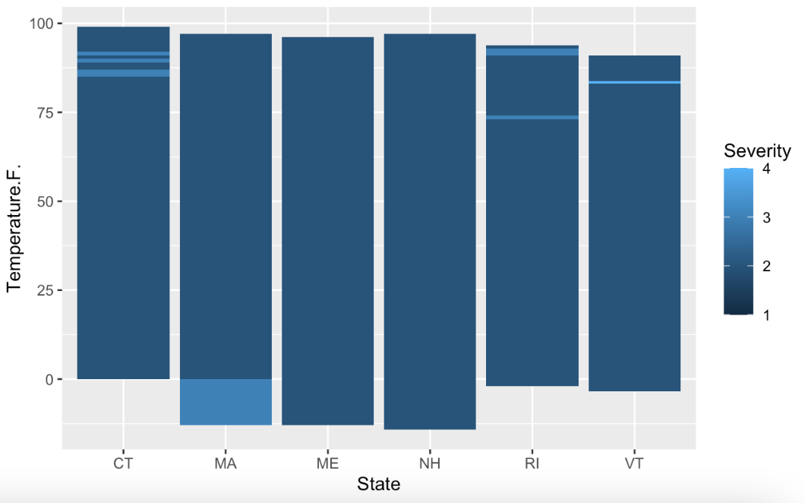
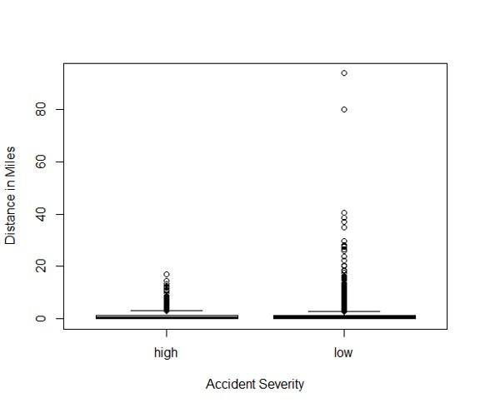
Interpretation of High Influence Variables
Severity of accidents in various states at different Weather conditions
Distance vs Severity Levels​

Slide 12
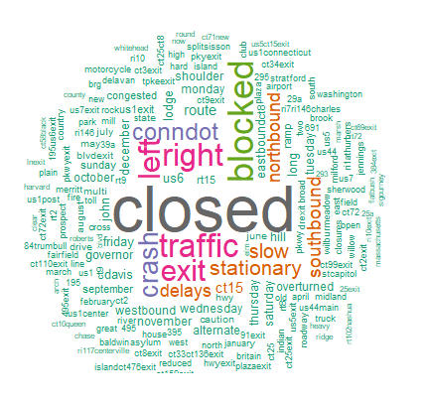
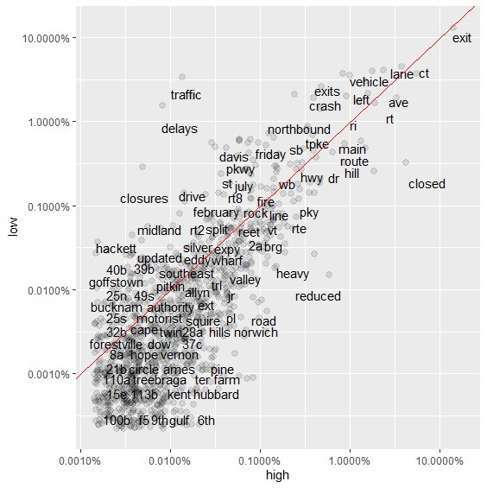
Text Mining

Slide 13
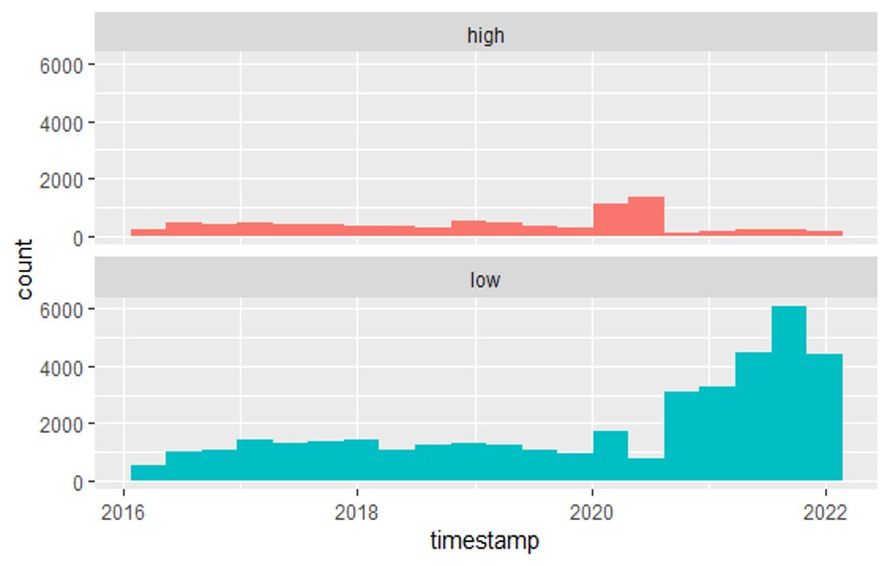
Accidents Across Various Time Period
The number of accidents has significantly increased during the pandemic years. Why ?
Notes:
According to a few experts, this driving behavior is likely to reflect widespread psychological feelings like isolation, loneliness, and depression. It is also said by a researcher that, along with high road accidents there are also other pandemic trends like the skyrocketing sales of alcohol, drug overdoses, and increase in homicides.

Slide 14
Conclusion from Analysis
Features influencing severity - Duration, Start_Lat, Distance.mi., Side, Wind_Speed.mph, and Temperature
Optimal model - Random Forest model - 88% accuracy
Hotspot locations - Connecticut, Massachusetts, and Rhode Island
“Governor John Davis Lodge Turnpike” highway in Connecticut - 10% of the total accidents in New England
Patterns observed - pandemic vs behavioral factors
Notes:
More accidents have taken place during the pandemic - stress, depression, the influence of alcohol or drugs - behavioral factors

Slide 15
Recommendations and Steps Forward
Recommendations
More traffic control cameras in hot spot locations
Highlighting entry and exit points
Educating drivers on lane usage
Recommend the use of public transportation
Steps Forward
50 to 75 % of incidents occur due to driver behavior – Collect additional data.
Analyze the severity of injuries due to an accident
Notes:
More traffic control cameras can be placed in hot spot locations
Clearly mentioning the entry and exit points, educating drivers about proper lane usage
The government can also recommend the use of public transportation by people whenever possible while commuting to work
--
Research says 50 to 75 % of incidents occur due to driver behavior – Collect additional data on driver details such as age, vision, and behavioral factors such as stress, the influence of alcohol, drugs, etc., to study further, which may help in more accurate predictions of the severity levels of road accidents.
Analyze if the severity of the accident is influenced by the severity of injuries due to an accident.

Slide 16
Thank You

