Slide 1

Comparing the models
Final Project Presentation
Phimonkae Wilairat
Vidhya Lakshmi Vaithilingam Palanimurugan
ALY6015: Intermediate Analytics
Prof. Dr. Roy Wada
August 17, 2022

Slide 2

Estimates of Motor Vehicle Traffic Fatalities in Crash Cases
Source : Fatality Analysis Reporting System (FARS)
from 2010 to 2015

Slide 3
Analysis Propose
To establish an accurate model for predicting the number of fatally injured persons in the crash using reliable predictor variables
Apply EDA technique and plot to identify the relationship between number of fatalities (response) and accident causes (predictors)
Find an appropriate forecasting model for fatalities

Slide 4

Dataset Overview
FARS contains data on a census of fatal traffic crashes within the 50 states, the District of Columbia, and Puerto Rico
Focus on the number of Fatalities
by looking through relevant cause
Collected from 2010 to 2015
Number of people
involed in the crash
185,426 crash case observations
Collected across 58 variables which include 34 quantitative variables and 24 categorical variables stating where, when, how the accident occurred, and for what reason
Driver conditions : Drunk, Invalid License, Previous Record Crashes, Age, Gender, etc.

Slide 5
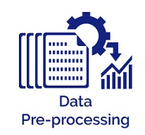

Data Pre-processing
Merge two dataframe by row (FARS 2010 -2014) and (FARS 2015)
Identify missing values and duplicate columns
Remove rows with NA from a list using na.omit()
Data imputation with mode or mean

Slide 6
Data Summary
High fatally injured incidents accounted for 7% of crashes occur each year. (>1 persons)
Texas had the highest number of fatality incidents (>1 persons), but in terms of percentage North Dakota at 10.63%
Incidents with more severe injuries are more likely to occur in small cities

Slide 7
Data Summary
“Car crash incidents usually occur when the weather is clear and during the daylight”

Slide 8
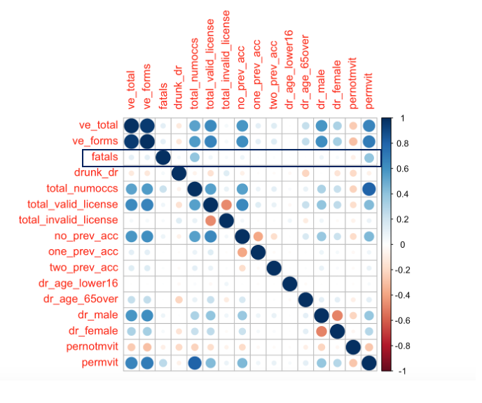
Correlation Matrix
Find out relationships relates to the number of fatalities
The “Number of fatalities” is correlated with:
“Number of occupants”
“Persons in Motor Vehicles in Transport”
It is about 0.5, which indicates that they’re positively correlated. More number of people involved in the crash is moderately related to higher number of fatalities.

Slide 9
Number of People Involved in Crash vs Number of Fatalities
Test the hypothesis that two groups have equal fatalities means
Use Welch Two Sample t-test (α = 0.05)
When the number of occupancy is greater than the average, the number of fatally injuries in car crashes is likely to increase.
**1.50 person per vehicle is the average vehicle occupancy
Baesd on data from the National Household Travel Survey

Slide 10
Categorical Variables that Affects Fatalities
Test the hypothesis that two groups have equal fatalities means
Use Welch Two Sample t-test (α = 0.05)
Fatalities number affected by:
When the Drivers was Under the Influence of Alcohol, Drugs, or Medication
Crash occurred on a Highway System
Hit and run case
Fire Occurrence

Slide 11
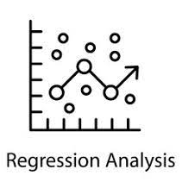
Prediction Models
SLM 1 : Linear Regression using all variables
Significant variables***
ve_forms
country
city
hour
nhs
drunk_dr
total_fire_exp
no_prev_dwi
one_prev_dwi
dr_alcohol_drug_med
total_moving_violations
pernotmvit
permvit
SLM 2 : Linear Regression
using high significant variables
SLM 3 : Linear Regression
using 10 random variables
Total_moving_violation
drunk_dr
total_not_registered
total_invalid_license
two_prev_sus
one_prev_oth
speed_related
dr_age_lower65
dr_other_impair
dr_alcohol_drug_med
LASSO Regression Model

Slide 12
Interpreting the Prediction Models
LRM #2 with significant variables:
Y = 0.9572 + 0.0164(nhs) + 0.0342(drunk_dr) +
0.1374(total_fire_exp) -0.0337 (no_prev_dwi) - 0.0474(one_prev_dwi) + 0.0208(dr_alcohol_drug_med) -0.0618(total_moving_violations) + 0.0221(pernotmvit) + 0.0687(permvit)
LRM #3 with 10 selected variables:
Y = 1.0417 - 0.0161(total_moving_violations) + 0.0191(drunk_dr) + 0.0370(total_not_registered) + 0.0127(total_invalid_license)
-0.0003(two_prev_sus) + 0.0148(one_prev_oth) +
0.0011(speed_related) + 0.0229(dr_age_lower65) +
0.0142(dr_other_impair) + 0.0179(dr_alcohol_drug_med)

Slide 13
Interpreting the Prediction Models
Linear Regression Model #1 | LASSO Regression model
All 56 variables are used. Intercept value is 572. | 47 variables are used when lambda minimum is selected. Lambda 1se would used only 5 variables.
22 variables are found to have negative coefficients | 20 variables are found to have negative coefficients
Rounding coefficients shows only 36 variables has significant effect on Y | Rounding coefficients shows only 23 variables has significant effect on Y
Significant negatively impacting variables: nm_involved , year, ve_forms, one_prev_dwi, total_moving_violations, no_prev_dwi | Significant negatively impacting variables: total_moving_violations, ve_forms , one_prev_dwi, total_hit_run, no_prev_dwi
Significant positively impacting variables: total_fire_exp, pernotmvit, permvit, variables with driver age, state, nhs, vehicle ownership and license status | Significant positively impacting variables: total_fire_exp, pernotmvit, permvit, drunk_dr, nhs, dr_alcohol_drug_med, previous accident history, dr_other_impair, vehicle ownership and license status

Slide 14
Comparing the Models
Prediction Model* | AIC | BIC | RMSE.Training.Data | RMSE.Testing.Data
LRM with all variables | 51104.99 | 51627.06 | 0.3479 | 0.3442
LRM with sig. variables | 51801.69 | 51902.44 | 0.3499 | 0.3463
LRM with 10 variables | 59152.84 | 59262.75 | 0.3687 | 0.3592
LASSO Regression Model** | NA | NA | 0.348 | 0.344
* Data used: 87,754 obs. over 57 variables | Training Data: 70,204 obs. 57 variables | Testing Data: 17,550 obs. 57 variables
** Nonzero predictors: 47 | Lambda min : 0.00020 | Lambda 1se: 0.01313 | Lambda minimum is used

Slide 15
Comparing the Models – Top 10 States
Top 10 states without imputing the data (n = 46,057)
Prediction Model | AIC | BIC | RMSE.Training.Data | RMSE.Testing.Data
LRM with all variables | 23856.94 | 24330.55 | 0.3594 | 0.3447
LRM with sig. variables | 24394.97 | 24486.37 | 0.3632 | 0.3458
LRM with 10 variables | 27662.97 | 27762.68 | 0.3835 | 0.3598
LASSO Regression Model |  |  | 0.3596 | 0.3441
Top 10 states – Using imputed data (n = 91,128)
Prediction Model | AIC | BIC | RMSE.Training.Data | RMSE.Testing.Data
LRM with all variables | 21708.75 | 22190.67 | 0.3468 | 0.3396
LRM with sig. variables | 22278.28 | 22369.68 | 0.3506 | 0.3431
LRM with 10 variables | 24641.65 | 24741.36 | 0.3647 | 0.356
LASSO Regression Model |  |  | 0.3469 | 0.3394
*Random sampling without replacement: Training Data: 30,000 obs. 57 variables | Testing Data: 10,000 obs. 57 variables
*Top 10 states: Texas, California, Florida, North Carolina, Pennsylvania, Georgia, New York, Ohio, Tennessee, Illinois

Slide 16
Comparing the Models – Impact of imputing
Using only complete cases in the dataset (n = 87,754)
Prediction Model | AIC | BIC | RMSE.Training.Data | RMSE.Testing.Data
LRM with all variables | 22371.46 | 22845.07 | 0.3506 | 0.3335
LRM with sig. variables | 22729.83 | 22821.23 | 0.3533 | 0.3358
LRM with 10 variables | 25664.88 | 25764.59 | 0.371 | 0.3538
LASSO Regression Model |  |  | 0.3508 | 0.3335
Using imputed data (n = 181,615)
Prediction Model | AIC | BIC | RMSE.Training.Data | RMSE.Testing.Data
LRM with all variables | 19770.16 | 20252.08 | 0.3358 | 0.3524
LRM with sig. variables | 20146.93 | 20238.32 | 0.3384 | 0.3561
LRM with 10 variables | 22561.69 | 22661.39 | 0.3523 | 0.3728
LASSO Regression Model |  |  | 0.3359 | 0.3527
*Random sampling without replacement: Training Data: 30,000 obs. 57 variables | Testing Data: 10,000 obs. 57 variables

Slide 17
Comparing the Models – Impact of sample size
RMSE Table - Using only complete cases in the dataset (n = 87,754)
 | Sampling 1 |  | Sampling 2
Prediction Model | Training Data | Testing Data | Training Data | Testing Data
LRM with all variables | 0.3506 | 0.3335 | 0.3479 | 0.3391
LRM with sig. variables | 0.3533 | 0.3358 | 0.35 | 0.3418
LRM with 10 variables | 0.371 | 0.3538 | 0.369 | 0.3535
LASSO Regression Model | 0.3508 | 0.3335 | 0.348 | 0.3389
RMSE Table - Using imputed data (n = 181,615)
 | Sampling 1 |  | Sampling 2
Prediction Model | Training Data | Testing Data | Training Data | Testing Data
LRM with all variables | 0.3358 | 0.3524 | 0.34 | 0.3366
LRM with sig. variables | 0.3384 | 0.3561 | 0.3428 | 0.3394
LRM with 10 variables | 0.3523 | 0.3728 | 0.3562 | 0.355
LASSO Regression Model | 0.3359 | 0.3527 | 0.3401 | 0.3366
*Random sampling without replacement: Training Data: 68,000 obs. 57 variables | Testing Data: 12,000 obs. 57 variables

Slide 18
Conclusion
More the number of occupants, the greater the risk of fatally injured people involved in the crash
Driving under the Influence of Alcohol, Drugs, or Medication leads to an increased risk of serious injury in an accident
In Crash cases occurred on highways, high fatalities numbers are observed when driver of the contact vehicle did not stop to render aid, and crash involves fire
Number of people involved in the crash, Fire in the crash, Violation history of drivers, their drunk status, Influence of Drugs, or Medication are the top factors that (positively) contributed to predicting fatalities

Slide 19
Thank You

