Slide 1

IPL VISUALIZATION ASSIGNMENT
Objective
Create an interactive dashboard highlighting some of the important statistics of IPL
Problem Statement
As a data analyst at IFP, a nationally recognized news agency, which is based out of New Delhi, and provides news reports and feeds to magazines, newspapers and TV broadcasters all over the country. The Sports Editor of the agency has approached you to build a Tableau dashboard of IPL statistics over the years since its inception in order to create an infographic for a newsletter that their team is working on. For this newsletter, in some cases, they will use the visual representations as you have created in Tableau directly for their infographic, and in a few other cases, they will use important statistics after trying out the different filters and customisations that you have provided for interactivity. Therefore, you are expected to build an interactive dashboard in Tableau for this purpose.

Slide 2
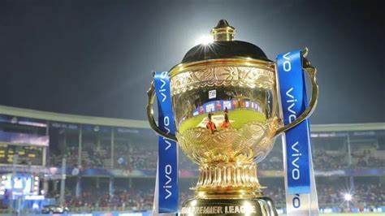
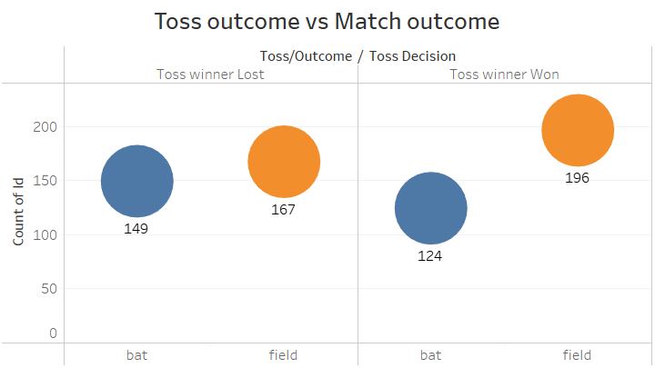
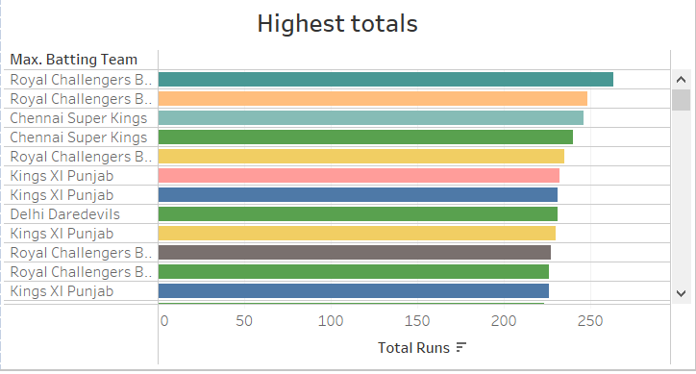
The teams who have won the toss and opted to field have won more matches.
Teams have lost more matches when they have opted to bat first
Royal Challengers Bangalore has both highest and lowest record for total runs

Slide 3
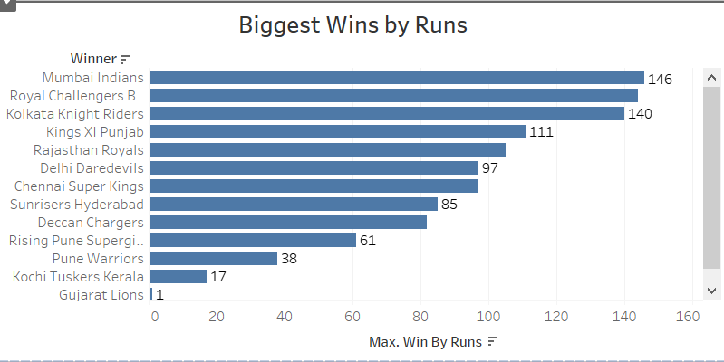
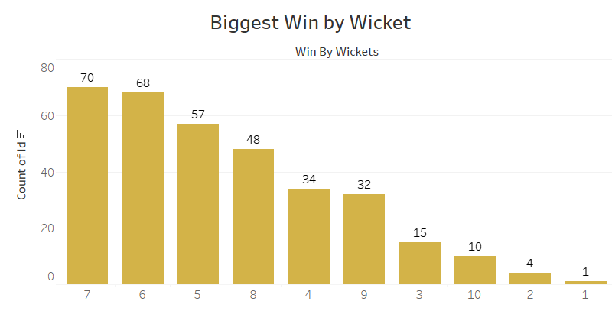
Mumbai Indians leads the chart with highest biggest wins by run
Royal Challengers Bangalore stands second with just 2 runs difference
Most of the teams win when they take 6 to 7 wickets
Kolkata Knight Riders have taken most number of wickets

Slide 4
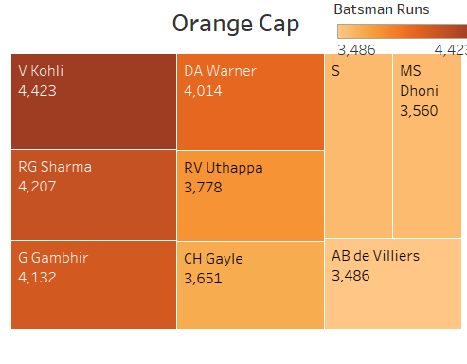
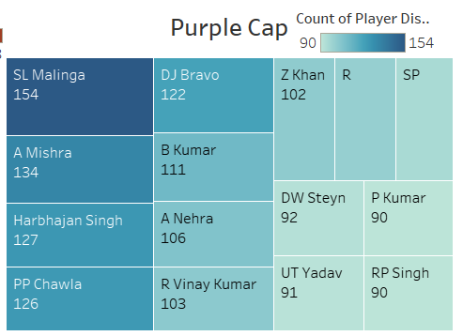
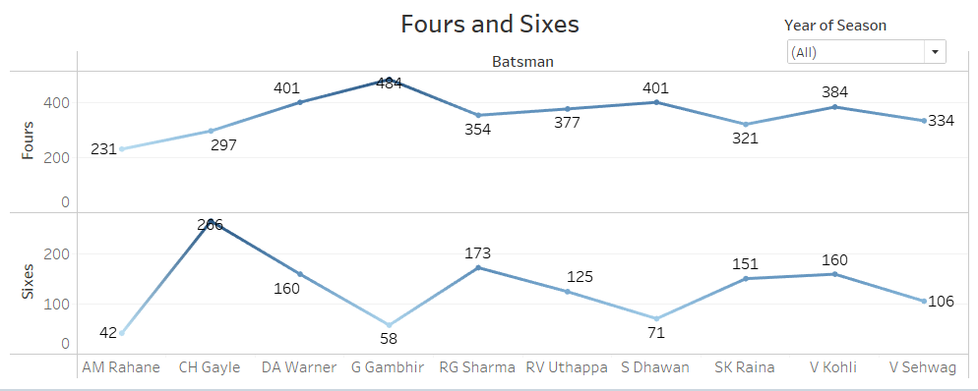
Virat Kohli followed by RG Sharma has scored the maximum number of runs and are the top two contenders for Orange Cap
SL Malinga followed by A Mishra has grabbed most number of wickets and are top two contenders for Purple Cap
G Gambhir has scored Maximum number of Fours
Chris Gayle has scored highest number of Sixes

Slide 5
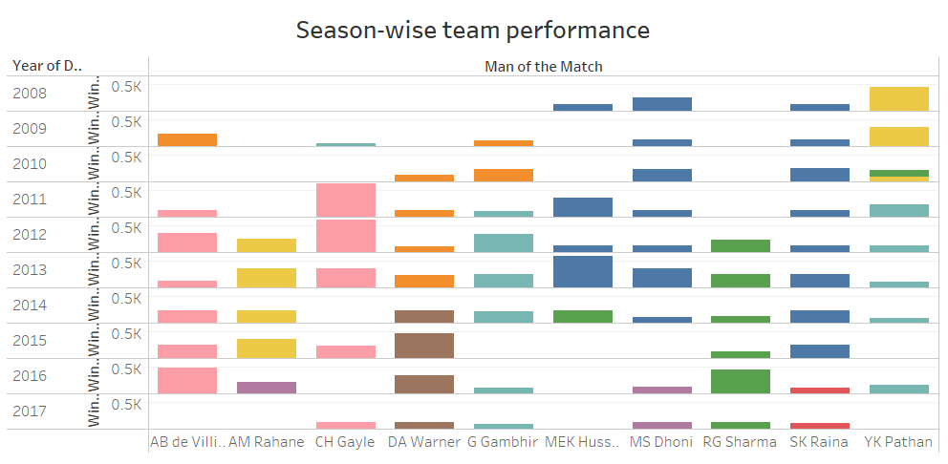
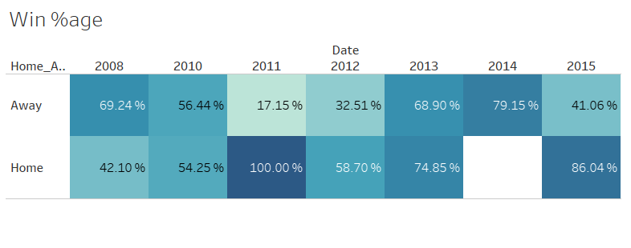
Overall Win percentage is more for most of the teams when played at home grounds, except for Mumbai Indians where win percentage is high even when they play Away

