Slide 1

Fake Engagement Detection
Presented by Vidhyashree G, 22MIA1089

Slide 2

Problem Statement
Social media platforms increasingly experience fake engagement generated by bots, automated scripts, and coordinated engagement groups. These activities artificially inflate likes, comments, and interactions, making genuine behaviour difficult to distinguish. Traditional spam filters detect only basic patterns and fail against advanced, human-like activity.
This project aims to identify and classify artificial engagement using behavioural, network, linguistic, and temporal patterns.

Slide 3



Key Features for Detecting Fake Engagement
Temporal Features
Engagement intervals reveal user activity patterns.
Network Features
Unique profiles engaged indicate social dynamics.
Linguistic Features
Comment similarities highlight user behavior trends.

Slide 4
Machine Learning Models
Techniques for Detecting Fake Engagement
XGBoost Classifier
Random Forest Regressor
The XGBoost Classifier is utilized to predict bot probability, leveraging gradient boosting to enhance accuracy and reduce overfitting, making it effective for identifying automated accounts in social media.
The Random Forest Regressor is employed for authenticity scoring, using ensemble learning to assess engagement patterns, providing a robust measure of user authenticity while minimizing prediction errors.

Slide 5



End-to-End System Pipeline Overview
Data Ingestion
Collecting behavioural and linguistic data inputs efficiently.
Preprocessing
Preparing data through encoding, scaling, and noise removal.
Feature Engineering
Crafting new metrics to enhance detection capabilities.

Slide 6
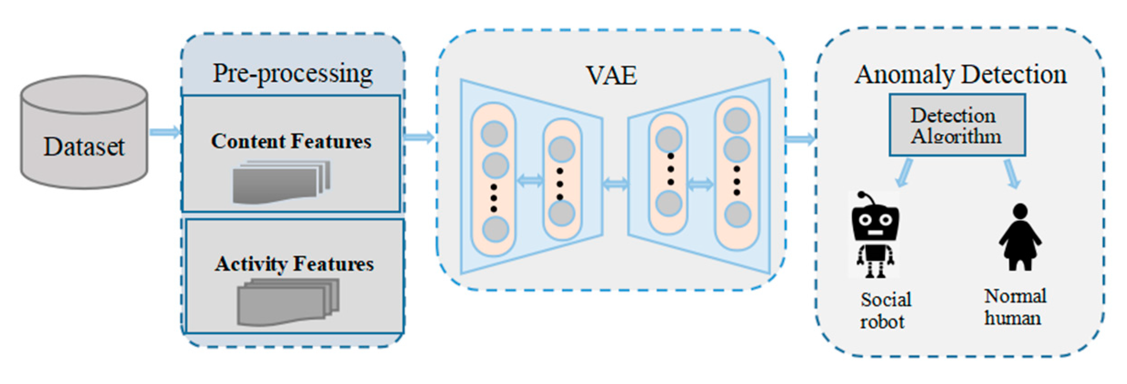

Slide 7
Key Findings from Behavioural Insights
Classification
Accuracy: High
Precision: Strong (avoids false bot flags)
Recall: High (detects fake users)
F1 Score: Balanced final measure
Regression
Low MAE & RMSE
Strong R² for authenticity prediction
Anomaly Detection
Clear separation of suspicious users
Detected coordinated clusters with high compactness

Slide 8



Key Findings from Behavioural Insights
Engagement Intervals
Short engagement intervals indicate strong automation presence.
Comment Similarity
High similarity in comments often flags potential bots.
Night Activity
Night-time spikes in activity are common among bots.

Slide 9
Practical Impact
Real-World Benefits and Applications
Remove Fake Engagement
Prevent Trend Manipulation
The detection system effectively identifies and eliminates fake likes, followers, and comments, ensuring a more authentic experience for users and fostering genuine interactions on social media platforms.
By addressing the issue of fake engagement, the system helps prevent the manipulation of trending topics, enabling genuine content to rise organically and enhancing the trust of users in platform integrity.

Slide 10



Future Research Directions in Engagement Detection
Deep Learning
Employs sophisticated algorithms for improved detection accuracy.
Real-Time Detection
Facilitates immediate identification of fake engagements online.
Behavioral Fingerprinting
Enhances detection across multiple social media platforms.

Slide 11

Thank You

