Slide 1
Team Name: 6IXMINDSLABS
Project Name : ForestGuard AI – Deforestation & Poaching Risk Detection System

Slide 2


Problem Statement:
Forest ecosystems are rapidly declining due to deforestation and wildlife poaching, leading to severe biodiversity loss and ecological imbalance.
Current monitoring methods rely on manual surveys and delayed satellite analysis, which:
cover limited areas
require high cost and manpower
fail to provide real-time alerts
The lack of an automated, scalable, and affordable monitoring system prevents authorities from taking timely action.

Slide 3
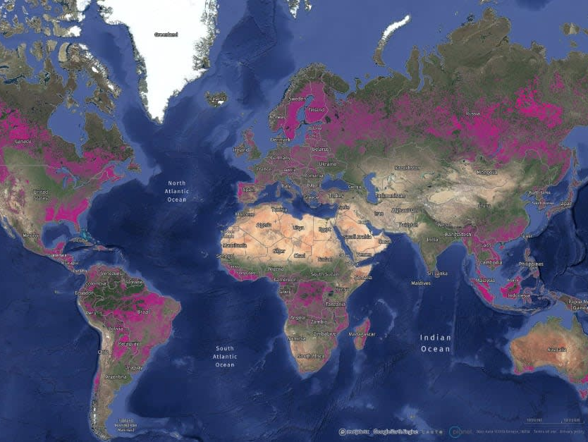
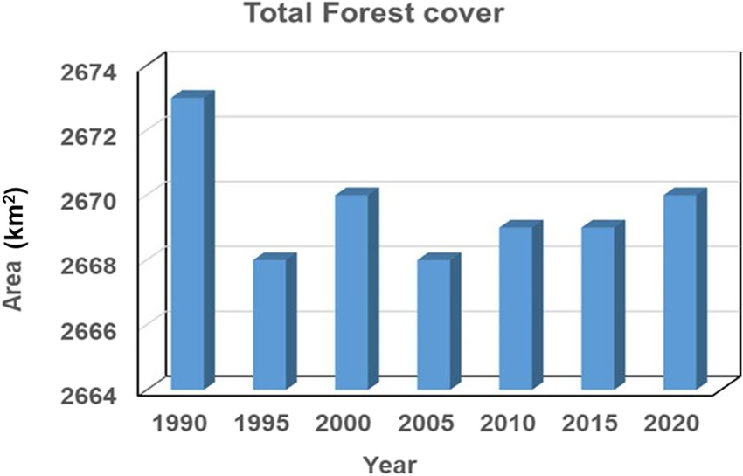
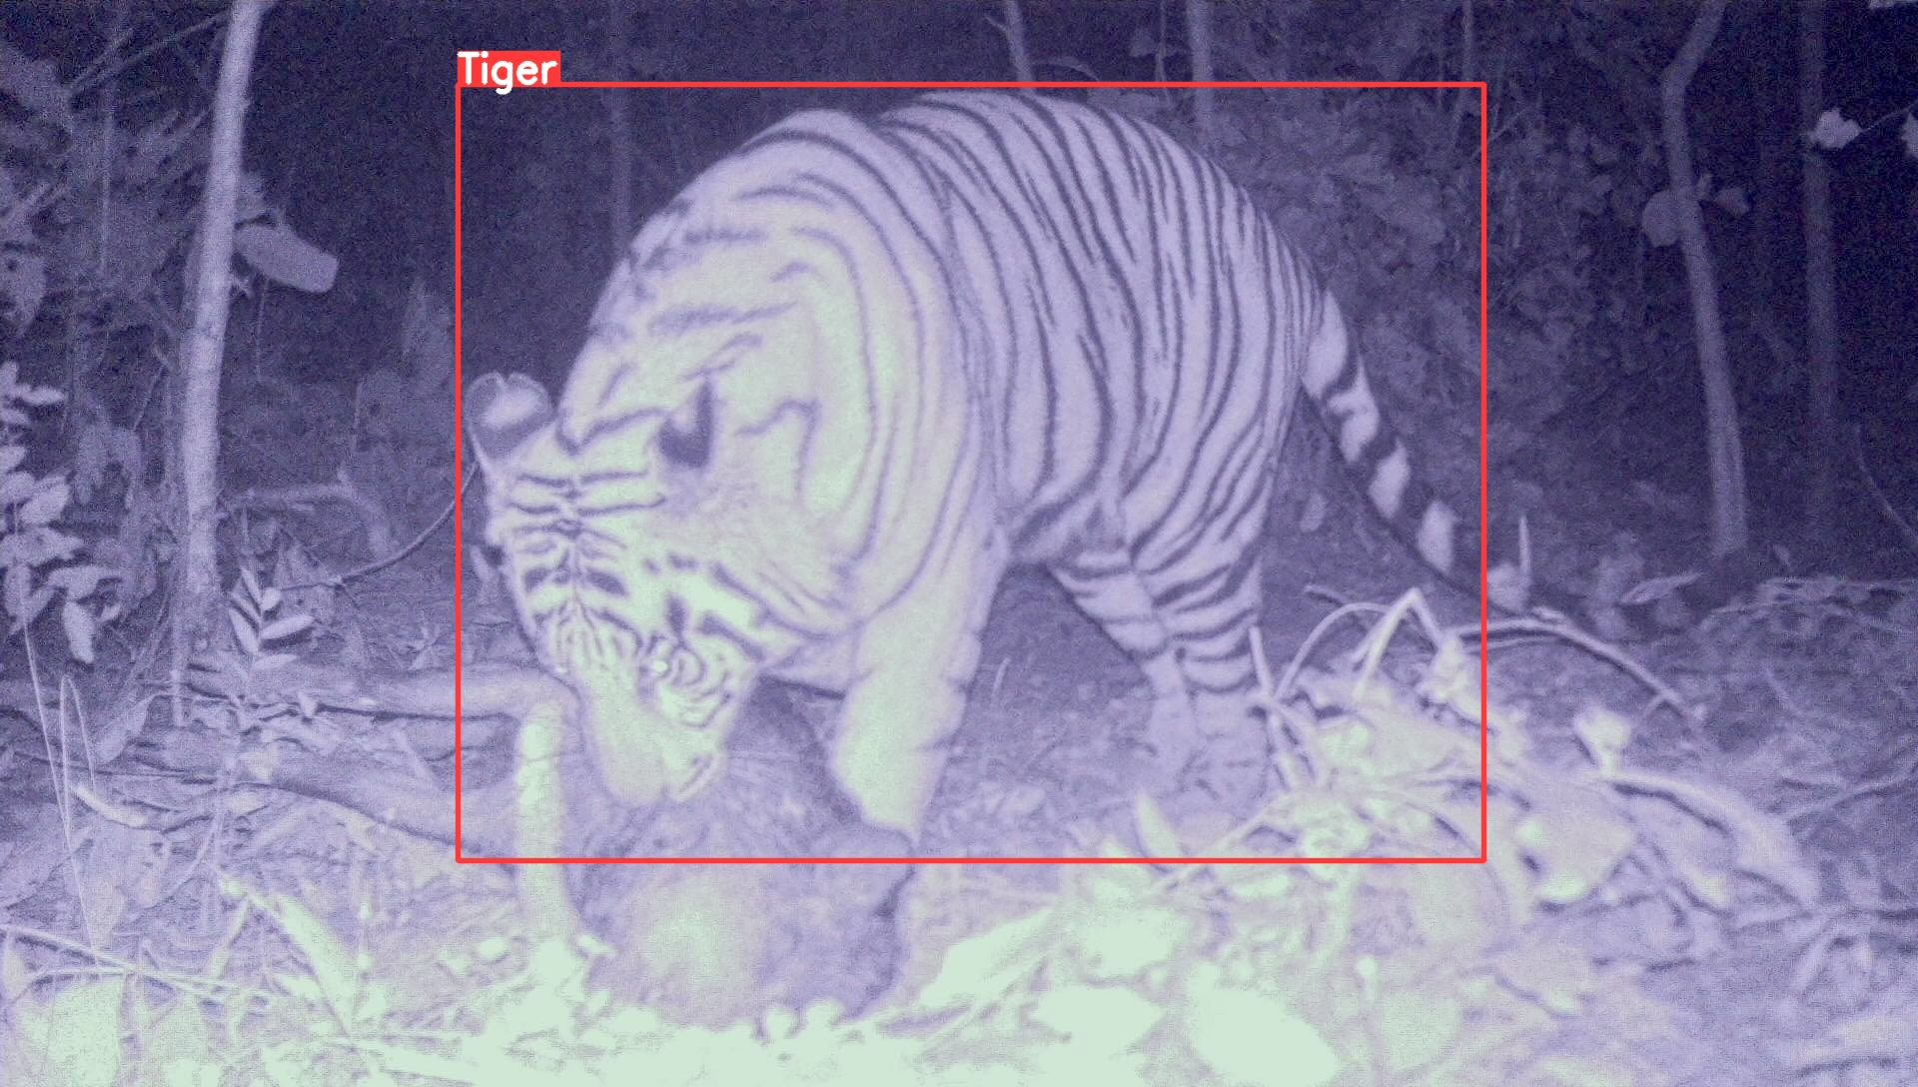
Existing solution:
Global Forest Watch
Long-Term Forest Loss Mapping
AI Camera Trap Monitoring
Global scale monitoring platform
Hansen Global Forest Change Dataset
Automated wildlife detection using AI camera traps

Slide 4
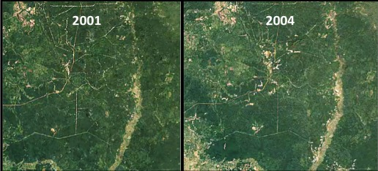
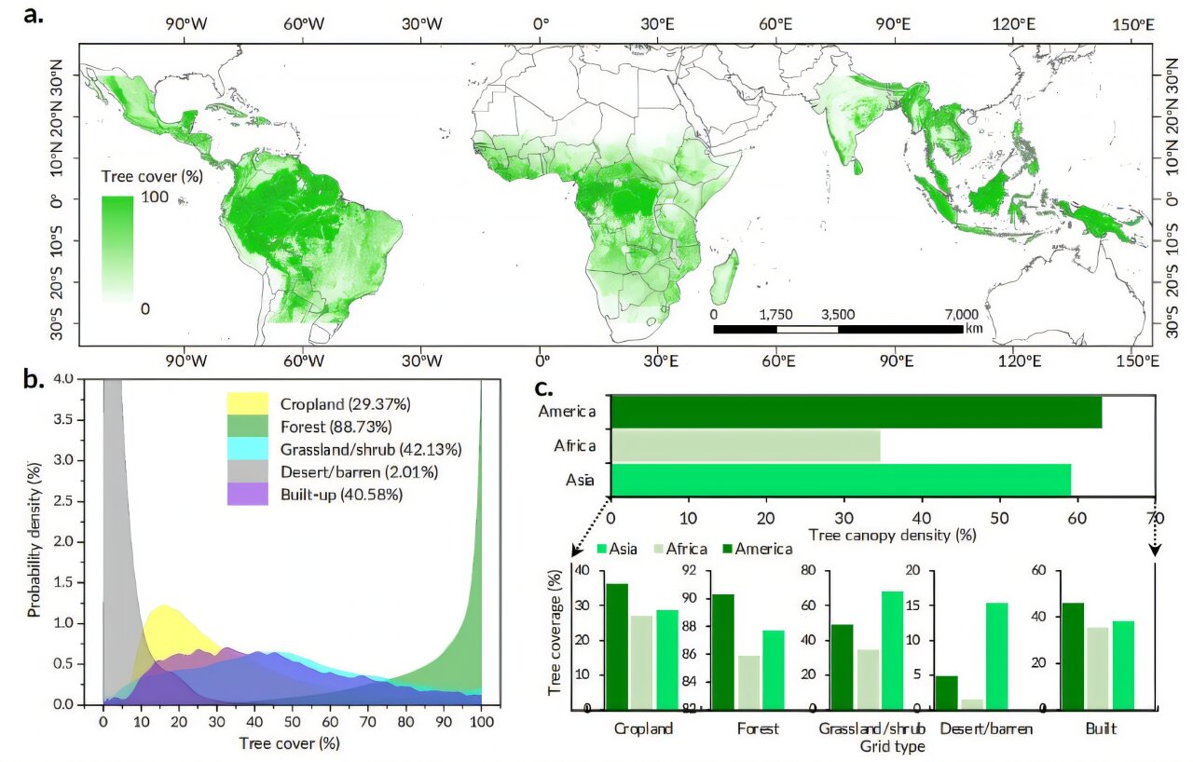
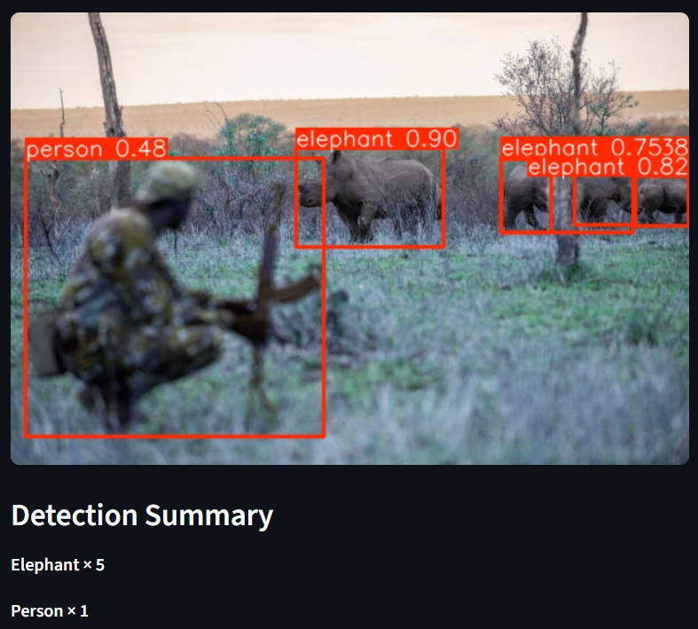
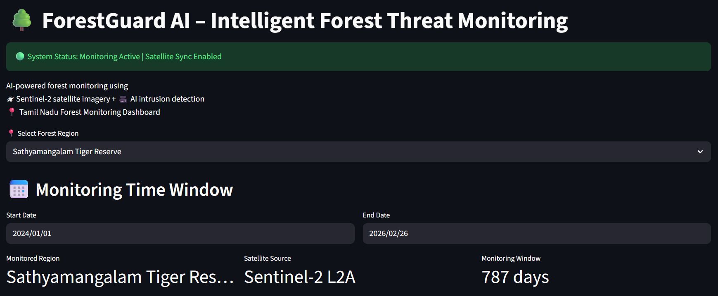
Proposed solution:
Deforestation Detection
Forest Loss Map with Affected Area
Multi-temporal satellite imagery showing deforestation.
Poaching Risk Detection
Dashboard Monitoring
.
Human presence detected inside protected zones for poaching alerts.

Slide 5









Tech stack
Python
Streamlit
Sentinel-2 / Landsat
PyTorch
Rasterio / GDAL
YOLOv8
CSS
HTML
NumPy & Pandas
JAVASCRIPT
JSON
Camera trap wildlife datasets

Slide 6
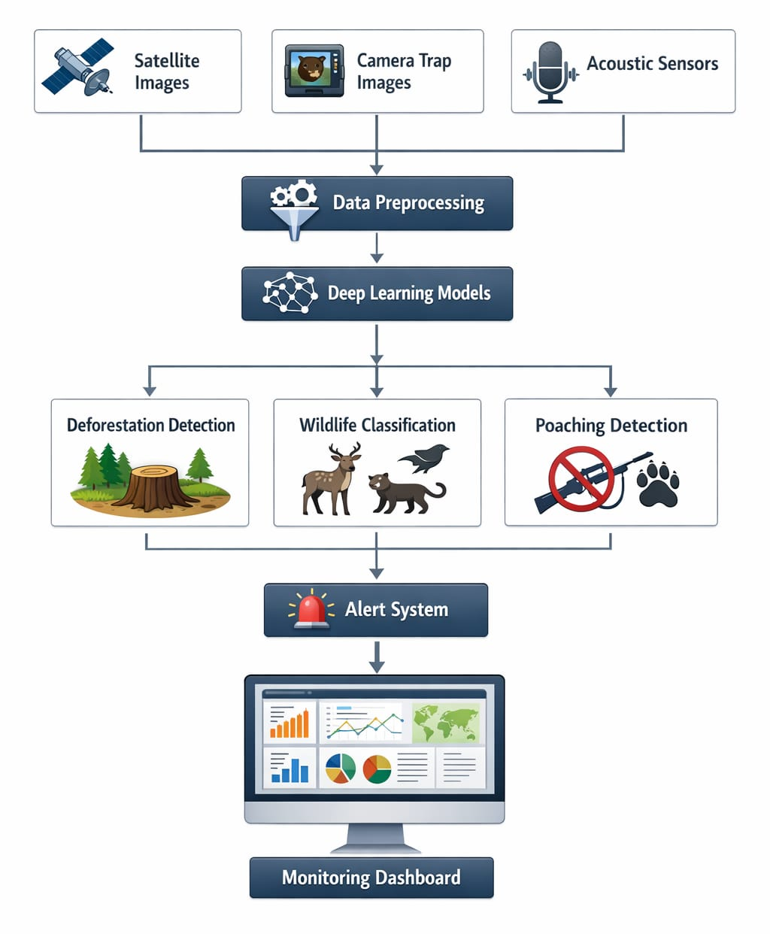
Architecture
Input Data Sources
Satellite Images
Camera Trap Images
Data Preprocessing
Poaching Detection
Image resizing and normalization
Noise removal and enhancement
Human presence in protected zones
Suspicious activity recognition
Deep Learning Models
Forest cover segmentation model
Wildlife species classification model
Deforestation Detection
Multi-temporal change analysis
Forest loss area estimation

Slide 7
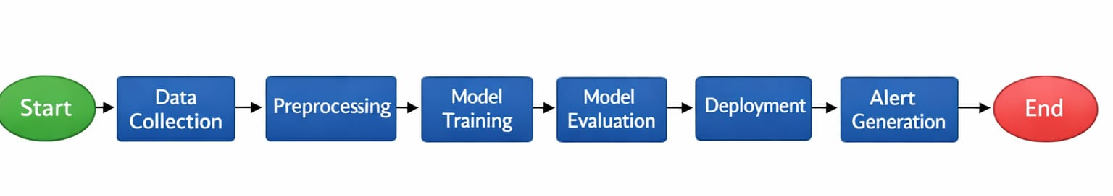
Flow diagram

Slide 8
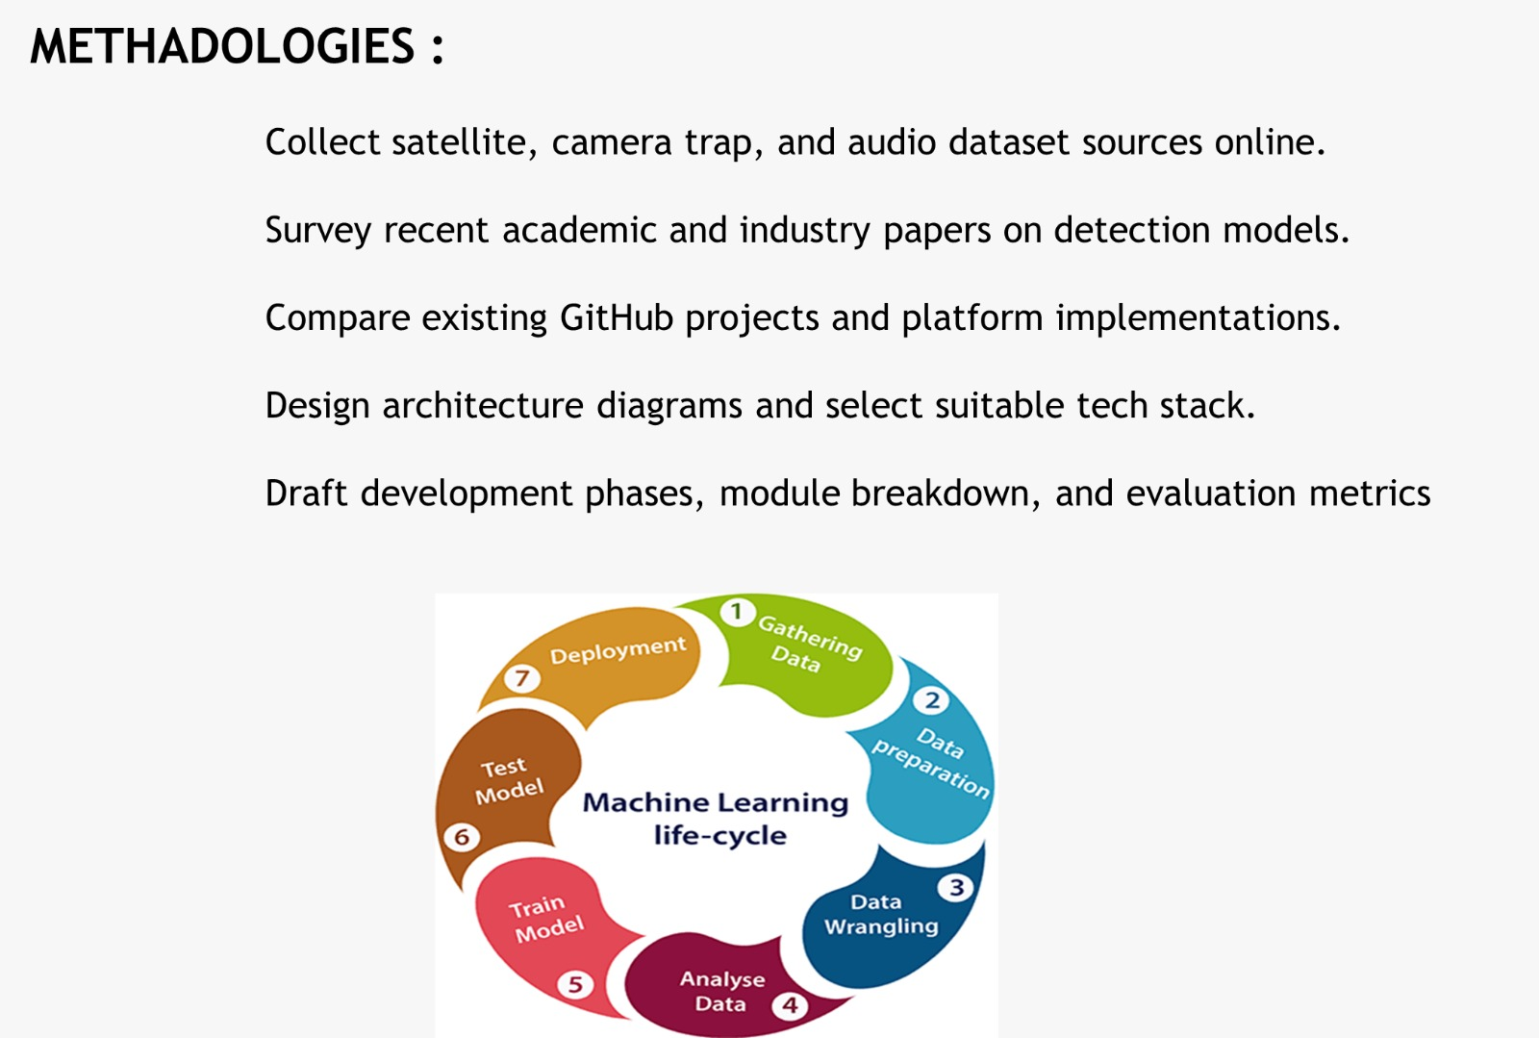
Methodologies

Slide 9
Modules
Data Acquisition Module
Data Preprocessing Module
Alert & Notification Module
AI Processing Module
Visualization & Dashboard Module
Deforestation Detection Module
Poaching Detection Module

Slide 10
Team roles
Nithishkumar, Pradeepa – AI/ML & System integration
Shankar – Frontend & Dashboard designer
Sathish, Eniyan – Backend Developer

