Slide 1
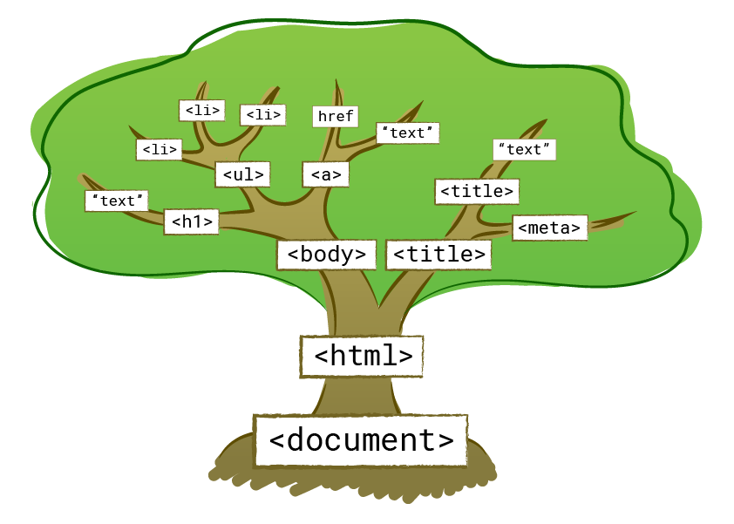
DOM

Slide 2
Document Object Model
D
M
O
HTML PAGE
ELEMENT &
ATTRIBUTES
Tree Structure of
HTML elements
Document
Object
Model

Slide 3
DOM TREE
HTML
HEAD
HEADER
SECTION
BODY
META
LINK
TITLE
H1
P
FOOTER
Header Text
Paragraph Text

Slide 4
WHY SHOULD WE LEARN?
Create
Read
Update
Delete
So we can manage/manipulate the DOM elements By Using Javascript
Easily control its elements, Attributes and all nodes

Slide 5
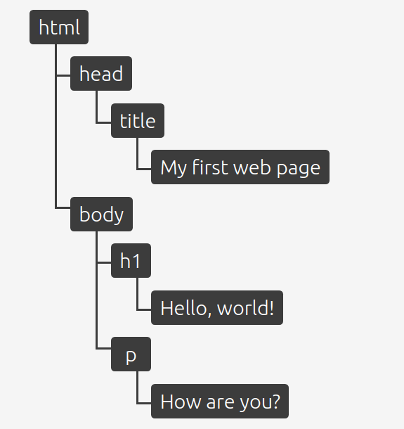
Example:

Slide 6
Thank You!!!

