Slide 1
POLICY MANAGEMENT SYSTEM
Final Evaluation

Slide 2
POLICY MANAGEMENT SYSTEM
TEAM NUMBER-9
PROJECT MEMBERS
JA06 DEVANSHU DAS
JA25 VIDHYA MALATHI
GUIDED BY
JAVEED

Slide 3
PROBLEM STATEMENT
Policy Management System is basically a system that helps to maintain the Policies and Payments. It also allows to search a Policy and allow end users to manage policies with ease. The basic functionality of the Policy Management System.
User Registration
Policy Registration
Search Policies

Slide 4
DESCRIPTION
A Policy Management System is Single page application it have many functionalities. we created project using Spring Boot as backend and Angular as frontend to implemented in our project. The admin can create, control and manage policies. The user can register the policies and also do the payments. We also add the search functionalities so that user can see the details.

Slide 5
MODULES
USER REGISTRATION
The User can able to register the details in the system, and it should be saved in the database.
(using MYSQL)
POLICY REGISTRATION
Policy Registration is used by the Admin to register policies. The policy details are stored in database and also generate the key (policy _id) is used to identify the policies in database.
Different types of policies are in database. The Policy types are,
Vehicle Insurance
Travel Insurance
Health Insurance
Life Insurance
Child Plan
Retirement Plan

Slide 6
MODULES
SEARCH POLICIES
In our application we provide the search functionalities to find the policies and the user can be able to see what are policies are buyed by user and also edit the details of user.
The User will access the database by getting the details on the user’s search criteria.(like Policy type, Amount)

Slide 7
USECASE DIAGRAM
Policy Management System(PMS)
User Registration
Admin
User
Policy Registration
Search Policies

Slide 8
FLOW DIAGRAM
PMS
Store User Information in database
Yes
Policy Registration
Is Admin?
Register User
Start
Login
Store Policy Information in
database
No
Search Policies
Store Policy Information in database

Slide 9
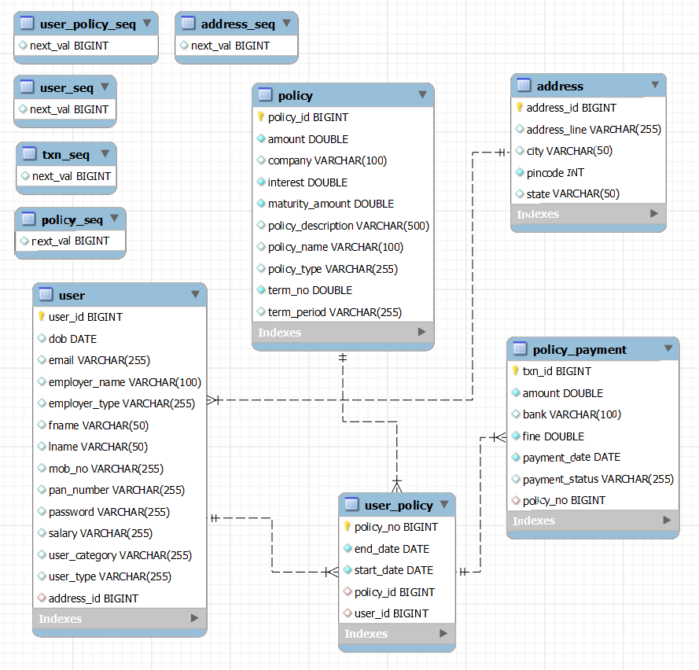
ER DIAGRAM
PMS

Slide 10
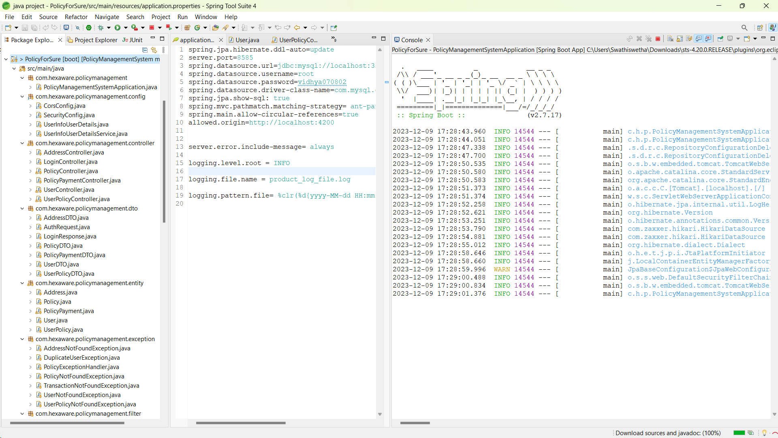
BACKEND
Using Spring Boot

Slide 11
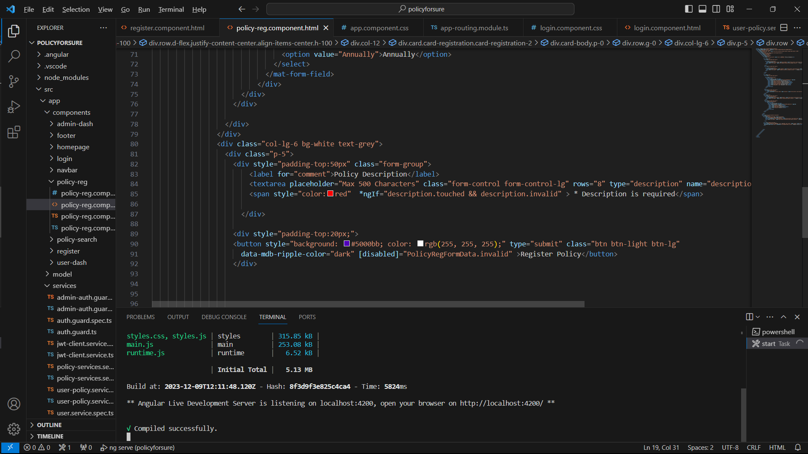
FRONTEND
Using Angular

Slide 12
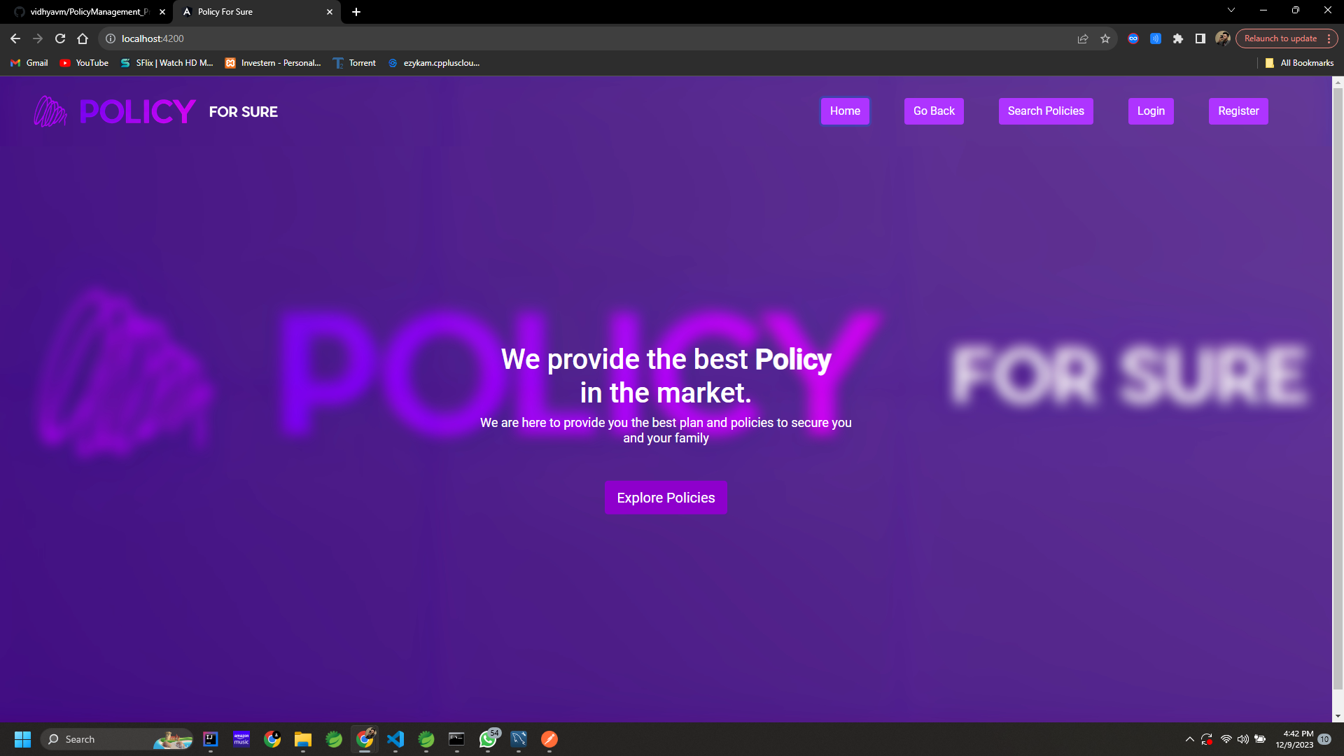
OUTPUTS
Home Page

Slide 13
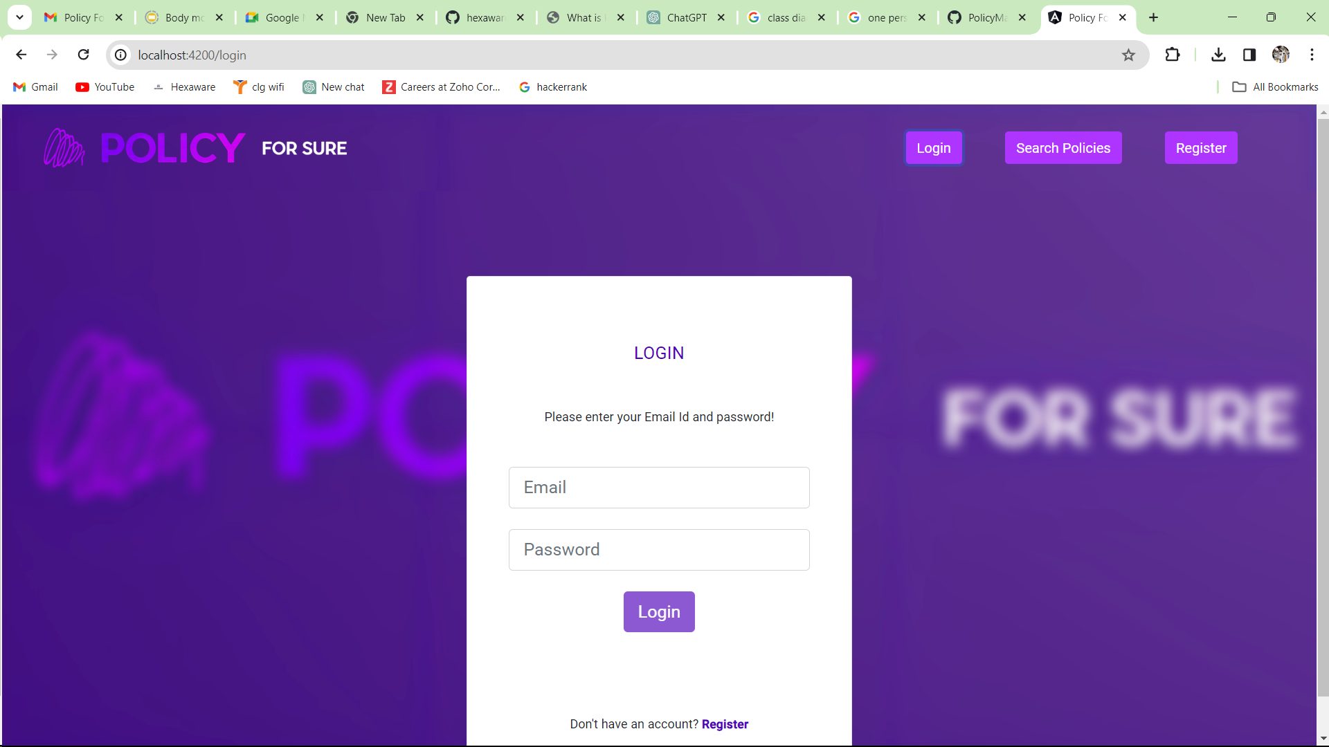
OUTPUTS
Login Page
13/20
11-12-2023
POLICY MANAGEMENT SYSTEM

Slide 14
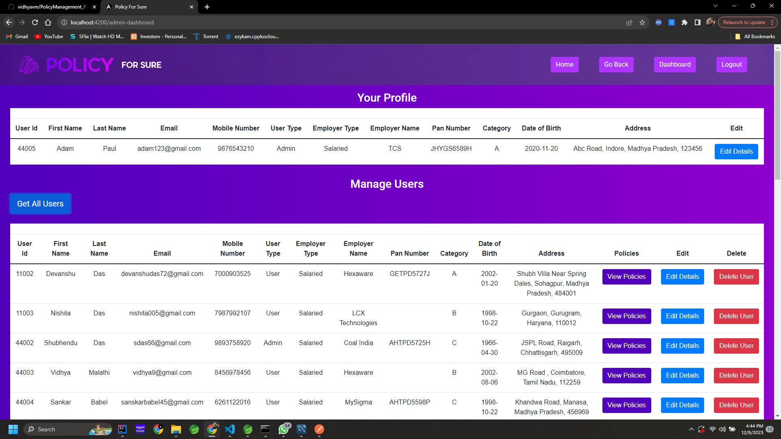
OUTPUTS
Admin Dashboard

Slide 15
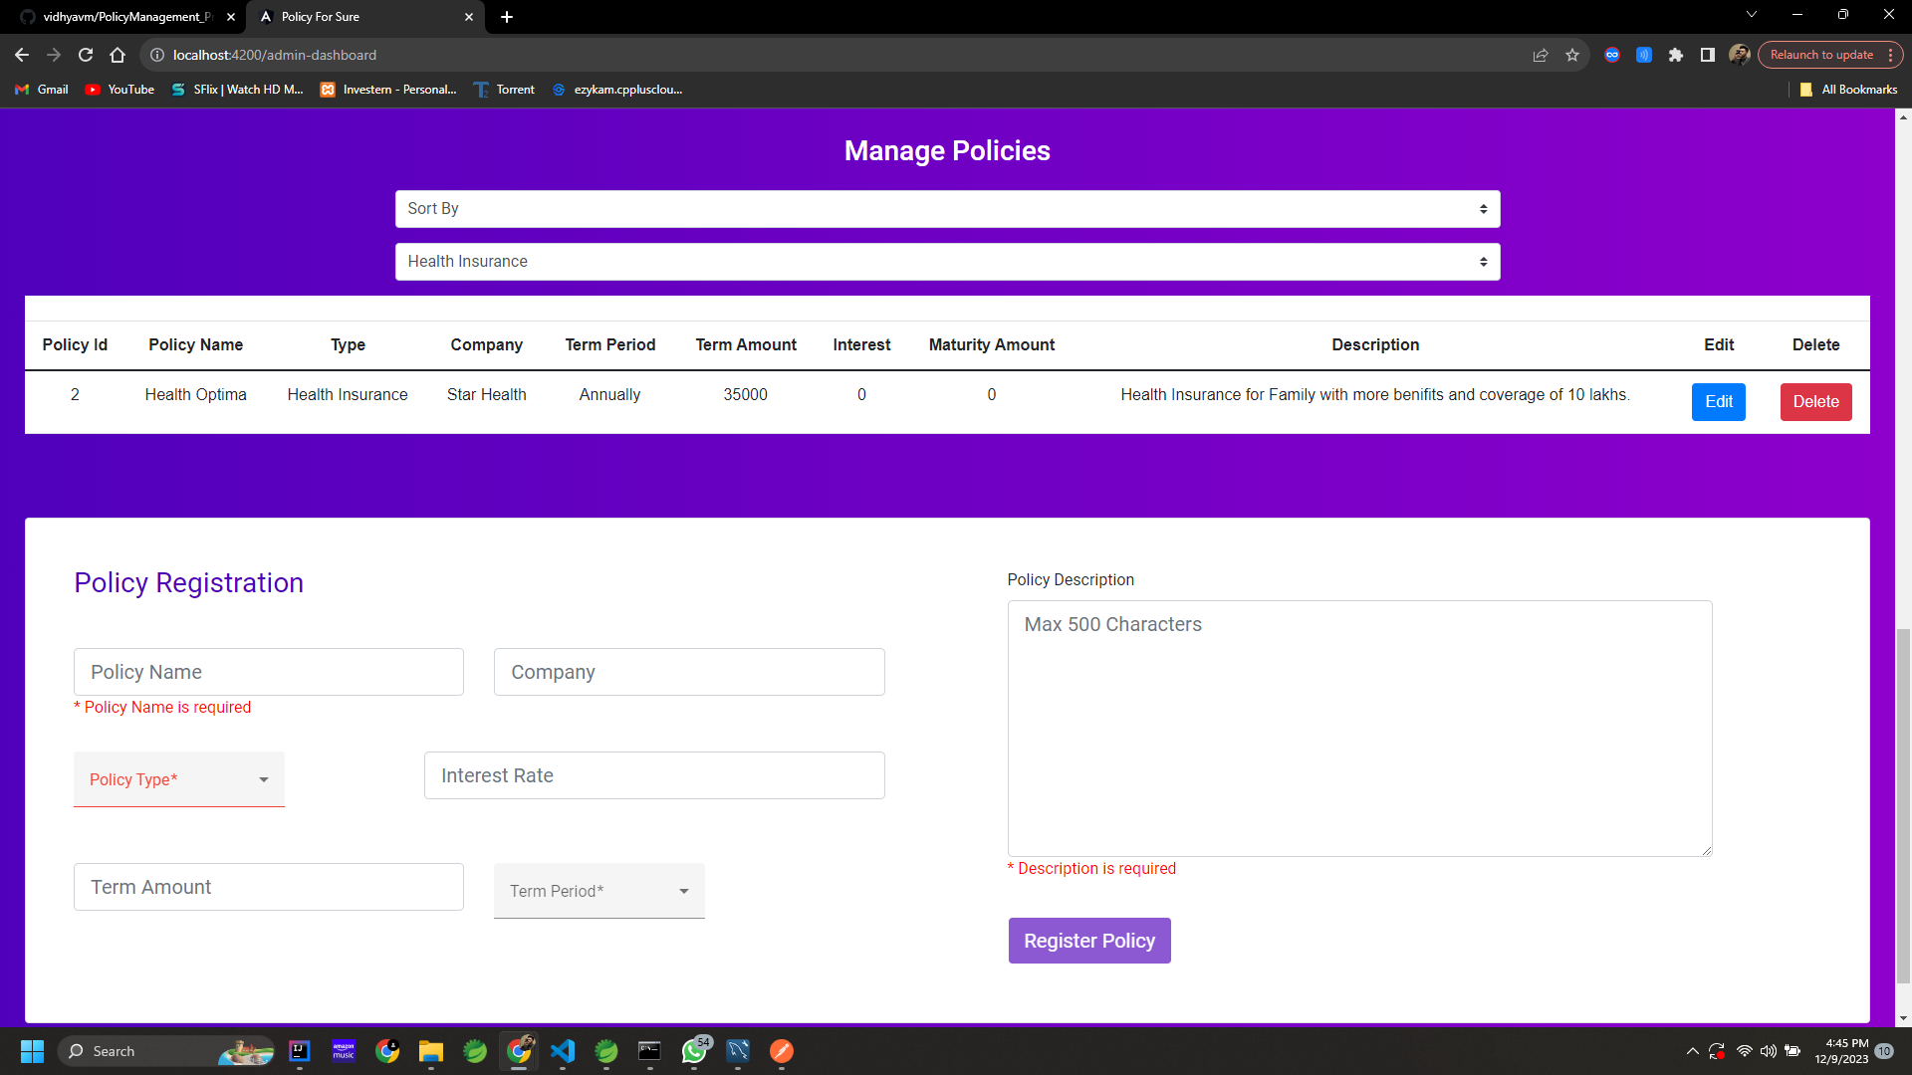
OUTPUTS
Admin Dashboard- Policy Registration

Slide 16
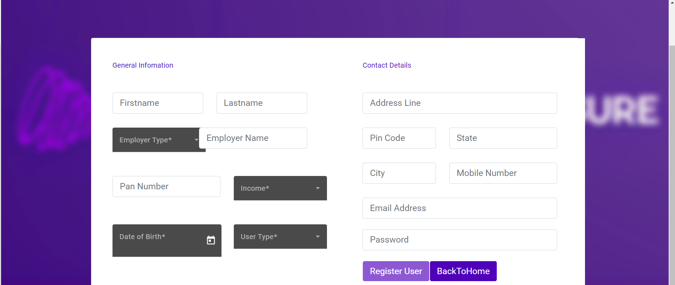
OUTPUTS
User Dashboard- User Registration

Slide 17
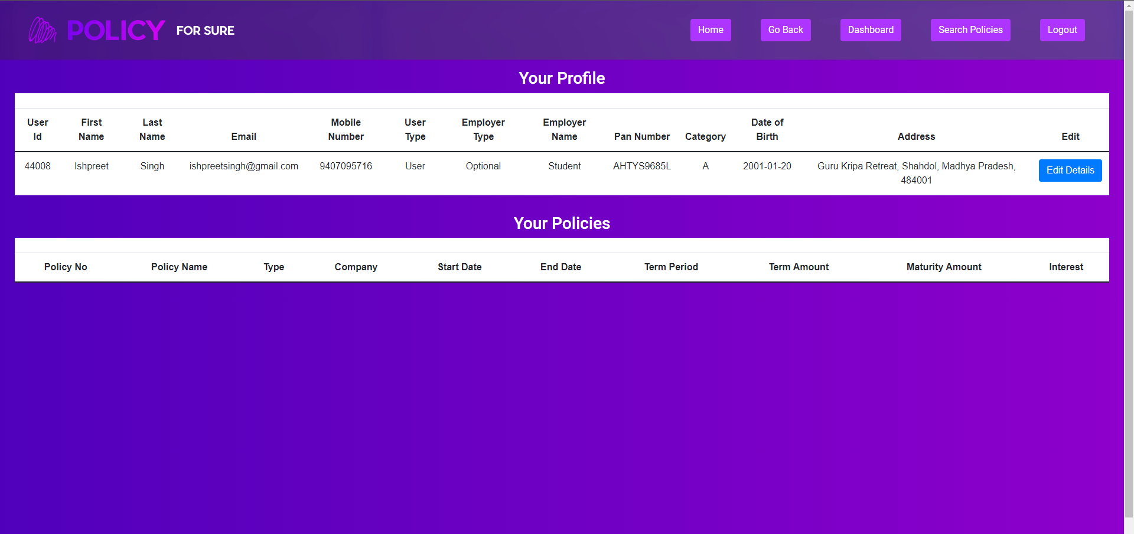
OUTPUTS
User Dashboard

Slide 18
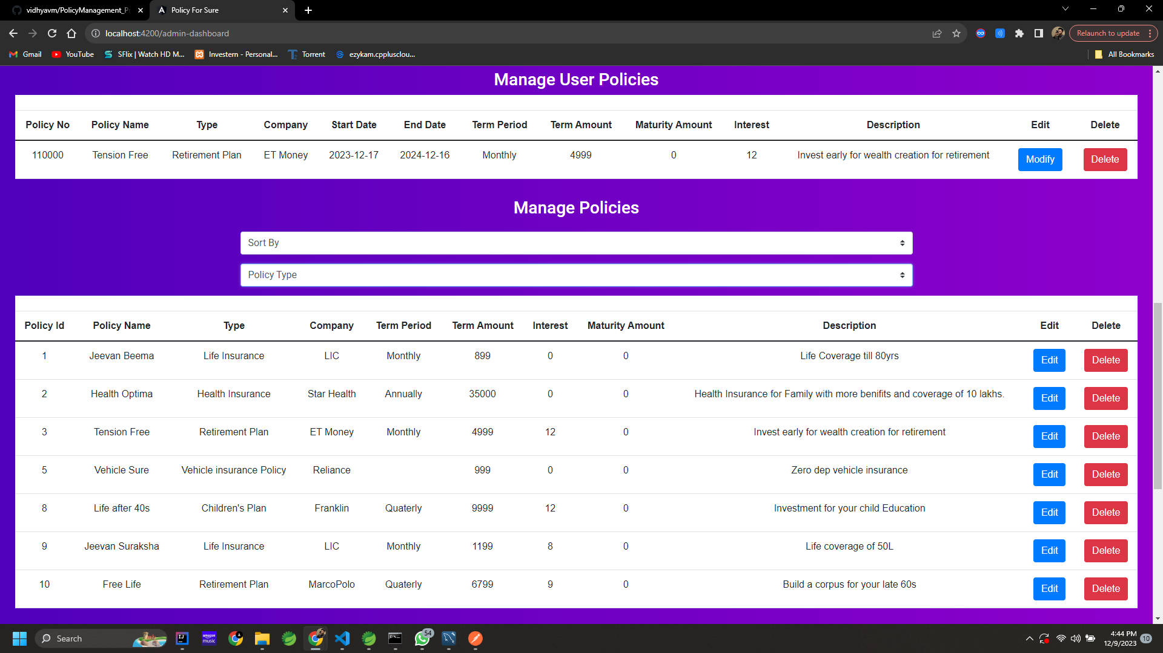
OUTPUTS
Search Policies

Slide 19
GITHUB LINKS
Links
Project_Hexaware: https://github.com/vidhyavm/Project_Hexaware

Slide 20
Thank you

