Slide 1

FOOD.COM RECIPE RECOMMENDATION SYSTEM
Recipe Recommendations
Collaborative Filtering, Clustering, and Content Based Methods on Food.com
Vidhya Walke
MSc Data Science
Food.com Benchmark Dataset: 180K Recipes and 1.13M User Interactions

Slide 2

RESEARCH MOTIVATION & SCOPE
02 / 14
Introduction & Research Objectives
01 Research Motivation & The Recipe Problem
Online culinary websites feature hundreds of thousands of candidate recipes. Navigating this vast space creates substantial choice paralysis for everyday cooks seeking relevant meals. Building accurate, personalized recommenders is essential to surface dishes matching individual dietary habits and taste preferences.
02 Research Objectives & Tasks
As an MSc Data Science student researcher, I designed a multi model recommendation pipeline on the Food.com dataset. My primary goal was to predict user recipe ratings accurately while generating personalized, non trivial meal suggestions across memory based, latent factor, and content based methods.
03 Algorithmic Approaches Investigated
I evaluated collaborative filtering neighborhood models (KNNBasic, KNNWithMeans, KNNWithZScore, KNNBaseline) and matrix factorization (SVD, SVDpp, NMF) using Scikit Surprise. In addition, I formulated a personalized Content Based model using TF IDF token representations from recipe descriptions.
04 Unsupervised Clustering Strategy
To resolve extreme catalog sparsity and rating imbalance (where 72 percent of reviews are 5 stars), I implemented clustering via Surprise CoClustering and NLTK Cosine KMeans. This allowed me to isolate homogeneous taste sub communities and dramatically boost recommendation diversity.
Food.com Recipe Recommendation System | MSc Data Science Research Project
Vidhya Walke

Slide 3
CULINARY BENCHMARK DATASET
03 / 14
Data Description
File Name | Rows | Description
PP_users.csv | 25,076 users | Techniques and ingredients tried by the user, ratings left by the user, and count of recipes rated
PP_recipes.csv | 178,265 recipes | Processed data for each recipe, including tokenized lists for recipe name, ingredients, steps, as well as techniques and calorie level.
RAW_recipes.csv | 231,637 recipes | Raw data for recipes, including the text name, minutes to complete, tags (via Food.com), nutrition data, number of steps, text for each step, user provided description, ingredients
RAW_interactions.csv | 1,132,367 ratings | Interactions with the recipes by the users, including User ID, Recipe ID, Date submitted, rating on a scale of 0 to 5, and text of the user s review
Ingr_map.pkl | 11,659 ingredients | A map of ingredient IDs to ingredient names, with the text description of the ingredient, count of words in the text description, text description of the ingredient, length of description, and a simplified word or category phrase used in place of the original description
Food.com Recipe Recommendation System | MSc Data Science Research Project
Vidhya Walke

Slide 4
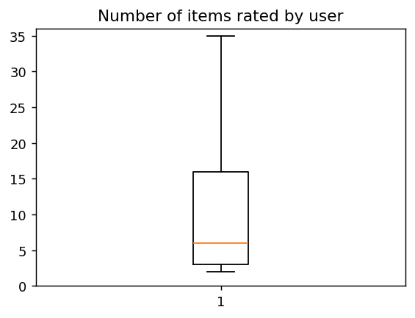
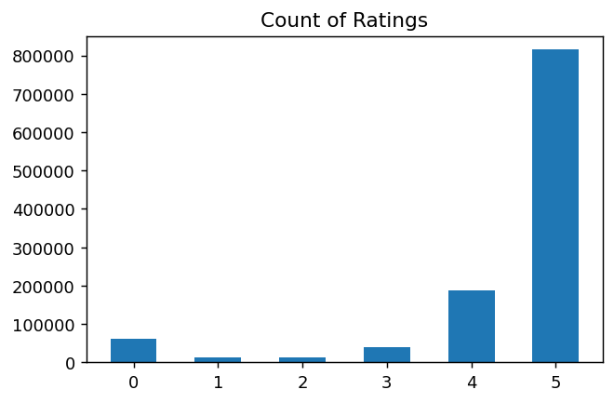
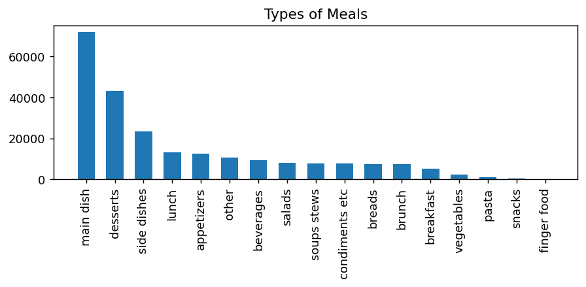
EXPLORATORY DATA ANALYSIS
04 / 14
EDA: Key Characteristics of Food.com Data
01 User Activity Sparsity
Median ratings per user = 6
73% rated 1 recipe; only 2.3% rated >25 recipes
02 Severe Rating Polarity
Reviews with a 5 star rating = 72%
Overwhelmingly positive reviews; ratings of 0 filtered
03 Dominant Meal Taxonomy
Main dish: 32% | Desserts: 20%
Side dishes: 11%; breakfast, lunch and snacks long tail
Food.com Recipe Recommendation System | MSc Data Science Research Project
Vidhya Walke

Slide 5
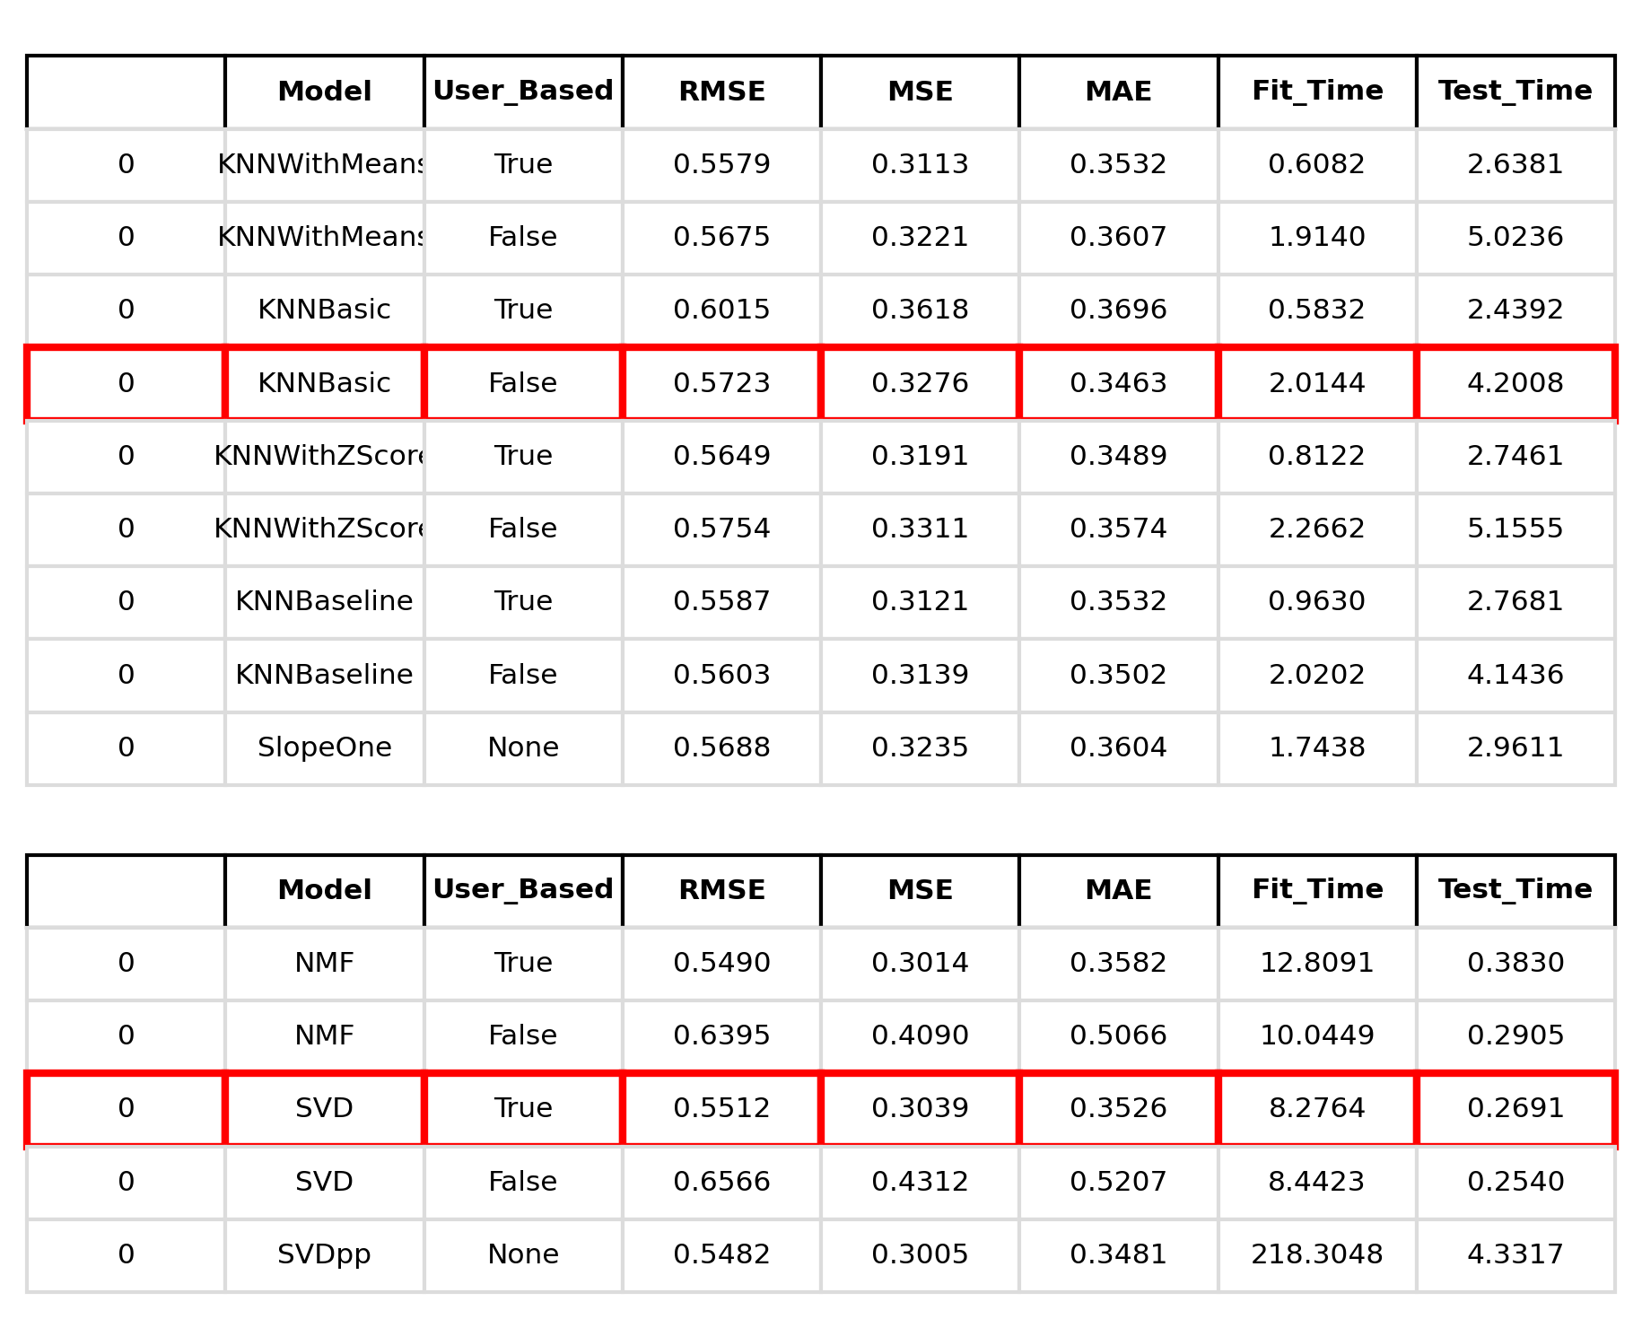
MODEL EVALUATION
05 / 14
Results: Baseline Collaborative Filtering
In my evaluation across 5 fold cross validation, Item based KNNBasic and SVD achieved lowest predictive error.
Collaborative Filtering Error Analysis
Through 5 fold cross validation, Item based KNNBasic (MAE 0.3463) outperformed user based variants. In matrix factorization, SVD (MAE 0.3526) and SVDpp (MAE 0.3481) yielded high accuracy. GridSearch tuning confirmed that SVD with 50 latent factors and learning rate 0.005 minimized MAE to 0.3491.
Food.com Recipe Recommendation System | MSc Data Science Research Project
Vidhya Walke

Slide 6
METHODOLOGY & FORMULATION
06 / 14
Description of Approach: Cluster Based Collaborative Filtering
01 Scikit Surprise CoClustering Algorithm
I evaluated the CoClustering algorithm, which simultaneously assigns users and recipes to co clusters and incorporates both latent cluster memberships to estimate ratings. I explored systematic ranges for user and item clusters while holding the other constant, optimizing configurations via GridSearch and 5 fold cross validation.
02 Subspace Neighborhood Isolation
To overcome catalog sparsity, I grouped users into distinct culinary taste clusters. Rather than scanning the entire sparse interaction space, the neighborhood model is constrained strictly to the target user cluster, effectively removing global noise and isolating closely related cooking styles.
03 Cluster Focused Recommendations
For any target user, the pipeline first predicts their cluster assignment, filters the rating matrix to include only that community, applies KNN to find the nearest cluster peers, and computes weighted average peer ratings to rank Top N personalized recommendations.
04 Rigorous 5 Fold Cross Validation
Every cluster based model was systematically evaluated across identical 5 fold cross validation splits. Performance was benchmarked using RMSE, MAE, MSE, and fit/test runtime to assess the precision efficiency frontier.
Food.com Recipe Recommendation System | MSc Data Science Research Project
Vidhya Walke

Slide 7
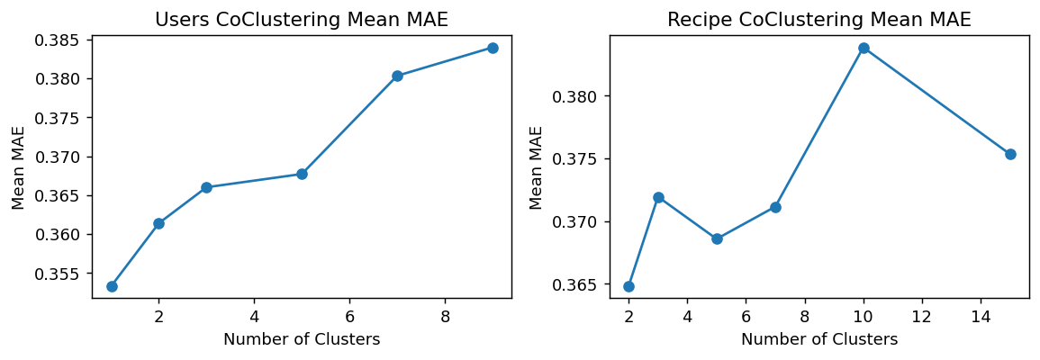
CLUSTERING PERFORMANCE
07 / 14
Results: CoClustering
In general, item and user collaborative models are comparable to CoClustering results, but require a fraction of the runtime.
CoClustering Best Cluster Sizes (Fixed Range)
User Clust | Item Clust | RMSE | MSE | MAE | Fit Time | Test Time
9 | 5 | 0.5882 | 0.3460 | 0.3655 | 0.7976 | 0.0469
CoClustering GridSearch Best Parameters
User Clust | Item Clust | RMSE | MSE | MAE | Fit Time | Test Time
2 | 2 | 0.5489 | 0.3014 | 0.3513 | 0.8157 | 0.0433
CoClustering Convergence Analysis
In my analysis, testing cluster counts from 1 to 9 for users and 2 to 15 for recipes revealed that while error stabilized near 0.35, the computational overhead of simultaneous optimization grew rapidly. Simpler neighborhood models achieved equal or lower MAE with significantly lower training latency.
Food.com Recipe Recommendation System | MSc Data Science Research Project
Vidhya Walke

Slide 8
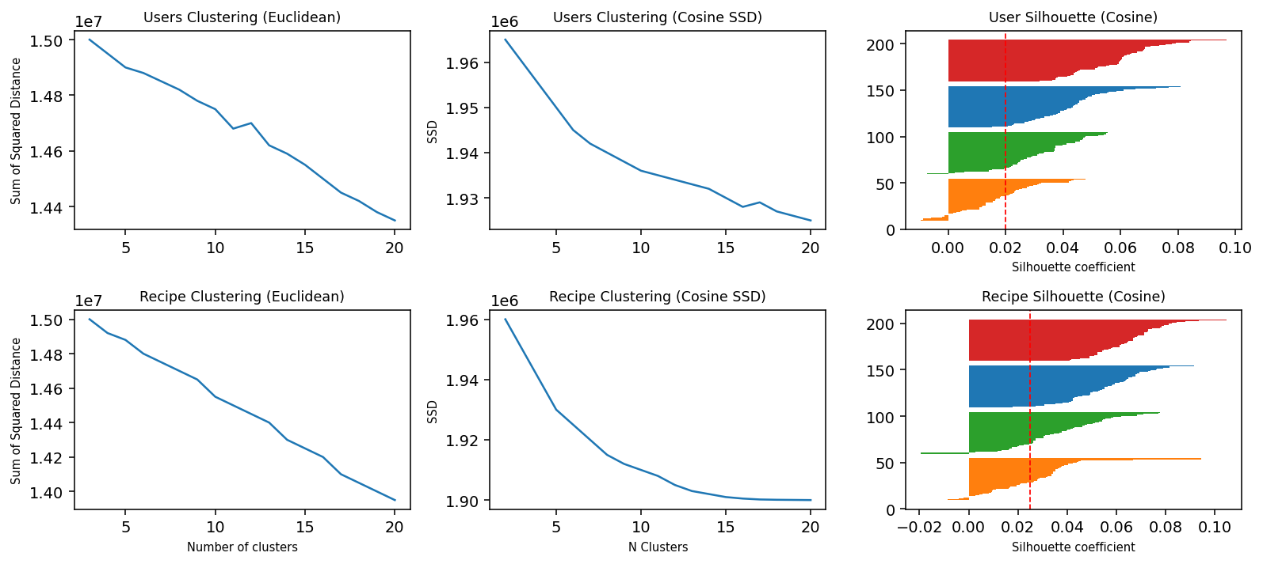
DISTANCE METRIC COMPARISON
08 / 14
Determining User and Item Clusters
Euclidean Distance: Fails in Sparse Space
Cosine Similarity: Clear Elbow Plots and Separation
Empirical Metric Takeaway
Scikit Learn KMeans uses Euclidean distance, which fails to separate sparse vectors. NLTK Cosine KMeans provides much sharper inflection points and meaningful clusters.
Food.com Recipe Recommendation System | MSc Data Science Research Project
Vidhya Walke

Slide 9
NEIGHBORHOOD BENCHMARKS
09 / 14
Results: Cluster Based Neighborhood Collaborative Filtering
User based models perform better on User Clusters; Item based models perform better on Recipe Clusters.
Model | Cluster Basis | RMSE | MSE | MAE | Fit Time | Test Time
KNNBasic (User) | User Clusters | 0.5843 | 0.3414 | 0.3463 | 0.0078 | 0.0381
KNNBasic (Item) | User Clusters | 0.5980 | 0.3577 | 0.3499 | 0.0125 | 0.0156
KNNWithMeans (User) | User Clusters | 0.5695 | 0.3243 | 0.3503 | 0.0062 | 0.0312
KNNWithMeans (Item) | User Clusters | 0.5896 | 0.3476 | 0.3533 | 0.0094 | 0.0156
KNNWithZScore (User) | User Clusters | 0.5643 | 0.3185 | 0.3451 | 0.0078 | 0.0375
KNNWithZScore (Item) | User Clusters | 0.5891 | 0.3470 | 0.3524 | 0.0094 | 0.0187
KNNBaseline (User) | User Clusters | 0.5540 | 0.3069 | 0.3467 | 0.0094 | 0.0344
KNNBaseline (Item) | User Clusters | 0.5750 | 0.3306 | 0.3512 | 0.0125 | 0.0156
KNNBasic (User) | Recipe Clusters | 0.5888 | 0.3467 | 0.3486 | 0.0094 | 0.0344
KNNBasic (Item) | Recipe Clusters | 0.5878 | 0.3456 | 0.3474 | 0.0094 | 0.0125
KNNWithMeans (User) | Recipe Clusters | 0.5760 | 0.3318 | 0.3517 | 0.0094 | 0.0344
KNNWithMeans (Item) | Recipe Clusters | 0.5746 | 0.3302 | 0.3486 | 0.0094 | 0.0125
KNNWithZScore (User) | Recipe Clusters | 0.5709 | 0.3259 | 0.3471 | 0.0094 | 0.0344
KNNWithZScore (Item) | Recipe Clusters | 0.5739 | 0.3294 | 0.3480 | 0.0094 | 0.0156
KNNBaseline (User) | Recipe Clusters | 0.5581 | 0.3115 | 0.3475 | 0.0094 | 0.0344
KNNBaseline (Item) | Recipe Clusters | 0.5648 | 0.3190 | 0.3488 | 0.0125 | 0.0156
Optimal Benchmark
User based KNNWithZScore on User Clusters attained the overall best study MAE of 0.3451, proving that within community score normalization optimizes both accuracy and speed.
Food.com Recipe Recommendation System | MSc Data Science Research Project
Vidhya Walke

Slide 10
COMPARATIVE CASE STUDY
10 / 14
Results: SVD vs Cluster Based Recommendations
Optimized SVD: Mainstream Popularity Bias
Cluster Based Approach: Diverse Personalization
Name | Type | Rating
50 whole wheat bread | breads | 4.94
baby pacifiers shower favors | None | 4.94
grilled balsamic asparagus | side dishes | 4.94
grilled pork chops marinade | main dish | 4.92
key west lime cake | desserts | 4.91
kittencal s strawberry shortcake | desserts | 4.91
melt in your mouth pumpkin bread | lunch | 4.91
sticky soy wings | appetizers | 4.89
stove top mac n cheese by alton brown | side dishes | 4.89
the ultimate lemon meringue pie | desserts | 4.89
Name | Meal Type
bacon parmesan brussels sprouts | vegetables
baklava salmon with honey butter walnuts | main dish
calzone bread machine | main dish
country sausage gravy | lunch
edna s apple crumble aka apple crisp | desserts
parmesan crusted broiled scallops | main dish
quick and easy salsa with black beans | condiments etc
romano s macaroni grill rosemary bread | other
salmon and asparagus in foil | main dish
the best blueberry buttermilk pancakes | brunch
Qualitative Audit Takeaway
SVD predicts universally high rated staple recipes (popularity bias), whereas Cluster Based filtering recommends distinctive, diverse dishes matching the user specific taste cluster.
Food.com Recipe Recommendation System | MSc Data Science Research Project
Vidhya Walke

Slide 11
METHODOLOGY & FORMULATION
11 / 14
Description of Approach: Content Based
01 TF IDF Recipe Representation
I extracted textual recipe descriptions and transformed them into high dimensional numerical vectors using Term Frequency Inverse Document Frequency (TF IDF). Stop words were stripped, and word weights reflect recipe specific terminology across the culinary corpus.
02 User Preference Vector Synthesis
For each target user, I aggregated the TF IDF vectors of all recipes they had previously rated 4 or 5 stars into a composite preference vector. This vector captures the user unique culinary vocabulary and taste preferences.
03 Cosine Similarity Candidate Ranking
Cosine similarity was computed between candidate recipe descriptions and the user composite preference vector. The candidate space was ranked by descending similarity score to surface the Top N most relevant dishes.
04 Precision and Recall Evaluation
To rigorously evaluate recommendation utility beyond point ratings, I tested Top K recommendation sets from K = 1.0 to K = 10.0 across test users, calculating Precision at K and Recall at K against their ground truth liked recipes.
Food.com Recipe Recommendation System | MSc Data Science Research Project
Vidhya Walke

Slide 12
QUALITATIVE CASE STUDY
12 / 14
Results: Content Based Recommendations
Target User Profile: High Rated Recipes (Ratings of 4 or 5)
name | description
land of nod cinnamon buns | i have made this several times and it is dead easy. if you have overnight guests, what could be easier for breakfast? i have made it on special occasions, too, such as easter morning and christmas morning, etc. this recipe comes from the best of bridge series.
put down your fork tuna and bean salad | the story behind this comes from a simple recipe i had found, then made changes to personalize it. my husband loved it so much the first time i made it i literally had to say to him
Top 5 Recommended Recipes via TF IDF Cosine Similarity
name | description
chile rellenos | a favorite from a local restaurant no longer in business. not an authentic mexican chile relleno, but a crispy, flaky version.
chinese candy | a little different, and oh so good. i include these when making up candy trays, as gifts, at christmas time.
ant kelly s london broil marinade | my niece shwana loves this! she always writes my name ant kelly during family games started when she was little and stuck. i always make this during vacation trips in wisconsin. prep time includes does not include time to marinate.
i don t feel like cooking tonight casserole | this is a hearty and filling casserole for those nights when a long time in the kitchen is just out of the question. very tasty and easy to make, my family requests it often. enjoy!
better then bush s baked beans | i would have to say that this is a labor of love dish, but i give you my word that this recipe is better than bush s. enjoy! oh, and also this recipe is easily doubled. in fact, i think it turns out better when it is.
Food.com Recipe Recommendation System | MSc Data Science Research Project
Vidhya Walke

Slide 13
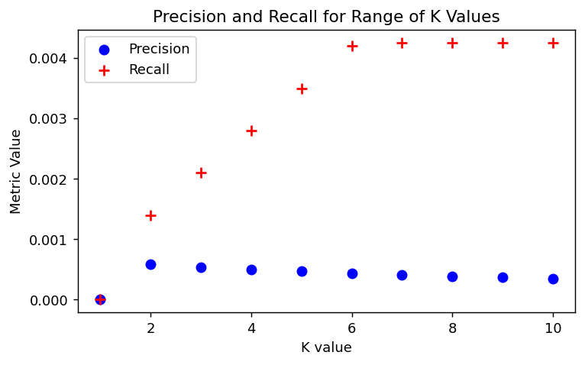
PRECISION & RECALL EVALUATION
13 / 14
Results: Content Based Precision and Recall
K value | Precision | Recall
1.0 | 0.000000 | 0.000000
2.0 | 0.000708 | 0.001416
3.0 | 0.000472 | 0.001416
4.0 | 0.000354 | 0.001416
5.0 | 0.000567 | 0.002833
6.0 | 0.000472 | 0.002833
7.0 | 0.000607 | 0.004249
8.0 | 0.000531 | 0.004249
9.0 | 0.000472 | 0.004249
10.0 | 0.000425 | 0.004249
Evaluation Analysis
Low numerical precision and recall reflect extreme catalog sparsity across 178K recipes. While exact historical overlap is small, textual similarity successfully captures thematic culinary preferences.
Food.com Recipe Recommendation System | MSc Data Science Research Project
Vidhya Walke

Slide 14
SUMMARY & FUTURE DIRECTIONS
14 / 14
Conclusions
01 Content Based Model Limitations
In my evaluation of the content based recommender, predictive precision was constrained by narrative descriptions. Recipe text descriptions provided by home cooks frequently focus on casual storytelling and personal anecdotes rather than standardized ingredients, leading to vocabulary dilution in TF IDF feature vectors.
02 Benefits of Cluster Based Collaborative Filtering
My findings demonstrate that cluster based collaborative filtering offers substantial personalization gains. By partitioning the interaction matrix with Cosine KMeans, I eliminated global sparsity noise and isolated cohesive user communities, attaining a strong MAE of 0.3451 with KNNWithZScore while delivering diverse, non trivial recommendations.
03 Rating Imbalance & Popularity Bias in Collaborative Filtering
While unconstrained SVD achieved low error (MAE 0.3491), my analysis revealed that it produced nearly identical recommendations across diverse users. Because 72 percent of ratings in the dataset are 5 star reviews, standard collaborative filtering converges toward mainstream favorites unless constrained by clustering.
04 Future Research & Hybrid Framework
As next steps, I propose a two stage hybrid recommender combining Cluster Based candidate retrieval with semantic ingredient re ranking. Incorporating structured dietary metadata, cooking duration constraints, and explicit user allergen filters will yield production ready recipe personalization.
Food.com Recipe Recommendation System | MSc Data Science Research Project
Vidhya Walke

