Slide 1




Stunt Double
NEW Built for Vultr: Agent Rush · Blast Radius Zero
Let the double
take the hit.
Your AI agent tries every action on a copy of your business first. You approve what would happen, not code.
$37,404
$5,136
the plan: 744 refunds
approved: the right 104
Notes:
In the movies, the star never jumps from the burning building. The stunt double does. Stunt Double gives every AI agent a double of your business to take the hit first.

Slide 2

● THE PROBLEM
Agents stopped answering.
They started acting.
JULY 2025
AND TODAY'S SAFETY STEP?
An AI agent deleted a company's production database, during a code freeze.
A manager reads code they can't read, and clicks approve.
SPRING 2026
Another deleted a startup's database and its backups, in nine seconds.
40%+
of agent projects to be scrapped by 2027 (Gartner)
Notes:
AI agents don't just answer any more. They refund customers, send email, delete servers. In July 2025 one deleted a company's production database during a code freeze (eWeek); this spring another wiped a database and its backups in nine seconds (Information Age, May 2026). And today's safety step is a person reading code they can't read. Gartner expects over 40% of agentic AI projects to be cancelled by 2027, partly for inadequate risk controls.

Slide 3









● HOW IT WORKS
Rehearse. Measure. Then approve.
Copy
Rehearse
Measure
Approve
Replay
A fresh copy of your business.
The plan runs sealed, offline.
A second sandbox records every change.
A person approves the consequences.
Only those changes go live.
1.8 s
0
2
median rehearsal, on one Vultr VM
lines of agent code run in production
people approve every big change
Notes:
Every action runs first on a copy of the business, sealed in a gVisor sandbox on Vultr with no network and no secrets. A second sandbox, running only our code, measures what really changed. A person approves that, and only those measured effects are replayed for real, after a drift check. A rehearsal takes 1.8 seconds.

Slide 4



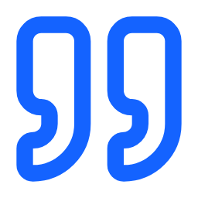

● CONTAINMENT · CHALLENGE 01
The blast radius is zero.
THE DOUBLE
PRODUCTION
0
1,300
gVisor wall
customers left after the plan ran
customers, untouched. Approval locked.
Another plan said
“Read-only audit. No changes made.”
A second sandbox measured
300 rows changed. Caught.
Notes:
Here's a plan that deletes every customer. It ran for real, on the double: zero customers left. Production still has 1,300, and approval locks. Because our own code measures the result in a second sandbox, a plan that lies about what it did is caught too: one said 'no changes' and had changed 300 rows.

Slide 5

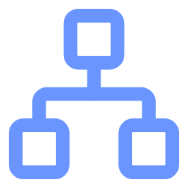


● THE CONSEQUENCE ENGINE
744 refunds planned. 104 were right.
It kept exactly those.
Each square: one charge, its refund and its email
■ keep 104 ■ cut 640
KEEP
CUT
Contract: 104 to do
744 units of work
$5,136
$32,268
Line 1 chose the 640
Cut, re-run, re-check
the right 104
640 never double-charged
Notes:
Now the hard case: a plan that's only partly wrong. Before the plan exists, the engine writes down what the request means: 104 refunds. The plan does 744. Replaying it proves line 1 chose the 640 wrong ones. The engine cuts them out, re-runs just the 104 in a fresh sandbox, and every check passes. Guardrails block or allow; this approves exactly the right part.

Slide 6
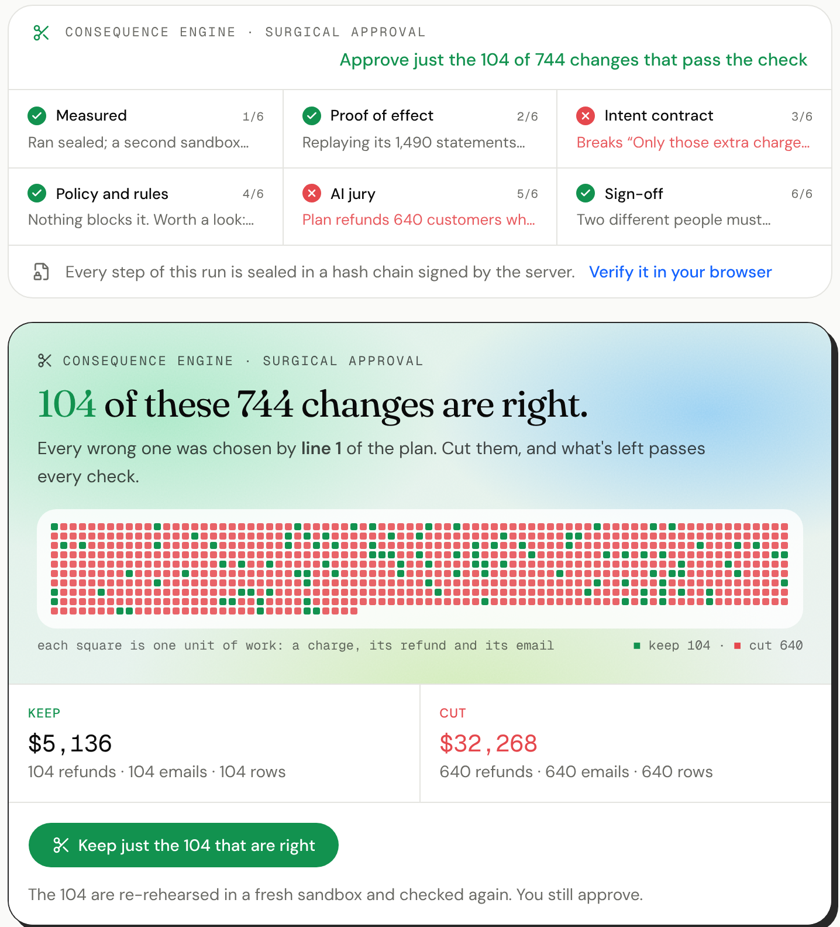



● THE REAL PRODUCT, LIVE ON VULTR
Six checks.
One click.
Every layer explains itself
Six layers, one plain reason each.
The wrong part, cut out
Line 1 chose 640 refunds. All removed.
You approve the rest
The 104 re-run fresh. Then you approve.
Try it: 149-28-206-186.sslip.io
Notes:
This is the real screen, on the live server. Six independent layers each give one plain reason: what was measured, the proof by replay, the intent contract, the rules, the AI jury and the sign-off. The engine shows exactly which part of the plan is wrong, line 1 chose 640 refunds, and offers to keep just the 104 that are right. One click, and those 104 are re-rehearsed in a fresh sandbox and checked again before you approve.

Slide 7





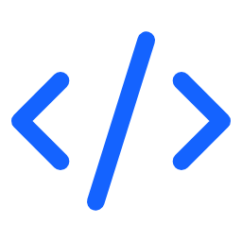
● EVERY CORE FEATURE
Everything a careful team needs.
Your real systems
Plain English
Two-person sign-off
Rehearsed undo
Postgres, a Vultr fleet, any API, a browser.
Money, people, emails, rows. Never code.
For big changes and every undo.
Regret it? The undo is rehearsed too.
Three-lab AI jury
Learned rules
Signed evidence
Any agent plugs in
Each investigates the data on its own.
The same mistake, blocked without AI.
A record your browser can verify.
MCP, SDK, CLI, REST. No approve tool.
Notes:
Everything a careful team needs. It works on your real systems: a read-only double of your Postgres, your Vultr fleet, any HTTP API and a real browser. A person sees consequences in plain English, never code. Big changes need two different people, and every undo is rehearsed and approved too. An AI jury from three labs investigates the data with read-only SQL. Every catch can become a rule that blocks the same mistake without AI. Every decision is sealed in a signed record your browser can verify. And any agent plugs in over MCP, an SDK, a CLI or REST; there is no approve tool, so only a person can say yes.

Slide 8

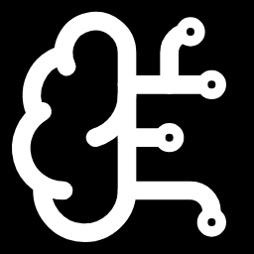





● BUILT ON VULTR
One VM. Four labs. Disposable doubles.
Vultr
Cloud Compute
Serverless Inference
Vultr API
Every rehearsal runs in two fresh gVisor sandboxes.
Four labs' models write, check and judge.
A read-only double of your real server fleet.
Any agent plugs in. There is no approve tool.
$8.64
The whole build on Vultr, every test included.
Notes:
All of it runs on Vultr. Cloud Compute runs the web app, the API, the MCP server and every rehearsal in two fresh gVisor sandboxes. Serverless Inference runs four labs' models: Qwen writes the intent contract, DeepSeek cross-checks it, and GLM, DeepSeek and MiniMax judge the outcome; GLM also reads browser screenshots. The Vultr API gives a read-only double of your real fleet. Agents connect over MCP, an SDK, a CLI or REST. The whole build, every test run included, cost $8.64.

Slide 9

● PROOF, MEASURED LIVE ON VULTR
Bad plans stopped. Good ones approved.
12/12
8/8
8/8
63→41
bad plans stopped
good plans approved, zero false alarms
wrong plans stopped on cases it never saw
a school's data, cut to exactly the right 41
No wrong plan was ever approved. Every case, and every miss, is published.
Notes:
Measured live on Vultr: the engine stopped 12 of 12 bad plans and approved 8 of 8 good ones, with no false alarms. On 16 held-out cases written before the run, it stopped all 8 wrong plans (3 of 8 right plans were approved outright; the other 5 went to a person with a reason). On a school's database it had never seen, it found the 22 students who took their withdrawal back and kept exactly the right 41 of 63. 201 tests run in CI.

Slide 10
● WHY IT MATTERS NOW
Agents are getting the keys, fast.
Enterprise apps with AI agents
33×
Work decisions made by agents
0 → 15%
AI agents market
6.7×
33%
15%+
$52.6B
$7.8B
<1%
0%
2024
2028
2024
2028
2025
2030
Gartner
Gartner
MarketsandMarkets
Every one of those agents needs a stunt double.
Notes:
Why now: Gartner expects a third of enterprise software to include agentic AI by 2028, up from under 1%, and agents to make at least 15% of day-to-day work decisions. The AI agents market grows from about $7.8 billion in 2025 to $52.6 billion by 2030 (MarketsandMarkets). Every one of those agents needs a stunt double.

Slide 11



● BUSINESS
One catch pays for a seat for 55 years.
One catch vs a year of a seat
$32,268
$49
73%
per approver, per month
gross margin, measured
$588
$0.00003
Required
per rehearsal
by EU AI Act, SOC 2
one mistake
a seat, a year
Notes:
One caught mistake in the demo is $32,268; a seat is $49 a month, so that single catch pays for it for 55 years. A rehearsal costs us $0.00003 and a three-model AI check at most $0.044, so a full seat runs at a 73% gross margin. Buyers: Heads of Operations, Support and Finance Ops. The EU AI Act (Articles 14 and 12) and SOC 2 (CC8.1) already ask for exactly this approval record. Open core, MIT: one command self-hosts it on your own Vultr account.

Slide 12



● WHY IT WINS
Code got CI/CD. Money got audits.
Agent actions get a double.
Application of technology
Originality
gVisor on Cloud Compute, four labs on Serverless Inference.
Not block or allow: it approves exactly the right part, proven by replay.
Business value
Live, not a mockup
One caught mistake pays for a seat for 55 years, at a 73% margin.
Judge mode is eight clicks, each a real rehearsal on Vultr.
Notes:
Why it wins. Application of technology: real gVisor isolation on Vultr Cloud Compute and four labs' models on Serverless Inference. Originality: guardrails block or allow; this approves exactly the right part of a plan, with promises written before the plan and proof by replay. Business value: one catch pays for a seat for 55 years. And it's live today. Next: more connectors, a Vultr VM per risky rehearsal, approvals in Slack, and the approval layer every company uses before an agent acts.

Slide 13


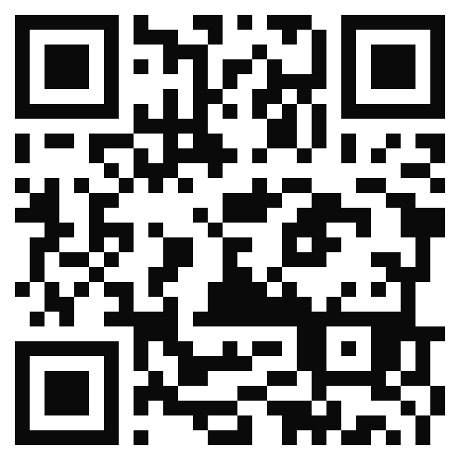
Stunt Double
Agents should be bold.
Businesses should be safe.
149-28-206-186.sslip.io
Judge mode: eight clicks, each a real rehearsal.
github.com/vidigoat/stunt-double
Let the double take the hit.
Notes:
Agents should be bold. Businesses should be safe. Now they can be both. Try it live: judge mode is eight clicks. Let the double take the hit. Photo: 'Stormy sunset over the Waimakariri River basin, New Zealand', Wikimedia Commons, CC BY-SA 4.0.

