Slide 1
PCB Defect
Detection
Imaging front-end and deep-learning detection pipeline

Slide 2

PART 1
Camera, Resolution & Working Distance
Designing the imaging front-end for PCB defect detection
150×150 mm
30–50
20 MP
Patches
Test board
px/mm target
Camera class
+ stitching

Slide 3

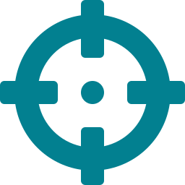


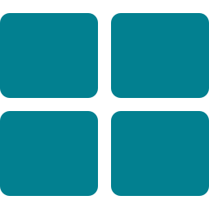

OVERVIEW
What this covers — and why it matters
A defect the camera cannot physically resolve is invisible to every model downstream. This work fixes the capture parameters that decide whether the dataset contains detectable defects at all.
Physical target
Board & defect sizes benchmarked to IPC-A-610
Resolution
The px/mm rule and full-board pixel budgets
The through-line
Camera & FOV
How sensor, focal length and FOV set resolution
Resolution, working distance, and capture strategy together set an upper bound on detection accuracy. Get them right and the ML model has a fair chance; get them wrong and no architecture can recover.
Working distance
The height derived from FOV, focal length & sensor
Capture strategy
Detection begins at the lens, not the model.
Full-board vs. component-level patches; stitching
Validation
Peer-reviewed papers and industrial AOI standards
3

Slide 4

Defect classes and their physical sizes
All defect classes with real-world sizes, per IPC-A-610. Board under test: 150 × 150 mm. The smallest features sit near or below 1 mm.
Defect class
Physical size
Category
Top view?
Solder bridge
0.05 – 0.3 mm
Solder
Yes
Solder ball
0.1 – 0.5 mm
Solder
Yes
Open circuit (trace)
0.1 – 0.5 mm
Board
Yes
Misalignment
0.1 – 2.0 mm
Component
Yes
WIDE SIZE RANGE
Scratch / trace damage
0.2 – 3.0 mm
Board
Yes
Defects span roughly 0.05 mm to 10 mm — over two orders of magnitude.
Dry / insufficient solder
0.3 – 1.0 mm
Solder
Yes (texture)
Pad damage
0.5 – 2.0 mm
Board
Yes
Excess solder
0.5 – 2.0 mm
Solder
Yes
The imaging setup must resolve the finest features while still covering large components — the requirement that drives every decision that follows.
Component liftup
0.5 – 3.0 mm
Component
Partial — oblique
Foreign object
0.5 – 5.0 mm
Contamination
Yes
Missing component
0.5 – 10 mm
Component
Yes
Wrong component
0.5 – 10 mm
Component
Yes
Tombstone
1.0 – 5.0 mm
Component
Partial — oblique
Polarity reversal
1.0 – 5.0 mm
Component
Yes
4

Slide 5
The core rule: 10 pixels across the smallest defect
Minimum px/mm = 10 pixels ÷ smallest defect size (mm)
px/mm
1 mm
0.5 mm
0.3 mm
Verdict
10
10²
5²
3²
Absolute min — risky
Why 10 px/mm is a floor, not a target
20
20²
10²
6²
Marginal for 1 mm
Defects near a tile edge lose pixels — effective coverage drops to 5–7 px.
30
30²
15²
9²
Recommended min
A 10×10 px region is a near-uniform blob — no texture for classification.
50
50²
25²
15²
Comfortable target
YOLO boxes include surrounding context — at 10 px the whole region is tiny.
100
100²
50²
30²
Safe for all defects
Real defects are irregular; below ~20 px shape information is lost entirely.
pixels across a defect at each resolution
Practical minimum 20–30 px/mm. 50 px/mm is the comfortable working target.
5

Slide 6

Pixel budget to cover the whole 150 mm board
Total pixels needed to image the full board at each target — this sets the camera class.
Target
Px (H)
Px (V)
Total
Single shot?
Cam
px/mm
Tile FOV
Tiles
Stitch?
10 px/mm
1,500
1,500
~2.25 MP
Any camera — trivial
12MP
10
402×303 mm
1
No
12MP
30
134×101 mm
4
Yes
20 px/mm
3,000
3,000
~9 MP
12MP+ single shot
12MP
50
80×60 mm
6
Yes
30 px/mm
4,500
4,500
~20 MP
20MP+ single shot
12MP
100
40×30 mm
20
Yes
20MP
10
549×367 mm
1
No
50 px/mm
7,500
7,500
~56 MP
Stitching required
20MP
30
183×122 mm
2
Barely
20MP
50
110×73 mm
6
Yes
100 px/mm
15,000
15,000
~225 MP
Stitching required
20MP
100
55×37 mm
15
Yes
Key result: at 30 px/mm a 20 MP camera (5496 × 3672) covers the full board in one shot — 5496 ÷ 30 = 183 mm > 150 mm. No stitching needed for the prototype.
6

Slide 7


We choose three things; the rest is calculated
Sensor, focal length and FOV are our decisions. Resolution and working distance follow from them by formula.
Sensor pixel count
Focal length
Field of View
from the camera datasheet
which lens we buy
physical area per patch
Working Distance = (FOV × Focal Length) ÷ Sensor Size
Worked example (20 MP, 35 mm lens, 35 mm FOV):
px/mm = Sensor Pixels (H) ÷ FOV (mm)
WD = (35 × 35) ÷ 13.3 = 92 mm
px/mm = 5496 ÷ 35 = 157 px/mm
Focal length
Smaller FOV
More megapixels
does NOT change resolution — only working distance moves if FOV is fixed.
fewer mm per patch, so the same pixels cover less area → higher px/mm.
more px/mm at the same FOV & WD — cleanest way to raise resolution.
7

Slide 8

FOV is derived from how the board is tiled
Board size and patch count fix the FOV; FOV then fixes px/mm and working distance. Example: a 5 × 6 grid = 30 patches over the 150 mm board.
Direction
Board
Steps
Step size
FOV/patch (20% overlap)
Horizontal (X)
150 mm
5 columns
30 mm
37.5 mm
The trade-off
Vertical (Y)
150 mm
6 rows
25 mm
31.25 mm
Fewer, larger patches → lower px/mm, less data to manage. More, smaller patches → higher px/mm, but more images and more boundary splits.
FOV/patch
px/mm (20 MP)
Patches (150 mm, 20% overlap)
50 mm
110 px/mm
16 (4×4)
35 mm
157 px/mm
30 (5×6)
25 mm
220 px/mm
64 (8×8)
Our dataset used component-level patches — matching the right-hand side of this trade-off.
20 mm
275 px/mm
100 (10×10)
8

Slide 9
Megapixels raise resolution; focal length does not
At a fixed 35 mm FOV, more sensor pixels means more px/mm. Focal length only moves the working distance — px/mm stays identical.
Camera
Sensor px (H)
FOV
px/mm
Focal length
FOV
WD
px/mm
Hikrobot 5MP (IMX264)
2448 px
35 mm
70 px/mm
25 mm
35 mm
66 mm
157 px/mm
Hikrobot 12MP (IMX226)
4024 px
35 mm
115 px/mm
35 mm
35 mm
92 mm
157 px/mm
Hikrobot 20MP (IMX183)
5496 px
35 mm
157 px/mm
50 mm
35 mm
131 mm
157 px/mm
Lucid Atlas10 (IMX925)
5328 px
35 mm
152 px/mm
75 mm
35 mm
197 mm
157 px/mm
Same FOV → resolution scales with sensor pixels
FOV fixed at 35 mm → focal length changes only WD
Design lever: to raise resolution without touching the physical setup, buy a higher-MP sensor. FOV and working distance stay the same — only pixels-per-mm change. Focal length is chosen purely to place the camera at a convenient bench height.
9

Slide 10

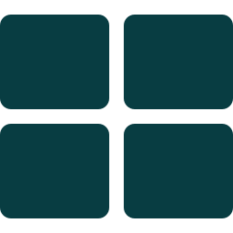


Full-board vs. component-level patches
Full-board capture
Component-level patches
One image (or stitched composite) of the entire 150 × 150 mm PCB.
Board split into a grid of small crops, each fed to the model.
Simple pipeline — one image per PCB
Defect fills a large fraction of each patch
Captures spatial context & component positions
20 × 20 mm at 50 px/mm = 1000² px
Strong for missing / wrong / polarity defects
Matches how our dataset was actually built
1 mm defect = 0.04% of a 4500² image
Defects at patch borders may be split
Extreme scale imbalance hurts small-defect detection
10

Slide 11
Most defects need only a top-down view
A fixed overhead camera is simple and repeatable. Only two defect types need an added oblique (30–45°) view.
Defect type
Top-down view
Oblique / side view
Missing component
Sufficient
Not needed
Fixed camera
Wrong component
Sufficient
Not needed
Mounted overhead. Simple, no moving camera parts, no alignment error — position is fixed and repeatable.
Solder ball
Sufficient
Not needed
Dry solder
Sufficient
Not needed
Solder bridge
Sufficient
Not needed
Pad damage
Sufficient
Not needed
Fixed + motorised stage
Misalignment
Sufficient
Not needed
Polarity reversal
Sufficient
Not needed
Camera stays put; the stage moves the PCB through a grid, capturing one tile per position for stitching.
Tombstone
Partial only
Required (30–45°)
Component liftup
Partial only
Required (30–45°)
11

Slide 12

When is stitching needed?
Stitching is required whenever a single camera frame cannot cover the board at the desired resolution.
Camera
Target
Tiles
Stitching?
20 MP
30 px/mm
1 (single shot)
No
How stitching works
20 MP
50 px/mm
6 tiles
Yes
The camera stays fixed while a motorised stage moves the PCB through a grid of positions — one tile captured per position, then software-stitched into a full high-resolution view.
2 MP
30 px/mm
4 tiles
Yes
Any camera
100 px/mm
15–20 tiles
Yes
The trade-off it buys
Stitching adds mechanical and software complexity, but it is the only way to reach high per-defect resolution on a large board — capturing many small, high-detail patches instead of one coarse overview.
For this project: reaching high resolution over the full board means stitching multiple patches.
12

Slide 13

Targets corroborated by literature & industry
Every parameter is backed by peer-reviewed research and industrial AOI standards.
DeepPCB — SJTU, 2019 (arXiv:1902.06197)
Scientific Reports — Nature, 2024
Benchmark captured at ~48 px/mm; 16000² images cropped to 640² patches — validates the 30–50 px/mm range.
Raising input 640→800 px measurably improves AP and AR; more pixels per defect directly helps detection.
ZhenHuaXing AOI Selection Guide
Small-Object Detection, YOLOv4 — Comp. & Elec. Eng., 2023
0402 parts need 25 µm/px = 40 px/mm; 01005 need <12 µm/px — our 30–50 band sits right in range.
Names low resolution as a primary cause of missed small objects — fix resolution at capture, not in the model.
Convergent conclusion
TRI — Introduction to AOI White Paper
Independent sources — academic and industrial — all place reliable PCB inspection in the 30–100 px/mm band. Our 30–50 px/mm target is squarely inside it.
10 µm/px = 100 px/mm is high-end fine-pitch AOI; 30–50 px/mm aligns with standard-component inspection.
13

Slide 14


How inspection is done now — and its limits
The current setup relies on manual adjustment for every board and defect. This is slow, non-repeatable, and hard to feed a consistent dataset to a model.
Current practice
What the analysis enables
Camera FOV limited to ~15 mm maximum
Resolution target derived from defect sizes, not guessed
No fixed working distance
Working distance fixed by formula once lens is chosen
Working distance changed manually per component size
Repeatable patch grid instead of ad-hoc hand movement
Camera moves only up and down (Z only)
A consistent, high-resolution dataset for the model
PCB moved by hand to capture different defects
Clear upgrade path: more patches → higher resolution
Camera cannot tilt — no oblique views
14

Slide 15


CONCLUSION
What we recommend, and what comes next
Adopt a 30–50 px/mm resolution target
This is the resolution band the analysis and the literature both point to for reliably detecting our defects.
Capture the board as many small patches
Small, high-resolution patches capture fine defects far better than one full-board image — so stitching multiple patches will be required.
Patch count & FOV need experimentation
Choosing how many patches (and therefore the FOV) is not a single formula — it needs experiments to balance resolution, defect coverage, and boundary splits.
Camera & lens then fix the working distance
Once the camera and lens are selected, the focal length is known — and the working distance follows directly from the FOV formula.
In short: resolution target is set; the capture strategy is patches + stitching; patch count needs experiments; the working distance falls out once the camera and lens are fixed.
15

Slide 16
PART 2
Deep-Learning Defect Detection
Building and training a detector on the annotated PCB dataset
~550
12
YOLO · RT-DETR
GMO-DETR
Images annotated
Defect classes
Baselines
Final model

Slide 17
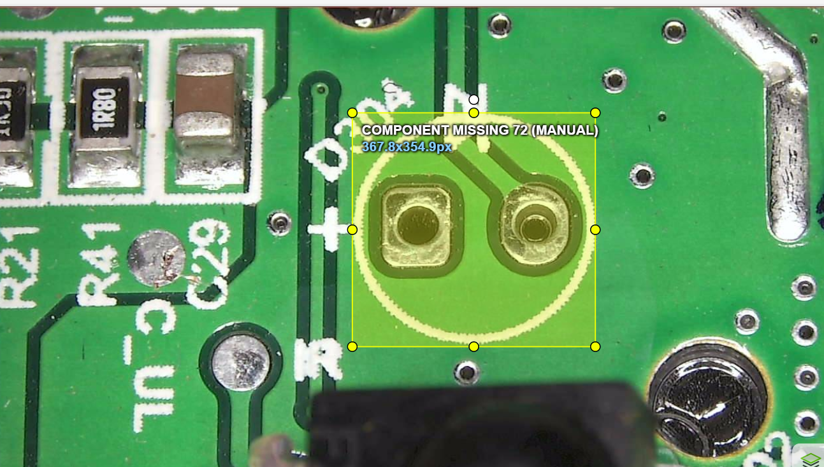
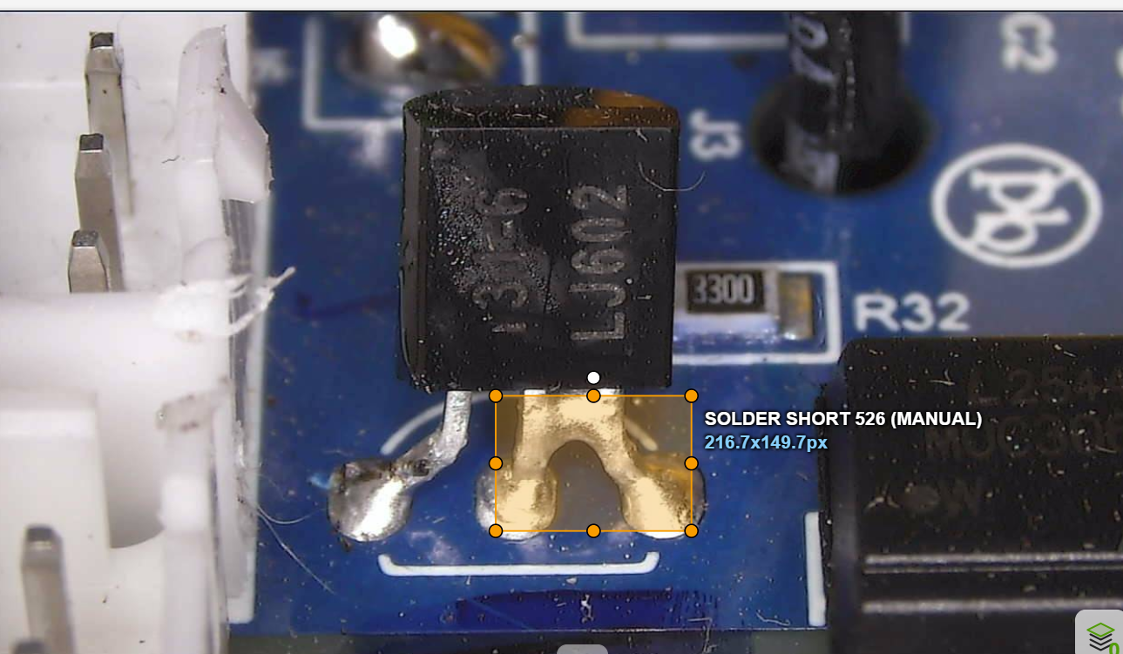
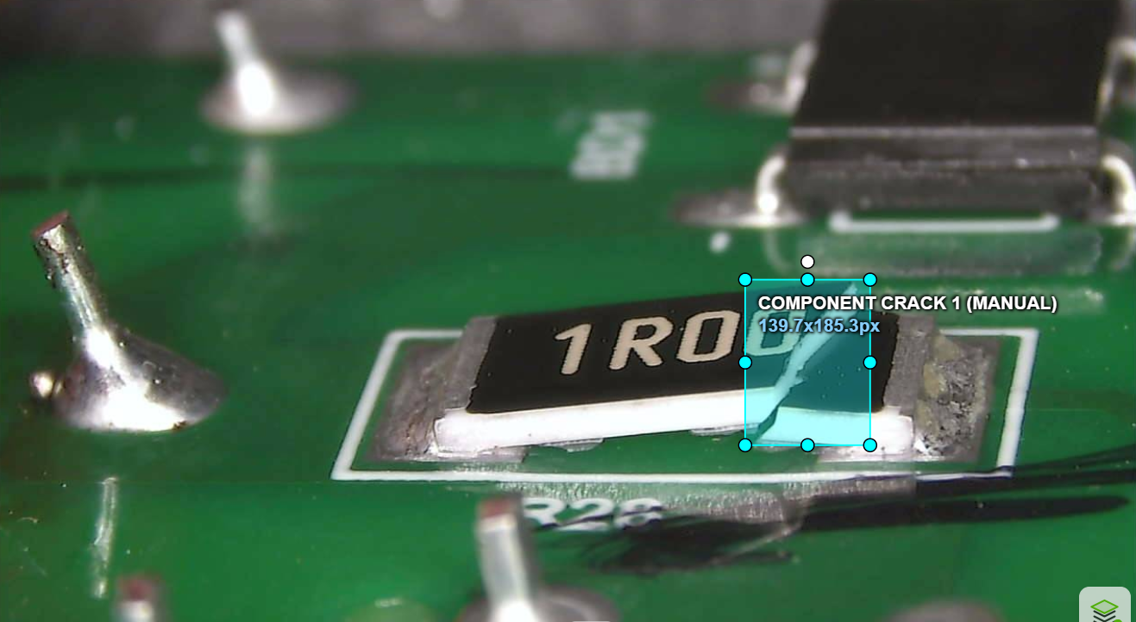
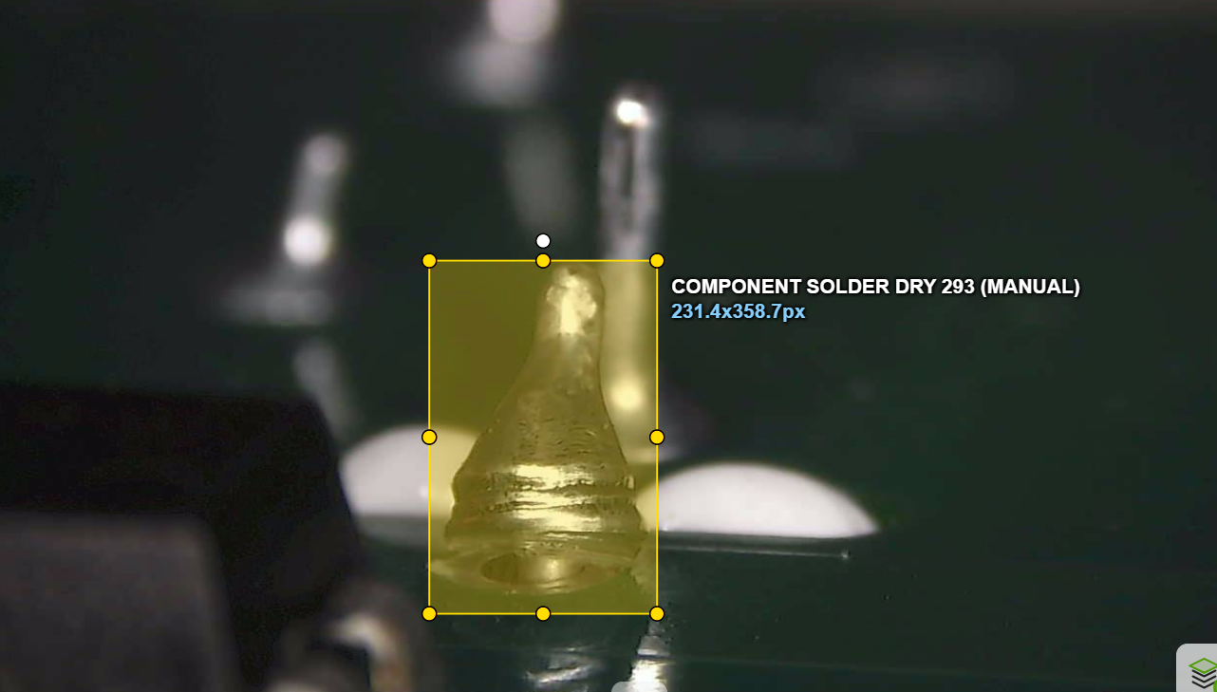
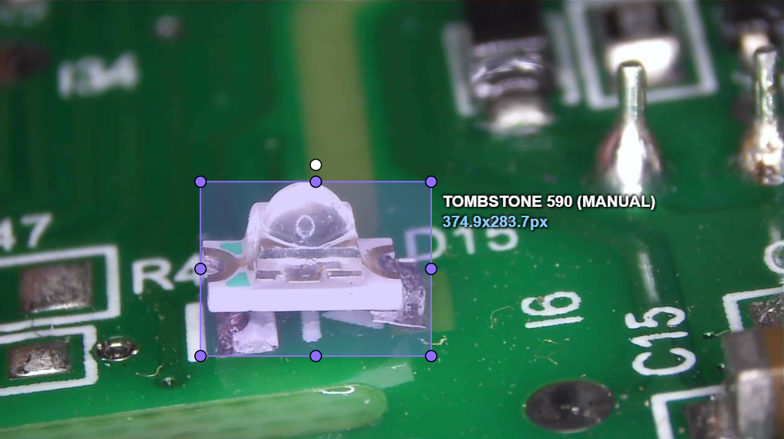
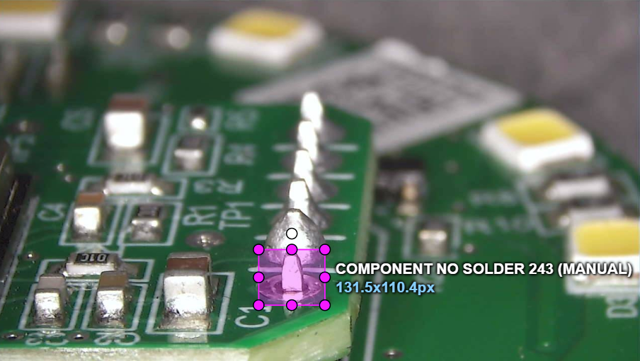
ANNOTATION
~550 defect images annotated in CVAT
Each defect was manually labelled with a bounding box and class in CVAT, producing the training dataset. A few examples across defect types:
Component Missing
Solder Short
Component Crack
Component Solder Dry
Component No Solder
Component Tombstone
17

Slide 18
Where we started: YOLO on ~92 images
An earlier YOLO model was trained on only ~92 annotated images. It set the initial benchmark — and made clear that more labelled data was needed.
mAP@0.5
mAP@0.5:0.95
Precision
Recall
0.497
0.248
0.479
0.500
~92 annotated images · YOLO · no negatives
The limitation: 92 images is very little for 12 defect classes — several classes had only a handful of examples, capping how well any model could learn. The next step was to annotate substantially more data.
18

Slide 19
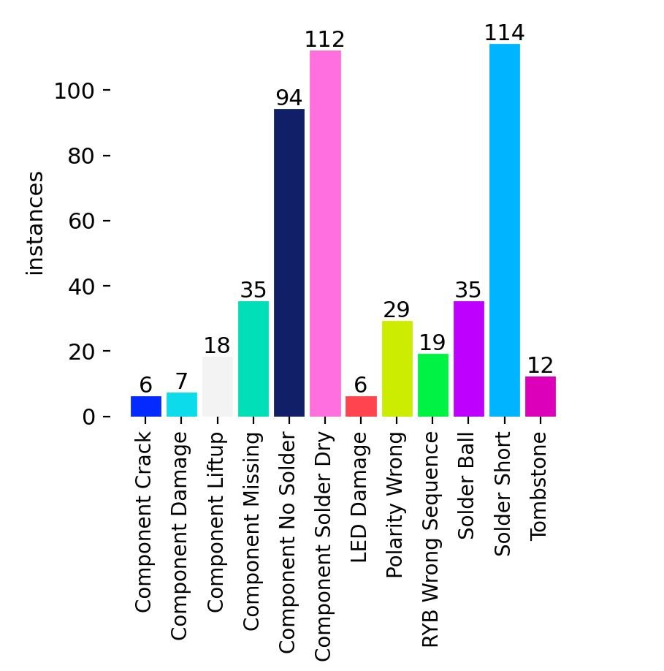

DATASET COMPOSITION
~550 images annotated across 12 classes
The dataset was expanded to ~550 images and ~600 defect instances. The class distribution is highly imbalanced — a key factor in the later results.
Defect class
Train
Val
Total
Solder Short
115
29
144
Component Solder Dry
113
25
138
Component No Solder
95
19
114
Component Missing
35
9
44
Solder Ball
35
8
43
Polarity Wrong
29
7
36
RYB Wrong Sequence
19
5
24
[ bar chart ]
Instances per defect category
Component Liftup
18
4
22
Tombstone
12
3
15
Component Damage
7
2
9
Component Crack
6
2
8
LED Damage
6
1
7
~600 total instances · 441 train + 110 val images · 548 images resolved
19

Slide 20

BASELINE RESULT
More data lifts the baseline across every metric
Re-training YOLO11s on the larger ~550-image dataset (plus negatives) improves every metric substantially over the ~92-image model.
mAP@0.5
mAP@0.5:0.95
Precision
Recall
Previous
Previous
Previous
Previous
0.497
0.248
0.479
0.500
New baseline
+0.236
New baseline
+0.221
New baseline
+0.331
New baseline
+0.145
0.733
0.469
0.810
0.645
Previous = ~92-image YOLO run (no negatives) · New baseline = ~550 images + non-def negatives, YOLO11s
Why it improved: more annotated data gives the model far more examples per class, and the added defect-free negatives reduce false positives on clean regions — together lifting precision and recall across the board.
20

Slide 21
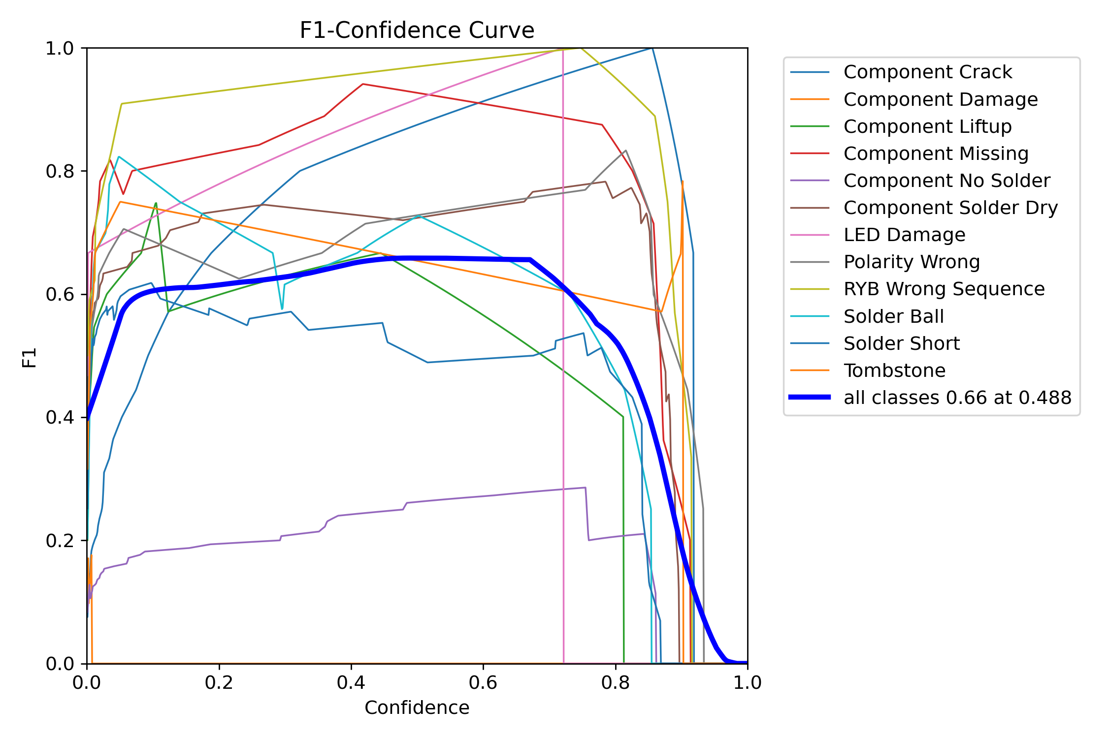
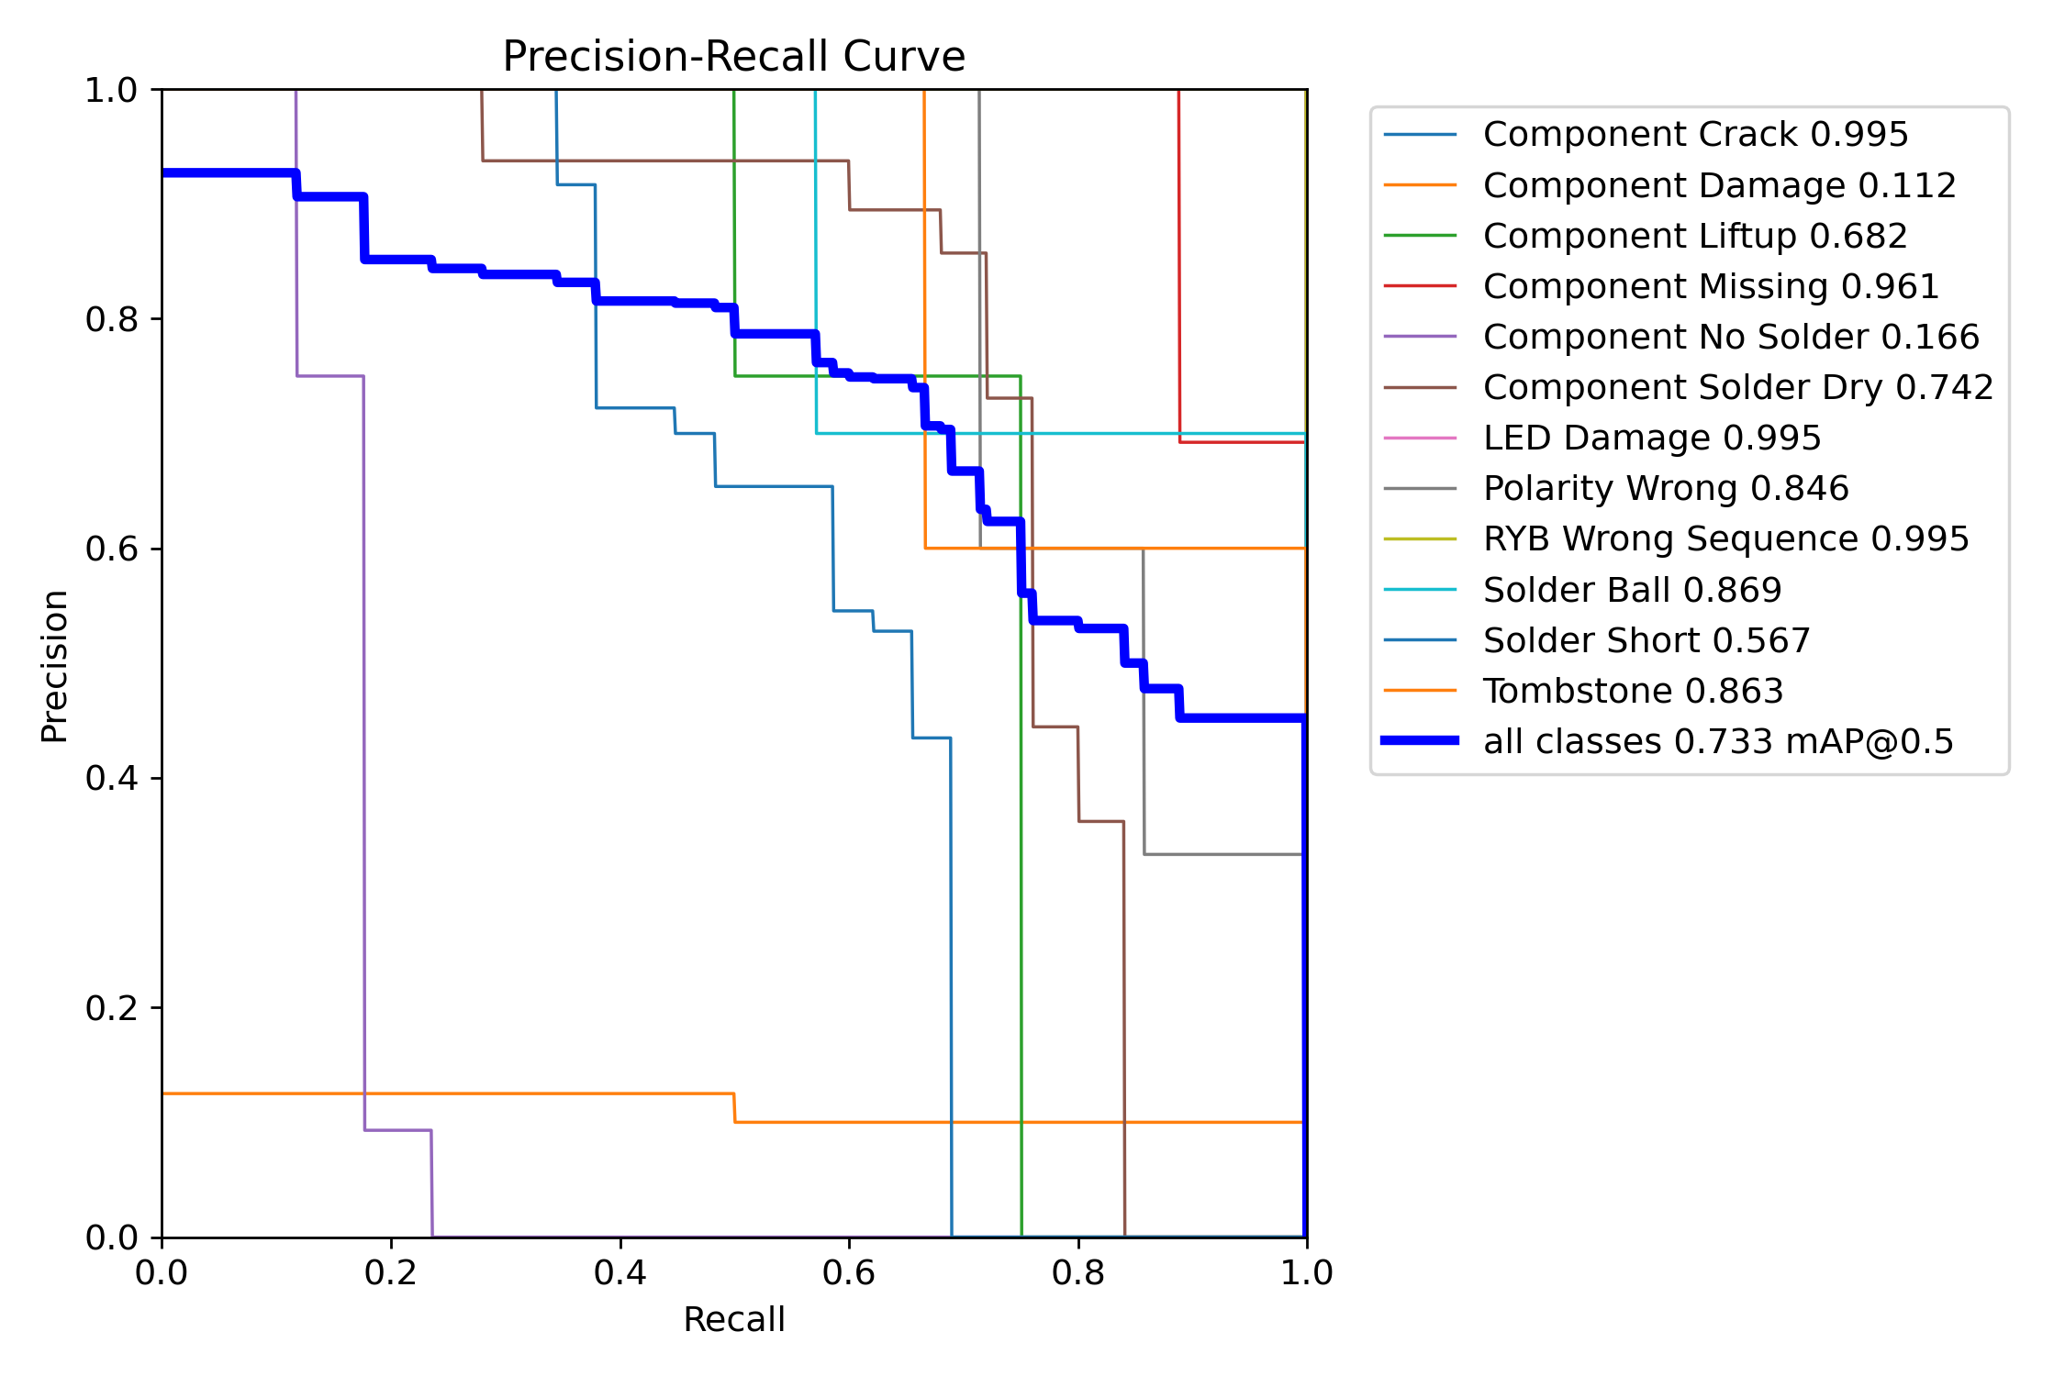
BASELINE DIAGNOSTICS
Baseline model — F1 & PR curves
21

Slide 22
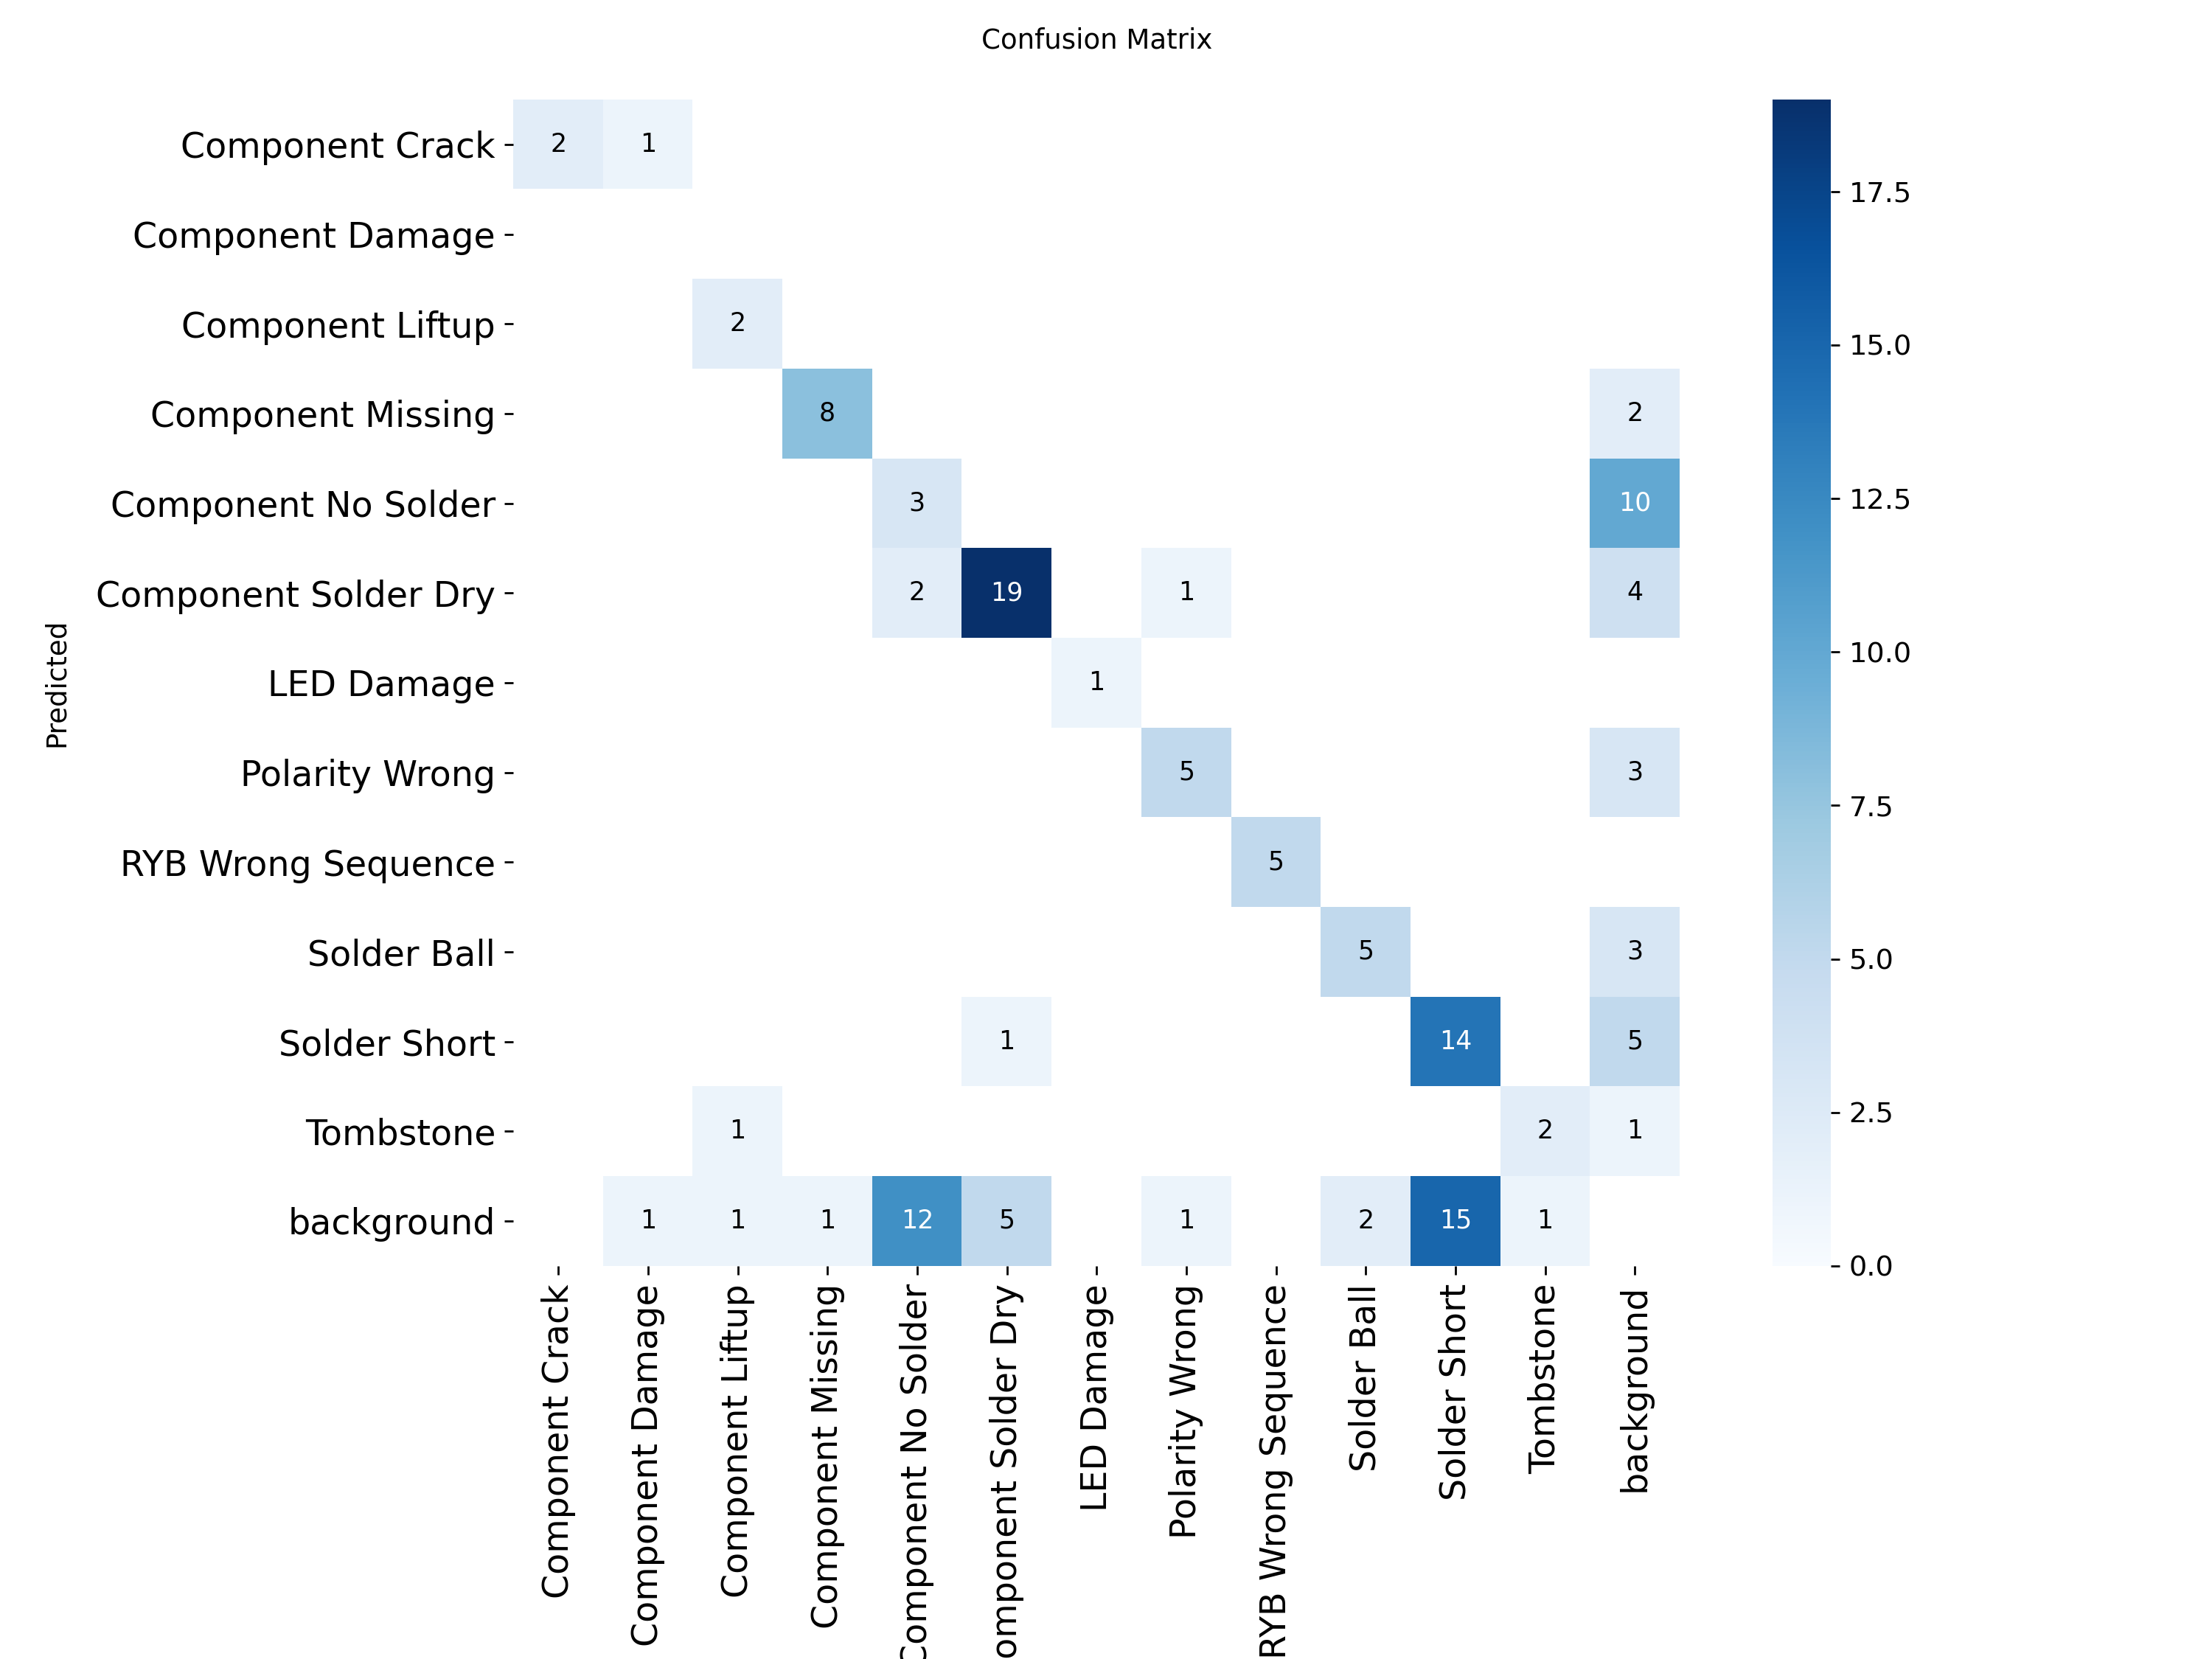
BASELINE DIAGNOSTICS
Baseline model — confusion matrix
21

Slide 23
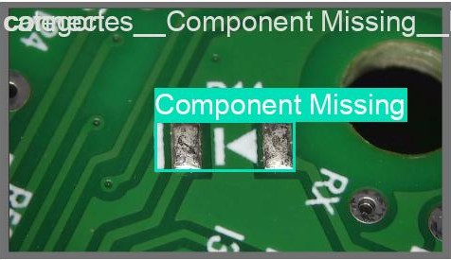
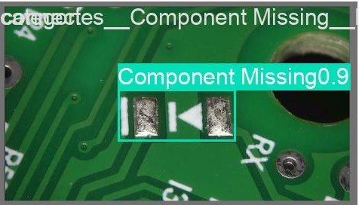
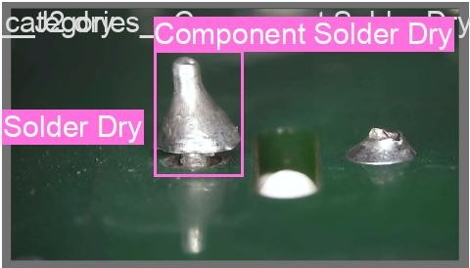
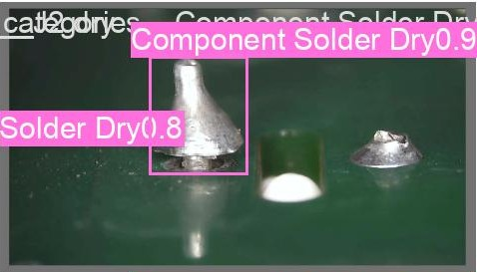


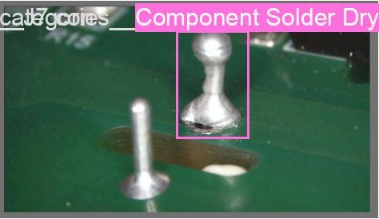
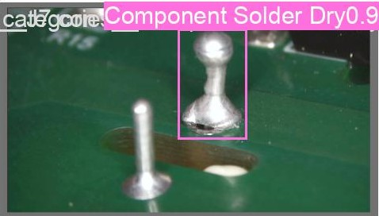
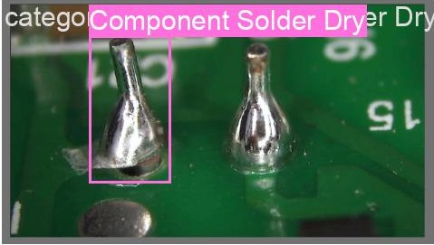
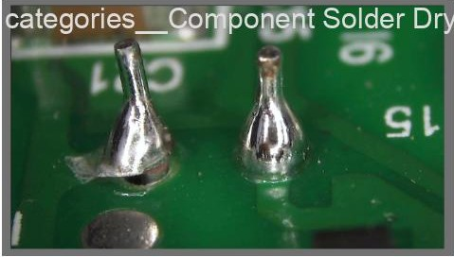
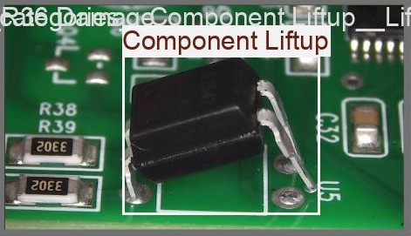
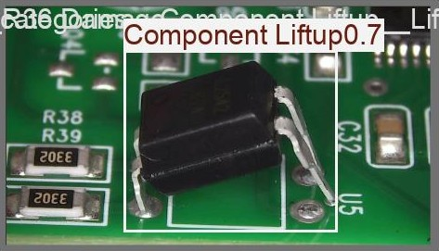
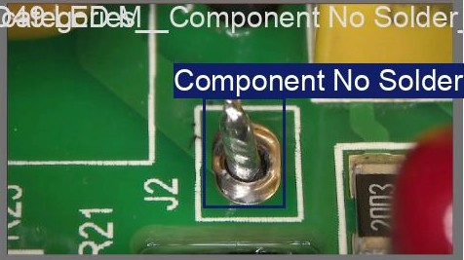
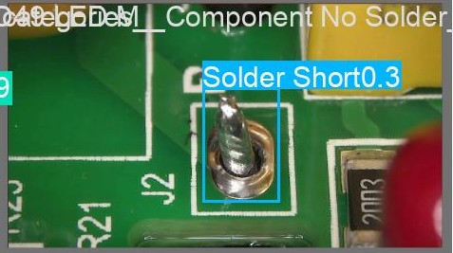
BASELINE PREDICTIONS
Baseline — ground truth vs prediction (val set)
#1
#2
Ground truth
Predicted
Ground truth
Predicted
#3
Ground truth
Predicted
Ground truth
Predicted
Ground truth
Predicted
Ground truth
Predicted
22

Slide 24
TRANSFER-LEARNING HYPOTHESIS
Can a solder-defect pretrain beat a generic start?
Next, a controlled test: does initialising from a PCB-solder dataset (SolDef_AI) transfer better than standard ImageNet/COCO weights?
A
Baseline
B
SolDef_AI pretrained
YOLO11s initialised from standard ImageNet / COCO weights, fine-tuned on our 12-class PCB dataset.
The same YOLO11s, but first pretrained on the SolDef_AI solder-defect dataset, then fine-tuned identically.
General-purpose features
Domain-specific features
Controlled comparison: A and B are identical in every way — same model, data, split, augmentation, epochs — except the initial weights. Any difference is attributable to pretraining alone.
23

Slide 25
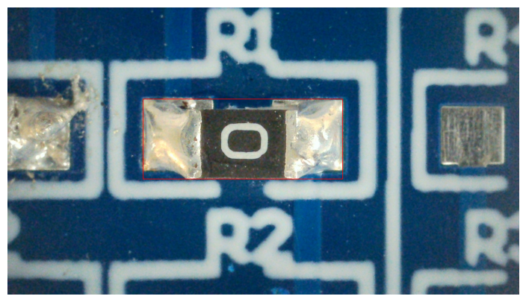
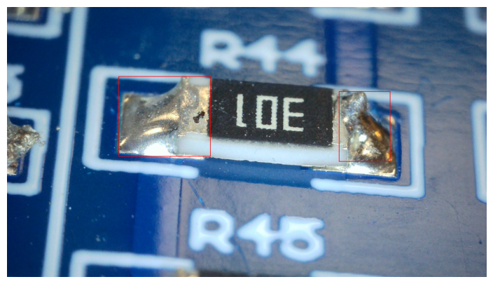
PRETRAINING SOURCE
The SolDef_AI solder-defect dataset
A public dataset of solder-joint appearance defects, used to pretrain the backbone before fine-tuning on our PCB data.
428
671
5
Classes
good · exc_solder · poor_solder · no_good · spike
Images
Annotations
Solder classes
24

Slide 26
TRAINING SETUP
Fine-tuning configuration — identical for both arms
Model
YOLO11s · 9.4M params
Why identical?
Image size
640 × 640
Both the baseline (A) and the pretrained model (B) are fine-tuned with exactly this recipe, on the same data and split.
Fine-tune epochs
150 (patience 30)
Frozen layers
10
Learning rate
0.001
The only difference is the initial weights — so any performance gap isolates the effect of pretraining alone.
Augmentation
HSV, rotate, shear, scale, flip, mosaic, copy-paste
Negatives
120 train + 30 val (non-def)
441 train · 110 val images · 12 classes · plus non-def negatives
Split
stratified by rarest class · 80/20
25

Slide 27
BASELINE VS PRETRAINED
SolDef_AI pretraining (B) underperforms baseline (A)
mAP@0.5
mAP@0.5:0.95
Precision
Recall
0.733 → 0.631
0.469 → 0.412
0.810 → 0.725
0.645 → 0.534
−0.102
−0.057
−0.085
−0.111
A = baseline (ImageNet init) · B = SolDef_AI pretrained · values are overall (all classes)
Defect class
A · mAP50
B · mAP50
Δ (B−A)
Component Crack
0.995
0.828
-0.167
Component Damage
0.109
0.008
−0.101
Component Liftup
0.682
0.365
−0.317
Component Missing
0.961
0.813
−0.148
Component No Solder
0.165
0.092
−0.073
Component Solder Dry
0.745
0.680
−0.065
LED Damage
0.995
0.995
+0.000
Polarity Wrong
0.846
0.855
+0.009
RYB Wrong Sequence
0.995
0.962
−0.033
Solder Ball
0.869
0.611
−0.258
Solder Short
0.566
0.495
−0.071
Tombstone
0.863
0.863
+0.000
26

Slide 28


INTERPRETATION
Why domain pretraining did not transfer
The hypothesis was reasonable — but the data shows it did not hold, and the pattern points to a clear cause.
SolDef_AI is small and narrow
428 images, 5 solder-appearance classes on one board type — too limited to learn broadly useful features.
Pretraining over-specialised the backbone
100 epochs on that narrow set displaced the broad, general-purpose features that ImageNet initialisation provides.
Label spaces do not align
SolDef_AI labels solder-joint quality; our task is component-level defects (missing, liftup, crack, polarity) — different concepts.
The drop is near-uniform
mAP@0.5 fell ~10 pts across almost every class — including the solder classes themselves, ruling out a "solder features transferred" story.
Takeaway: pretraining on a small, narrow domain dataset can hurt — a broad ImageNet start generalised better for our diverse defect classes.
29

Slide 29
REFINING THE BENCHMARK
Narrowing to 8 well-populated classes
Four classes had too few validation instances (≤2) to give reliable per-class numbers. Restricting to the 8 well-populated classes yields a trustworthy benchmark.
Kept · 8 classes
Dropped · 4 rarest
Solder Short
Component Solder Dry
Too few instances for meaningful per-class evaluation:
Component No Solder
Component Missing
Component Crack
8 inst
Component Damage
9 inst
Solder Ball
Polarity Wrong
LED Damage
7 inst
RYB Wrong Sequence
Component Liftup
Tombstone
15 inst
8-class dataset: 508 images · 565 annotations · 407 train / 101 val images (plus 96 train + 24 val non-def negatives).
30

Slide 30
8-CLASS BASELINE
A solid, well-behaved 8-class baseline
YOLO11s at 640px, 150 epochs, with negatives. Overall metrics and per-class mAP@0.5 on the 101-image validation set.
mAP@0.5
mAP@0.5:0.95
Precision
Recall
0.757
0.524
0.799
0.743
Defect class
mAP@0.5
mAP@0.5 (bar)
Component Missing
0.962
Component Solder Dry
0.796
Solder Ball
0.844
Component Liftup
0.845
RYB Wrong Sequence
0.824
Solder Short
0.707
Polarity Wrong
0.653
Component No Solder
0.424
Per-class values are mAP@0.5. Component No Solder is the hardest class (low-contrast, ambiguous).
31

Slide 31
RESOLUTION EXPERIMENT
Higher resolution does not help — 640px wins
Retraining at 640 / 960 / 1280px with everything else identical. Per-class values are mAP@0.5:0.95.
Defect class
640
960
1280
Component Liftup
0.583
0.576
0.552
Verdict
Component Missing
0.728
0.665
0.728
Component No Solder
0.310
0.130
0.260
640px is the right choice.
Component Solder Dry
0.576
0.473
0.585
Polarity Wrong
0.562
0.597
0.303
960px is within noise on mAP@0.5 and worse on the stricter mAP@0.5:0.95. 1280px is worse on both.
RYB Wrong Sequence
0.553
0.579
0.404
Solder Ball
0.425
0.411
0.415
Solder Short
0.453
0.452
0.442
mAP@0.5 (mean)
0.757
0.763
0.725
Resolution is not the bottleneck — and 640px trains fastest.
mAP@0.5:0.95
0.524
0.485
0.461
32

Slide 32
CROSS-VALIDATION
5-fold CV: the benchmark is real, not luck
Training five times on different folds gives every metric an error bar — the real measurement uncertainty.
mAP@0.5
mAP@0.5:0.95
Precision
Recall
0.761
0.500
0.789
0.718
± 0.021
± 0.020
± 0.040
± 0.030
5-fold cross-validation · YOLO11s · 640px · 8 classes
Two things this proves: (1) the single-split baseline (0.757) sits right inside 0.761 ± 0.021 — it was a real, stable result. (2) The resolution differences (≤ 0.04) fall within one std, so they are noise — 640px is confirmed as the right choice.
33

Slide 33
TOWARD TRANSFORMERS
Two detector paradigms: CNN vs. transformer
Defect detection is an object-detection problem — every defect needs a box (where) and a class (what). Two architectural families solve it very differently.
CNN detectors · YOLO family
Detection transformers · DETR family
Image
Image
↓
↓
CNN backbone
Backbone
↓
↓
Grid + anchor boxes
Transformer encoder (self-attention)
↓
↓
NMS (duplicate removal)
Object queries → set prediction
↓
↓
Boxes
Boxes · no NMS
Local receptive field — weak at global, relational defects
Global self-attention — captures relational defects
Hand-tuned components (anchors, thresholds)
End-to-end: no anchors, no NMS
Duplicate-suppression (NMS) is brittle on dense boards
Duplicates removed by design (bipartite matching)
34

Slide 34



TOWARD TRANSFORMERS
Why transformers fit PCB defects better
The transformer’s properties line up directly with what makes assembled-PCB defects hard for CNN detectors.
Global context via self-attention
No anchors, no NMS
Many defects are relational — a solder short is "two pads that should be separate, connected"; a tombstone is defined by pose relative to both pads; polarity by orientation vs. footprint. Self-attention reasons across the whole board in one step.
Set prediction removes the two hand-tuned heuristics that fail on dense, overlapping, multi-scale boards — where anchors and NMS wrongly merge or split nearby detections.
Native multi-scale
Scales with data
Defects span a sub-millimetre solder ball to a whole missing component in one image. Deformable multi-scale attention handles this extreme size range — arguably the single most important property for PCBs.
Weaker built-in assumptions than CNNs means transformers keep improving as data grows, where CNNs tend to plateau — a strong fit for a scaling PCB-inspection dataset.
35

Slide 35
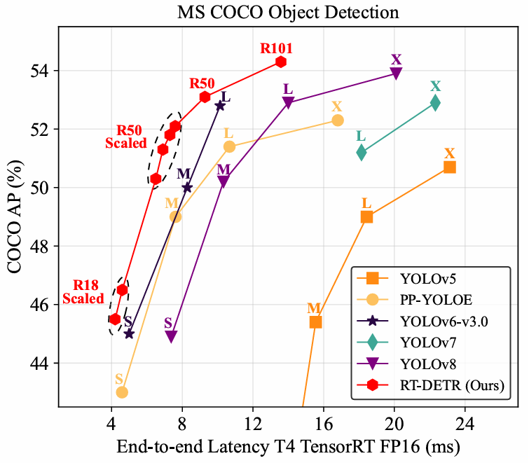

RT-DETR
RT-DETR: real-time detection transformer
The first end-to-end DETR fast enough for real-time use (Baidu, CVPR 2024) — the base architecture for our transformer experiments.
[ Figure 1 ]
Accuracy vs. latency —
RT-DETR sits above the YOLO curve
Removes NMS — end-to-end, no post-processing
Real-time speed — matches YOLO latency
Beats YOLO — higher accuracy at equal latency
Source: Zhao et al., CVPR 2024
Zhao et al., "DETRs Beat YOLOs on Real-time Object Detection", CVPR 2024

Slide 36
MOTIVATION
Why RT-DETR: two problems it solves at once
YOLO is fast but needs NMS; earlier DETRs dropped NMS but were too slow to run in real time. RT-DETR fixes both.
Problem 1 · YOLO needs NMS
Problem 2 · DETRs were too slow
Runs after every inference — extra latency that grows with box count
Earlier DETRs already removed NMS — but at high computational cost
Confidence / IoU thresholds trade recall vs. precision
Their multi-scale encoder is the bottleneck (heavy attention)
Thresholds are hand-tuned per dataset — brittle and unstable
So the NMS-free advantage was never usable in real time
RT-DETR’s answer: set prediction removes NMS (no duplicates by design, no thresholds), and an efficient hybrid encoder cuts the DETR compute cost — making it the first DETR that is both NMS-free and genuinely real-time.
37

Slide 37
ARCHITECTURE
How RT-DETR works — four stages
An image flows through four stages. The efficient hybrid encoder is the key innovation that makes a transformer detector real-time.
1
2
3
4
Backbone
Hybrid encoder
Query selection
→
Decoder + heads
→
→
ResNet extracts features at three scales (S3, S4, S5) from the image.
AIFI adds global context on the deepest map; CCFF fuses scales efficiently. This is what keeps it fast.
Uncertainty-minimal selection picks the best encoder features as initial object queries.
The decoder refines queries into final boxes and defect classes — no NMS needed.
Our training configuration
Model rtdetr-l (HGNetv2 backbone) Image 640px Epochs 150 (patience 30) Batch 8 LR 1e-4 (AdamW-style)
Augmentation HSV, rotate 15°, shear 10°, scale 0.5, flips, mosaic Data 8 classes · 150 negatives · same stratified split & recipe as YOLO
38

Slide 38
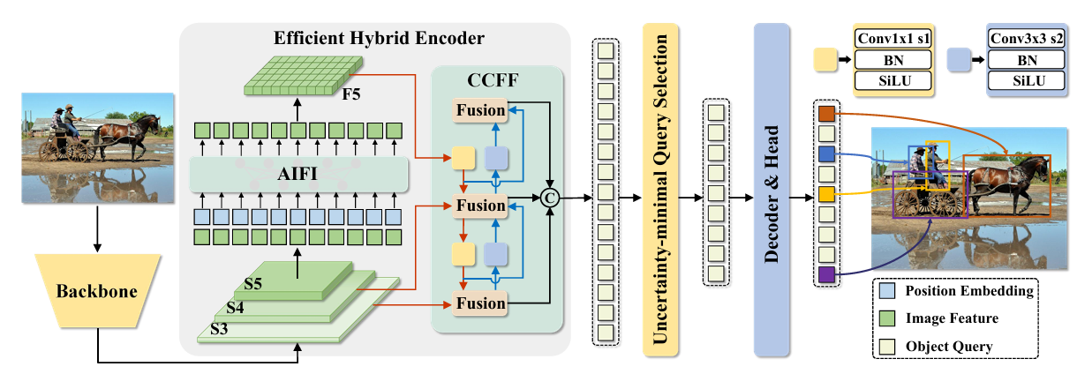

ARCHITECTURE
RT-DETR architecture — full overview
Reading the diagram
Backbone
feeds three feature scales (S3, S4, S5) into the encoder
AIFI
self-attention on S5 only — the deepest, most semantic map (lower maps aren’t worth it)
CCFF
[ Figure 4 — Overview of RT-DETR ]
fuses scales via lightweight fusion blocks (RepBlocks)
Source: Zhao et al., "DETRs Beat YOLOs on Real-time Object Detection", CVPR 2024
Query selection
picks queries by aligning classification and localization confidence
Decoder
refines queries into boxes + classes — NMS-free
39

Slide 39
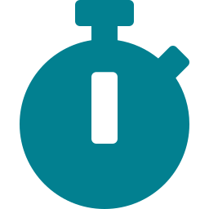


THE TRADE-OFF WIN
Transformer accuracy at near-YOLO cost
RT-DETR’s thesis: for a given inference latency, it reaches higher accuracy than YOLO — while training at nearly the same speed. Our own run bears this out.
Training time
Inference
Fair comparison
~29 min
33.6 ms
Same recipe
vs YOLO ~26 min — only ~3 min (~11%) longer for the full 150 epochs, despite being a heavier transformer.
≈ 30 FPS per image on our setup — genuinely real-time detection.
640px, 150 epochs, identical data, split, batch and augmentation as the YOLO baseline.
Total training time — 150 epochs (lower = faster · estimated)
RT-DETR
~29 min
YOLO
~26 min
The takeaway: RT-DETR delivers transformer-grade detection at near-YOLO training cost and real-time inference — the "no compromise" result the paper promises, reproduced on our own setup.
40

Slide 40

RESULTS
RT-DETR on our 8-class PCB dataset
RT-DETR beats the YOLO baseline on every metric — most clearly on the stricter mAP@0.5:0.95 (tighter boxes).
mAP@0.5
mAP@0.5:0.95
Precision
Recall
YOLO 0.757 RT-DETR 0.770
YOLO 0.524 RT-DETR 0.556
YOLO 0.799 RT-DETR 0.807
YOLO 0.743 RT-DETR 0.749
+0.013
+0.032
+0.008
+0.006
Defect class
mAP@0.5
Component Missing
0.984
Why the gains are modest
RYB Wrong Sequence
0.928
Solder Ball
0.860
RT-DETR’s edge comes from a weaker inductive bias that needs large data to pay off. On only ~550 images it is data-starved, so it can’t show the decisive margin it reaches on large benchmarks.
Component Liftup
0.796
Component Solder Dry
0.776
Solder Short
0.747
Polarity Wrong
0.678
Even so, it already matches and slightly beats YOLO — with far more headroom as data scales.
Component No Solder
0.391
Per-class values are mAP@0.5.
41

Slide 41
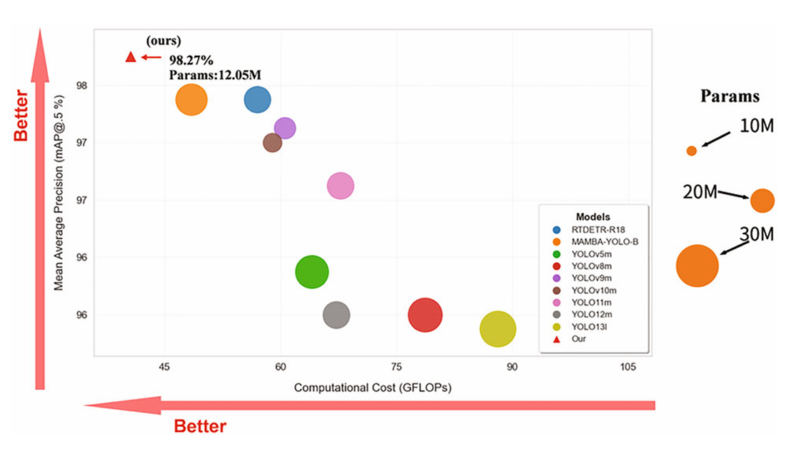
GMO-DETR
GMO-DETR: a lightweight RT-DETR for PCBA defects
Purpose-built for assembled-PCB inspection (J. Real-Time Image Processing, 2026) — the current state of the art for this exact task.
[ Figure 2 ]
Accuracy vs. computational cost —
GMO-DETR in the upper-left corner
98.27% mAP@0.5 — best accuracy on PCBA-DET
12.05M params — 39.4% smaller than RT-DETR
40.6 GFLOPs — 28.8% less computation
Source: Su et al., JRTIP 2026
Su et al., "GMO-DETR: a lightweight transformer for accurate and efficient PCBA defect detection", JRTIP 2026

Slide 42
GMO-DETR
Four targeted changes to RT-DETR
GMO-DETR keeps RT-DETR’s end-to-end design and replaces four components — each chosen to cut computation while improving sensitivity to small, low-contrast defects.
Component
RT-DETR uses
GMO-DETR uses
What it does
Backbone
ResNet / HGNetv2
GMONet
GhostConv stem + dual-path MambaOut blocks
Encoder attention
AIFI (self-attention)
TAIFI
token-statistics attention, linear complexity
Neck fusion
RepC3
CAFF
multi-branch fusion + directional attention
Neck convolutions
standard Conv
GSConv
group-shuffle convolutions
The design goal: together these reduce parameters by 39.4% and computation by 28.8% versus RT-DETR — while raising mAP@0.5 — making the model deployable on edge hardware in a factory.
43

Slide 43
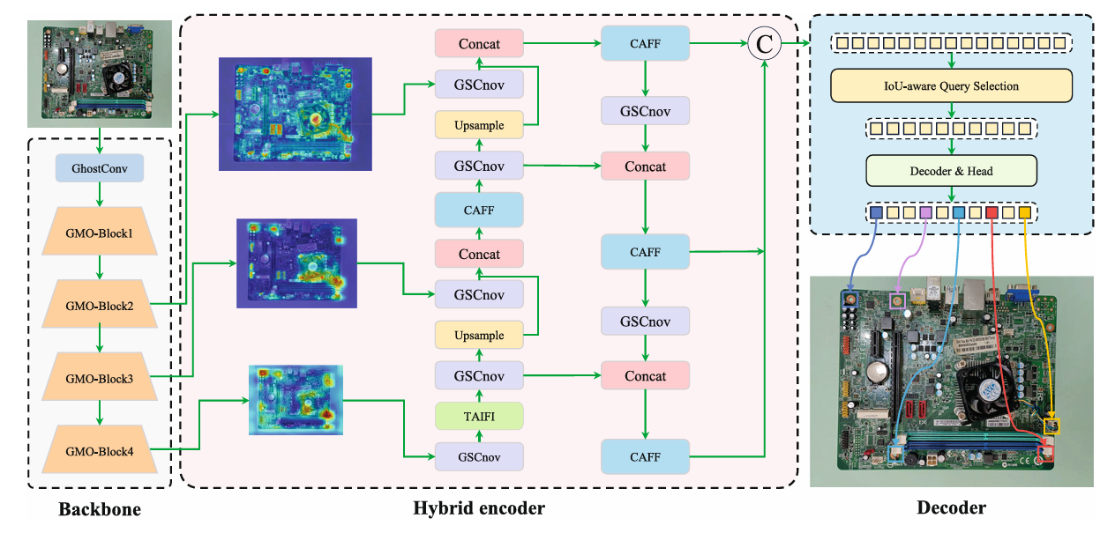
ARCHITECTURE
GMO-DETR architecture — full overview
Reading the diagram
Backbone
GhostConv stem → GMO-Block1–4, emitting three feature scales
TAIFI
statistical attention on the deepest map
CAFF
[ Figure 1 — Architecture of the GMO-DETR network ]
context-aware fusion at each scale junction
Source: Su et al., JRTIP 2026
GSConv
every neck convolution, for a uniform lightweight neck
Decoder
IoU-aware query selection → boxes + classes
44

Slide 44
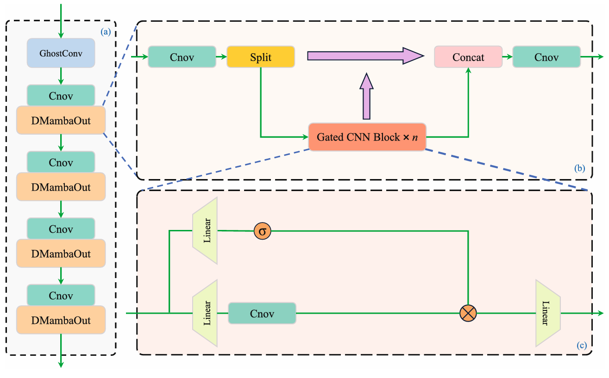
MODULE 1 OF 4
GMONet — the backbone
1
How it works
GhostConv at the input only
the raw image is the most redundant stage, so cheap operations save the most here
Dual-path blocks deeper in
[ Figure 3 ]
one path models long-range context; a shortcut path carries detail straight through
GMONet structure — backbone, DMambaOut, and the Gated CNN block
Replaces the ResNet backbone
fewer parameters, without flattening fine structure
Source: Su et al., JRTIP 2026
What it buys us: Subtle defect signatures survive to the deep layers instead of being washed out — the shortcut path is what preserves them.
45

Slide 45
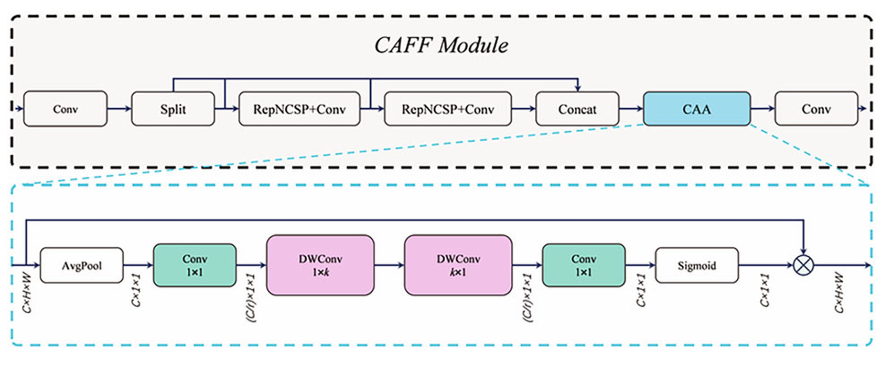
MODULE 2 OF 4
CAFF — context-aware feature fusion
2
How it works
Replaces the static fusion block
a multi-branch structure aggregates features along better gradient paths
Context Anchor Attention on top
[ Figure 5 ]
pools context, then applies horizontal and vertical strip convolutions
CAFF module — multi-branch aggregation refined by Context Anchor Attention
Produces a saliency map
discriminative regions amplified, busy background suppressed
Source: Su et al., JRTIP 2026
What it buys us: Directional sensitivity — well matched to elongated defects such as circuit traces and hairline cracks.
46

Slide 46
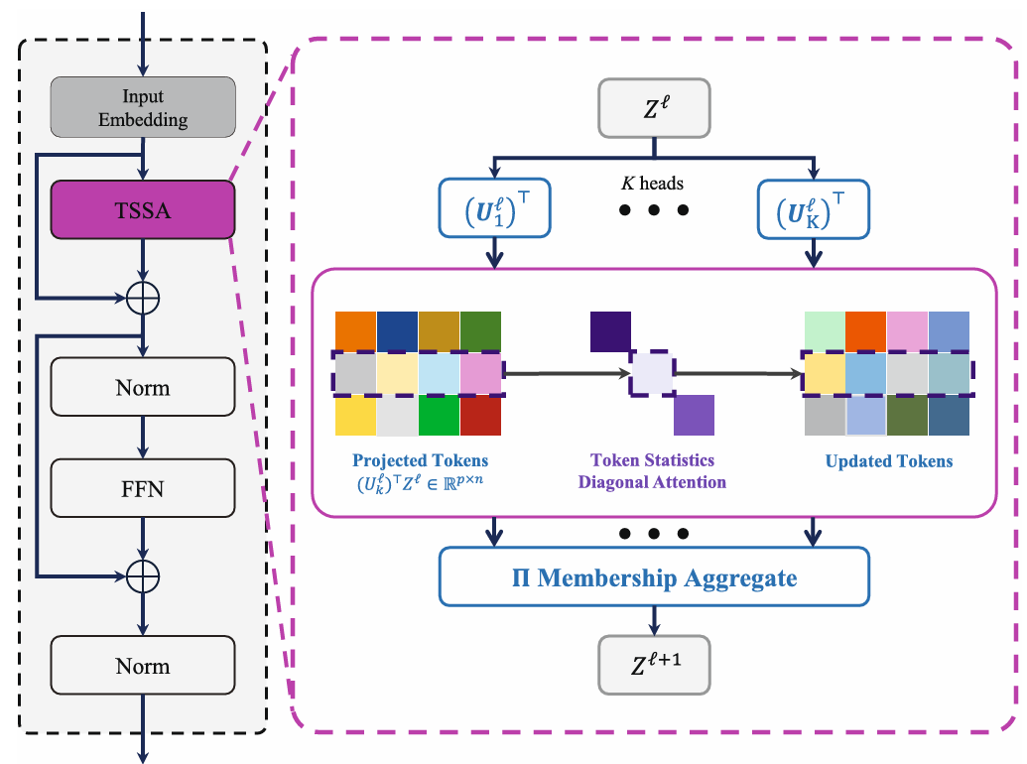
MODULE 3 OF 4
TAIFI — token-statistics attention
3
How it works
Standard self-attention is quadratic
cost explodes on high-resolution boards, and faint anomalies get diluted
Scores tokens statistically instead
[ Figure 6 ]
how far each token deviates from the overall feature distribution
TAIFI module — low-rank projection heads and statistical token weighting
Linear cost in sequence length
no all-pairs comparison is ever computed
Source: Su et al., JRTIP 2026
What it buys us: Better at surfacing low-contrast defects — micro-voids and hairline cracks against a noisy substrate.
47

Slide 47
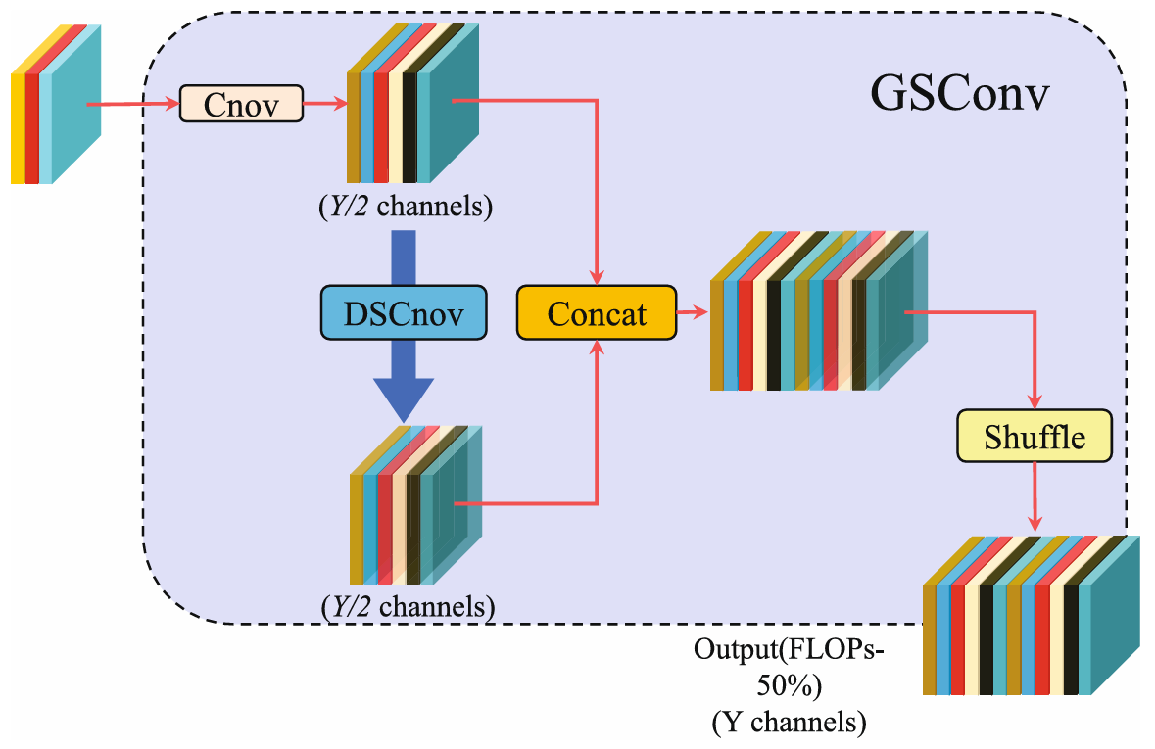
MODULE 4 OF 4
GSConv — lightweight neck convolutions
4
How it works
Two branches instead of one
a standard convolution and a depthwise convolution, each producing half the channels
Concatenate, then channel-shuffle
[ Figure 4 ]
mixing is preserved despite the split
GSConv — standard and depthwise branches, concatenated and channel-shuffled
Used at every neck stage
a uniform lightweight neck rather than a patchwork
Source: Su et al., JRTIP 2026
What it buys us: Roughly half the computation of a standard convolution, with feature fusion quality intact.
48

Slide 48



PUBLISHED RESULTS
State of the art on PCBA-DET
The paper’s benchmark on 6,384 assembled-motherboard images. GMO-DETR leads on accuracy and efficiency simultaneously.
Model
FPS
P (%)
R (%)
F1
mAP@0.5
mAP@.5:.95
Params(M)
GFLOPs
Size(MB)
YOLO11m
148.01
95.34
94.93
95.12
97.27
58.98
20.03
67.7
38.7
RT-DETR
87.57
96.61
96.19
96.39
97.96
58.81
19.88
57.0
77.0
GMO-DETR
86.62
97.10
96.81
96.95
98.27
58.08
12.05
40.6
46.5
Bold = best of the three. GMO-DETR wins 6 of 9: precision, recall, F1, mAP@0.5, parameters and GFLOPs.
Best accuracy
Best efficiency
Statistically verified
Highest precision, recall, F1 and mAP@0.5 — the primary industrial metric.
Smallest model (12.05M) and lowest computation (40.6 GFLOPs) of the three.
5 independent runs: 98.29% ± 0.128%; Wilcoxon test p = 0.031 vs the baseline.
49

Slide 49



OUR IMPLEMENTATION
Rebuilding GMO-DETR from the paper
The authors released no code. The entire architecture was reconstructed from the paper’s equations and figures, then integrated into a working detector.
Four modules implemented from scratch
GMONet (GhostConv stem, GMO-Blocks, dual-path DMambaOut, Gated CNN blocks), CAFF with Context Anchor Attention, TAIFI with token-statistics attention, and GSConv.
Each module checked against its original source
The gated block against MambaOut, the attention block against the Context Anchor Attention paper, and the token-statistics attention against its reference implementation — rather than inferred from equations alone.
Integrated into a working detector
Registered as custom modules inside the Ultralytics framework and expressed as a full model definition on top of RT-DETR, so the decoder, query selection and detection loss are the proven originals.
Outcome: a complete, trainable GMO-DETR — reproduced independently from a paper with no public implementation.
50

Slide 50
OUR RESULTS
GMO-DETR trained on our PCB dataset
Trained with the paper’s configuration on our 12-class dataset: 640px, 200 epochs, batch 8, AdamW, lr 1e-4 · 2.6 hours on a single GPU · 19.3 ms inference.
mAP@0.5
mAP@0.5:0.95
Precision
Recall
0.534
0.350
0.682
0.408
Defect class
mAP@0.5
tombstone
0.995
Why below the published figure
ryb_wrong_sequence
0.895
component_crack
0.830
component_solder_dry
0.677
The paper reaches 98.27% on 6,384 images. We trained on 441. A lightweight transformer with four new modules is the most data-hungry model we have tried — it cannot converge to its potential on a set this small.
polarity_wrong
0.582
component_missing
0.567
solder_short
0.517
solder_ball
0.479
led_damage
0.398
component_no_solder
0.344
The architecture is proven and trains stably — the bottleneck is data, not the implementation.
component_liftup
0.117
component_damage
0.000
Per-class mAP@0.5 · 12 classes · 110 validation images
51

Slide 51
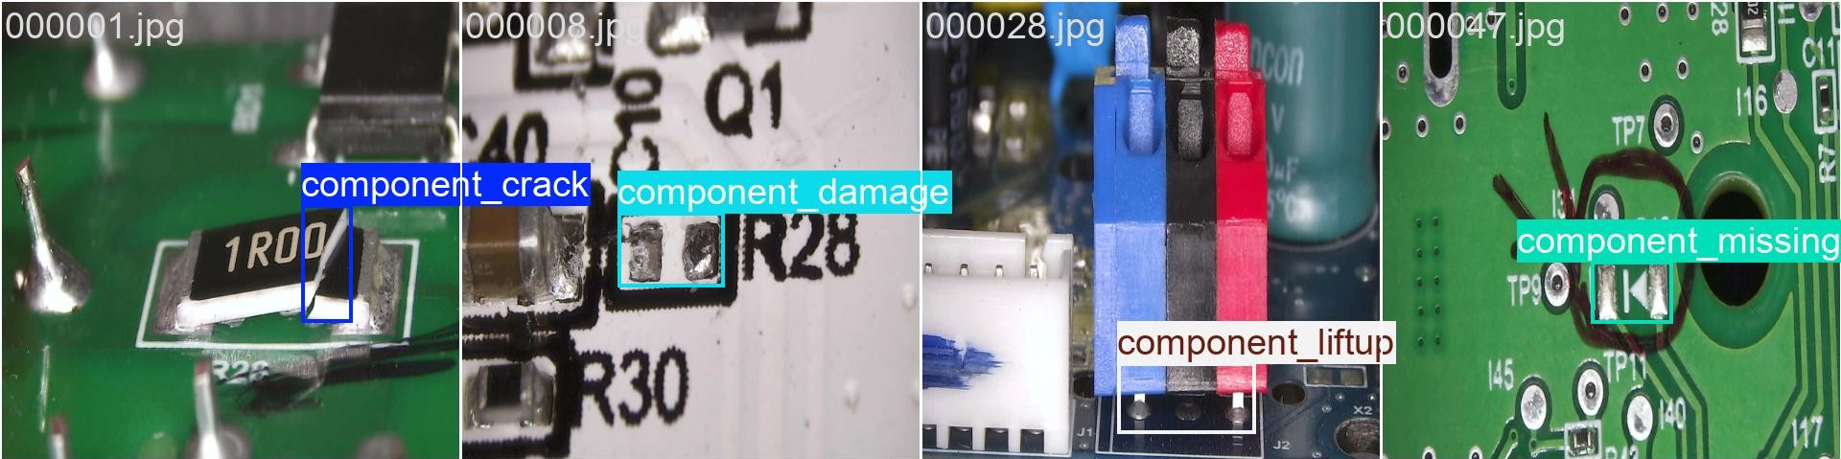
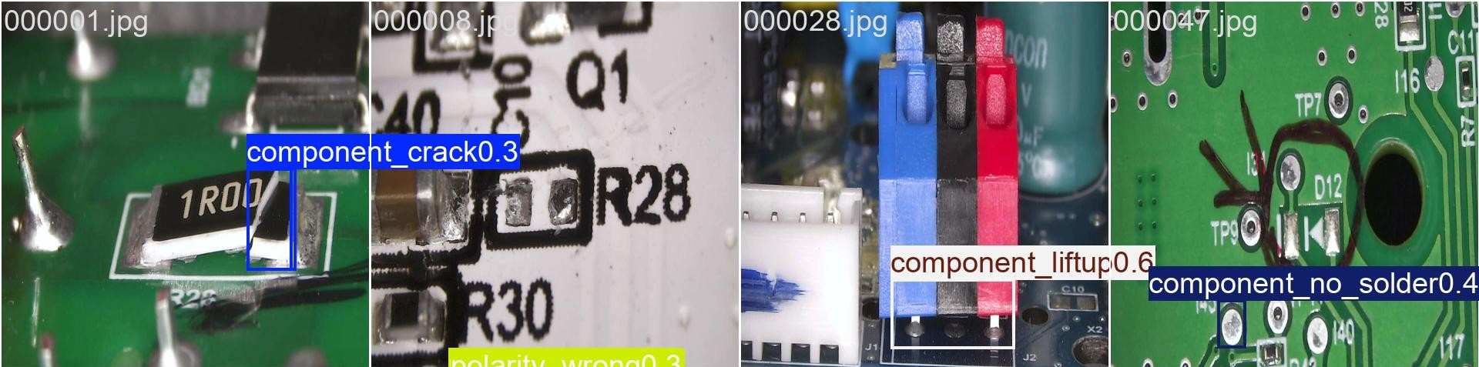
GMO-DETR PREDICTIONS
GMO-DETR — ground truth vs prediction (val set)
52

Slide 52
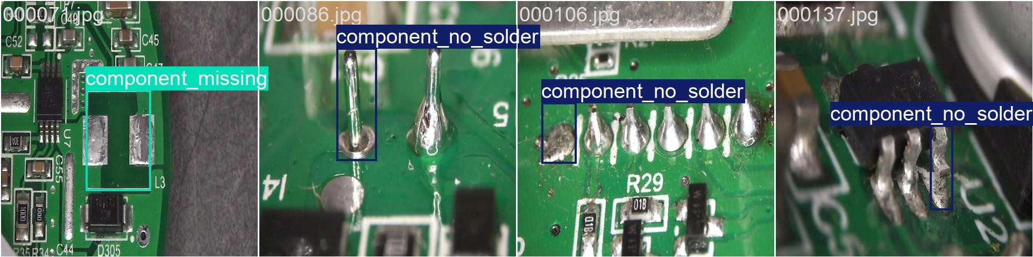
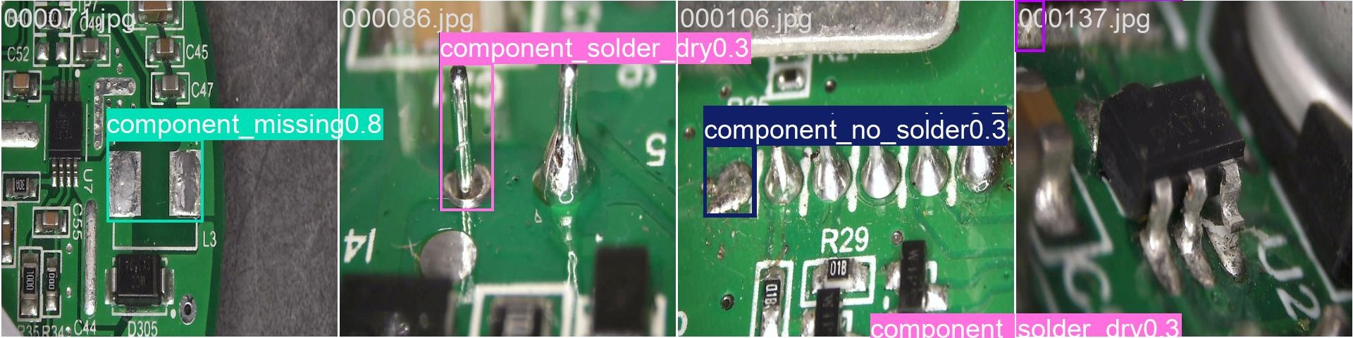
GMO-DETR PREDICTIONS
GMO-DETR — ground truth vs prediction (val set)
52

Slide 53
Thank you
Questions and discussion welcome
PCB Defect Detection · Imaging front-end and deep-learning detection pipeline

