Slide 1
Music Recommendation System
Group Name: KHVM
Meet Kadiya (AU1841099)
Kahaan Patel (AU1841110)
Vidit Vaywala (AU1841128)
Hemil Shah (AU1841135)

Slide 2
Introduction
Recommender system is a system that seeks to predict or filter preference according to the user’s different choices.
Music recommendation system is a system which learns from user preferences and data and recommends songs after evaluating that data.
In this first phase of the project, we have build a recommender system using k-nearest neighbors algorithm.
In the second phase of the project, we tried to improve and make our recommendation system more personalized by using the Singular Value Decomposition algorithm.
Our dataset consists of 2 million records containing user ids, song ids and the number of times a user has listened to a particular song.

Slide 3
Problem Statement
We are aiming to build a music recommendation system that uses collaborative filtering and machine learning algorithms like K-nearest neighbors and Singular Value Decomposition (SVD) to recommend songs to user based on their preferences.

Slide 4
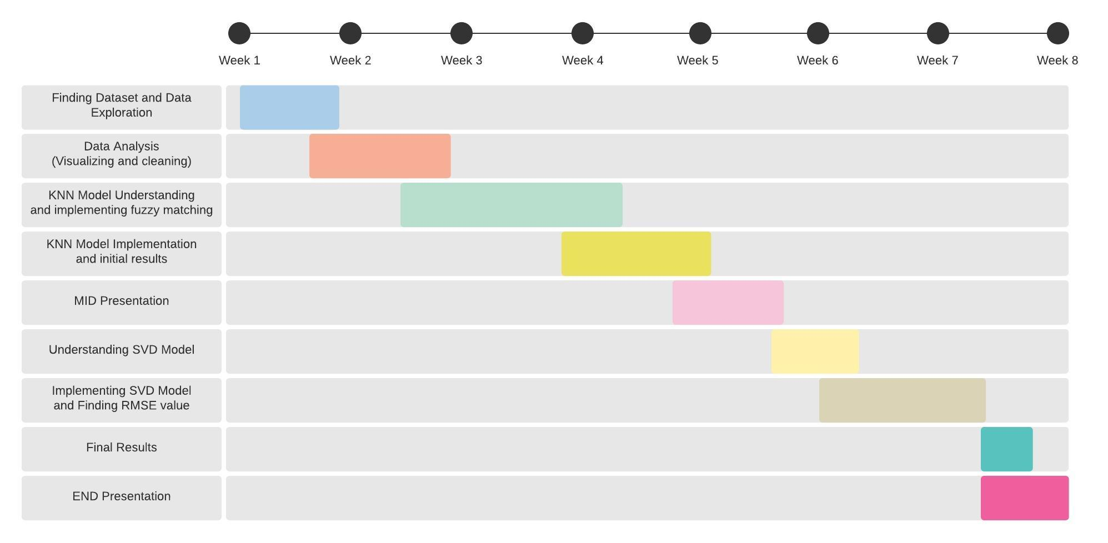
GANTT chart

Slide 5
Existing body of work
We referred to some articles that implemented a music recommendation system using classification algorithms and we decided to go ahead with creating our Music recommendation system using the K-Nearest Neighbours algorithm.
We explored the K-nearest neighbor algorithm in detail. When KNN makes a song prediction, it calculates the "distance" between the target song and every other song in its database. It then ranks the songs based on their distances and returns the top k as the most similar song recommendations.
The k-nearest neighbours (KNN) algorithm relies on item feature similarity

Slide 6
Existing body of work
In the post mid semester part of the project, we wanted to make our system more personalized and better and hence we built it using another algorithm - Singular Value Decomposition.
SVD is a collaborative filtering technique which is used in the recommender system. SVD uses a matrix structure where each row and column represents as a user and item
The aim of singular value decomposition is to minimise a dataset with a large number of values to a dataset with considerably fewer values while also retaining a substantial portion of the original data's heterogeneity.

Slide 7
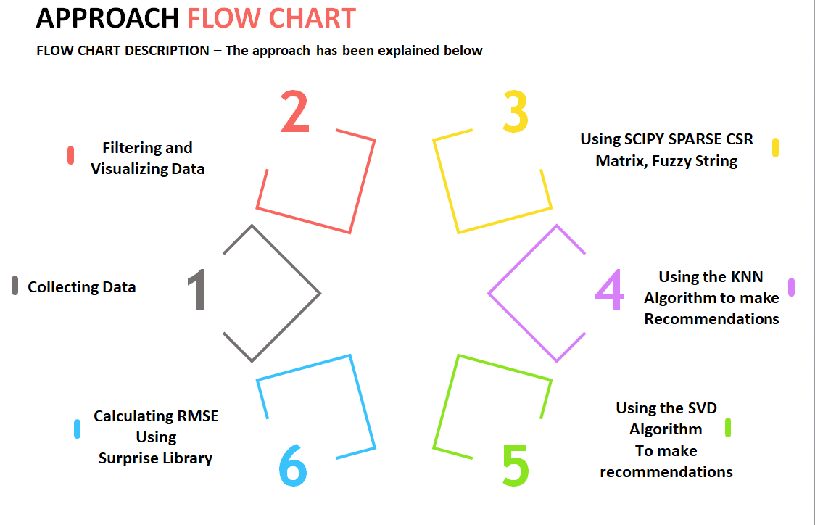
Approach

Slide 8
In detailed Approach
Collecting Data - We have used the million song dataset that is available online for developing our model. It consists of users id, songs id ,title ,author and how many times a user has listened to a song.
Filtering and Visualizing data - Using the Pandas and the seaborn library we filtered out the dataset and then explored its characteristics after visualizing it using boxplots, histograms, etc.
Using Scipy Sparse CSR Matrix and Fuzzy String Matching- A lot of values in our matrix are 0 and hence we are dealing with an extremely sparse matrix. We will use the CSR matrix to represent our sparse matrix.When a user enters a song's name partially correctly then our fuzzy matcher matches the user's input to all the songs in our database. And then it selects the song with the highest ratio.

Slide 9
In detailed Approach
For example, if the user enters “Mary mee” instead of “Marry me(this is the actual song name)” then the fuzzy matcher will understand that the user wanted to select the song “Marry me”.
4. Using KNN algorithm to make predictions and Getting the Recommendations - Using the scikit-learn library we used the k-nearest neighbor algorithm to find the best recommendations to a particular song that user inputted. Our model provides recommendations to the user based on evaluation of the k-nearest neighbors of our input song.
5. Using SVD algorithm to make predictions - We are using the scipy.sparse.linalg.svds to find SVD values of our matrix. This gives us 3 matrix u,s,v_T which gives us ratings for every user’s listen count.Then we define our own function for getting

Slide 10
In detailed Approach
recommendation from user id. Here we take user id from user and the number of song user wants to get as recommendations and then using our own function we give the recommendations to user.
6. Calculating RMSE using surprise library - We are using the surprise library for finding RMSE value. In surprise library we have to insert which algorithm we want to use, so here we give input of algorithm as SVD and metric as RMSE value. Then surprise.GridSearchCV will give us the best parameters and then we use k-fold cross_validate function to find best value for RMSE , train and test time. Finally using the accuracy function we will get best accuracy of our model using surprise library.

Slide 11
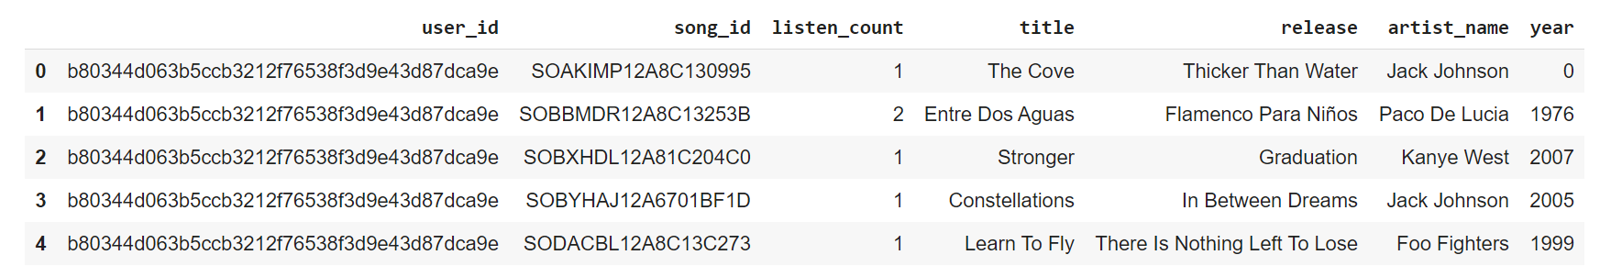
Final Results (1)
Dataset

Slide 12
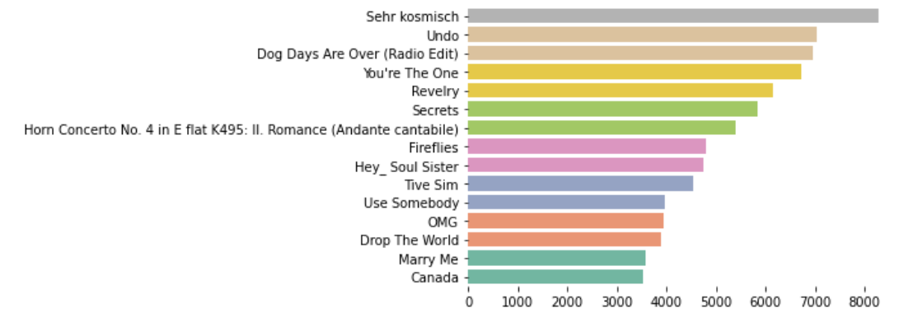
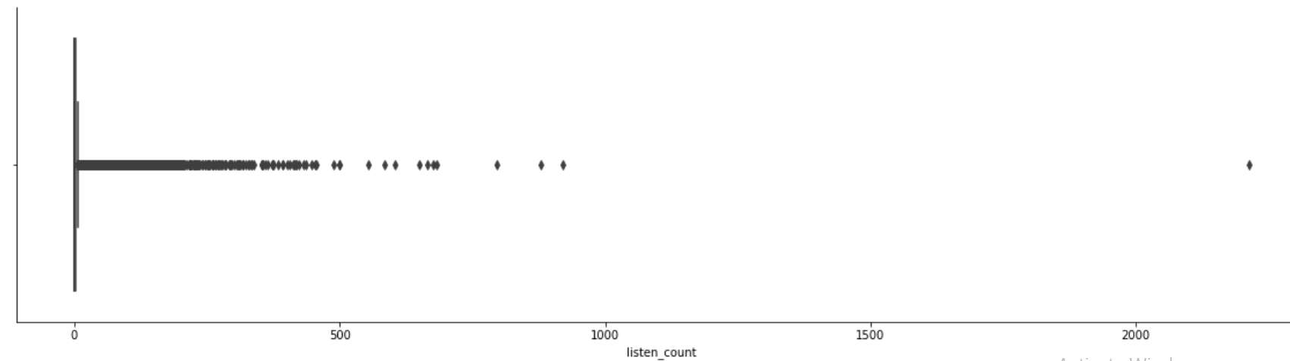
Final Results (2)
Filtering and Visualization

Slide 13
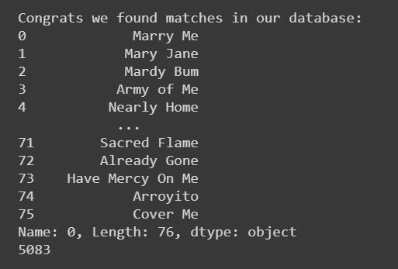
Final Results (3)
Using Fuzzy Matching

Slide 14
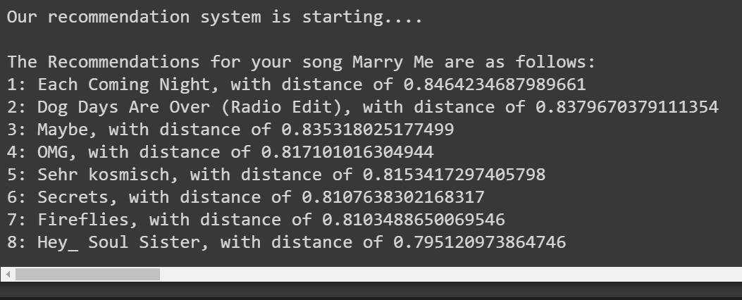
Final Results (4)
Recommendation using KNN

Slide 15
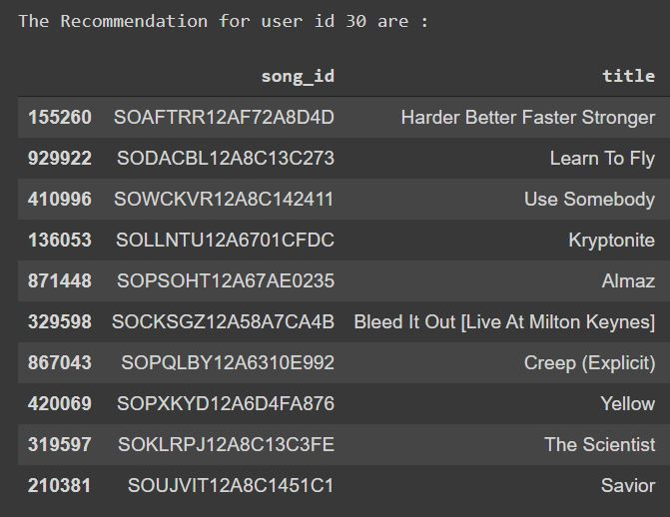
Final Results (5)
Recommendation using SVD

Slide 16
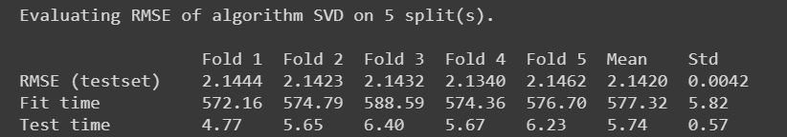
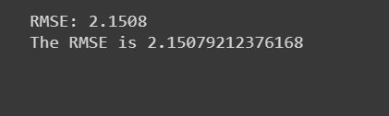
Final Results (6)
RMSE using surprise

Slide 17
Conclusion
In the first phase of the project, we successfully build a recommendation system using the K-nearest neighbors algorithm.
In the second phase of our project, we wanted to make this recommendation system more personalized and hence we used the Singular Value Decomposition (SVD) algorithm to build it.
We were able to get good results from the recommendation system using both the KNN and SVD algorithms.
The future work in this project is to try and predict a user’s emotion and then recommend appropriate songs to him/her.

Slide 18
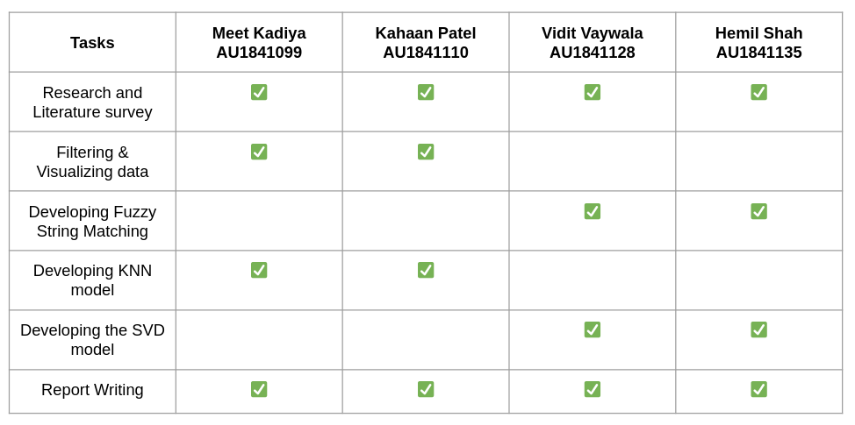
Role of each group member

Slide 19
References
B. Srebrenik, “Introduction to Music Recommendation and Machine Learning,” Medium, 04-Dec-2018. [Online]. Available: https://medium.com/@briansrebrenik/introduction-to-music-recommendation-and-machine-learning-310c4841b01d#:~:text=These%20music%20recommendation%20systems%20are,comes%20to%20a%20certain%20item.&amp;text=These%20two%20classes%2C%20or%20approaches,Filtering%20and%20Content%20Based%20Filtering. [Accessed: 17-Mar-2021].
“Using KNN algorithm for classification of textual documents,” IEEE Xplore. [Online]. Available: https://ieeexplore.ieee.org/abstract/document/8079924/?casa_token=35bn2HhwmIMAAAAA%3AVpJ_PGOtzqnKRqKBM68rdV0f81Kn73IUTSHMrOrPfXMVSMnNNbB68SDpo2i2shlczwjd7Dqd5lx6d8w. [Accessed: 17-Mar-2021]
C.-S. Mike Wu and D. Garg, “Movie Recommendation System Using Collaborative FilteringChing-Seh Mike Wu,” IEEE Xplore. [Online]. Available: https://ieeexplore.ieee.org/document/8663822. [Accessed: 17-Mar-2021].
A. Nguyen, “Singular Value Decomposition in Recommender Systems,” Home, 19-May-2016. [Online]. Available: https://repository.tcu.edu/handle/116099117/11320. [Accessed: 11-Apr-2021].

Slide 20
Thank You

