Slide 1
Music Recommendation System
Group Name: KHVM
Meet Kadiya (AU1841099)
Kahaan Patel (AU1841110)
Vidit Vaywala (AU1841128)
Hemil Shah (AU1841135)

Slide 2
Introduction
Recommender system is a system that seeks to predict or filter preference according to the user’s different choices.
Music recommendation system is a system which learns from user preferences and data and recommends songs after evaluating that data.
In this first phase of the project, we have build a recommender system using k-nearest neighbors algorithm.
Our dataset consists of 2 million records containing user ids, song ids and the number of times a user has listened to a particular song.

Slide 3
Problem Statement
We have divided our problem statement into three phases-
First phase - building a simple recommendation system using the k-nearest neighbors way of classification.
Second phase - improving the model built in the first phase and checking how other algorithms or hyperparameters help us in improving our developed model.
Third phase - Working on the second part of our problem statement that deals with identifying user’s mood using Support Vector Machine and then recommending songs to users.

Slide 4
Existing body of work
We referred to some articles that implemented a music recommendation system using classification algorithms and we decided to go ahead with creating our Music recommendation system using the K-Nearest Neighbours algorithm.
After completing the above task we wanted to build a music recommender system using Support Vector Machines that identifies user’s emotions and then recommends songs to them.
We researched and found out that almost all of these user emotion detection system are build using deep learning and hence we decided to try and implement one using the Support Vector Machine Algorithm of machine learning

Slide 5
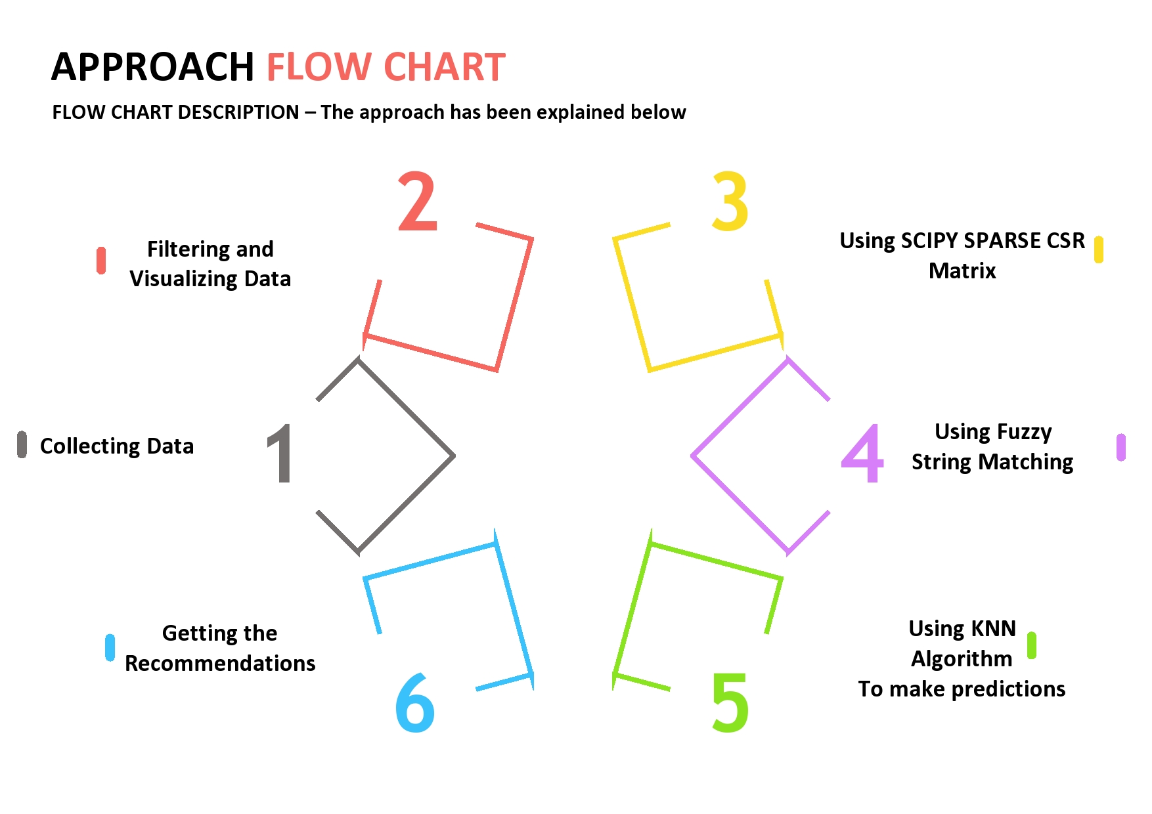
Approach

Slide 6
In detailed Approach
Collecting Data - We have used the million song dataset that is available online for developing our model. It consists of users id, songs id ,title ,author and how many times a user has listened to a song.
Filtering and Visualizing data - Using the Pandas and the seaborn library we filtered out the dataset and then explored its characteristics after visualizing it using boxplots, histograms, etc.
Using Scipy Sparse CSR Matrix - A lot of values in our matrix are 0 and hence we are dealing with an extremely sparse matrix. We will use the CSR matrix to represent our sparse matrix.

Slide 7
In detailed Approach (2)
4. Using Fuzzy String Matching - When a user enters a song's name partially correctly then our fuzzy matcher matches the user's input to all the songs in our database. And then it selects the song with the highest ratio. For example, if the user enters “Mary mee” instead of “Marry me(this is the actual song name)” then the fuzzy matcher will understand that the user wanted to select the song “Marry me”.
5. Using KNN algorithm to make predictions - Using the scikit-learn library we used the k-nearest neighbor algorithm to find the best recommendations to a particular song that user inputted
6. Getting the Recommendations - Our model provides recommendations to the user based on evaluation of the k-nearest neighbors of our input song.

Slide 8
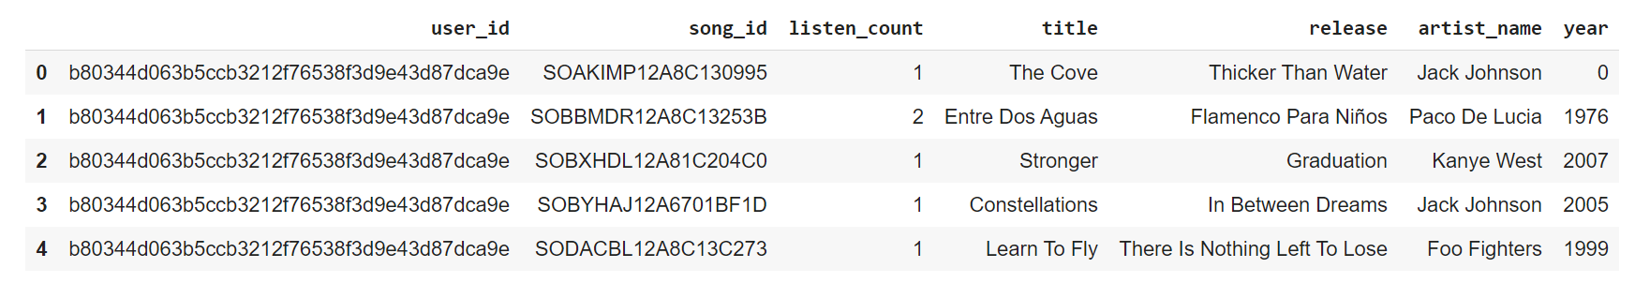
Initial Results (1)
Dataset

Slide 9
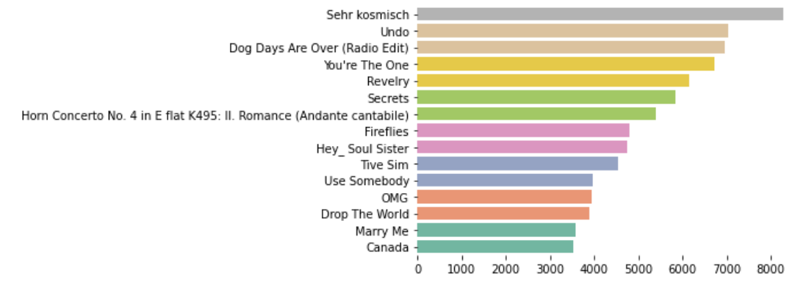
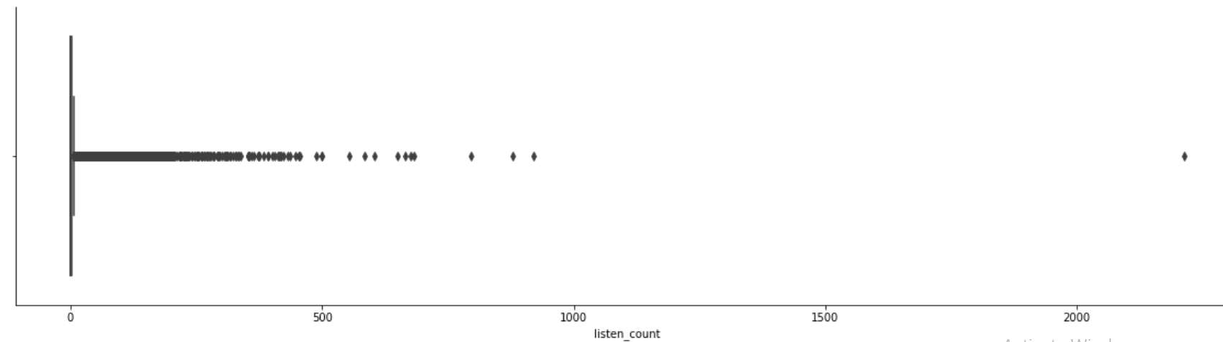
Initial Results (2)
Filtering and Visualization

Slide 10
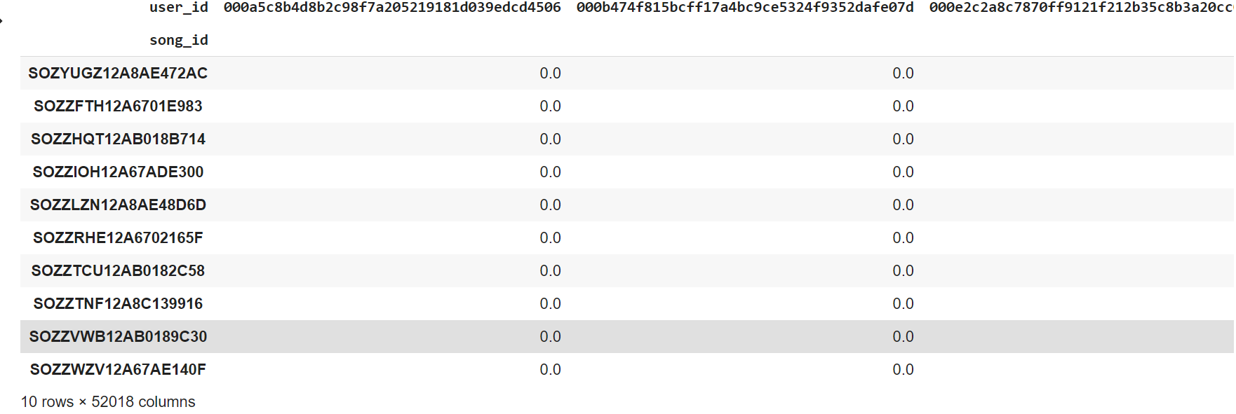
Initial Results (3)
Using SCIPY CSR Matrix

Slide 11
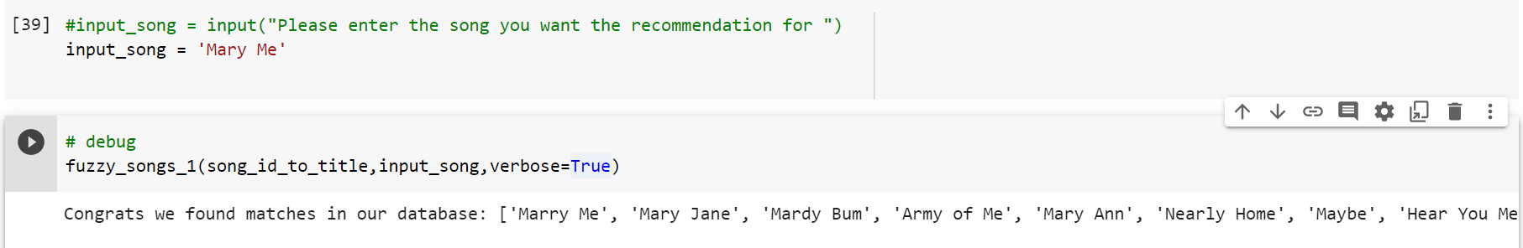
Initial Results (4)
Using Fuzzy String Matcher

Slide 12
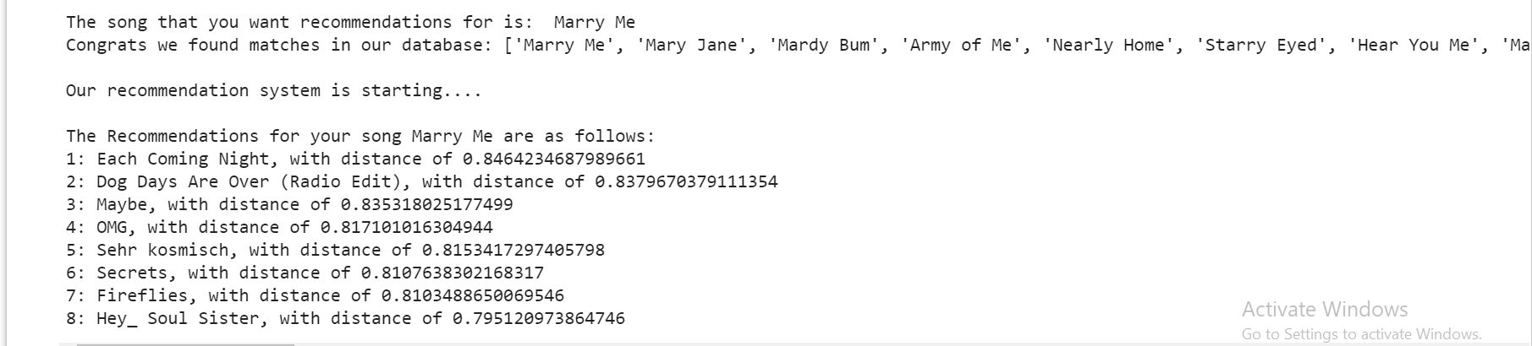
Initial Results (5)
FINAL OUTPUT - RECOMMENDATIONS

Slide 13
Role of each group member
Tasks | Meet Kadiya AU1841099 | Kahaan Patel AU1841110 | Vidit Vaywala AU1841128 | Hemil Shah AU1841135
Research and Literature survey | ✅ | ✅ | ✅ | ✅
Filtering & Visualizing data | ✅ | ✅
Developing Fuzzy String Matching |  |  | ✅ | ✅
Developing KNN model | ✅ | ✅
Developing the SVD model |  |  | ✅ | ✅
Report Writing | ✅ | ✅ | ✅ | ✅

Slide 14
Future work
Checking the accuracy of and improving the model built in the first phase and checking how other algorithms or hyperparameters help us in improving our developed model.
Working on the second part of our problem statement that deals with identifying user’s mood using Support Vector Machine and then recommending songs to users.
We have carried out some initial research on the topic of Support Vector Machine. Our next task would be to apply those researched principles towards achieving our goal of Music recommendation system using mood prediction.

Slide 15
References
B. Srebrenik, “Introduction to Music Recommendation and Machine Learning,” Medium, 04-Dec-2018. [Online]. Available: https://medium.com/@briansrebrenik/introduction-to-music-recommendation-and-machine-learning-310c4841b01d#:~:text=These%20music%20recommendation%20systems%20are,comes%20to%20a%20certain%20item.&amp;text=These%20two%20classes%2C%20or%20approaches,Filtering%20and%20Content%20Based%20Filtering. [Accessed: 17-Mar-2021].
“Using KNN algorithm for classification of textual documents,” IEEE Xplore. [Online]. Available: https://ieeexplore.ieee.org/abstract/document/8079924/?casa_token=35bn2HhwmIMAAAAA%3AVpJ_PGOtzqnKRqKBM68rdV0f81Kn73IUTSHMrOrPfXMVSMnNNbB68SDpo2i2shlczwjd7Dqd5lx6d8w. [Accessed: 17-Mar-2021]
C.-S. Mike Wu and D. Garg, “Movie Recommendation System Using Collaborative FilteringChing-Seh Mike Wu,” IEEE Xplore. [Online]. Available: https://ieeexplore.ieee.org/document/8663822. [Accessed: 17-Mar-2021].

Slide 16
Thank You

