Slide 1
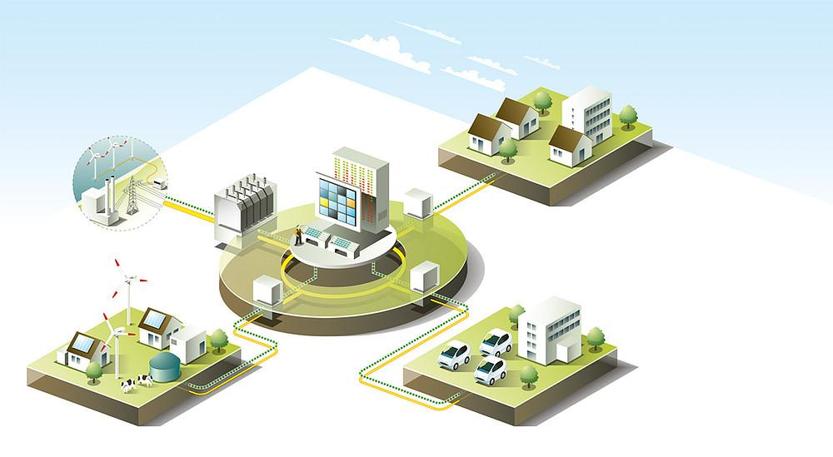
Prediction of Economic Growth from Electrical Power Consumption
By: Tejus, Andrew, Gilmo, Vidit
Notes:
Andrew slide : The cover photo shows an intelligent power system that can communicate bidirectional. Utilities to make money, they need to charge based on quantity, so vast amounts of power data is available to analyze.

Slide 2
Research Questions
How does the state’s power consumption relate to the GDP?
How well does each state’s power consumption predict their GDP?
Notes:
Andrew Slide

Slide 3
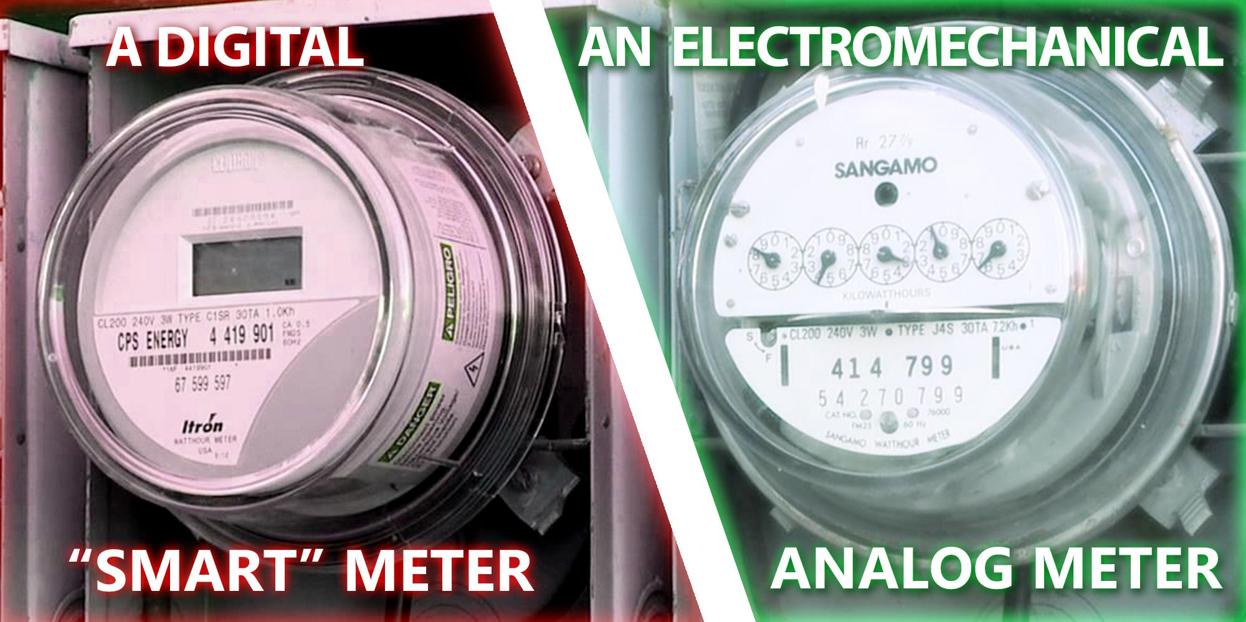
Background
Just a meter for billing
Notes:
gilmo slide

Slide 4
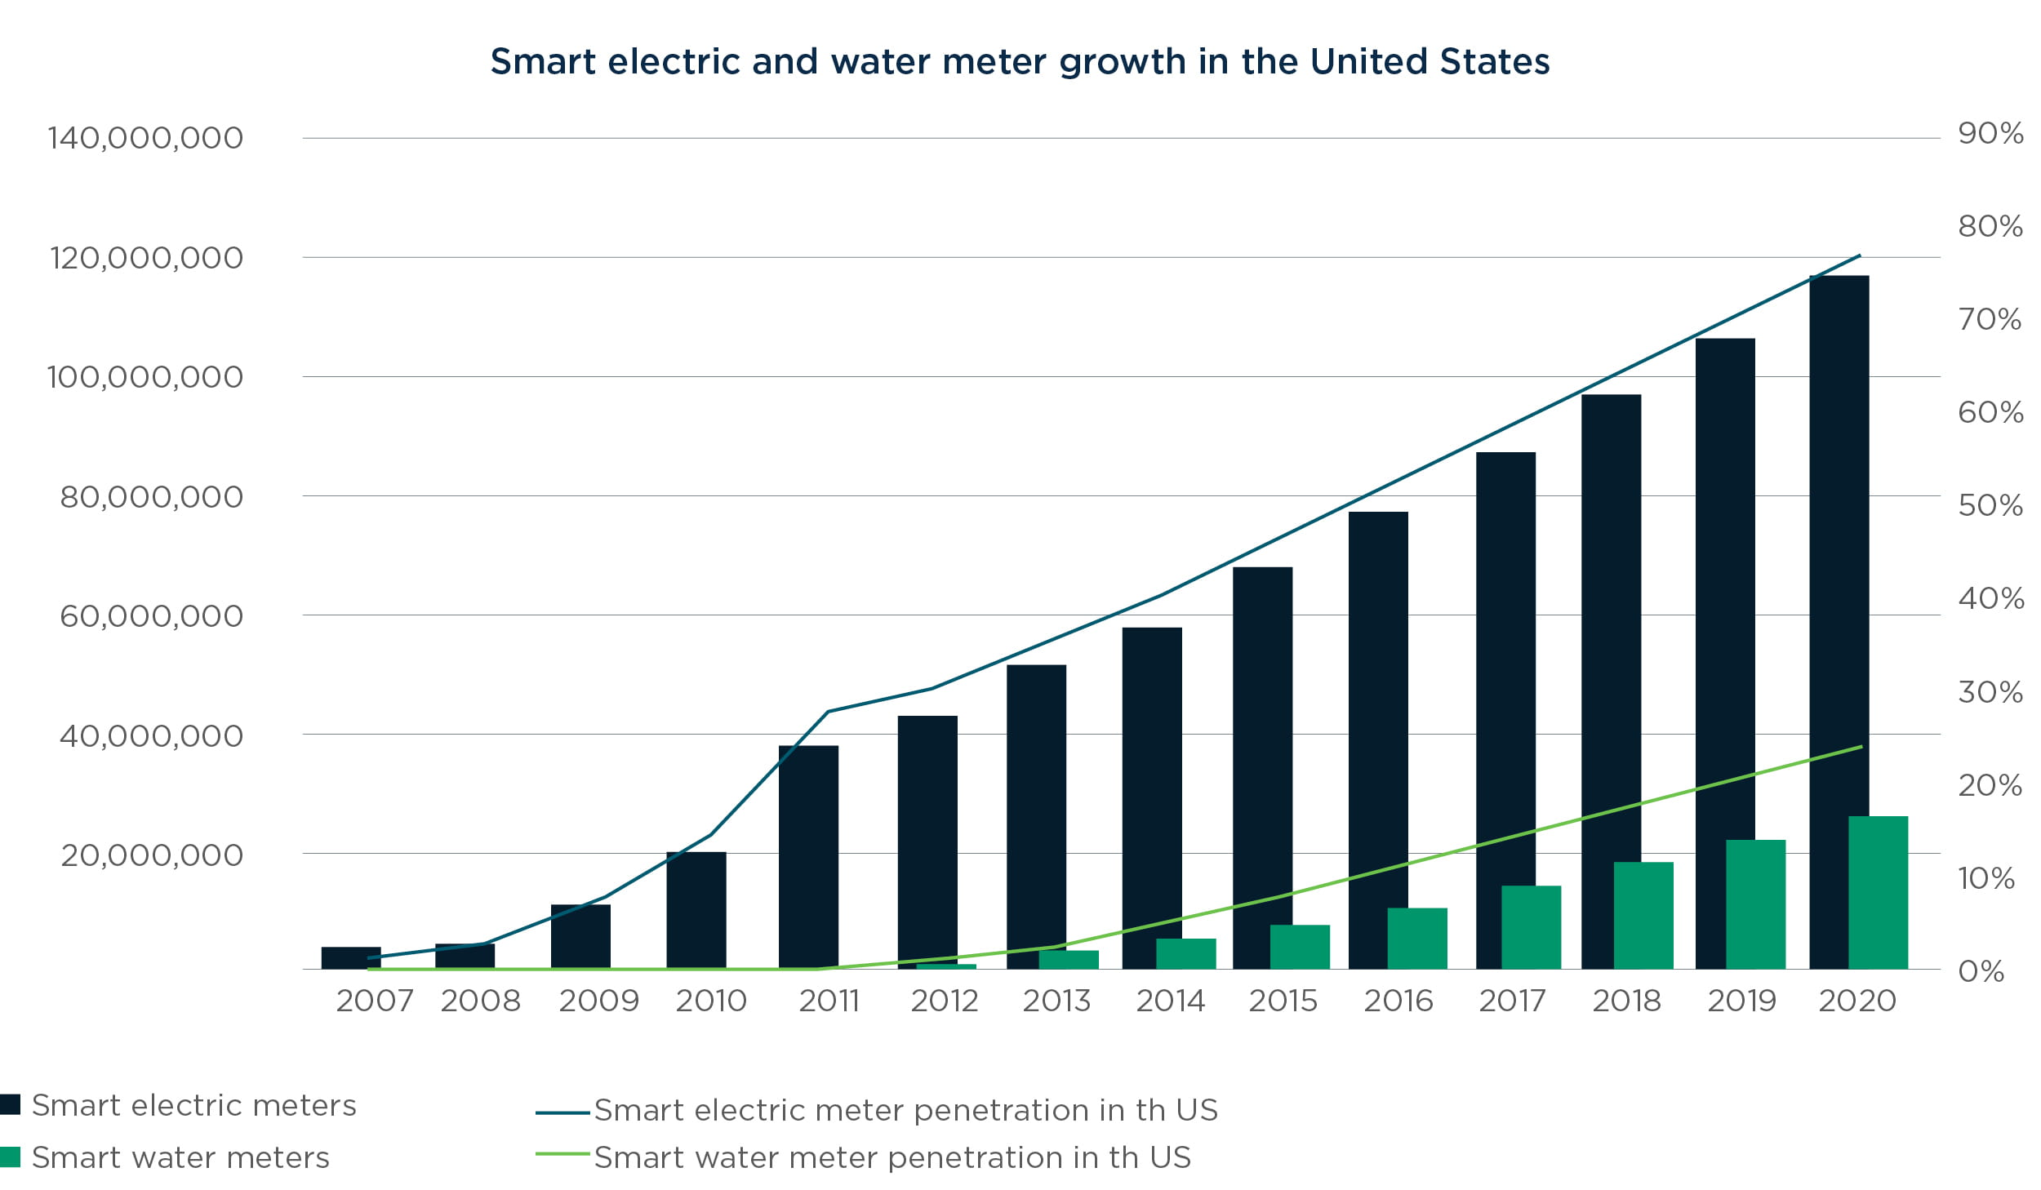
Deployment of Smart Meter
Notes:
gilmo slide

Slide 5
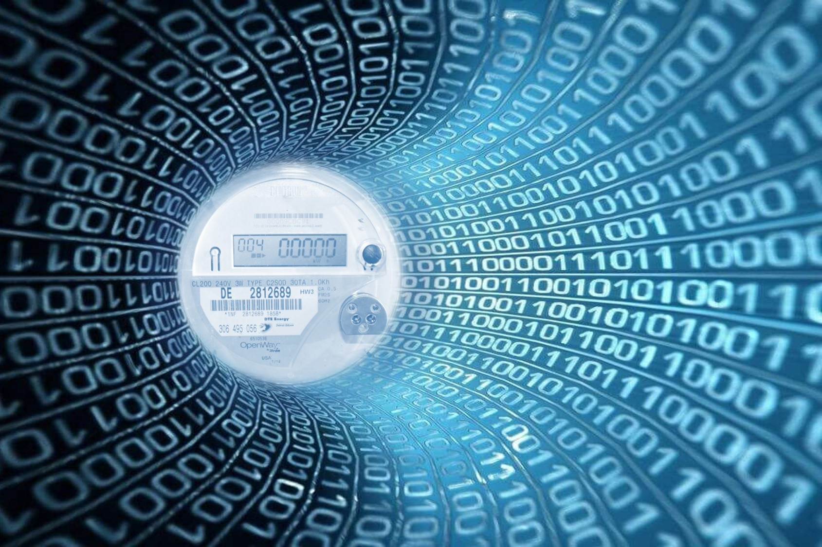
Excellent Source of Data
Notes:
gilmo slide

Slide 6
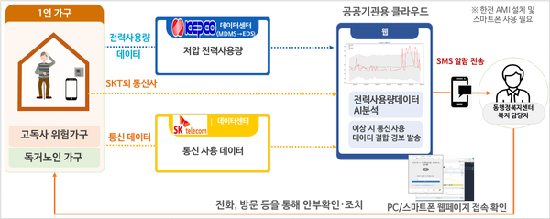
Power Data Example #1
Notes:
gilmo slide

Slide 7



Our Project’s Possible Application
If you analyze the electricity consumption in a specific area, you can find out which area has the greatest potential, and through this, you will be able to open a new business in the optimal location.
Notes:
Vidit slide :If you analyze the power consumption of a particular company, your stock investment can be more efficient.

Slide 8
Data
Data Source
1. Annual power usage by state of USA (1990~2018)
- https://www.eia.gov/electricity/data/state
2. GDP by state of USA (1997~2018)
https://raw.githubusercontent.com/trackandy/state_gdp_data/main/state_gdp_data.csv
Notes:
Vidit slide

Slide 9
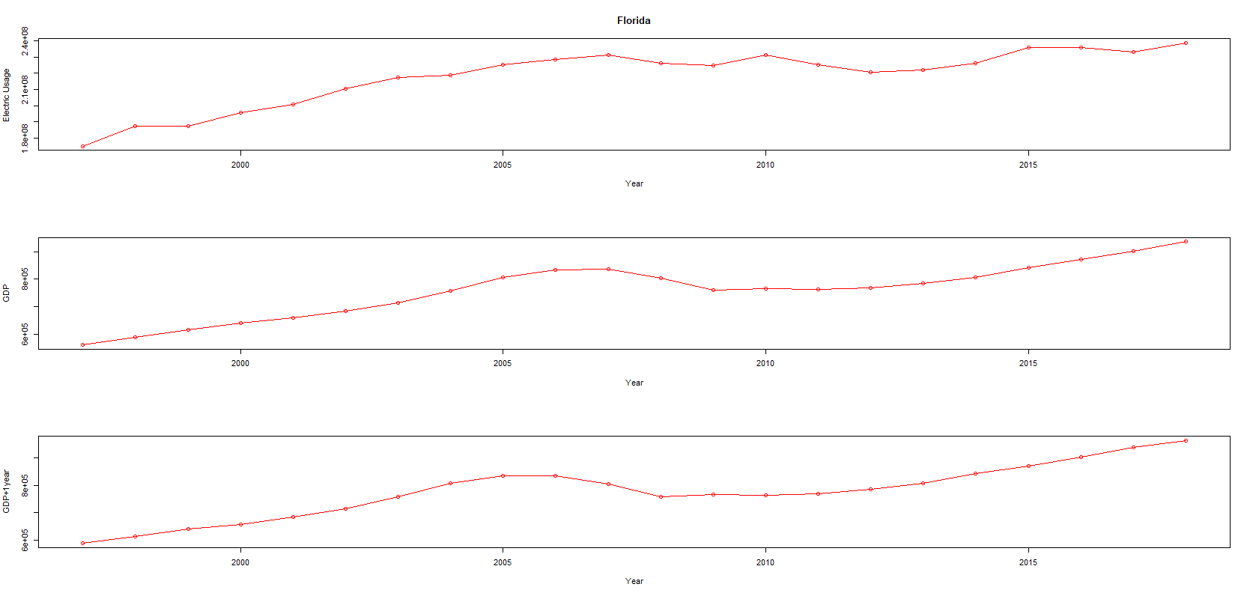
Analysis Result - Florida
Notes:
tejus slide

Slide 10
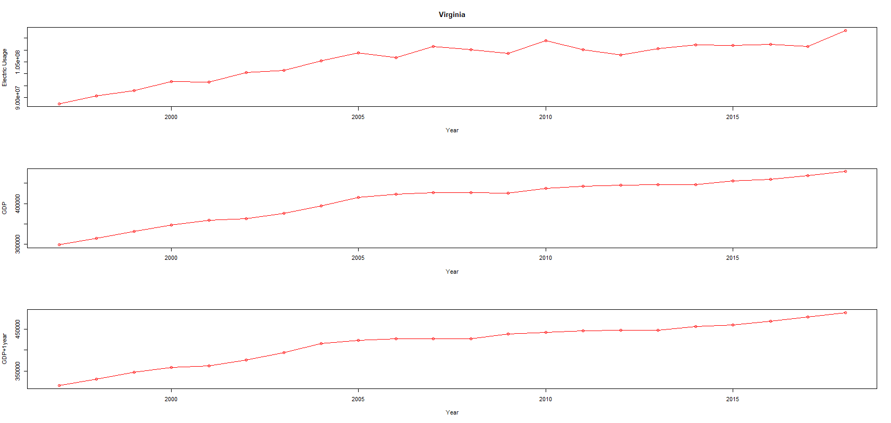
Analysis Result - Virginia

Slide 11
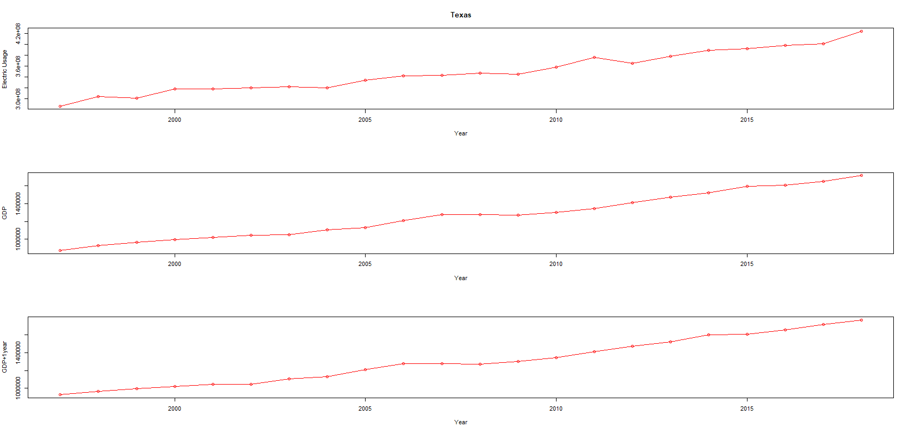
Analysis Result -Texas
Notes:
tejus slide

Slide 12
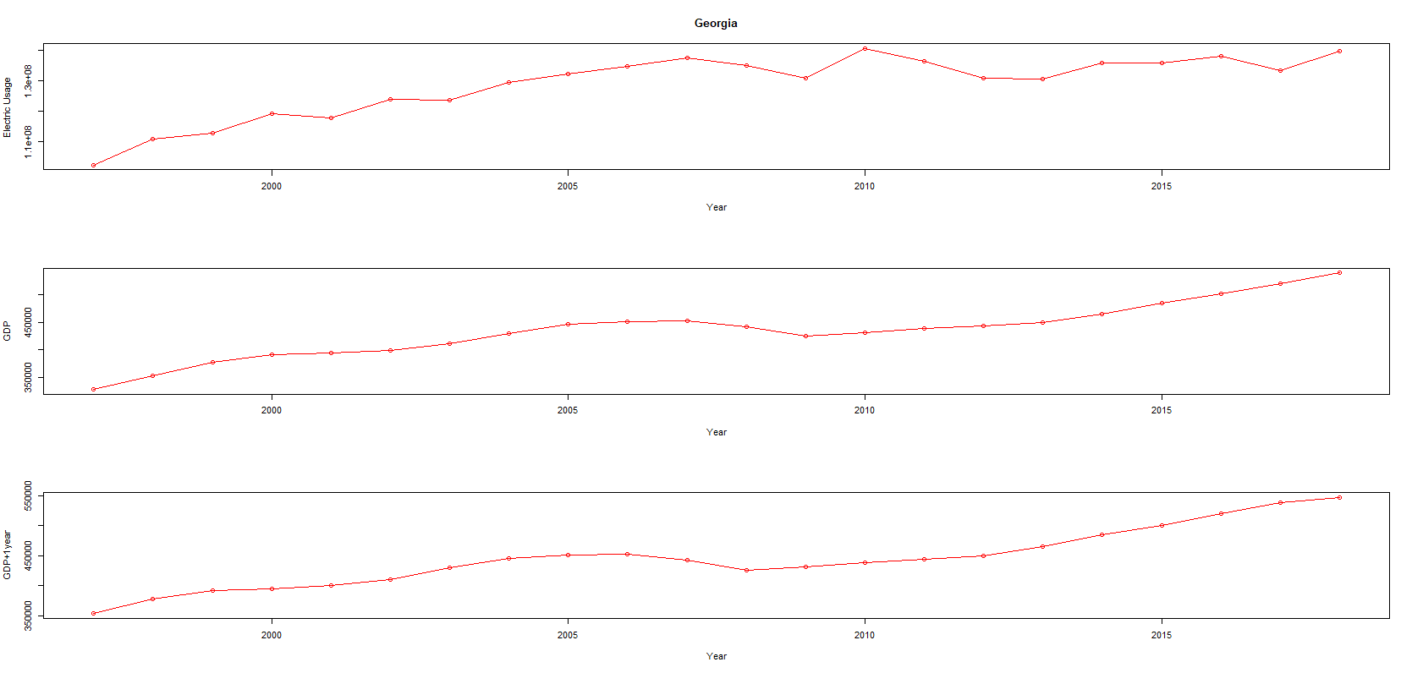
Analysis Result - Georgia

Slide 13
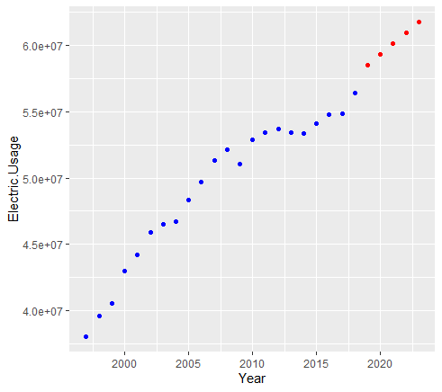
Predicting Energy usage based on previous Data for the state of Colorado
Notes:
Vidit Slide

Slide 14
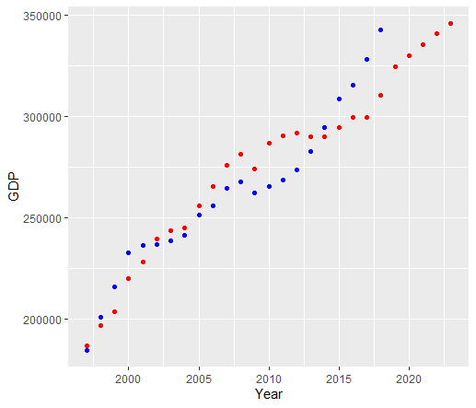
Predicting GDP data based on Electric Usage for the state of Colorado
Notes:
Vidit Slide

Slide 15
Conclusion
As a result of data analysis, it was found that electricity consumption and GDP had a positive correlation
Daily and monthly correlation analysis between electricity consumption and GDP can be used as a leading indicator of economic trends.
Notes:
Andrew slide

Slide 16
Possible Sources of Bias
One of the possible sources of bias is the source data, regarding how it was collected and reported.
There’s a possibility of selection bias, as the power consumption records could be of only the major cities and not the countryside.
Questions?
Notes:
Andrew Slide

Slide 17
Thank You

