Slide 1


Human resources slide 1
Team Titans
“A breach alone is not a disaster, but mishandling it is.”
Name: Vidit Gupta PRN: 21030241052
Name: Hritik Saxena PRN: 21030241200
Name: Suriya Narayanan R PRN: 21030241102
Name: Satyabrata Saha PRN: 21030241154
Name: Mohammad Adib Aslam PRN: 21030241240

Slide 2
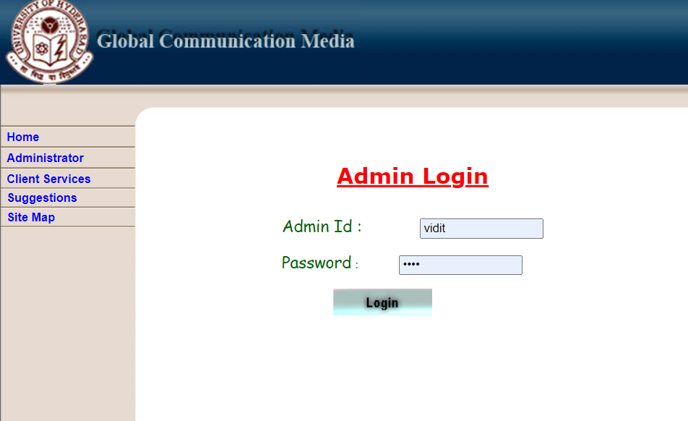
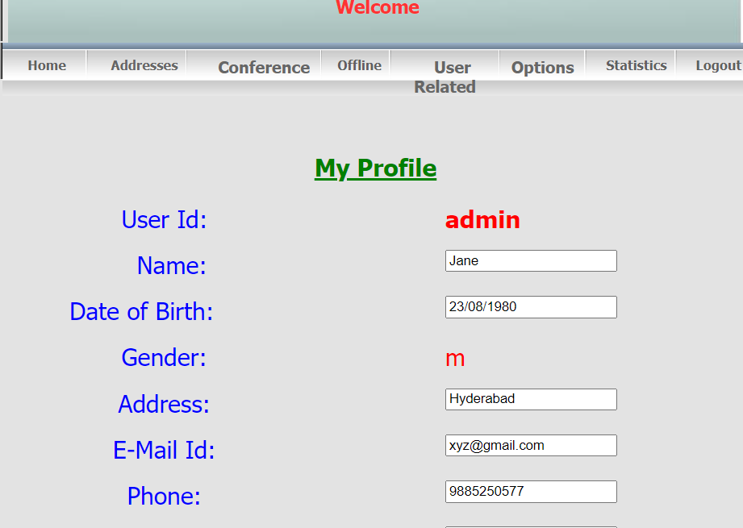
Human resources slide 3
Introduction
Global communication media
University of Hyderabad
The project that we are assigned to is the “Global Communication Media”. This web based java application basically works on two modules i.e. the admin and the client. In the admin module, a person i.e. the admin has the control and the authority to edit, delete, activate or ban any user form the system. The admin can conduct conference, start meetings, create and delete rooms and send the updates.
Coming to the client part., the user can access the system if and only if they have a unique they have a unique ID and password provided by the admin, and the user can attend conference, meeting. The client can join meetings, send suggestions and provide updates on the day to day work of the organization.
System Requirements
In order to build the system and to deploy the application to the server, there are certain technologies and frameworks used. Some of them are:
Windows
Apache Tomcat
JavaScript
JDBC
JSP
MySQL

Slide 3
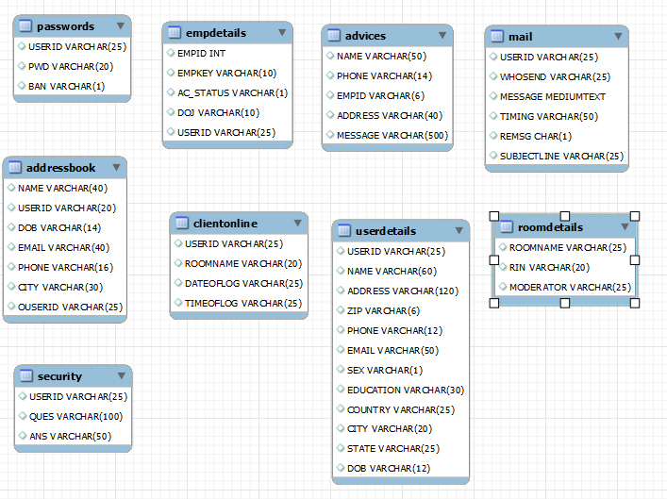
Human resources slide 3
Project details
Global communication media
University of Hyderabad
Modules & table details:
Admin
Create, update and delete conference rooms
Create, edit, activate and delete users.
Moderator privileges
View Statistics
Ban users
2. User
User registration
Create room
Moderator
View profile
Listing all the members in the room

Slide 4







Human resources slide 3
Project details
Global communication media
University of Hyderabad
Software and hardware requirements
Software requirements
Server operating system: Windows 2000
Client operating system: Windows 10 Pro
Java JDK 16.0.1
Apache tomcat
Apache Maven as a building tool
javaee-web-api
Mysql-connector-java
HTML, JavaScript, JSP, Servlets, CSS
MySQL Database
2. Hardware requirements
Multi Core 64bit x86 CPU
8 GB RAM
Default 1MB query cache size

Slide 5
Human resources slide 3
AUDIT CHECKLIST
Sr. No. | Item | Description(what to audit)
1 | Access Control | Login as root user and normal user and check if you can insert and select rows in tables. Check if there are any user roles and privileges associated with the logged in user. Identify the key differences in the access privileges between user, admin and guest user.
2 | Logs | Check if any log entry is there in tables .(user ID along with the timestamp should be associated with every activity) Check for any loggers in application for tables in the database that is check the application logs if the query being fired is getting logged or not.
3 | User information | Check how the user information is stored in tables. Check the user activity if stored and logged or not. Check the archival policy and deletion mechanism for user information
4 | Tables | Check the table creation Check data types of columns of the table. Observe the values inserted in the table. Look for relationship between tables. Check for encryption Check the constraints for any column. Validate any primary keys if present. Validate any foreign keys

Slide 6
Human resources slide 3
AUDIT CHECKLIST
​ Sr.​ No.​ ​ | ​ Item​ | ​ Description(what to audit)​
5 | Stored functions | Check if any stored functions are being implemented.
6 | Stored triggers | Check if any triggers or conditions are being implemented.
7 | Stored procedures | Check if any Stored procedures are being executed.
8 | Encryption of data | Validate if the sensitive and confidential information like password, email, contacts and messages are being encrypted. Validate if the connection to database is done in an encrypted format.
9 | Links to the database | Validate how the connection between application and database is getting established. Look for drivers and check if they are outdated or not.
10 | Sources of database access | Check what all .jsp files or servlets are responsible for entries in tables of matrimony database. Validate the flow of jsp and servlet and database and see how the logic is being implemented.

Slide 7
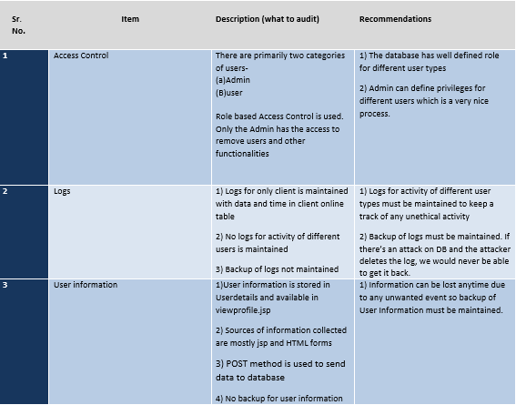
Human resources slide 3
AUDIT FINDINGS

Slide 8
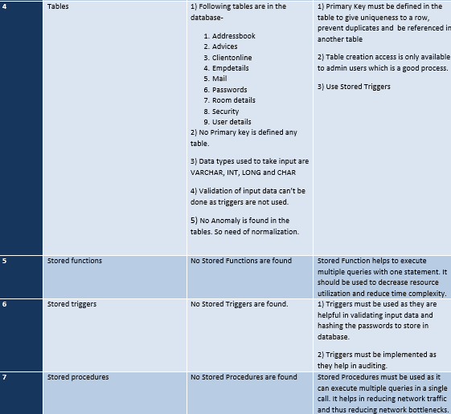
Human resources slide 3
AUDIT FINDINGS

Slide 9
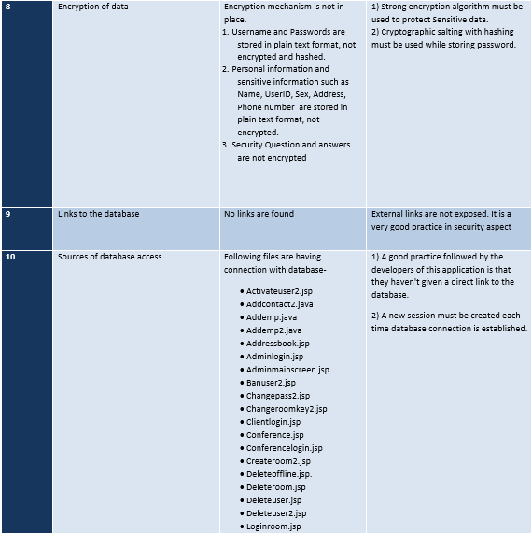
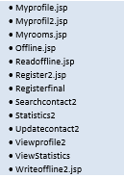
Human resources slide 3
AUDIT FINDINGS
Other Pages

Slide 10




Human resources slide 3
Vulnerabilities Identified
Sensitive Data Exposure
Broken Authentication
Insufficient Logging and Monitoring
Vulnerable and Outdated Components

Slide 11
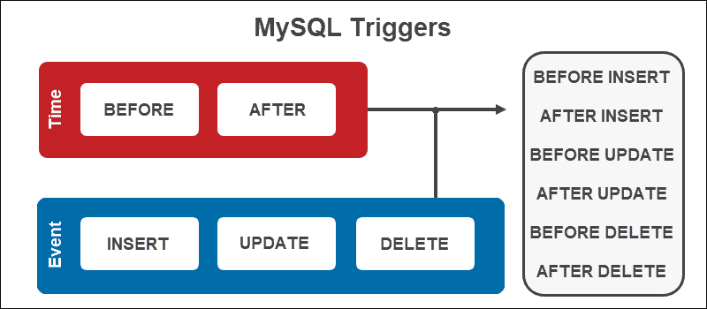
Human resources slide 3
Proposed Trigger
1. Trigger for hashing the password.
DELIMITER //
CREATE TRIGGER t_pwd AFTER INSERT ON passwords FOR EACH ROW
BEGIN
SET new. password=SHA2(new. password, 256);
END
//
DELIMITER ;

Slide 12

Project Bheem By Harsh Bothra
A simple collection of small bash-scripts which runs iteratively to carry out various tools and recon process & store output in an organized way. This project was created initially for automation of Recon for personal usage and was never meant to be public as there is nothing fancy about it but due to request by community, Project Bheem is now Public.
GitHub - harsh-bothra/Bheem

Slide 13
Manual Recon Highlights
Manual Recon gave us index.html(Home page of website) using wget command. We cleaned the data in index.html to gather info about all the subdomains present in that website.
We cleaned the data in index.html to gather info about all the subdomains present in that website. Some domains had multiple subdomains in index.html page and some had only one or two domains. Also we had to try different delimiters and options related to cut command:
For Example :
For Domain squareup.com we got only one subdomain i.e. xms-production-f.squarecdn.com
To get this subdomain we had to experiment with different delimiters and options available in cut commands
For Example :
cat index.html | grep href | cut -d '/' -f 3 | grep .com | cut -d '"' -f 1

Slide 14
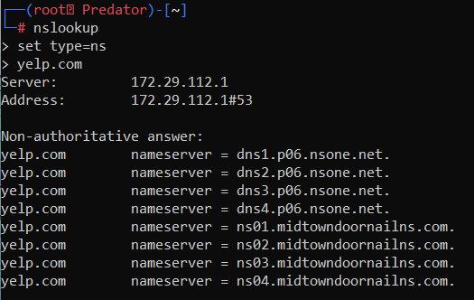
NSLOOKUP Scan Highlights
NSLOOKUP nslookup is a network administration command-line tool for querying the Domain Name System(DNS) to obtain the mapping between domain name and IP address, or other DNS records. Few Results for our team were :
1. nslookup yelp.com
Server: 192.168.0.1
Address: 192.168.0.1#53
Non-authoritative answer:
Name: yelp.com
Address: 151.101.52.116

Slide 15
NMAP Scan Highlights
NMAP, short for Network Mapper, is a free, open-source tool for vulnerability scanning and network discovery. Network Admins use Nmap to identify what devices are running on their systems, discovering hosts that are available and the services they offer, finding open ports and detecting security risks.
•In NMAP Scan for IP 151.101.52.116 associated to domain yelp.com we identified that
•Port 80(used for HTTP)
•Port 443(used for secured transmission or HTTPS) were open. They are using default ports which is not a good practice as it might attract attackers to get access to their website.
•Also Operating system version and kernel version
•OS CPE: cpe:/o:linux:linux_kernel:1.0.9 cpe:/h:cisco:catalyst_1900 cpe:/o:oracle:virtualbox
Aggressive OS guesses: Linux 1.0.9 (88%), Cisco Catalyst 1900 switch (87%), Oracle Virtualbox (85%), OUYA game console (85%)
For Example(NMAPonYelp.com)

Slide 16
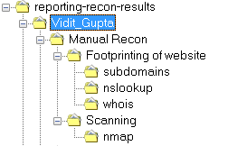
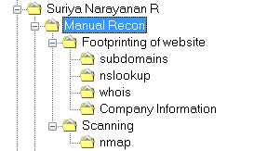
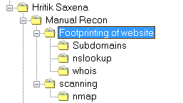
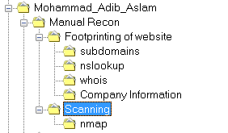
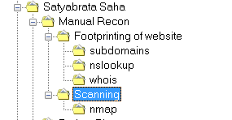
Treepad
Manual Recon

Slide 17
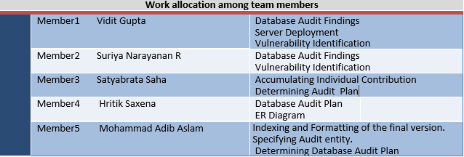
Human resources slide 3
Work Allocation among Team Members
Name | Div | PRN | Domain | Distribution
Vidit Gupta | A | 21030241052 | priceline.com | Nslookup and NMap
Suriya Narayanan R | B | 21030241102 | squareup.com | Nslookup and NMap
Satyabrata Saha | C | 21030241154 | tech.gov.sg | Nslookup and NMap
Mohammad Adib Aslam | D | 21030241240 | yelp.com | Nslookup and NMap
Hrithik Saxena | D | 21030241200 | algolia.com | Nslookup and NMap
Database auditing
Project Bheem

Slide 18
Human resources slide 3
Learnings from Mini-Project
Only admin has access to remove users and other functionalities.
Logs for only client is maintained with data and time in client online table.
No logs for activity of different users is maintained
Encryption mechanism is not in place which indicates that the Username and Passwords are stored in plain text format, not encrypted and hashed.
No relationship among the 9 tables are there which clearly depicts the absence of primary key.

