Slide 1
NASA: Asteroid Classification
VIDIT GOYAL
AI Technology and Systems

Slide 2
Problem Description
Given more than 40 parameters on an asteroid, It is difficult to classify the asteroid as Hazardous or Non Hazardous .

Slide 3
Proposed Solution
The solution to the problem has been given using the given steps:
Data preprocessing→ Removing Null values, Converting object valves to integer values and Neo Reference ID, Name, Close Approach Date, Orbit ID, Orbit Determination Date, Est Dia in KM(min), Est Dia in KM(max) and other valves were dropped as they were not necessary.
Principal Component Analysis: 19 Attributes were left after data pre-processing and that 19-D Date was reduced to 2 dimentional data using PCA .
Machine Learning: Finally, the Model was fit on the data using various classifiers such as Decision tree classifier, XG Boost and Gradient Boosting Algorithm.

Slide 4
Dataset used
The dataset was obtained from NeoWs (Near Earth Object Web Service) that is a RESTful web service for near earth Asteroid.
link to the data: https://www.kaggle.com/shrutimehta/nasa-asteroids-classification/downloads/nasa-asteroids-classification.zip

Slide 5
Benefits and Impact
By observing some parameters on an asteroid, it will be easier to classify an Asteroid as Hazardous or Non-Hazardous. This can help prepare countermeasures if the asteroid is Hazardous.

Slide 6
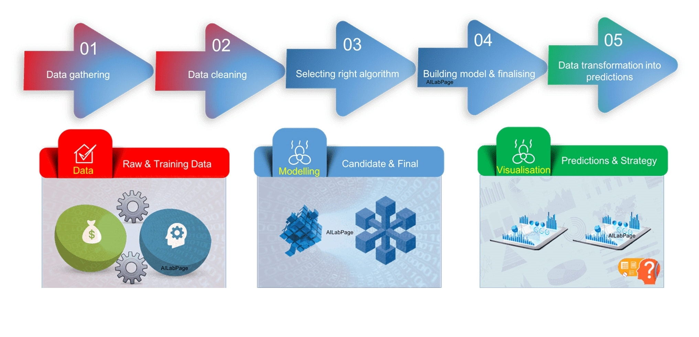
Solution Discussion

Slide 7
Challenges
There were 40 attributes in the dataset provided. It was difficult to decide which values to consider and which values to drop.

Slide 8
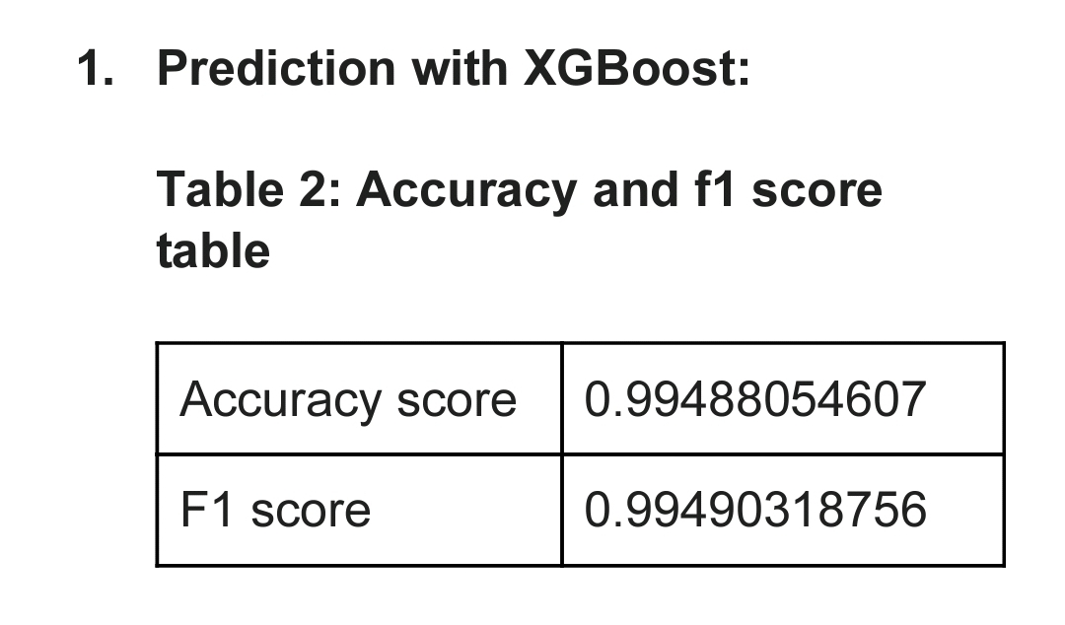
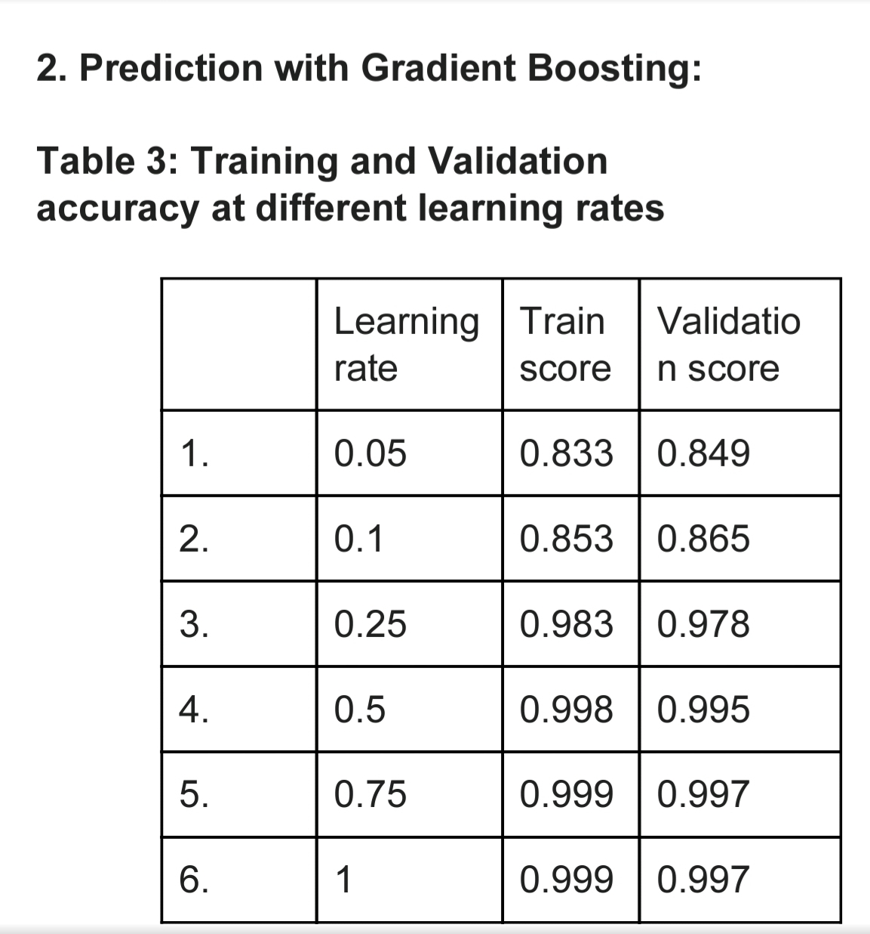
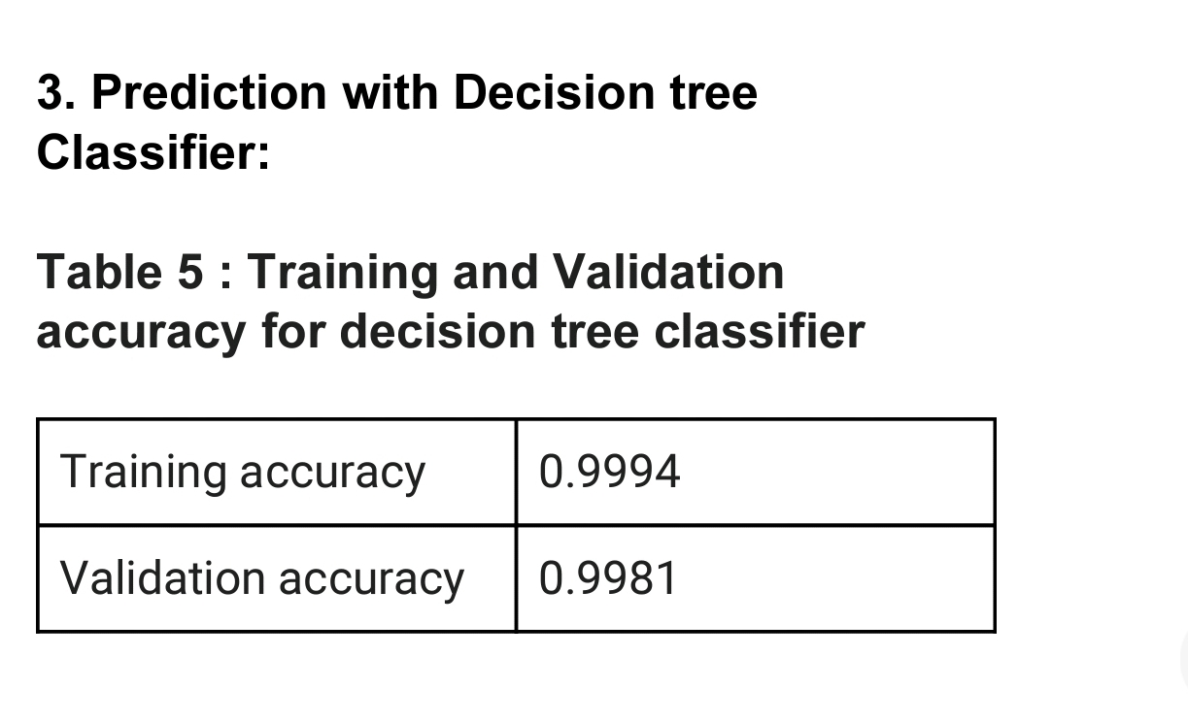
Results
The results from 3 different classifiers is as follow:

Slide 9
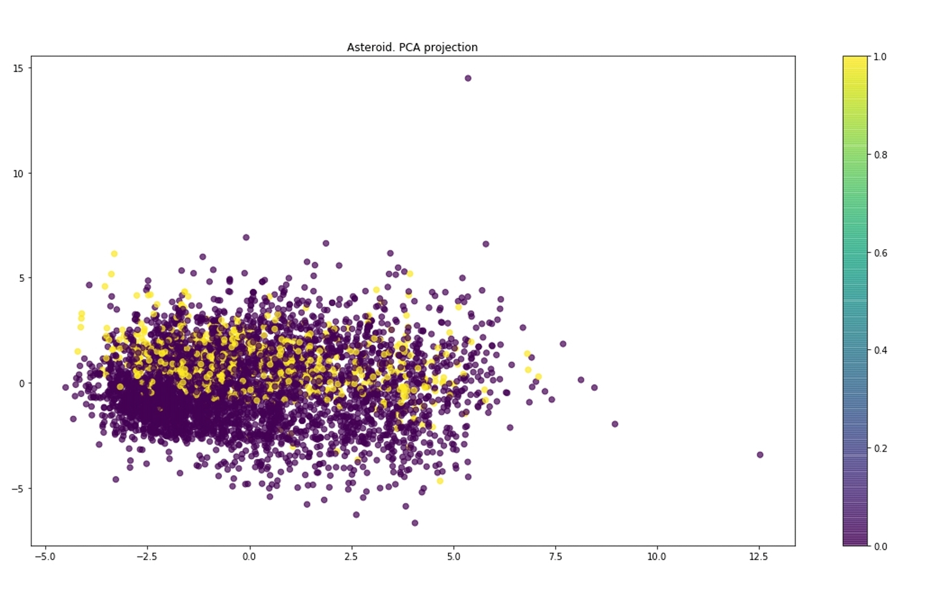
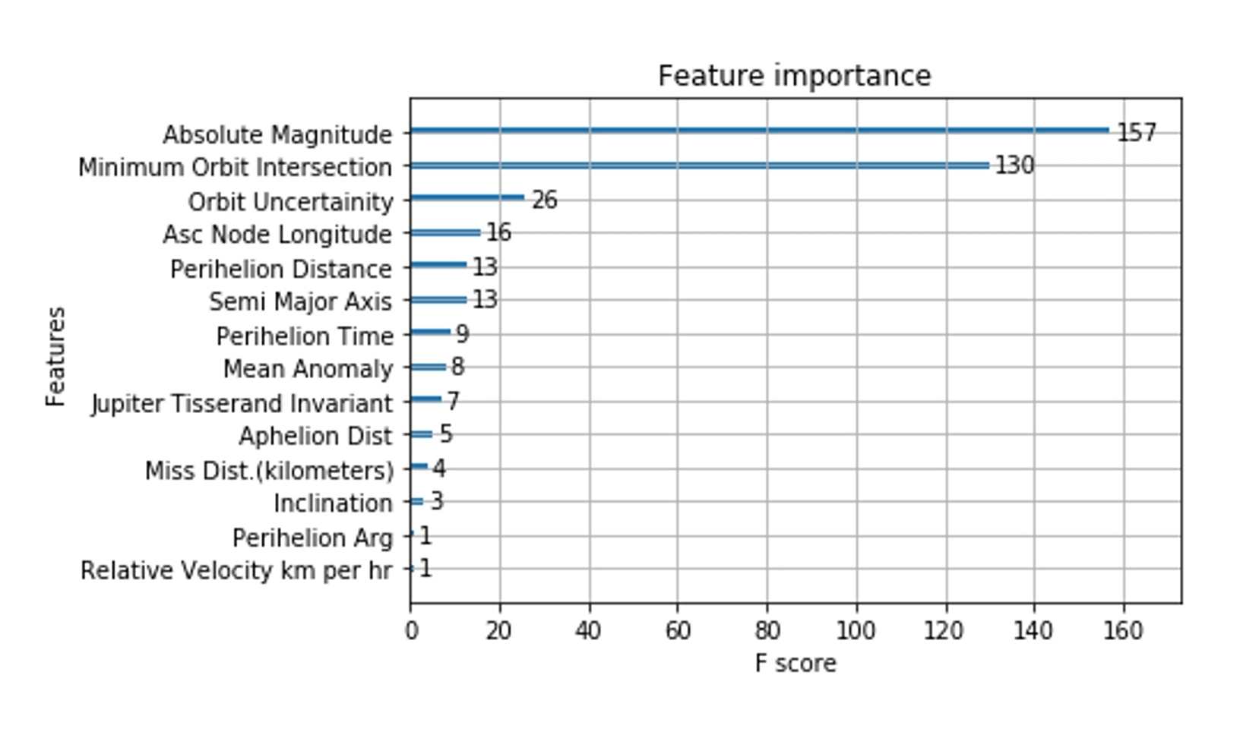

Slide 10
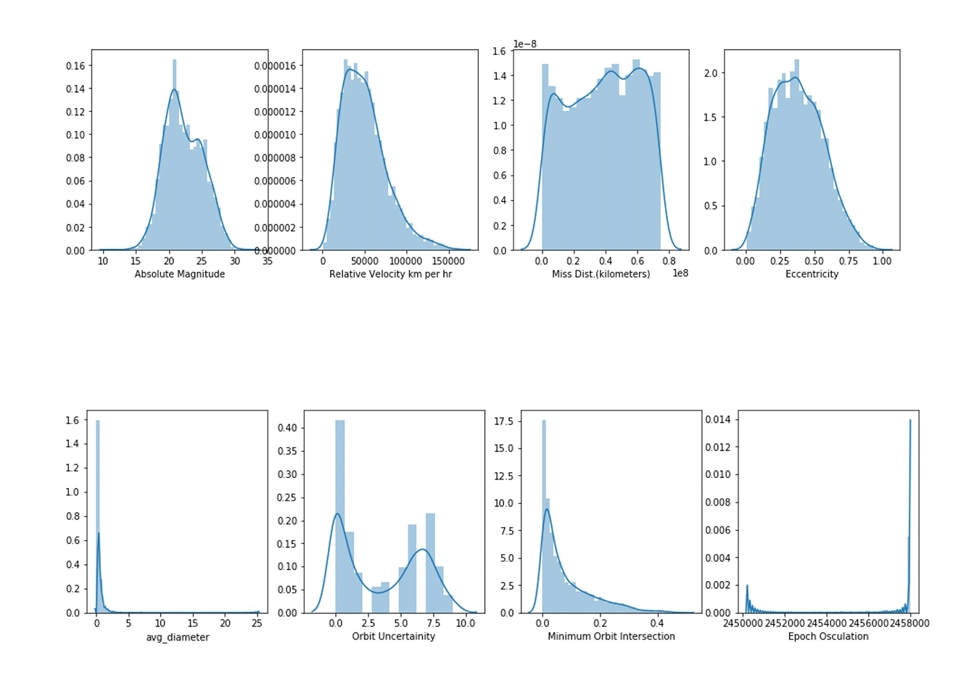
Bell-shaped curve shows that it is normally distributed.
This type of curve shows that it is right skewed and some are bi-modal.

Slide 11
Future work
The model can be fit on more parameters if required.
Also other classifiers can be used.

Slide 12
Summary
l. Principal component analysis helps make data easier to explore and visualize. It is a simple non-parametric technique for extracting information from complex and confusing data sets.
2. Out of the 3 classifiers, XGB classifier has the highest Training accuracy of 0.9994 and also the highest f1 score of 0.9949. Therefore it is the best performing model for classifying asteroid as Hazardous or Non-Hazardous.

Slide 13


