Slide 1
INDIA LEARNS LMS
Faculty Guide
Teach. Grade. Guide. Repeat.
Everything you need to run your courses — without paperwork.
FOR FACULTY
India Learns LMS · Faculty guide
1 / 17

Slide 2
ABOUT YOU
Who this is for
You teach a course. This system runs the rest.
Course content is loaded for you — modules, sessions, slide decks, assignments. You take attendance, run the lesson, grade the work, write feedback. The system handles timetables, records, notifications, receipts, and certificates.
India Learns LMS · Faculty guide
2 / 17

Slide 3
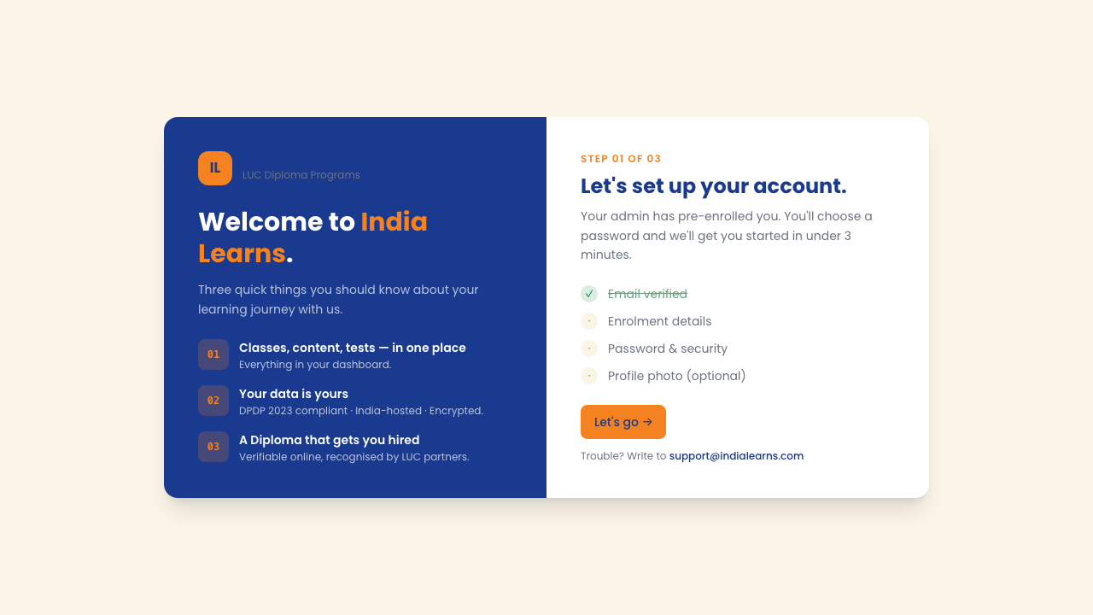
GETTING STARTED
How you sign in
Three steps to access
● Admin sends you a magic-link invitation by email.
● Click the link, choose a password (12+ characters).
● You're in. Bookmark the URL for next time.
● Forgot your password? Use the reset link on the sign-in screen.
● Works on laptop, tablet, phone — same login, same URL.
The India Learns sign-in screen
India Learns LMS · Faculty guide
3 / 17

Slide 4
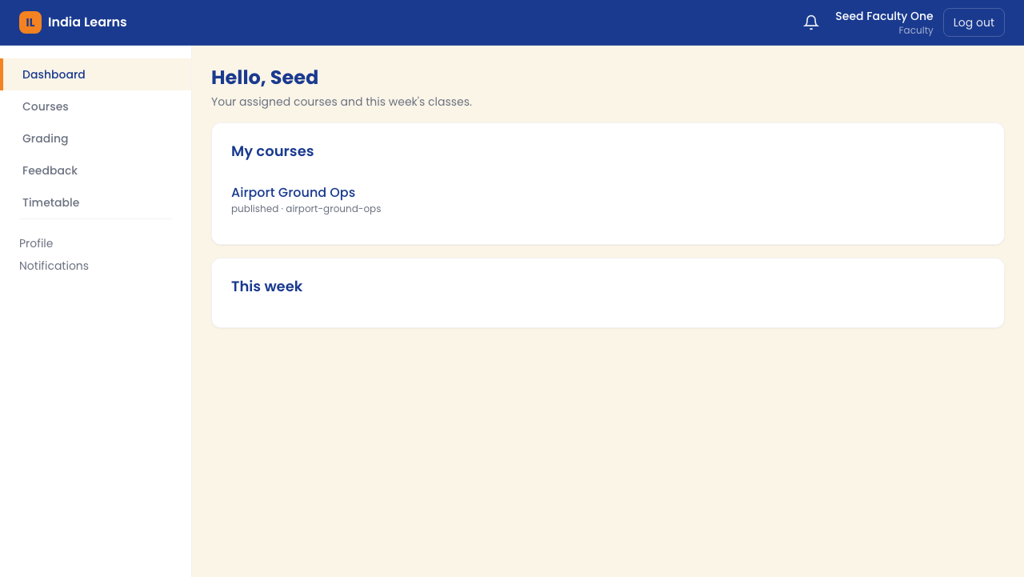
HOME SCREEN
Your dashboard at a glance
What you see when you sign in
● Personal greeting — 'Hello, Seed' with the time of day.
● My Courses — every course you're assigned to teach.
● This Week — your upcoming classes with day, time, and room.
● Awaiting your feedback — student submissions waiting on your draft.
● Notifications — admin announcements, ticket replies, schedule changes.
● Click any card to jump straight into that workflow.
Faculty dashboard — your home screen
India Learns LMS · Faculty guide
4 / 17

Slide 5
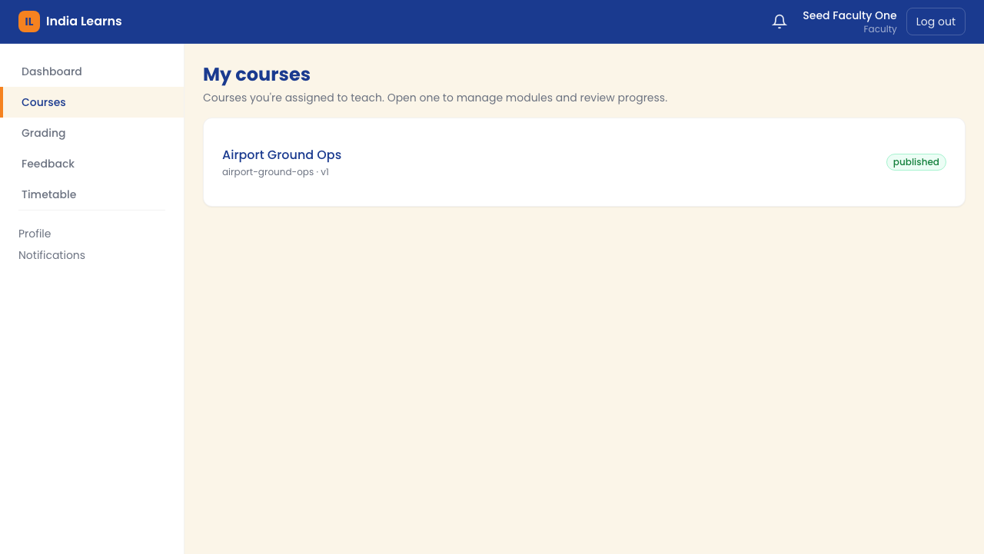
COURSES
My Courses — everything you teach
One row per course you teach
● Each row shows the course title and its publish state.
● 'Sandbox' = still in preparation, students don't see it yet.
● 'Published' = live, students enrolled in the batch can access it.
● Click any course to enter the course shell (Overview, Content, Gradebook, etc.).
● You only see courses you're assigned to — other faculty's work stays private.
The My Courses list
India Learns LMS · Faculty guide
5 / 17

Slide 6
INSIDE A COURSE
Course Overview — your control panel
Stat cards at the top
[ SCREENSHOT NEEDED ]
[ Screenshot to add: course Overview tab with stat cards ]
● Modules — how many modules in the course.
● Sessions — total lessons across all modules.
● Assignments — total assignments students will work through.
● Grading backlog — submissions waiting for your action.
● Each number is clickable — jumps you straight to that view.
[ Screenshot to add: course Overview tab with stat cards ]
India Learns LMS · Faculty guide
6 / 17

Slide 7
INSIDE A COURSE
The Content tab — your course tree
Module → Session hierarchy
[ SCREENSHOT NEEDED ]
[ Screenshot to add: Content tab with modules expanded ]
● Top level: Modules (e.g. M1, M2, M3 …).
● Click a module to expand its sessions.
● Each session is a lesson — its own page with content + attendance.
● Drag sessions to reorder them. Within a module or across modules.
● Auto-generated sessions (assessments, finals) are locked from reorder.
[ Screenshot to add: Content tab with modules expanded ]
India Learns LMS · Faculty guide
7 / 17

Slide 8
SESSION DETAIL
Inside a session — the left column
What students learn here
[ SCREENSHOT NEEDED ]
[ Screenshot to add: session detail page, left half ]
● Description — what this lesson covers (from your curriculum).
● Materials — the slide deck for this lesson. Click 'Open viewer' to flip through.
● Assignments — what students need to submit related to this lesson.
● Mark Complete button — click when the session is done.
● 7-day undo window — you can revert if clicked by accident.
[ Screenshot to add: session detail page, left half ]
India Learns LMS · Faculty guide
8 / 17

Slide 9
SESSION DETAIL
Inside a session — the right column
Your tools as the teacher
[ SCREENSHOT NEEDED ]
[ Screenshot to add: session detail page, right half ]
● Attendance panel — every enrolled student listed. Defaults to 'Present'.
● Toggle individuals to absent / late / excused with the dropdown.
● Click Save attendance — confirmation appears, counter flips immediately.
● Private notes — your personal observations about this session.
● Faculty-only — never shown to students, admins, or super-admin oversight.
● Use it like a journal across sessions. Searchable next term.
[ Screenshot to add: session detail page, right half ]
India Learns LMS · Faculty guide
9 / 17

Slide 10
MATERIALS
The slide viewer
Click 'Open viewer' → flip slides → close.
The slide viewer opens with the lesson's slides. Use the left/right arrow keys to navigate. A speaker notes panel shows presenter guidance from your curriculum team. Press Escape (or click 'Back to session') to close. No PowerPoint file to download — slides render right in the browser.
India Learns LMS · Faculty guide
10 / 17

Slide 11
DAILY ROUTINE
Taking attendance — step by step
1
Open the session
Click into any session from the Content tab. The attendance panel is on the right.
2
Mark students
Defaults to 'Present' for everyone. Toggle individuals using the dropdown.
3
Save
Click 'Save attendance'. You'll see 'Saved.' confirmation and the counter flip to 'X of N recorded'.
4
Edit anytime
Made a mistake? Edit and save again. Last value wins. Audit log keeps the history.
5
Mark Complete is now enabled
Once at least one attendance row is saved, you can mark the session complete.
India Learns LMS · Faculty guide
11 / 17

Slide 12
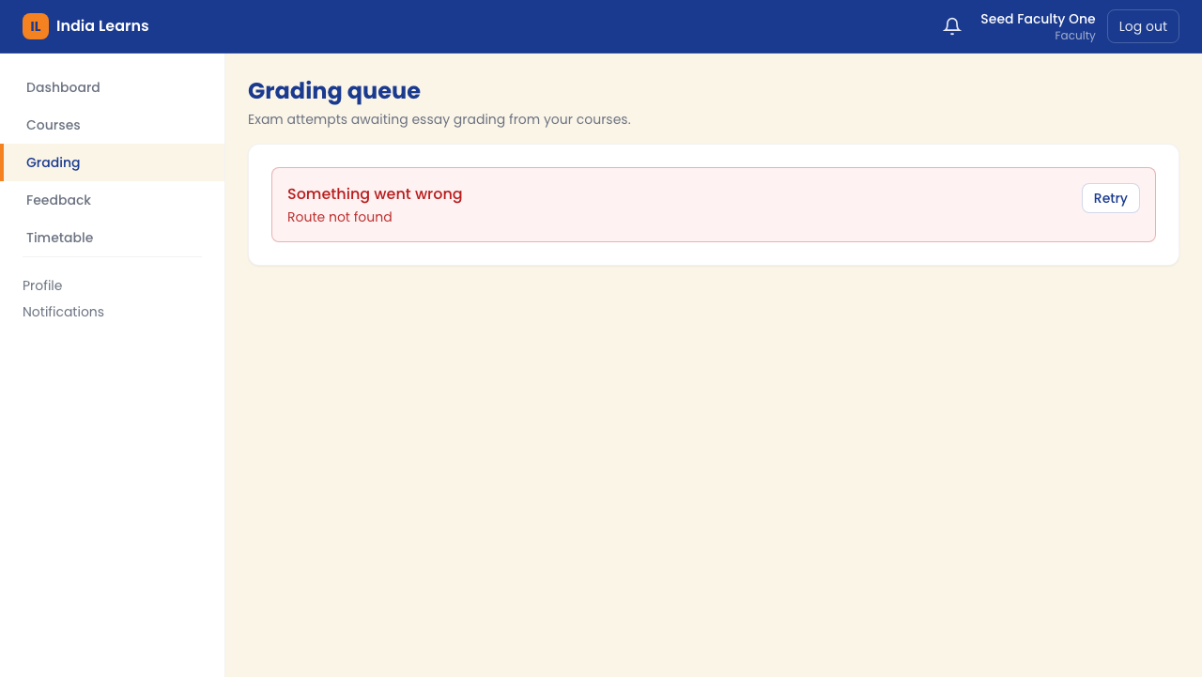
GRADING
Gradebook — your grading command centre
Grid view of progress
● Rows = students enrolled in the course.
● Columns = assignments in the course.
● Each cell shows status: submitted, draft, published, missing.
● Badge at top — 'X assignments · Y students'.
● Backlog count — submissions waiting for your action.
● Click any cell to grade individually, or click a column header for bulk grading.
The gradebook grid
India Learns LMS · Faculty guide
12 / 17

Slide 13
GRADING
Per-assignment grading
Four filter views
[ SCREENSHOT NEEDED ]
[ Screenshot to add: per-assignment grading view with filter chips ]
● Needs grading — submissions that haven't been touched yet. Start here.
● Drafts — grades you've saved as drafts but not yet published.
● Graded — everything you've published. Visible to the student.
● Missing — enrolled students who haven't submitted past the due date.
● Each chip shows a count — find what needs attention fast.
[ Screenshot to add: per-assignment grading view with filter chips ]
India Learns LMS · Faculty guide
13 / 17

Slide 14
GRADING
The two-step grading flow
1
Save draft
Score the work, write feedback, click 'Save draft'. The student sees nothing yet — only you can see the score.
2
Edit freely
Refine the grade and feedback as many times as you want. No one else sees a thing during the draft state.
3
Publish
Click 'Publish' when you're ready. Confirm the dialog. Now the student sees the grade and feedback.
4
Editing a published grade?
It automatically flips back to draft. You must publish again — by design, so 'Publish' always means 'I'm sure'.
5
Bulk publish
Select multiple drafts and publish them all at once. Audit-logged per row.
India Learns LMS · Faculty guide
14 / 17

Slide 15
SCHEDULE
Your timetable & weekly digest
Schedule + email summary
[ SCREENSHOT NEEDED ]
[ Screenshot to add: faculty timetable view ]
● Weekly timetable filtered to YOUR classes — room, course, time, day.
● Pick any week with the week-picker.
● Rescheduled / added classes are highlighted.
● Mobile-friendly — pull it up before class on your phone.
● Monday digest email — every Monday 9 AM, summary of what's awaiting feedback (drafts >7 days, ungraded essays).
● Each digest item is clickable — go straight to the work.
[ Screenshot to add: faculty timetable view ]
India Learns LMS · Faculty guide
15 / 17

Slide 16
SETTINGS
Profile & notification preferences
● Profile — update your name, photo, phone, email. Change password.
● Notification preferences — choose which events email you, WhatsApp you, or notify you in-app.
● Turn the Monday digest on or off.
● Set quiet hours — no notifications during teaching slots.
● Always-on alerts (system errors, urgent admin pings) ignore quiet hours.
India Learns LMS · Faculty guide
16 / 17

Slide 17
SUPPORT
Getting help
Stuck? Reach out — we want you teaching, not debugging.
Technical issue with the system → raise a Technical ticket from your dashboard, a real human responds within 24 hours. Question about your curriculum content → talk to your curriculum lead. Question about a student's enrolment or fee status → ping admin or finance directly. The system is built to support you, not block you.
India Learns LMS · Faculty guide
17 / 17

