Slide 1
INDIA LEARNS LMS
Faculty Guide
Detailed walkthrough
A complete reference for faculty using India Learns LMS.
FOR FACULTY
India Learns LMS · Faculty guide
1 / 31

Slide 2
OVERVIEW
What you'll learn in this guide
● How to sign in for the first time and reset your password.
● The top navigation — every link explained.
● Your dashboard — what each card means and how to act on it.
● Your courses — Sandbox vs Published, and how to open one.
● Inside a course — Overview, Content, Gradebook, Roster tabs.
● Running a session — slide viewer, attendance, completion, undo.
● Grading — the gradebook grid, per-assignment filters, score and feedback.
● The two-step grading flow — save draft, then publish.
● Your timetable, the Monday digest, and notifications.
● Profile, password, notification preferences.
● Common mistakes and how to recover from them.
● Where to go when you need help.
India Learns LMS · Faculty guide
2 / 31

Slide 3
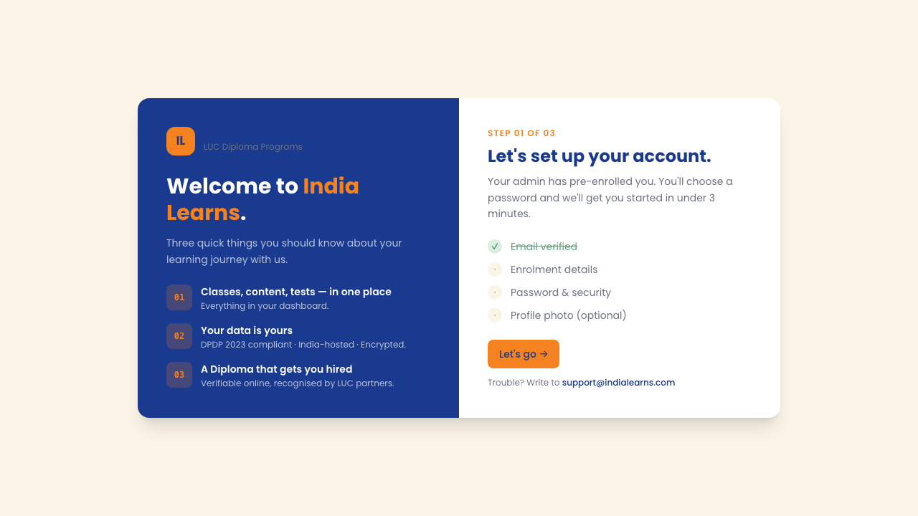
GETTING STARTED
Signing in — the first time
What happens
● Admin emails you a magic-link invitation.
● Click the link in the email.
● Set a password (12+ chars, mix of letters and numbers).
● You're signed in — bookmark the URL.
● Link expires after 7 days — ask admin to resend if it does.
The India Learns sign-in screen
India Learns LMS · Faculty guide
3 / 31

Slide 4
GETTING STARTED
Signing in — every day after
● URL — your bookmarked link (app.indialearns.com or your subdomain).
● Email — the same one admin used when they invited you.
● Password — the one you set on first login. Case-sensitive.
● Stay signed in — tick this box on your own device. Don't tick it on a shared computer.
● Sign in button — submits the form. If it shakes, the email/password don't match.
● Forgot password? — the link under the form. Sends a reset email. Open the email, click the link, set a new password.
● Three wrong attempts — the system locks you out for 15 minutes (security). Wait it out or reset.
● Browser warnings — ignore Chrome's 'save password' prompt only if you're on a shared device.
India Learns LMS · Faculty guide
4 / 31

Slide 5
LAYOUT
The top navigation — what each link does
Always available, top of every page
app.indialearns.com
India Learns
· · · · · ·
⚙
● Logo (top-left) — click to go home.
● Dashboard — your daily home screen.
● My Courses — every course you teach.
● Timetable — your weekly schedule.
● Tickets — raise & track support issues.
● Bell icon — unread notifications count.
● Profile circle — settings, sign out.
Logo (top-left)
→
Click to go to your dashboard from anywhere.
Dashboard
→
Your home — what needs attention today.
My Courses
→
Every course you teach. Sandbox or Published.
Timetable
→
Your weekly schedule — only your classes.
Tickets
→
Raise a tech issue. Track it through resolution.
Bell icon
→
Unread notifications count. Click for the full list.
Profile circle
→
Settings, preferences, sign out menu.
India Learns LMS · Faculty guide
5 / 31

Slide 6
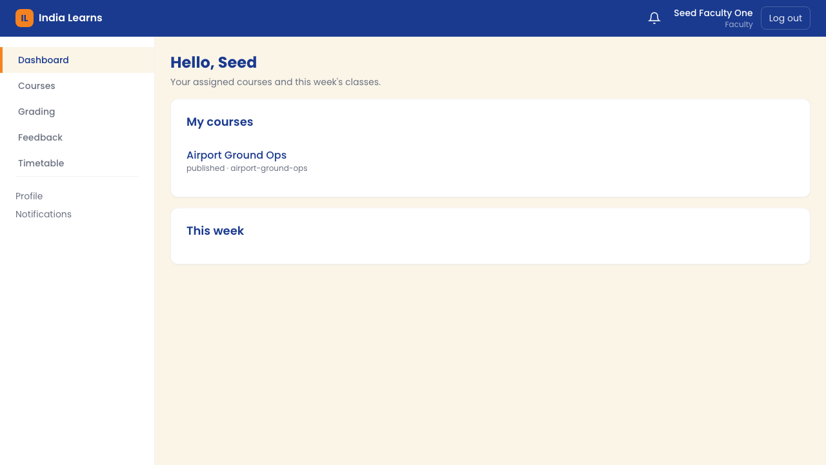
HOME SCREEN
Your dashboard — every card explained
What you see when you sign in
● Personal greeting — your name + time of day.
● My Courses card — quick links to each course.
● This Week card — your upcoming classes.
● Awaiting your feedback — submissions to grade.
● Notifications card — recent admin pings.
● Every card is clickable — jumps you into it.
Faculty dashboard — your home screen
India Learns LMS · Faculty guide
6 / 31

Slide 7
HOME SCREEN
Dashboard cards — what to click and when
● My Courses card — shows every course assigned to you. Click a course name to enter it.
● This Week card — next 5–7 classes. Click any row to open that session directly.
● Awaiting your feedback — submissions that need grading. Click any to open the grading screen.
● Notifications card — the 5 newest unread messages. Click the bell at top-right to see ALL.
● Quick actions (if shown) — shortcuts like 'Take attendance for today's class' or 'Open digest'.
● Empty states — if a card says 'Nothing to do here', that's good. Means you're caught up.
● Refresh — the dashboard refreshes automatically. Pull-to-refresh on phone, or use browser refresh.
India Learns LMS · Faculty guide
7 / 31

Slide 8
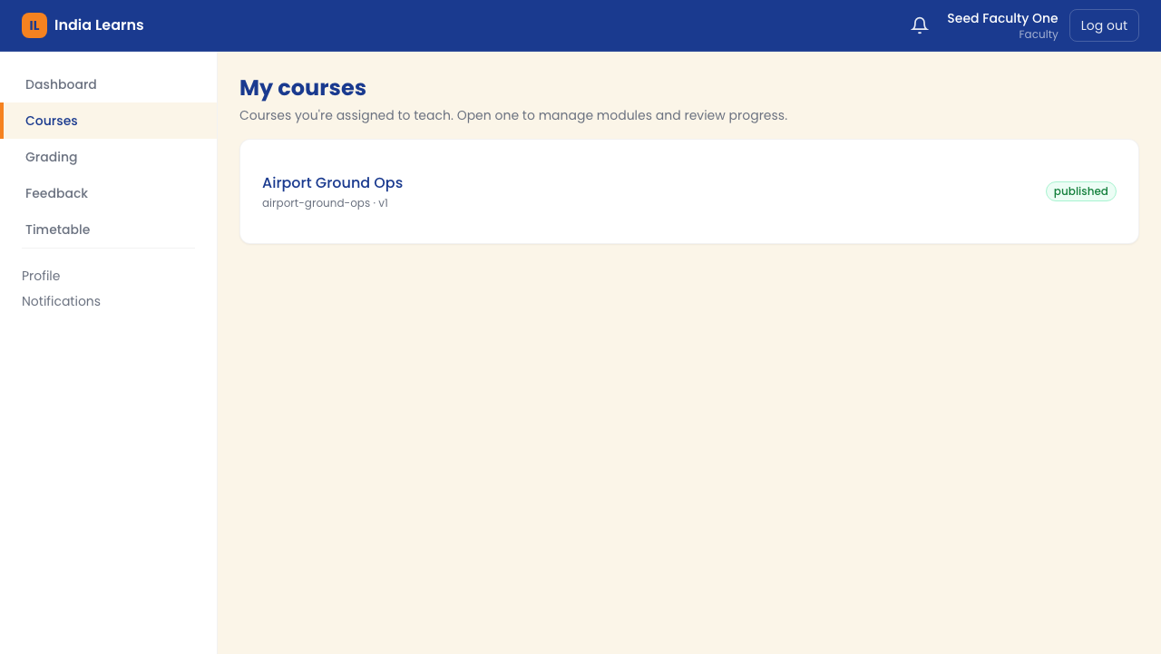
COURSES
My Courses — opening a course
One row per course you teach
● Course title and code (e.g. AVI-101).
● State badge — Sandbox or Published.
● Cohort/batch name.
● Click any row to enter the course shell.
● You only see your own courses.
The My Courses list
India Learns LMS · Faculty guide
8 / 31

Slide 9
COURSES
Sandbox vs Published — what the badges mean
SANDBOX
PUBLISHED
Course is still being prepared
Course is live for students
● Students enrolled in the batch CANNOT see the course.
● You can edit content, change order, fix typos freely.
● Curriculum team may still be loading materials.
● Use this state to prepare — no student impact.
● Admin flips to Published when ready.
● Students see the course on THEIR dashboard.
● They can access content, submit assignments.
● You can still edit, but changes are visible.
● Attendance, grading, completion all active.
● This is the 'live teaching' state.
India Learns LMS · Faculty guide
9 / 31

Slide 10
COURSE SHELL
Inside a course — the four tabs
● Overview — your control panel. Stat cards (modules, sessions, assignments, grading backlog) + upcoming sessions list.
● Content — the module → session tree. Where you go to teach. Drag-to-reorder lives here.
● Gradebook — the grading command centre. Grid view of every student × every assignment.
● Roster — the list of students enrolled in this course. Names, emails, attendance summary.
● Switching tabs — click the tab name. No data is lost — you can switch freely.
● Browser back — takes you back to My Courses. Browser forward returns to the same tab.
● URL bookmarking — the URL changes per tab. Bookmark 'Gradebook' to land there every time.
India Learns LMS · Faculty guide
10 / 31

Slide 11
INSIDE A COURSE
Overview tab — your course control panel
Stat cards at the top
app.indialearns.com
Overview
Content
Gradebook
Roster
● Modules — how many modules in the course.
● Sessions — total lessons across all modules.
● Assignments — total assignments students will work through.
● Grading backlog — submissions awaiting your action.
● Upcoming sessions — your next 3-5 classes.
● Click any number to jump straight to that view.
3
12
8
14
Modules
Sessions
Assignments
Grading backlog
All counts are clickable — jump straight to that view.
UPCOMING SESSIONS
Mon 20 May
S1.2 Industry overview
Room 204
Tue 21 May
S1.3 Safety basics
Room 204
Thu 23 May
S2.1 Customer interaction
Room 204
India Learns LMS · Faculty guide
11 / 31

Slide 12
INSIDE A COURSE
Content tab — your course tree
Module → Session hierarchy
app.indialearns.com
Overview
Content
Gradebook
Roster
● Top level: Modules (M1, M2, M3…).
● Click ▼ to expand a module's sessions.
● Click again to collapse.
● Each session is a lesson — its own page.
● Drag the ⋮⋮ handle to reorder sessions.
● Auto-generated finals are locked from reorder.
▼
M1 — Foundations
⋮⋮
S1.1 Welcome & syllabus
⋮⋮
S1.2 Industry overview
⋮⋮
S1.3 Safety basics
▼
M2 — Core skills
⋮⋮
S2.1 Customer interaction
⋮⋮
S2.2 Product knowledge
▼
M3 — Assessment
⋮⋮
Final quiz (auto-generated)
India Learns LMS · Faculty guide
12 / 31

Slide 13
INSIDE A COURSE
Content tab — every button explained
● ▼ Expand triangle — click to show a module's sessions. Click again to hide them.
● ⋮⋮ Drag handle (left of each session) — click and hold, then drag to reorder. Drop on the target spot.
● Session title — click to open the session detail page. That's where attendance + complete live.
● Module title — click anywhere on the navy bar to expand/collapse.
● Lock icon (if shown) — auto-generated sessions (finals, exams) can't be reordered.
● Drag across modules — yes, you can drag a session from M1 into M2 if curriculum allows.
● Undo a drag — browser back doesn't undo it. Drag it back manually.
● No 'add session' button — sessions come from the curriculum. To add, talk to admin or curriculum lead.
India Learns LMS · Faculty guide
13 / 31

Slide 14
SESSION DETAIL
Inside a session — left side
What students learn here
app.indialearns.com
Aviation › M1 Foundations › S1.2 Industry overview
● Description — what this lesson covers.
● Materials — the slide deck.
● 'Open viewer' button — to preview slides.
● Assignments — what students will submit.
● Mark Complete button — when session is done.
● 7-day undo window — you can revert.
S1.2 — Industry overview
DESCRIPTION
Introduces India's aviation sector, key regulators,
and the major career pathways for diploma graduates.
MATERIALS
📑 s1.2-industry-overview.pdf
Open viewer
ASSIGNMENTS
A1.2 Industry stakeholders worksheet · Due Friday
✓ Mark Complete
7-day undo window
India Learns LMS · Faculty guide
14 / 31

Slide 15
SESSION DETAIL
Inside a session — right side
Your tools as the teacher
app.indialearns.com
Attendance — S1.2 Industry overview
● Attendance panel — every enrolled student.
● Status dropdown per student.
● Defaults to Present for everyone.
● Save attendance — commits the row.
● Counter — '26 of 28 recorded'.
● Private notes below — only you see them.
26 of 28 recorded
STUDENT
STATUS
Aarav Sharma
Present
Diya Mehta
Present
Ishaan Patel
Late
Kavya Reddy
Absent
Mira Bose
Present
Rohan Nair
Excused
Sara Iyer
Present
Save attendance
🔒 Private notes below — only you see them
India Learns LMS · Faculty guide
15 / 31

Slide 16
ATTENDANCE
Attendance statuses — when to use which
Present
Late
Absent
Excused
Student attended the full session. The default. Use for everyone unless you note otherwise.
Student arrived after the session started but did attend. Use for partial attendance.
Student did not attend. Counts against attendance percentage.
Pre-approved absence (illness, family emergency). Doesn't count against attendance %.
A note about percentages:
The attendance % shown on the student's dashboard counts only Present and Late as 'attended'. Absent counts against. Excused is neutral.
If unsure, mark Absent — you can edit later. The audit log keeps the history.
India Learns LMS · Faculty guide
16 / 31

Slide 17
DAILY ROUTINE
Taking attendance — step by step
1
Open the session
From Content tab, click the session you're teaching. Attendance panel is on the right.
2
Skim the list
Every enrolled student shows up. All default to Present.
3
Toggle exceptions only
Click the dropdown next to a student. Pick Absent / Late / Excused as needed.
4
Save attendance
Click the orange 'Save attendance' button. You'll see 'Saved.' confirmation.
5
Counter updates
The header now shows 'X of N recorded'. Hits 'N of N' once everyone's marked.
6
Edit anytime
Made a mistake? Edit and save again. Last save wins. All changes audit-logged.
India Learns LMS · Faculty guide
17 / 31

Slide 18
MATERIALS
The slide viewer — keyboard & buttons
● Open viewer button — click on the session detail page. Viewer opens fullscreen.
● → Right arrow key — next slide. Also Space bar or PgDn.
● ← Left arrow key — previous slide. Also PgUp.
● Home key — jump to first slide.
● End key — jump to last slide.
● Speaker notes panel — shows presenter guidance from your curriculum team. Toggle on/off via the notes icon.
● Slide counter (bottom) — shows current slide and total (e.g. '7 / 24').
● Escape key (or 'Back to session') — closes the viewer, returns to session detail.
● No PowerPoint download — slides render in the browser. To save a copy, ask your curriculum lead.
India Learns LMS · Faculty guide
18 / 31

Slide 19
SESSION LIFECYCLE
Marking a session complete — and undoing it
1
Take attendance first
The Mark Complete button stays disabled until you've saved at least one attendance row.
2
Click Mark Complete
The session is now 'Done'. Students see a green tick. Auto-advances them to the next.
3
Confirmation banner appears
'Session marked complete. Undo within 7 days.' shown at the top.
4
Need to undo? Click Undo
Reverts to Not Started. Attendance is preserved — only the completion flag flips.
5
After 7 days
Undo button disappears. To revert later, talk to admin.
6
What students see
A 'Completed' badge. Their progress bar advances.
India Learns LMS · Faculty guide
19 / 31

Slide 20
GRADING
Gradebook — the big picture
What this grid tells you
app.indialearns.com
Gradebook
● Rows = students enrolled.
● Columns = assignments in course.
● Each dot = state of that submission.
● Click any cell to grade that student.
● Click a column header for bulk view.
● Backlog chip — what needs action.
8 assignments
28 students
14 to grade
Student
A1.1
A1.2
A1.3
A2.1
A2.2
A3.1
Aarav Sharma
✓
✓
D
S
—
—
Diya Mehta
✓
✓
✓
S
✕
—
Ishaan Patel
✓
D
S
—
—
—
Kavya Reddy
✓
✓
✓
✓
D
—
Mira Bose
✓
✓
S
✕
—
—
Rohan Nair
✓
D
D
S
—
—
✓
Published
D
Draft
S
Submitted
✕
Missing
India Learns LMS · Faculty guide
20 / 31

Slide 21
GRADING
Per-assignment view — four filters
What each filter shows
app.indialearns.com
● Needs grading — start here. Not yet touched.
● Drafts — saved, not yet published.
● Graded — published. Visible to student.
● Missing — past due, no submission.
● All — everyone, regardless of state.
● Numbers update as you grade.
A1.2 — Industry stakeholders worksheet
Due Fri 23 May · Max marks 20
Needs grading · 6
Drafts · 3
Graded · 12
Missing · 2
All · 28
SHOWING: NEEDS GRADING (6)
A
Aarav Sharma
Submitted 19 May, 18:42
Grade →
D
Diya Mehta
Submitted 19 May, 20:11
Grade →
I
Ishaan Patel
Submitted 20 May, 09:05
Grade →
K
Kavya Reddy
Submitted 20 May, 11:30
Grade →
M
Mira Bose
Submitted 20 May, 14:12
Grade →
India Learns LMS · Faculty guide
21 / 31

Slide 22
GRADING
The grading screen — every field
Two panels side-by-side
app.indialearns.com
A
Aarav Sharma · A1.2 Industry stakeholders worksheet
● LEFT — the student's submission.
● Their text answer, attached files.
● Click any attachment to preview.
● RIGHT — your grading panel.
● Score input, feedback textarea.
● Save draft, then Publish.
Submitted 19 May 18:42 · 3 days early
SUBMISSION
SCORE
The Indian aviation sector is regulated primarily by the DGCA,
with the Airports Authority of India (AAI) overseeing infrastructure.
Major career pathways for diploma graduates include:
• Ground operations & customer service
• Cabin crew (with airline-specific training)
• Cargo handling & logistics
• Aviation security (with BCAS certification)
Each pathway requires specific certifications…
17
/ 20
FEEDBACK
Solid work, Aarav.
Strong on regulatory bodies. Would have liked
to see one more career pathway (technical /
maintenance side). Watch the spelling on
'BCAS' — capitalised.
Save draft
Publish
📎 industry-stakeholders.pdf · 423 KB
India Learns LMS · Faculty guide
22 / 31

Slide 23
GRADING PHILOSOPHY
Why two steps? Save draft, then Publish.
1
Save draft = private
Score and feedback are saved on your account only. The student sees nothing yet.
2
Refine freely
Reopen later. Adjust the score. Rewrite feedback. As many times as you want.
3
Publish = visible
Click Publish. Confirm. NOW the student sees the score and feedback.
4
Editing a published grade?
Auto-flips back to Draft. You must Publish again. Forces a 'I'm sure' moment.
5
Bulk publish from gradebook
Select multiple drafts → Publish all. One audit-log entry per row.
6
No accidental sends
Publish is always a deliberate two-click action. No surprise visibility flips.
India Learns LMS · Faculty guide
23 / 31

Slide 24
GRADING IMPACT
What students see before and after Publish
WHILE IT'S A DRAFT
AFTER YOU PUBLISH
Student sees:
Student sees:
● 'Submitted on [date]' — the date they uploaded.
● 'Awaiting feedback' — nothing else.
● No score, no comments.
● No notification fires.
● They can resubmit if window is open.
● Their score (e.g. 17 / 20) — prominently.
● Your written feedback — full text.
● Notification: email + in-app + WhatsApp.
● Their dashboard 'Recent feedback' updates.
● Cannot resubmit (unless reopened by admin).
India Learns LMS · Faculty guide
24 / 31

Slide 25
SCHEDULE
Your timetable & Monday digest
Two ways to plan your week
app.indialearns.com
● Timetable — your week, your classes only.
● Week-picker to jump to any week.
● Rescheduled classes highlighted in orange.
● Mobile-friendly — open before class.
● Monday digest — email every Mon 9 AM.
● Drafts >7 days old + ungraded essays flagged.
Your week
‹ Week of 18 May ›
Mon 18
Tue 19
Wed 20
Thu 21
Fri 22
09:00
S1.2 Industry
S2.1 Customer
S3.1 Final review
Room 204
Room 204
Room 204
11:00
S1.3 Safety
Office hour
Room 204
Room 101
14:00
S2.2 Product
Room 204
📧 Monday digest · Sent 9 AM · 3 items awaiting feedback
India Learns LMS · Faculty guide
25 / 31

Slide 26
ALERTS
Notifications — what fires and when
● Bell icon (top right) — shows unread count. Click for the full list.
● In-app notification — appears on the dashboard 'Notifications' card too.
● Email notification — to the email admin has on file for you.
● WhatsApp notification — to your number, if WhatsApp is enabled in your profile.
● Triggers — Class scheduled/rescheduled, schedule cancelled, student message via ticket, admin announcement, submission awaiting your grade, drafts >7 days old.
● Monday digest email — weekly summary of what's awaiting your feedback.
● Mark as read — click the notification. Or 'Mark all as read' at the top of the list.
● Per-channel control — Profile → Notification preferences lets you turn each channel on or off per event type.
India Learns LMS · Faculty guide
26 / 31

Slide 27
SETTINGS
Profile & preferences — what you can change
● Display name — how you appear to students. Use your professional name.
● Photo — optional. Helps students identify you. JPG/PNG up to 2 MB.
● Phone number — for WhatsApp messages. Include country code.
● Email — your sign-in email. Changing it requires admin approval.
● Change password — current password + new password (twice). 12+ chars.
● Notification preferences — matrix of event × channel (in-app, email, WhatsApp). Toggle each.
● Monday digest — turn the email on or off.
● Quiet hours — set a window where no notifications fire (e.g. 22:00–07:00 + during teaching slots).
● Sign out — from the profile menu at top-right. Always sign out on shared computers.
India Learns LMS · Faculty guide
27 / 31

Slide 28
TROUBLESHOOTING
"I accidentally..." — quick fixes
● ...marked a session Complete too early — Click Undo on the banner (within 7 days). Attendance is kept.
● ...published a grade with a typo — Reopen the grade. It flips back to Draft. Fix it. Publish again.
● ...marked the wrong student Absent — Edit the dropdown, click Save attendance again. Last save wins.
● ...dragged a session to the wrong place — Drag it back. There's no undo button for reorder.
● ...locked myself out of my account — Wait 15 minutes. Or use 'Forgot password' to reset.
● ...closed the slide viewer mid-class — Click 'Open viewer' again on the session detail page. It resumes.
● ...don't see a course I should be teaching — Check the State badge. If Sandbox, ask admin to assign or publish. If missing, raise a ticket.
● ...need to fix something more than 7 days old — Raise an admin ticket. They have edit rights past the undo window.
India Learns LMS · Faculty guide
28 / 31

Slide 29
REFERENCE
Glossary — terms you'll see
● Batch / Cohort — a group of students who started the program together. Each batch has its own timetable.
● Sandbox — a course state. Built, not yet shared with students.
● Published — a course state. Live and visible to enrolled students.
● Session — a single lesson. Has its own page with materials + attendance.
● Module — a grouping of related sessions. Course → modules → sessions.
● Assignment — work the student submits. You grade it.
● Submission — the student's response to an assignment (their answer + files).
● Draft (grade) — score saved but not yet visible to the student. Editable freely.
● Published (grade) — score visible to the student. Edits flip back to Draft.
● Audit log — system record of who did what when. Used for accountability.
● Magic link — passwordless email link used for initial invitation and password reset.
India Learns LMS · Faculty guide
29 / 31

Slide 30
REFERENCE
Common tasks cheat sheet
Daily teaching
Grading session
Weekly catch-up
1
Sign in → Dashboard
1
Open course → Gradebook
1
Monday: open digest email
2
Click today's class on This Week
2
Click 'X to grade' chip
2
Click drafts >7 days link
3
Mark attendance
3
Open Needs Grading filter
3
Publish each one
4
Run the lesson with slide viewer
4
Grade → Save draft
4
Check Awaiting feedback
5
Click Mark Complete
5
Bulk publish at the end
5
Plan upcoming sessions
India Learns LMS · Faculty guide
30 / 31

Slide 31
SUPPORT
Getting help
Stuck? Reach out — we want you teaching, not debugging.
TECHNICAL ISSUE with the system → raise a Technical ticket from your dashboard. A real human responds within 24 hours, resolves within 5 days. QUESTION about your curriculum content → talk to your curriculum lead. QUESTION about a student's enrolment or fee status → ping admin or finance directly. The system is built to support you, not block you.
India Learns LMS · Faculty guide
31 / 31

