Slide 1
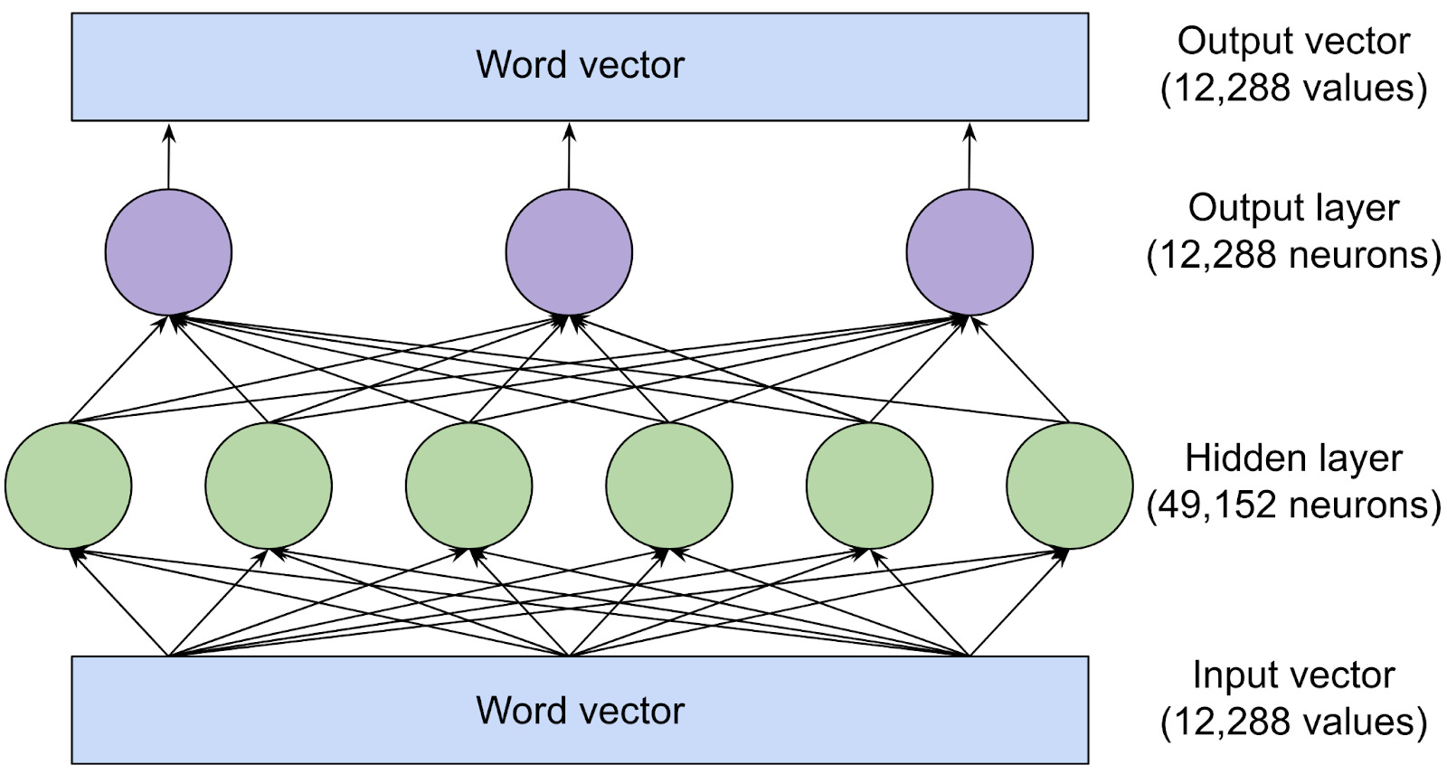
What is an LLM?

Slide 2
A Large Language Model predicts the next word/token in a sequence
It learns:
✅ Grammar & sentence structure
✅ Relationships between words (king ↔ queen)
✅ World knowledge (Mysuru, India, rulers, etc.)
Learned from billions of text examples → forms patterns, not stored facts

Slide 3
What happens when you type a prompt?
Example prompt:
“Who was the last king of Mysuru?”
LLM pipeline:
1 Break text into tokens
2 Convert tokens → vectors (embeddings)
3 Model processes vectors using learned parameters
4 Predicts next tokens → forms final answer

Slide 4
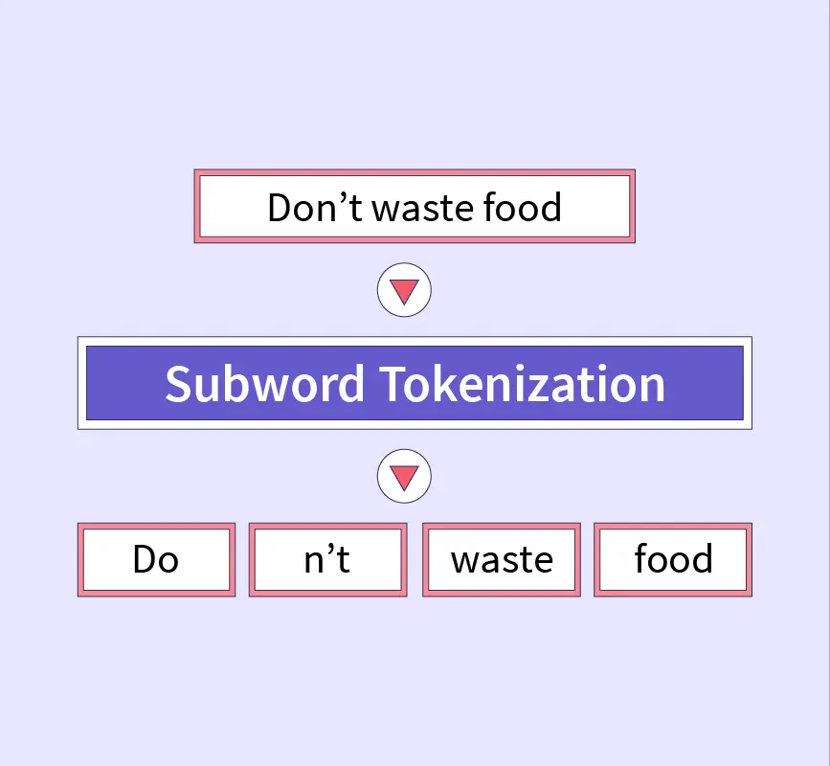
What is a Token?

Slide 5
What is a Token?
Smallest pieces of text model understands
Not always full words
Can be:
➤ Words
➤ Sub-words
➤ Characters
➤ Special symbols

Slide 6
Word-Based Tokenization
Splits on spaces/punctuation.
Pros: Simple, human-readable.
Cons: Rare words (e.g., "Mysuru") become "unknown" tokens (UNK), handled as [UNK].
Example: "Who was the last king of Mysuru?" → ["Who", "was", "the", "last", "king", "of", "Mysuru", "?"]

Slide 7
Subword Tokenization (e.g., Byte-Pair Encoding – BPE)
Merges frequent character pairs into subwords (e.g., "ing" or "un").
Pros: Handles rare words by breaking them (e.g., "Mysuru" → "Mys" + "uru"); smaller vocab.
Cons: Less intuitive splits.
How It Works: Start with characters, iteratively merge common pairs (e.g., "t" + "h" → "th").

Slide 8
Why subwords?
✔ Reduces vocabulary size
✔ Handles rare/new words like “Mysuru” better
✔ Efficient training

Slide 9
Character-Based Tokenization
Splits into single characters.
Pros: Tiny vocab (~100 tokens); no unknown words.
Cons: Long sequences (e.g., sentence needs 50+ tokens); slower processing.

Slide 10
Tokenization Techniques
Technique | How it splits | Pros | Cons | Models
Word-level | Full words | Simple | Fails on rare words | Old models
Character-level | Every character | Handles anything | Very long sequences | Some research
BPE (Byte Pair Encoding) | Frequent chunks | Good balance | Sometimes weird splits | GPT-2, Llama
WordPiece | Subword optimized | Great for search | Needs vocabulary | BERT
SentencePiece | Unicode-level | Multi-language | Requires training | GPT-3, PaLM

Slide 11
Differences Table:
Technique | Vocab Size | Handles Rare Words? | Speed | Example Split for "Mysuru"
Word-Based | Large | Poor (uses UNK) | Fast | ["Mysuru"]
Subword (BPE) | Medium | Good (subparts) | Medium | ["Mys", "uru"]
Character | Small | Excellent | Slow | ["M", "y", "s", "u", "r", "u"]

Slide 12
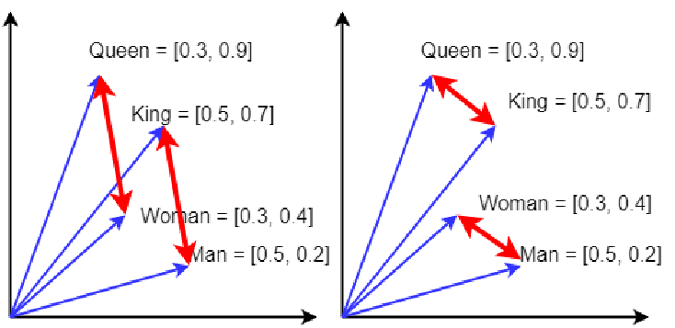
Embeddings: From Words to Vectors
Example semantic relation:
queen — king = woman — man
Embeddings give meaning, not just spelling

Slide 13
Embeddings: From Words to Vectors
What Are Embeddings? Numerical representations of tokens – high-dimensional vectors (e.g., 768 numbers) capturing meaning.
How Learned: During training on huge datasets, model adjusts vectors so similar words are "close" in space.
Vocabulary Example: Model trained on 50,000 unique tokens. "King" stored as: [0.23, -0.45, 1.12, ..., 0.67] (a 768-float vector).
Analogy: Like coordinates on a map – "king" at (5, 3), "queen" nearby at (5.1, 2.9) because they're related.
Process: Token ID → Lookup embedding table → Vector ready for math in the model.

Slide 14
What has the model “learned”?
LLMs learn statistical relationships from massive text corpus:
Example:
“king” → royalty, ruler, historical context
“Mysuru” → city in Karnataka, Wodeyar dynasty
So when prompt says:
→ “last king of Mysuru”
Model connects king + Mysuru via embeddings + learned knowledge
⚠️ It does not copy from database — it predicts based on patterns

Slide 15
The Model's "Brain" – Parameters and Processing
Parameters = weights inside neural network
Represent model memory + knowledge
Example sizes:
GPT-3: 175B | Llama2: 70B
Bigger parameters →
✔ Better understanding
✔ More knowledge
✘ More compute required

Slide 16
Transformer Architecture (Simplified)
Attention: Focuses on relevant tokens (e.g., "king" attends to "last" and "Mysuru").
Layers: Stack of math ops on embeddings to predict next token.

Slide 17
Tokens & Context Window
Model | Context Window
GPT-3 | 2K tokens
GPT-4 | up to 128K
Claude 3 Opus | 200K+

Slide 18
Full Pipeline Example – From Prompt to Answer
Prompt: "Who was the last king of Mysuru?" Tokenize (BPE): ["Who", " was", " the", " last", " king", " of", " Mys", "uru", "?"]
Embed: Each → Vector (e.g., "king" = [0.23, -0.45, ...])
Process: Model uses params to link "last king Mysuru" → Historical pattern match.
Generate: Predicts tokens: "The", " last", " king", " of", " Mysuru", " was", " Krishnaraja", " Wadiyar", " IV", "." (Within context window).

Slide 19
Quick Probability Example
Token | Probability
Jayachamarajendra | 0.65
Wadiyar | 0.20
Tipu | 0.05
Fake names | <0.02

Slide 20
Why do LLMs sometimes hallucinate?
No direct access to live facts (unless using RAG)
If training data is incomplete → model “fills gaps”
Prediction ≠ Truth
Fix:
✅ Retrieval-Augmented Generation (RAG)
✅ Guardrails
✅ Human review

