Slide 1

Project

Slide 2
Objectives
01
Project description
Understanding the project requirement and how to approach the problem.

Slide 3

Project Description

Slide 4

Blog Website
Problem statement
Jack Carter is a famous blogger of your area whose blog was in PHP wants to migrate into React. He came up to you and wants you to create an entirely new multipage blog. You decided to create his blog in ReactJS.

Slide 5
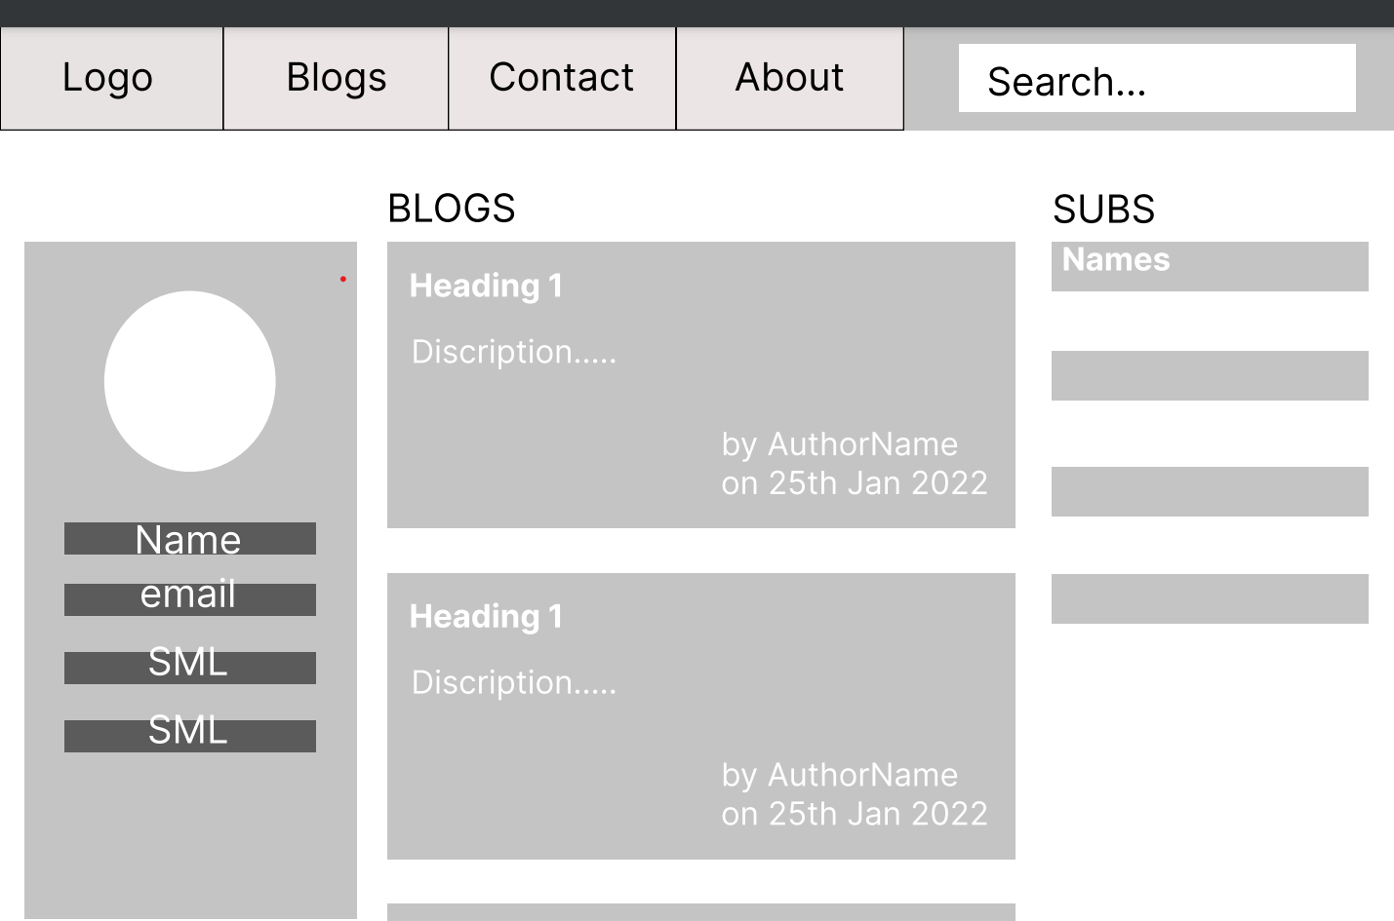
Features In Blog Website
Landing Page
Landing Page should contains list of some of his blogs and his brief profile. The Jack's profile should contain at least: profile picture of the blogger, name, social links. Landing page should also display total subscriber count and random subscriber name. Random name can be fetched from: https://randomuser.me/api

Slide 6

Features In Blog Website About Us
About Us page should contain complete profile of Jack. (Should contain at least: profile picture, name, description, gallery of his images/videos.

Slide 7
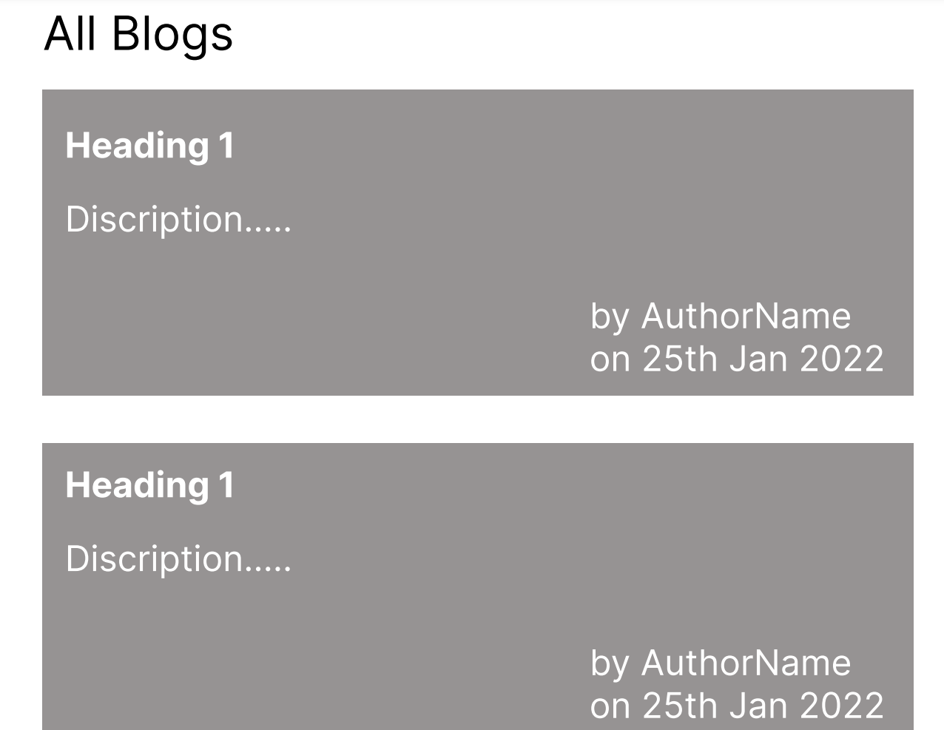
Features In Blog Website Blog Page
Blog Page should contain list of all the blogs posted by Jack

Slide 8
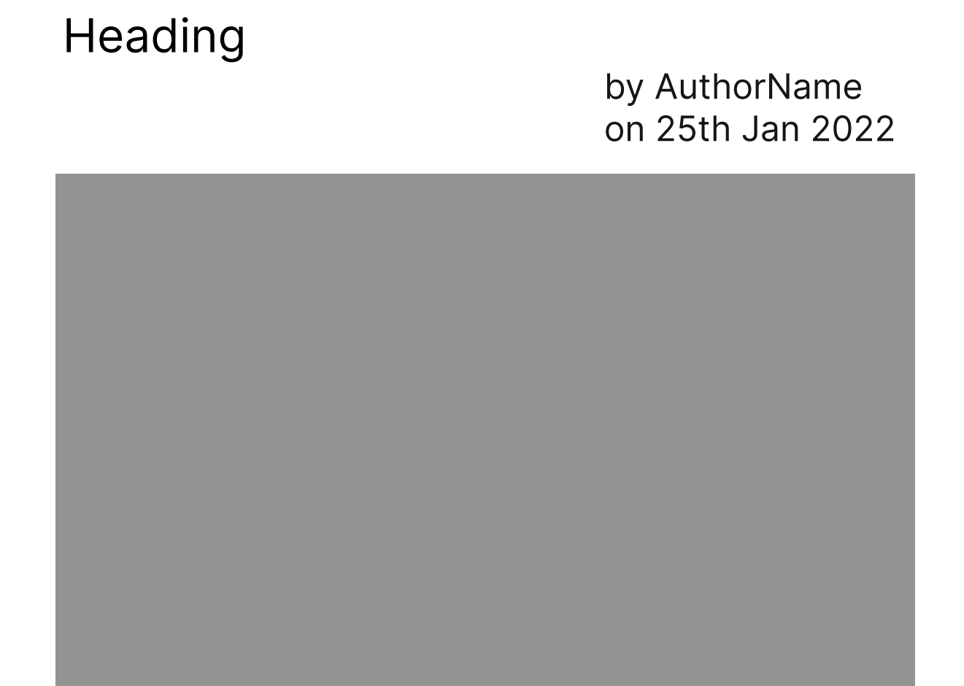
Features In Blog Website Blog Post Page
Blog Post Page should contain the blog content and the author who posted it with the date. It should also contain the category of the blog post and number of likes the blog got.

Slide 9
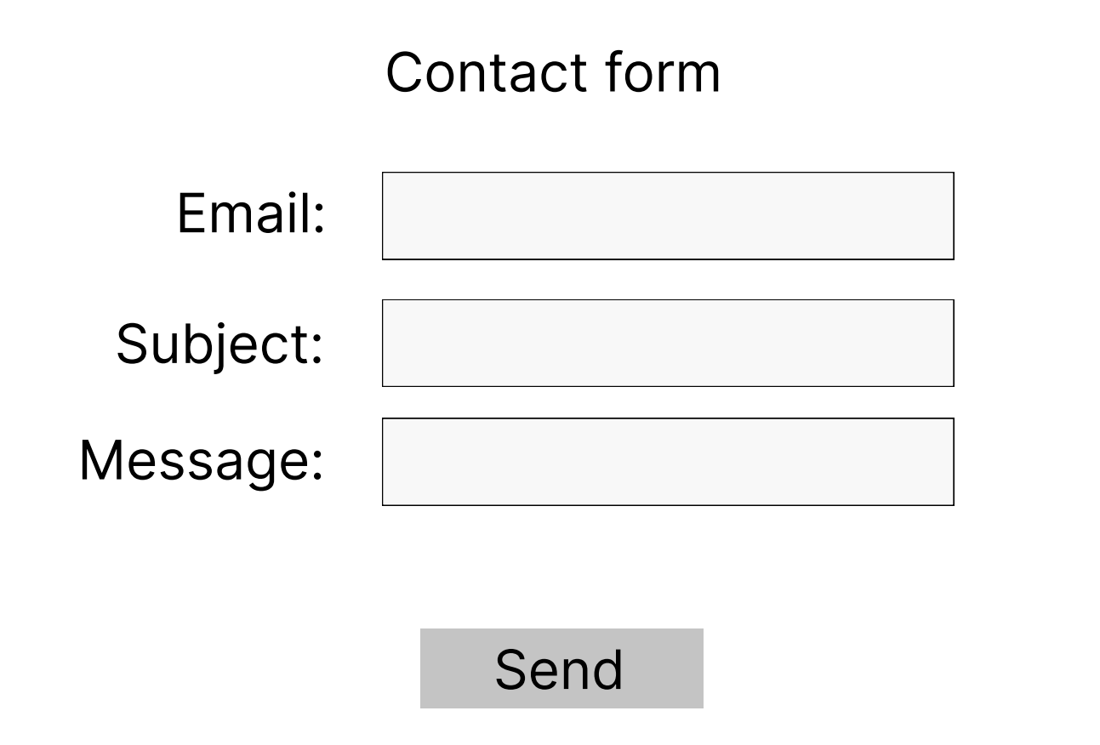
Features In Blog Website Contact Us Page
Contact Us Page should contain a form from where Jack can be contacted. Once submitted it should display that form got submitted and the data should be printed in console.

Slide 10
Hands-on

Slide 11


