Slide 1

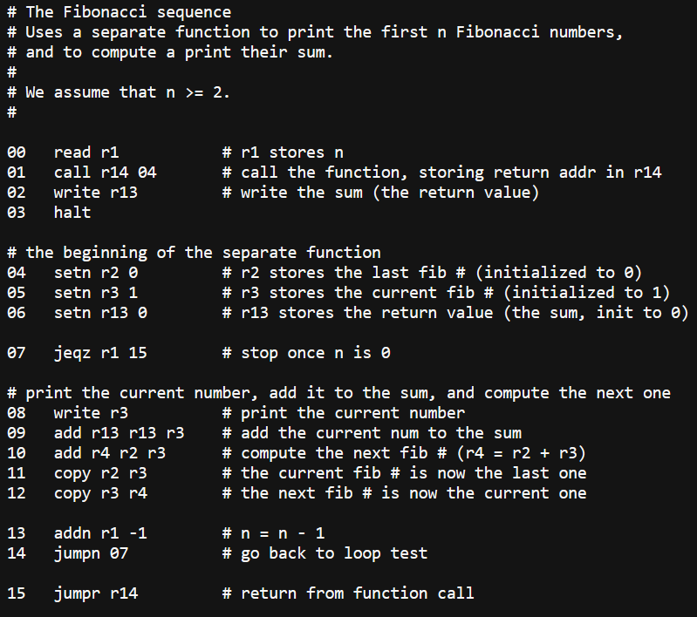
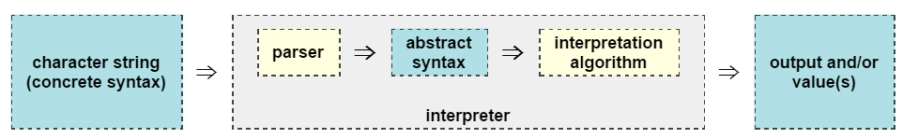
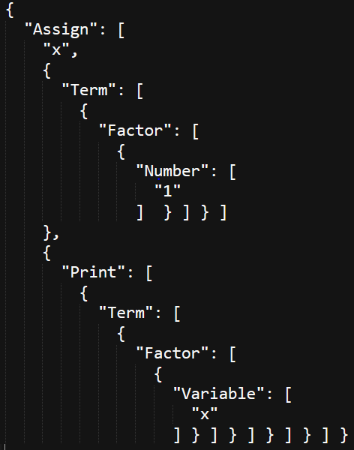
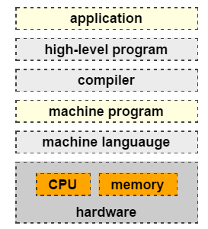
Bridge: Development of an Intermediary Programming Language
Vidhu Nath
Advisor: Andrei Lapets, Ph.D., The Rafik B. Institute for Computing and Computational Science
Abstract
Components
Background
Language
This Keystone Project is the creation of a small, contained, and functional programming language that can be used to introduce non-technical users to the concepts of computer science and programming. It has three main goals:
Create a language is user friendly
Develop the tokenizer, parser, and interpreter components of the language
Spread simple understanding of programming concepts.
With these three goals, Bridge has been designed with user interaction in mind, and aims to provide users with the confidence to use programming languages.
There are three main components of Bridge: the tokenizer, the parser, and the interpreter. The general structure of a programming language is as below, courtesy of Andrei Lapets:
Below is a more comprehensive representation:
Consider the following input, which is called concrete syntax:
x = 1; print x
The tokens produced by the tokenizer on this input would be:
[“x”, “=“, “1”, “;”, “print”, “x”]
These tokens would be read into the parser, which outputs the following abstract syntax:
The interpreter takes this result to output the result of running the code:
1
This is the output of the “print” on the variable “x”.
The foundation of a programming language is the series of low-level instructions it provides the hardware. These instructions take form as assembly language, which directly interacts with the machine. Below is an example of assembly:
Programming languages are the basis for any software, from Facebook to MacOS to video games. Any application which relies on a programming language can be represented as below:
The combination of the high-level code typed with the low-level instructions is what produces all of the software that exists.
A programming language and its functionality can be represented by its Backus-Naur Form (BNF). Below is the BNF for Bridge:
Program ::=
Assign | assign variable := expression ; program
Print | print expression
For | for term times program ; program
If | if formula program ; program
End | end
Expression ::= term | formula
Formula ::=
And | formula and formula
Or | formula or formula
Not | not formula
Greater Than | term gt term
Less Than | term lt term
Greater Than/Equal | term ge term
Less Than/Equal | term le term
Equal | term eq term
True | true
False | false
Term ::=
Plus | term + term
Minus | term – term
Factor | factor
Factor ::=
Mult | term * term
Div | term / term
Power | term ^ term
Mod | term % term
Number | (0[1-9][0-9]*)
Variable | [a-z][A-Za-z]*
Objectives
The purpose of Bridge is to provide a means of bringing programming understanding to a population that otherwise might avoid such a pursuit. The goal is not to produce many high-level programmers, but to excite every day users about the possibilities and potential within programming. By including only a limited functionality, Bridge encapsulates the ideas of programming without overwhelming users with features.
Acknowledgements
I would like to thank Professor Andrei Lapets for being my advisor; Eric Dunton for being a valuable resource; Rachel Costa and Lauren Mattera for testing my language. Also a very special thank you to Charles Dellheim and the entirety of Kilachand Honors College and Boston University.

