Slide 1
WHO Data Mining Experiment
Vidhu Nath
CS 591 - DM

Slide 2
About the Dataset - WHO
Variety of health, economic, environmental, commercial, and political indicators
358 columns/features
Extracted from various sources like the World Bank, UNAIDS, International Labour Organization, and WHO itself
Comprehensive categorization
Brackets for education levels and economic indicators
Male, Female, Infant, Youth, and Total categories for cancers and diseases
Many features means tougher choices for which to use effectively/uniquely
Data collect from 1990-2011 as averages, lends itself to linear regressions

Slide 3
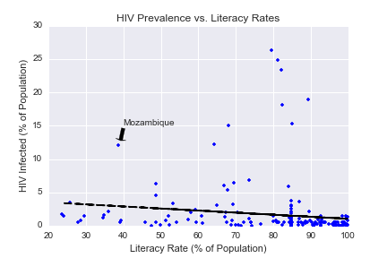
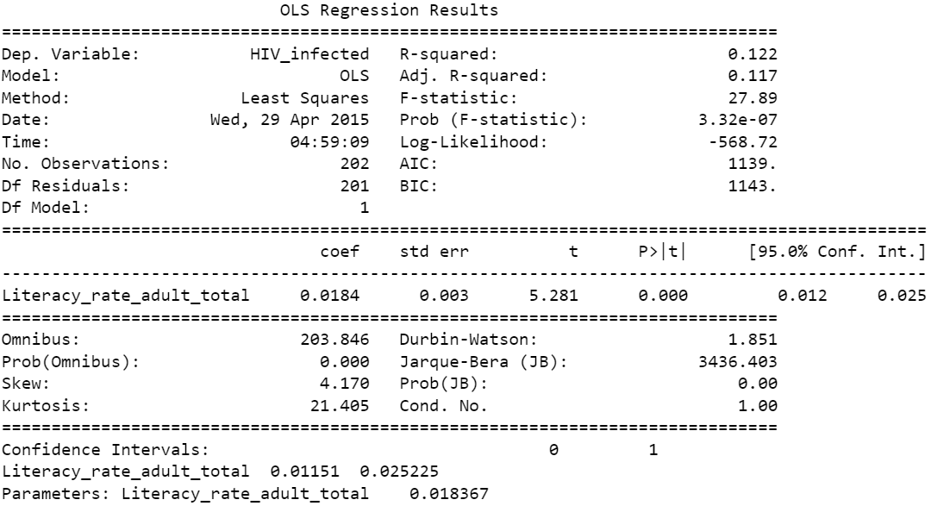
Hypothesis 1.0: Do higher literacy rates correlate to lower HIV/AIDS incidences?
Justification: HIV/AIDS is preventable in most situations, education helps provide reasons and means for prevention
Linear regression results:
R-squared: 0.122; Adjusted R-squared: 0.117; F-statistic: 27.89
Conclusion: Weak correlation, many extenuating factors (location, traditions, etc.)

Slide 4
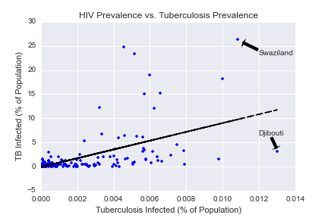
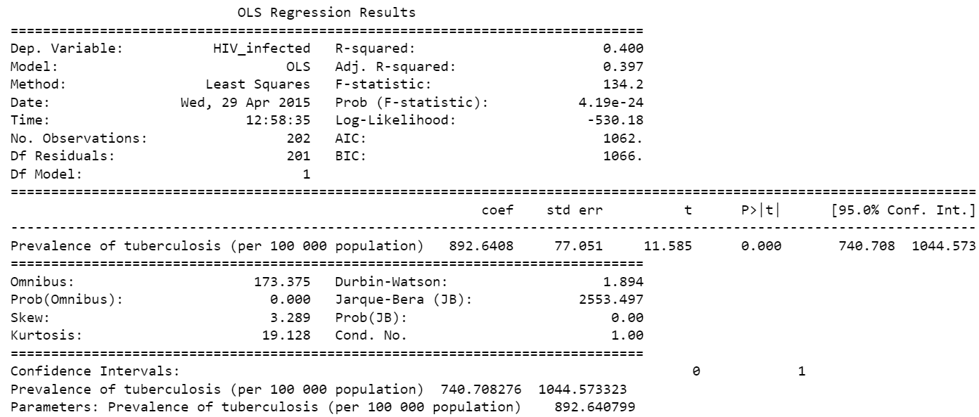
Hypothesis 1.1: Do HIV/AIDS rates correspond to Tuberculosis rates?
Justification: Diseases might group together as they spread, especially infectious diseases
Results:
R-squared: 0.400; Adjusted R-squared: 0.397; F-statistic: 134.2
Conclusion: Medium-Weak correlation, mostly likely due to low-economic regions where both are more prevalent than in better economic regions

Slide 5
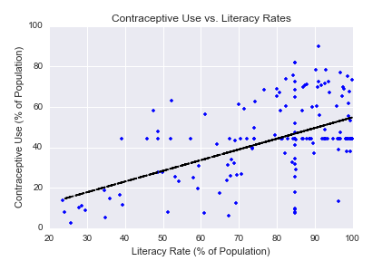
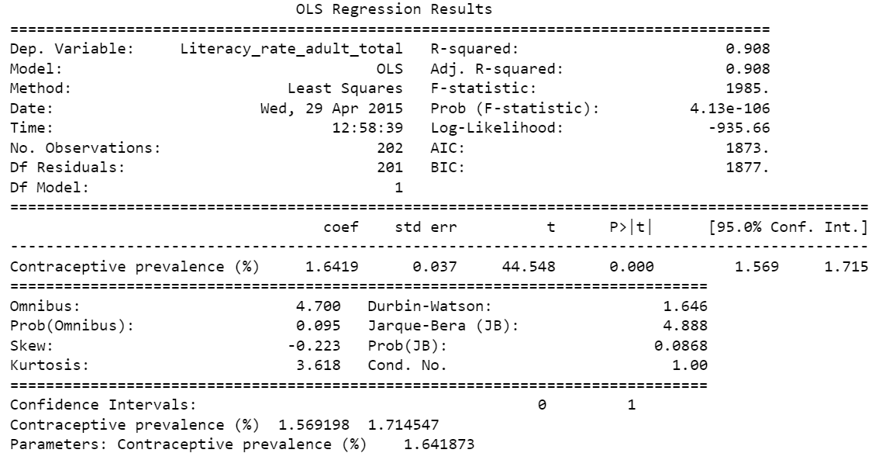
Hypothesis 1.2: Do higher literacy rates correspond to higher contraceptive use?
Justification: More education means more use of contraceptives – doesn’t directly relate to HIV/AIDS prevalence
R-squared: 0.908; Adjusted R-squared: 0.908; F-statistic: 1985.
Conclusion: Very strong correlation, interesting due to previous graph, high F-stat means something else might be going on

Slide 6
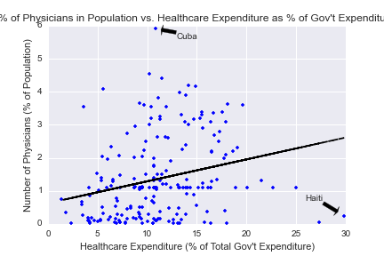
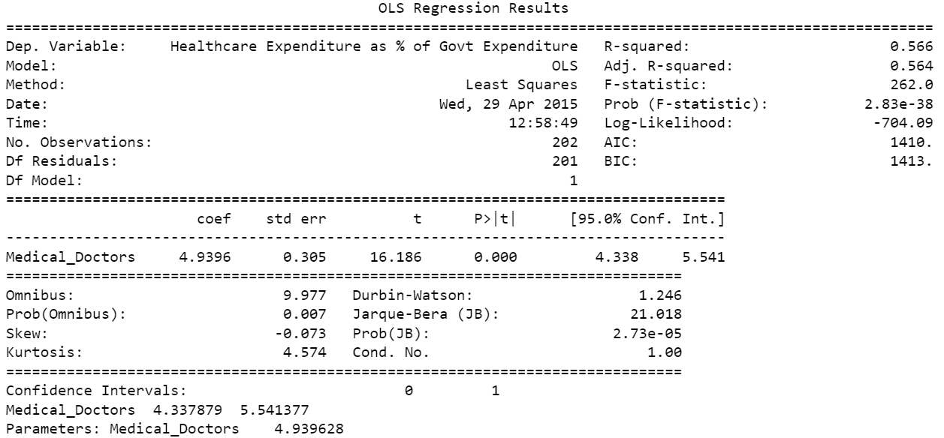
Hypothesis 2.0: Does high government expenditure in healthcare mean more doctors in the population?
Justification: Higher spending in healthcare would mean more opportunities for doctors in terms of demand and in opportunities -> better compensation
R-squared: 0.566; Adjusted R-squared: 0.564; F-statistic: 262.0
Conclusion: Medium Correlation, Possibly to extenuating factors in population sizes and densities. Also, lower income nations would be less willing to spend more per person on healthcare

Slide 7
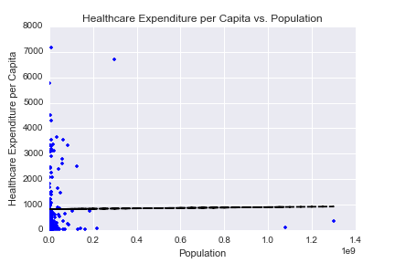
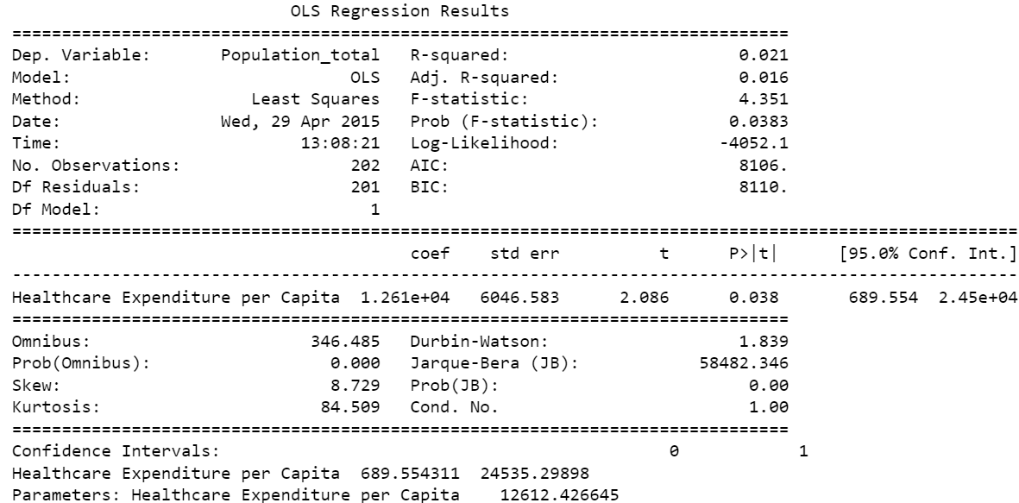
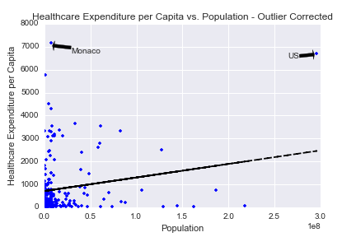
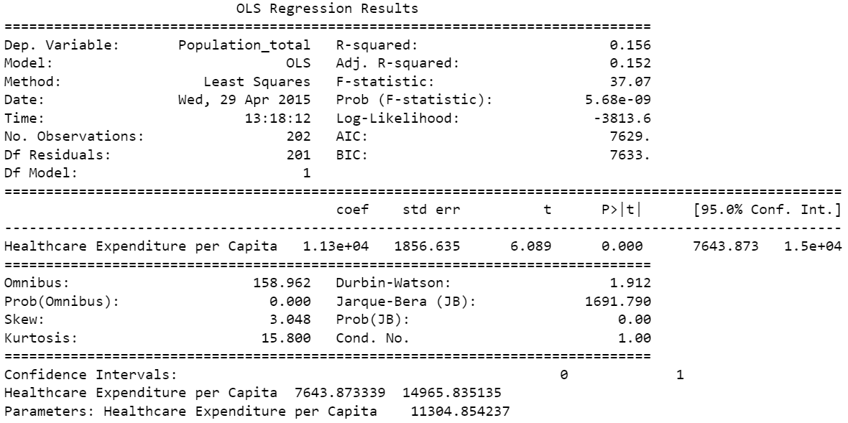
Hypothesis 2.1: Do higher populations lead to higher healthcare expenditure per person?
Justification: More population means more taxes and more demand for healthcare.
R-squared: 0.156; Adjusted R-squared: 0.152; F-statistic: 37.07
‘
Conclusion: Weak correlation even after removing two biggest outliers. Maybe removing more improve results. Might be due to disparities in quality of life in countries due to wealth

Slide 8
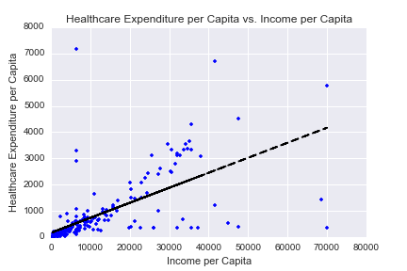
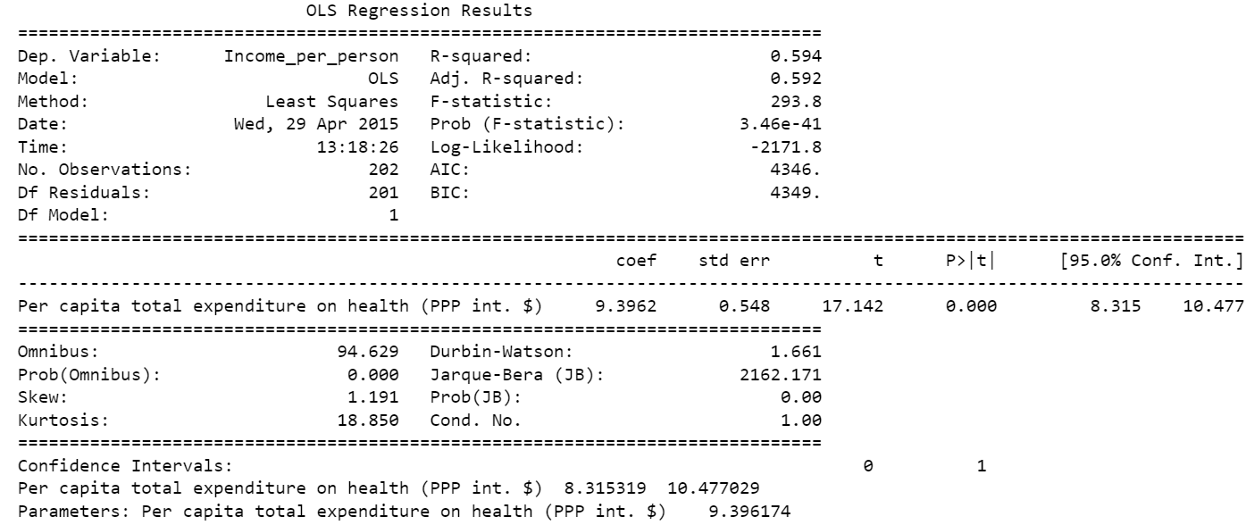
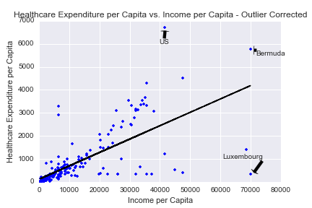
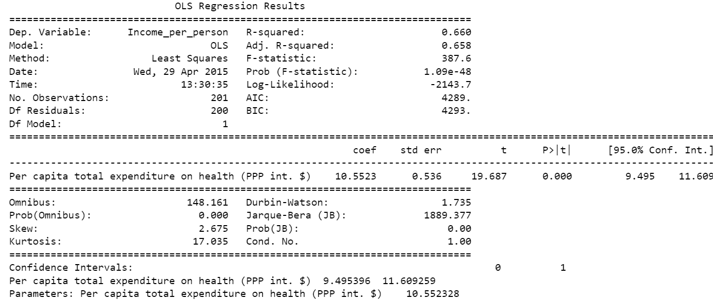
Hypothesis 2.2: Do people who earn more per person spend more on healthcare per person?
Justification: More disposable income would mean more spending on healthcare
R-squared: 0.660; Adjusted R-squared: 0.658; F-statistic: 387.6
Conclusion: Medium/strong correlation, might be indicative of wealthier nations spending more, but might be extenuated by disparities in quality of life

Slide 9
What is the most prevalent disease in each country in the world?
Approach:
Collect male + female statistics on cancer deaths
Create labels to iterate through to apply to country series
Define a max-value function to determine the highest disease rate
Map countries to disease types
Conclusions: Stomach Cancer is the most prevalent cancer in the world
Pretty much worldwide

