Slide 1
Main presentation title
Subtitle if needed Your name

Slide 2
Slide header
Some content
list 1
list 2

Slide 3
Section header

Slide 4
Tables
 | mpg | cyl | disp | hp | drat
Mazda RX4 | 21.0 | 6 | 160 | 110 | 3.90
Mazda RX4 Wag | 21.0 | 6 | 160 | 110 | 3.90
Datsun 710 | 22.8 | 4 | 108 | 93 | 3.85
Hornet 4 Drive | 21.4 | 6 | 258 | 110 | 3.08
Hornet Sportabout | 18.7 | 8 | 360 | 175 | 3.15
An example table

Slide 5
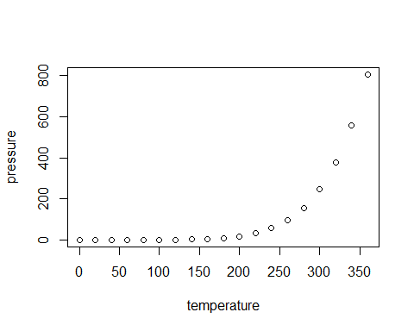
Plots

Slide 6
Columns & Images
Content of the left column.
list 1
list 2
Content of the right column.
list 1
list 2

