Slide 1
Untitled
Your Name

Slide 2
Test
Content of the left column.
Content of the right column.

Slide 3
Table
speed | dist
4 | 2
4 | 10
7 | 4
7 | 22
8 | 16
9 | 10
Sepal.Length | Sepal.Width | Petal.Length | Petal.Width | Species
5.1 | 3.5 | 1.4 | 0.2 | setosa
4.9 | 3.0 | 1.4 | 0.2 | setosa
4.7 | 3.2 | 1.3 | 0.2 | setosa
4.6 | 3.1 | 1.5 | 0.2 | setosa
5.0 | 3.6 | 1.4 | 0.2 | setosa
5.4 | 3.9 | 1.7 | 0.4 | setosa

Slide 4
Slide with ggplot
pressure
200
400
600
800
0
0
100
200
300
temperature

Slide 5
Slide with ggplot
800
600
pressure
400
200
0
0
100
temperature
200
300

Slide 6
ggplot in left column

Slide 7
ggplot in right column
Some
Bullets
pressure
200
400
600
800
0
0
100
200
300
temperature

Slide 8
ggplot in both columns
pressure
200
400
600
800
0
0
100
200
300
temperature

Slide 9
custom plot locations
pressure
0
0
200
temperature
800
pressure
400
0
0
100
200
300
temperature

Slide 10
Section header

Slide 11
Section header (Slide 3)

Slide 12
Slide Title (Slide 4)

Slide 13
 | mpg | cyl | disp | hp | drat
Mazda RX4 | 21.0 | 6 | 160 | 110 | 3.90
Mazda RX4 Wag | 21.0 | 6 | 160 | 110 | 3.90
Datsun 710 | 22.8 | 4 | 108 | 93 | 3.85
Hornet 4 Drive | 21.4 | 6 | 258 | 110 | 3.08
Hornet Sportabout | 18.7 | 8 | 360 | 175 | 3.15
An example table

Slide 14
Slide content header (Slide 4)

Slide 15
Slide content header (Slide 4)

Slide 16
Slide Title (Slide 4)

Slide 17
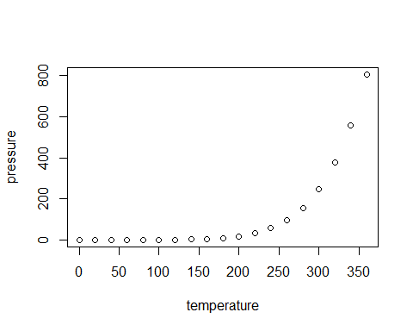
TRUE

