Slide 1
Untitled
Sub-title Your Name

Slide 2
In the morning

Slide 3
Test text

Slide 4
Table
 | mpg | cyl | disp | hp | drat
Mazda RX4 | 21.0 | 6 | 160 | 110 | 3.90
Mazda RX4 Wag | 21.0 | 6 | 160 | 110 | 3.90
Datsun 710 | 22.8 | 4 | 108 | 93 | 3.85
Hornet 4 Drive | 21.4 | 6 | 258 | 110 | 3.08
Hornet Sportabout | 18.7 | 8 | 360 | 175 | 3.15
An example table

Slide 5
Breakfast
Eat eggs
Drink coffee

Slide 6
Dinner
Eat spaghetti
Drink wine

Slide 7
Dinner
Eat spaghetti
Drink wine

Slide 8
Dinner
Eat spaghetti
Drink wine

Slide 9
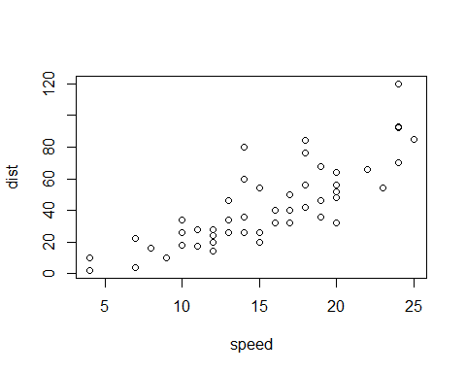
A scatterplot.

Slide 10
Going to sleep
Get in bed
Count sheep

