Slide 1

Music Recommendation System
Milestone 1

Slide 2


Context:
* With the ever-increasing volume of songs on the Internet, searching for songs of interest has become a tedious task for users. Every Internet based company wants to increase customer time spent on their platform and increase company’s revenue.
* Smart Recommendation systems can recommend songs based on users’ likes/dislikes among millions of customers and billions of songs. Win-Win for customers and internet-based companies.
Objective:
Build a Recommendation system to propose the top 10 songs for a user based on the likelihood of listening to those songs and further increasing customer time spent on the platform.

Slide 3

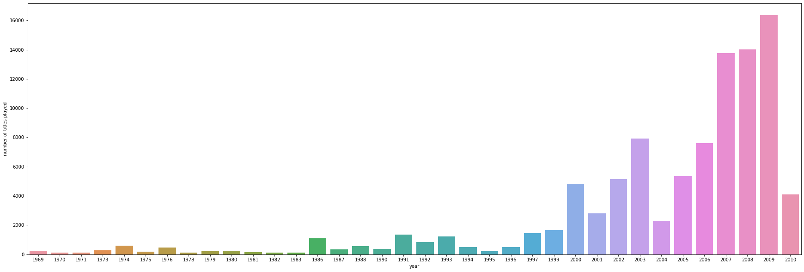

Key Questions:
What kind of content customers are most likely to consume.
What are the most popular songs to suggest a new user.
Identify songs for existing users that are similar to their listening history.
Identify users who have similar tastes in music and recommend similar songs to them.
Identify songs based on ratings, reviews, artists, genre, year released etc.
Majority titles played were from year 2009 followed by 2008, 2007, 2003 and 2006.
Data Source
http://millionsongdataset.com/

Slide 4

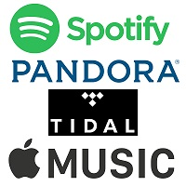

PROPOSED MODEL SOLUTION
* Popularity-Based Recommendation System using the Data Exploration.
* Similarity-Based Collaborative Filtering recommendation System
* User-User
* Item-Item
* Model Based Collaborative Filtering –Matrix Factorization
* Cluster Based Recommendation System
* Content Based Recommendation System
Measures of success
Explore models, Fine-tune the Hyperparameters, Evaluate performance using the below
parameters.
Precision@k
Recall@k,
F1_score@k
RMSE
Recommend Top 10 songs from the High-Performance Recommendation system to the users.

Slide 5

THANK YOU!

