Slide 1

DengueSeq Analysis Pipeline
https://github.com/grubaughlab/DENV_pipeline
Ammar Aziz – VIDRL

Slide 2
Objectives
Demonstrate how to download and install the DENV_Analysis pipeline
Understand how the pipeline operates
Understand how to run the pipeline
Interpret pipeline outputs

Slide 3
How does DengueSeq analysis pipeline work?
Reads
.fastq
Alignment
.bam
Consensus
.fasta
Reads mapped to references
Contiguous sequence extracted

Slide 4
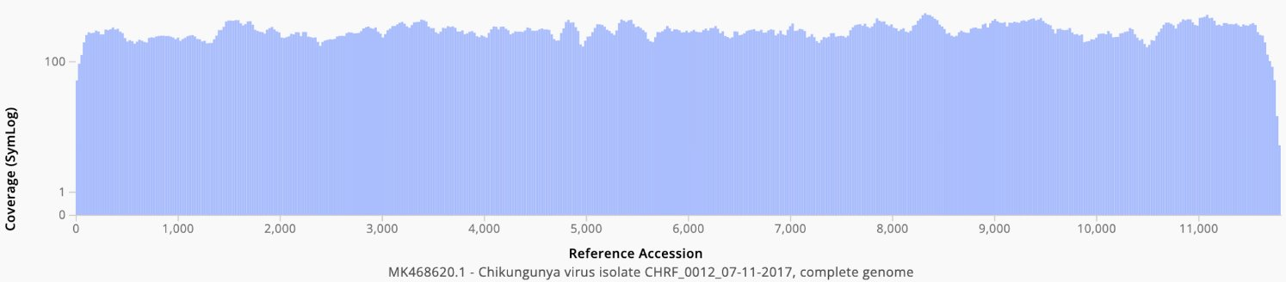
How does DengueSeq analysis pipeline work?
Align to reference using BWA-MEM
Convert SAM to BAM using samtools
Sort bam file
Trim primers using iVar
Create consensus using iVar by applying SNPs to reference
Calculate coverage using samtools
DENV1​
DENV2​
DENV2-Sylvatic​
DENV3​
DENV4​
DENV4-Sylvatic​
Finally – select consensus genome with highest coverage​

Slide 5
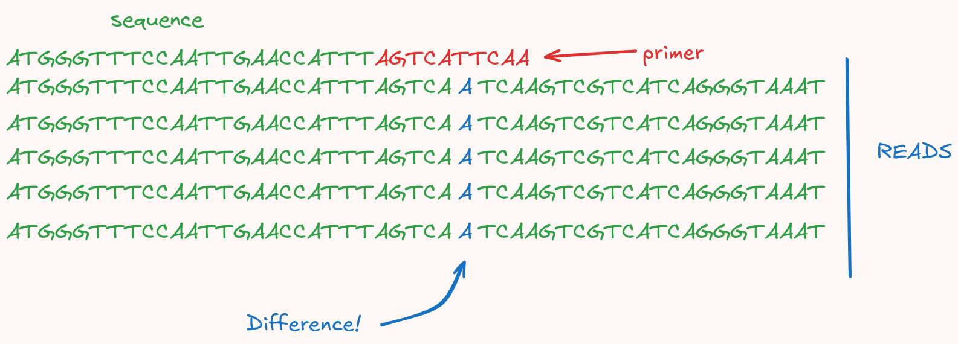
Why trim primers?
Primer sequence can not be incorporated into consensus sequence

Slide 6
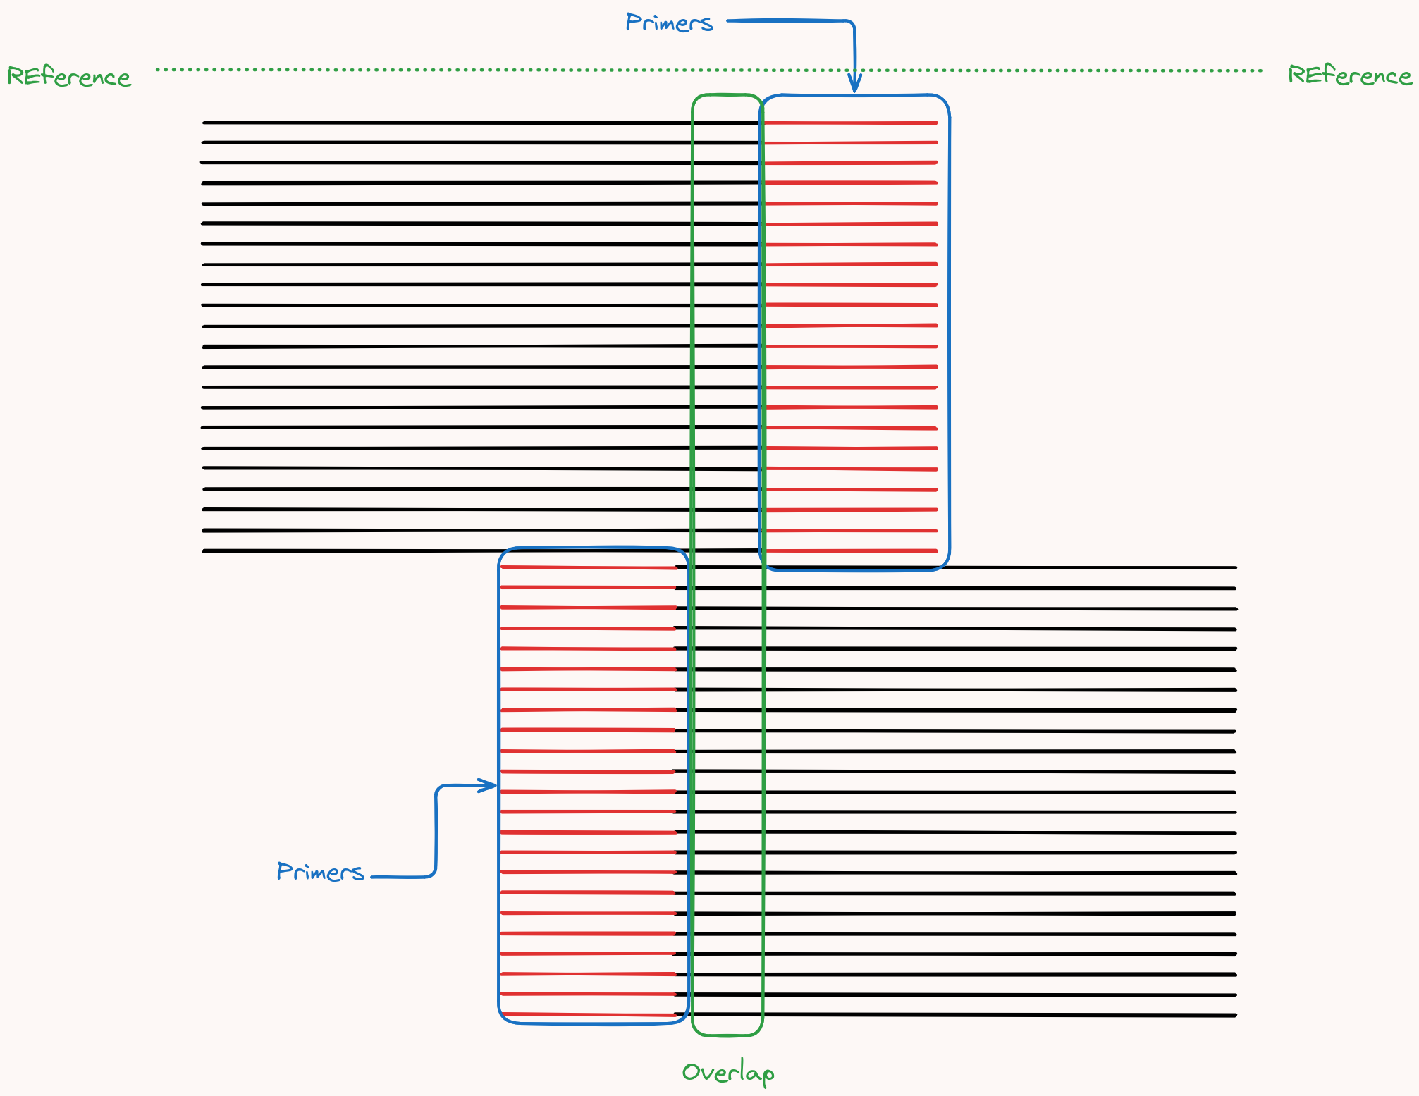
Why trim primers?
No information loss because of amplicon design.
Primers overlap

Slide 7
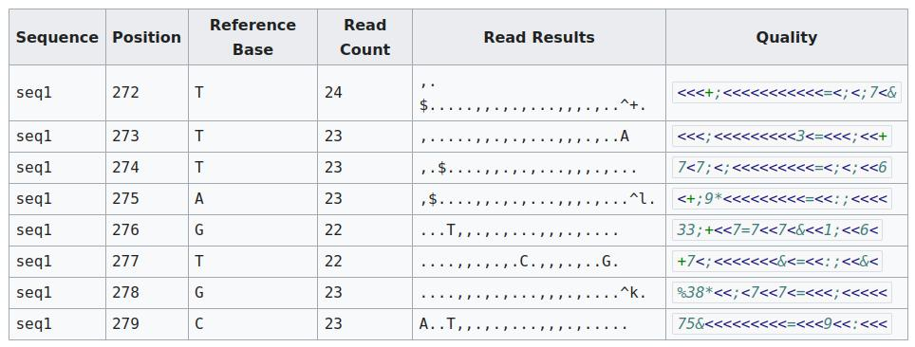
How is a consensus created?
Create consensus using iVar by applying SNPs to reference
Two methods – essentially the same:
Use a dedicated variant caller to identify mutations (SNPs, INDELs), then apply mutations to reference
Use the samtools mpileup format – take the majority call
iVar uses the mpileup format
https://en.wikipedia.org/wiki/Pileup_format

Slide 8
Next steps
Analysis pipeline is only available through command line interface.
We must learn CLI + Conda to install and run the pipeline

Slide 9
Questions?

