Slide 1

Introduction to CLI
Adapted from Software Carpentries: https://datacarpentry.github.io/shell-genomics/01-introduction.html
Ammar Aziz – VIDRL

Slide 2
Objectives
Describe key reasons for learning shell.
Navigate your file system using the command line.
Access and read help files for bash programs and use help files to identify useful command options.
Demonstrate the use of tab completion, and explain its advantages.

Slide 3
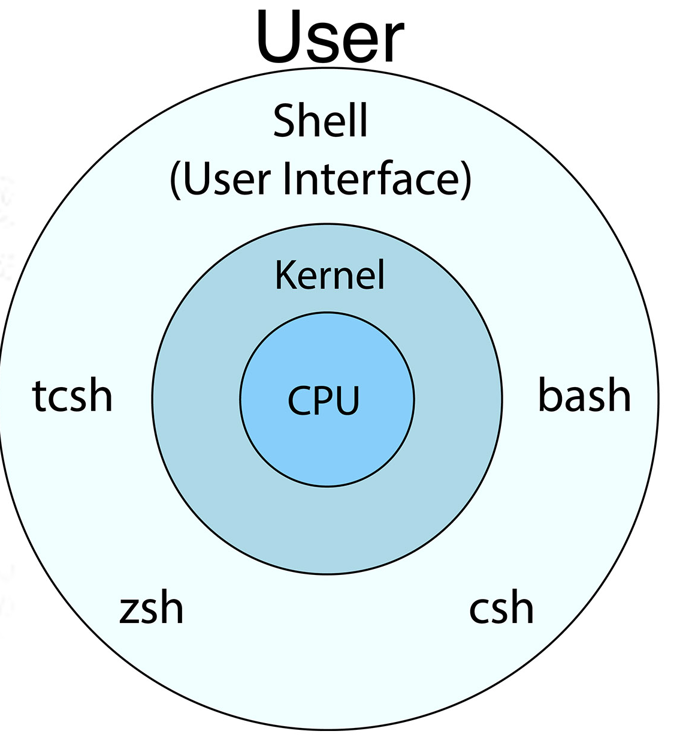
What is a shell?
A shell is a computer program that presents a command line interface which allows you to control your computer using commands entered with a keyboard instead of controlling graphical user interfaces (GUIs) with a mouse/keyboard/touchscreen combination.

Slide 4
Why should (you) care?
Many bioinformatics tools can only be used through a command line interface.
Automate your work.
Less error-prone and more reproducible
It also gives you a way to communicate unambiguously what you’ve done, so that others can inspect or apply your process to new data.
Many bioinformatic tasks require large amounts of computing power.
These tasks require large compute clusters

Slide 5



How to access the shell - Windows
Command Prompt – deprecated?
Not useful for bioinformatics
PowerShell – use this one
Can run Conda/CLI tools
More modern, similar commands and behavior to Linux
Not posix compatible but good fine for conda
Windows Terminal - Ignore
Runs all the above shells and more in one program
Ignore

Slide 6
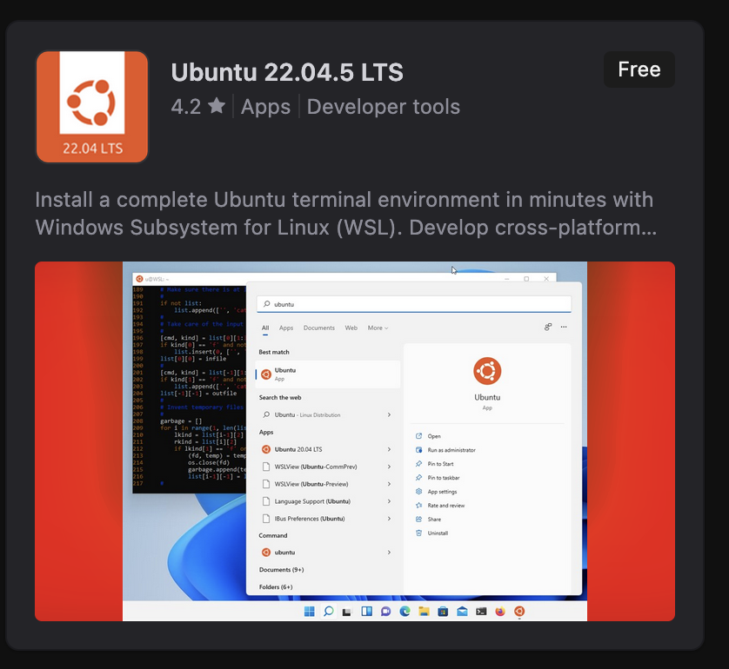

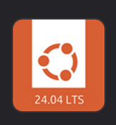
How to access the shell – Linux in My Windows?
Windows introduced a Linux compatibility layer which allows running Linux inside Windows.
Linux terminal in Windows! Perfect for bioinformatics.
Install from Windows Store

Slide 7

How to access the shell - MacOS
Simply called Terminal
Can run nearly all bioinformatics CLI tools
Flavor: zsh
Note on architecture:
The 'silicon' models of Macbooks run ARM architecture, different than 'standard' Intel/AMD x86.
Some bioinformatics tools will not run on ARM due to missing software
Rapidly improving due to cross compilation to ARM

Slide 8
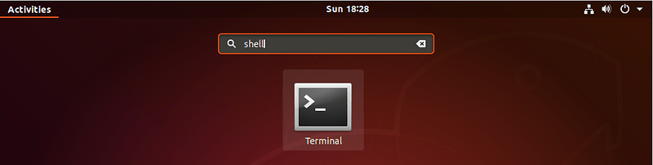
How to access the shell – Linux (Ubuntu)
Called Terminal
Flavor: Bash
We will focus on Linux (Ubuntu) terminal - concepts apply to all

Slide 9
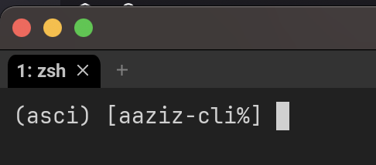
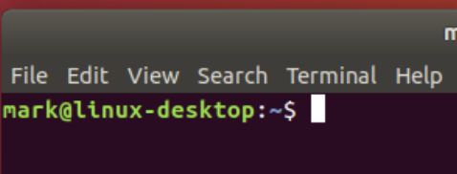
Terminal Basics - Prompt
The dollar sign is a prompt, which shows us that the shell is waiting for input; your shell may use a different character as a prompt and may add information before the prompt. When typing commands, either from these lessons or from other sources, do not type the prompt, only the commands that follow it.
Prompts can be changed!

Slide 10
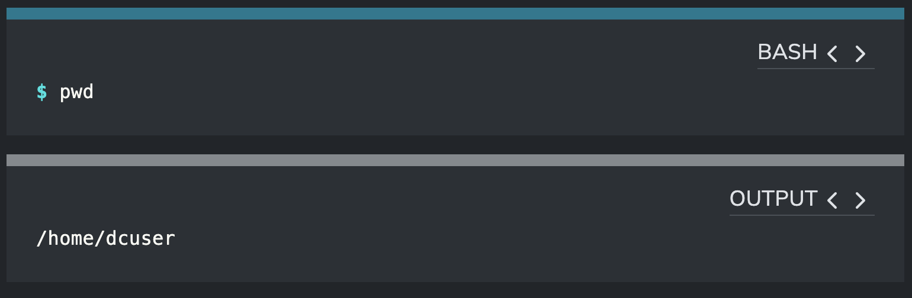
Navigating - pwd
Enter 'pwd'
You should see a directory path printed out (probably something like /home/YOUR_USERNAME)

Slide 11
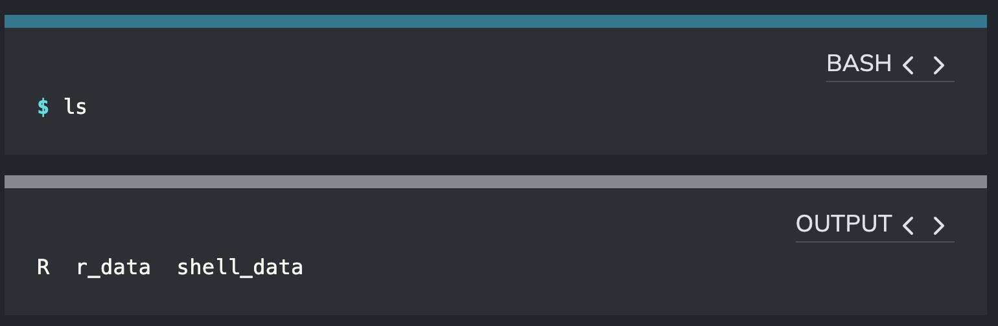
Navigation - ls
The command 'ls' short for listing shows the contents of the current working directory

Slide 12
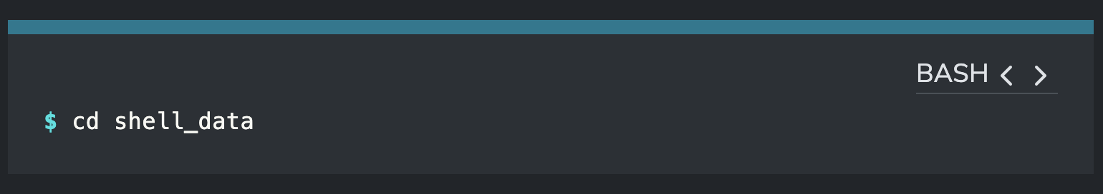
Navigation - cd
The command 'cd' (changed directory) allows us to move into a folder – changing the working directory

Slide 13
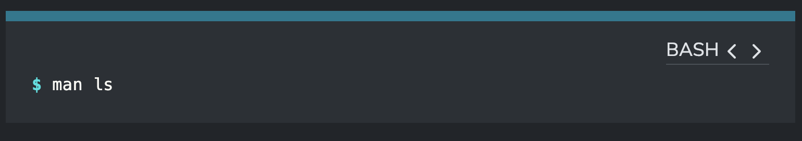
Commands - help
Use the command 'man' (short for manual) to show the help pages

Slide 14
Demonstration – listing files and entering directories

Slide 15
Tab completion

Slide 16
File system (FS)
File system controls the location and access to files on your system:
Location of the files
Size
Metadata
Permissions
And much more
Understanding the FS system is important for navigating and manipulating files

Slide 17
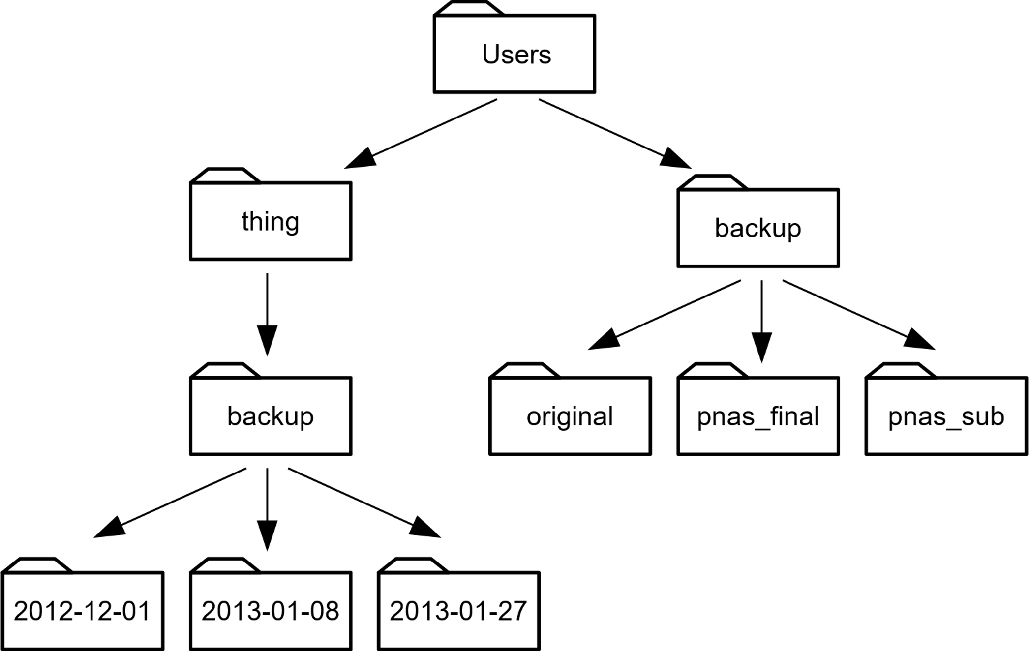
The file system
Most file systems have a tree like structure.

Slide 18
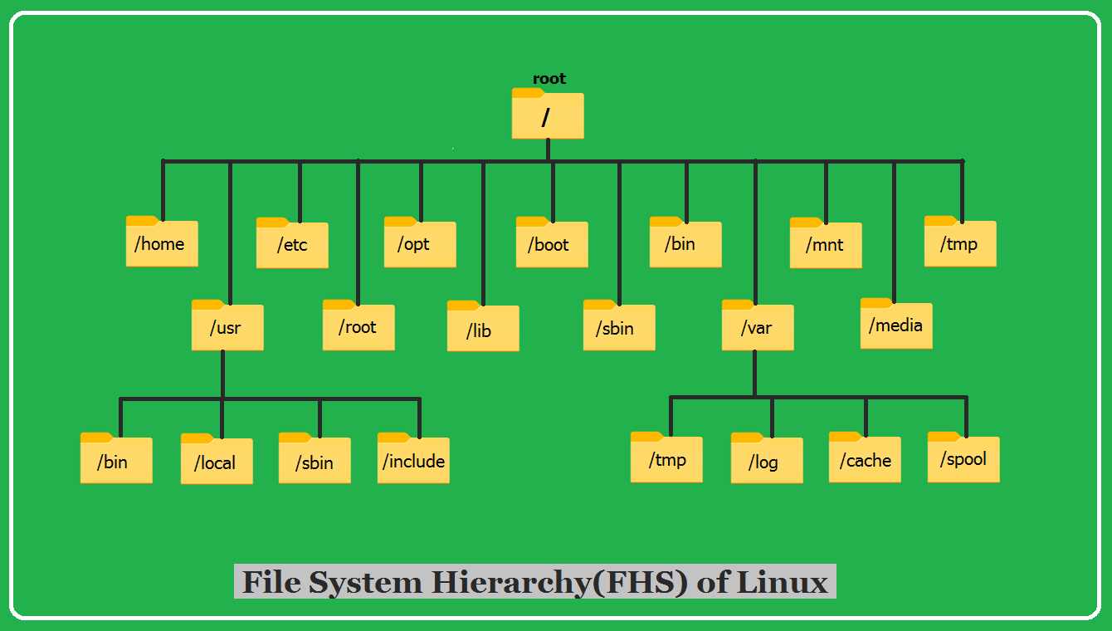
Top most level
Your files are
here!
NOT where your files live!

Slide 19
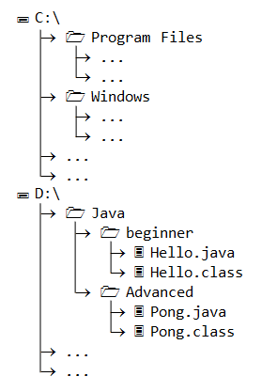
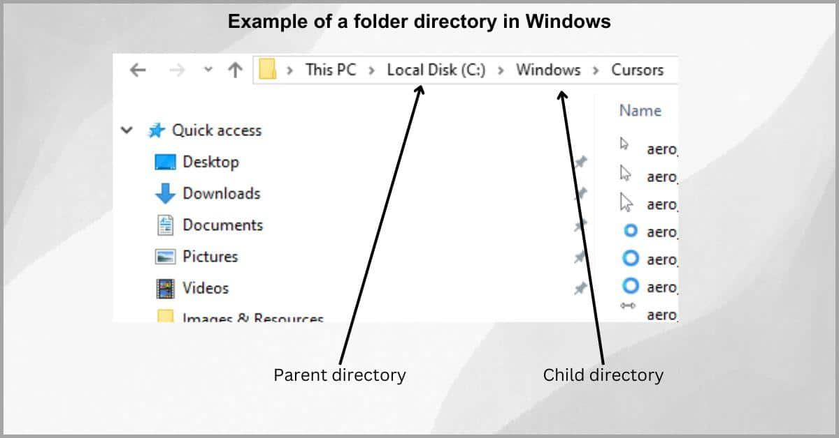
Windows FS

Slide 20
Finally
The shell gives you the ability to work more efficiently by using keyboard commands rather than a GUI.
Useful commands for navigating your file system include: ls, pwd, and cd.
Most commands take options (flags) which begin with a -.
Tab completion can reduce errors from mistyping and make work more efficient in the shell.

Slide 21
Questions? + Resources for future learning
Data Carpentry is excellent:
https://datacarpentry.github.io/shell-genomics/01-introduction.html
https://sandbox.bio (based on Carpentries):
https://sandbox.bio/tutorials/carpentries-shell-novice/
In browser interactive learning – check it out!
Much more bioinformatics training at https://sandbox.bio/
Test your skills at https://cmdchallenge.com
Hardcore: Aaron Quinns University course:
https://github.com/quinlan-lab/applied-computational-genomics
Slides, videos, homework

