Slide 1

Introduction to Conda
Ammar Aziz – VIDRL

Slide 2
Objectives
What is Conda
What problems Conda solves
How to use Conda to install bioinformatics tools/software
Learn briefly about virtual environments

Slide 3
Software (tool) Management
Installing bioinformatics software was often very challenging.
Each tool or program can have many dependencies
Snippy has 17 software dependencies
Each of those can have their own dependencies!
Updating software adds even more complexities
Different software has different dependencies – leading to conflicts – how do you resolve these?
The default install mode was installing system-wide*
Creates complex dependencies between your research projects that shouldn’t really exist!
* virtual environments (Environment Modules) on linux have been around since 1990s but required advanced Linux knowledge to setup and maintain.

Slide 4
Conda – the scientific software manager
Conda can quickly install, run, and update packages and their dependencies.
Conda can create, save, load, and switch between project specific software environments on your local computer.
Although Conda was created for Python programs, Conda can package and distribute software for any language such as R, Ruby, Lua, Scala, Java, JavaScript, C, C++, FORTRAN.

Slide 5
Why use Conda
Conda provides prebuilt packages, avoiding the need to deal with compilers
Conda is cross platform, with support for Windows, MacOS, GNU/Linux, and support for multiple hardware platforms, such as x86 and ARM.
Conda allows for using other package management tools (such as pip) inside Conda environments
Anaconda (software distribution) provides commonly used data science libraries and tools, such as R, NumPy, SciPy and TensorFlow built using optimised, hardware specific libraries
This requires commercial license – use with care

Slide 6
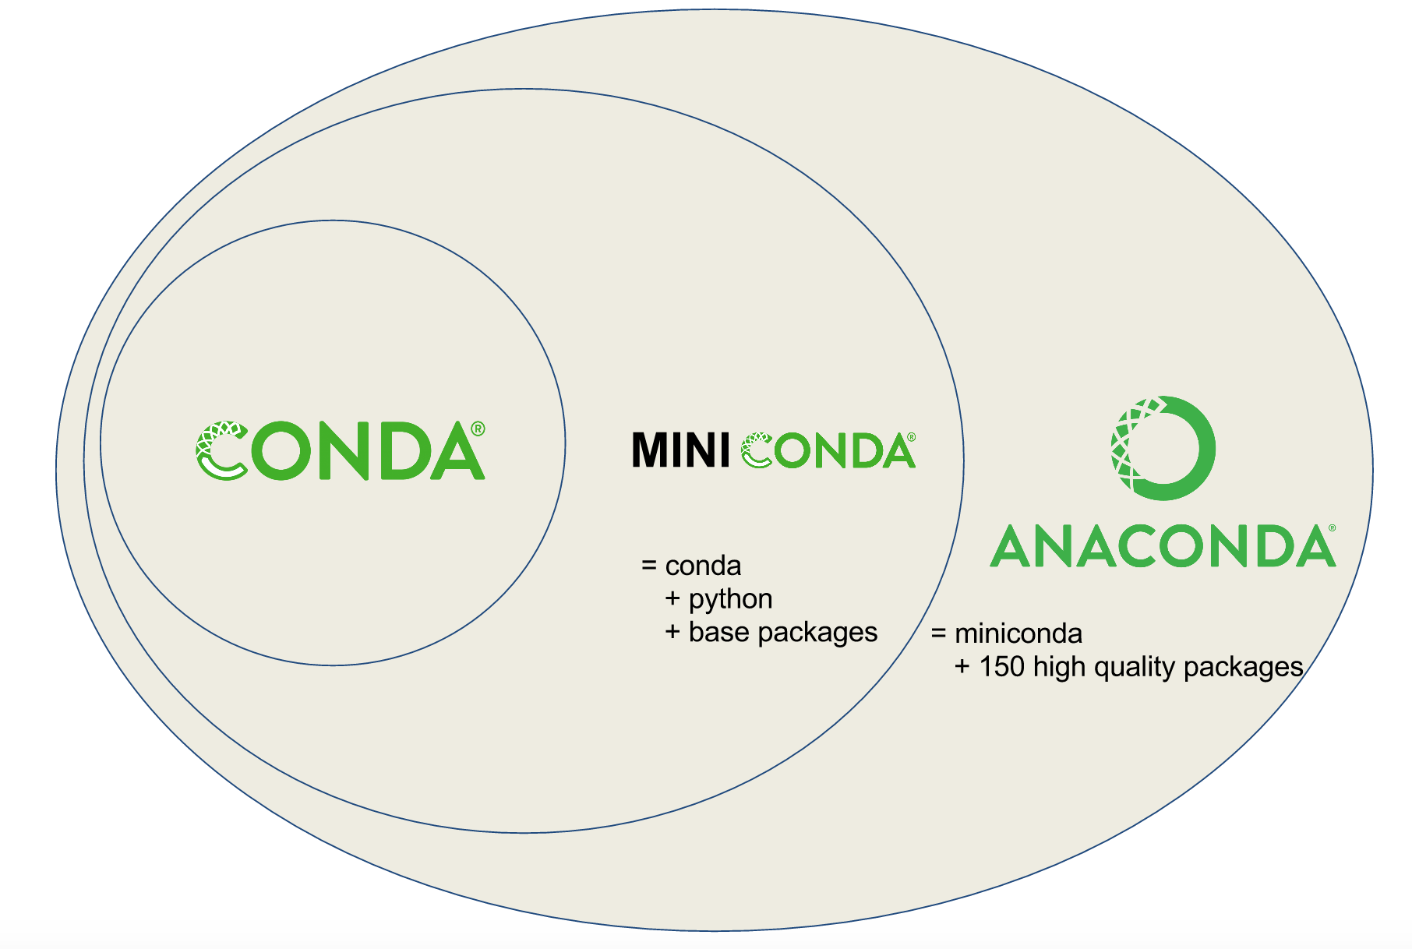
Conda vs. Miniconda vs. Anaconda
Conda is a tool for managing environments and installing packages. Preloaded with many packages
Miniconda combines Conda with Python and a small number of core packages
Anaconda is the company behind Conda software
Anaconda is also the name of a mega distribution with lots of software including R, Jypter, and many more
Mamba – faster implementation of Conda

Slide 7
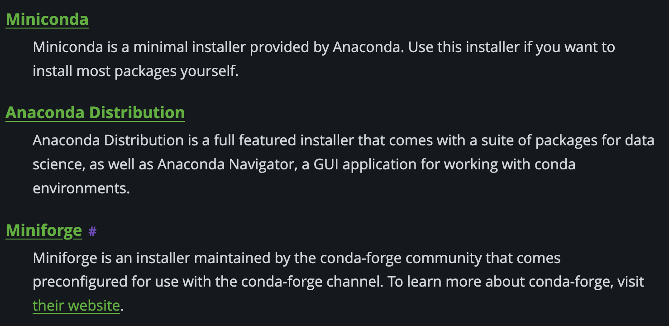
Conda distributions
'Distributions' refers packaging/delivering the same or similar software, each distribution has the same 'base' software with different optional software added. In the case of Conda distributions, they all perform the same task : install software

Slide 8

Which Conda distribution to use?
Use Miniforge – open source, does not include 'defaults' channel, comes preinstalled mamba
Read more on why:
https://ubinfie.github.io/2024/10/15/anaconda-defaults.html
https://conda-forge.org/download

Slide 9
Installing Conda (miniforge) - Linux/MacOS
Go to https://conda-forge.org/download/
Select your operating system to download
Navigate to where you downloaded the file
Run this command:
bash Miniforge3-$(uname)-$(uname -m).sh

Slide 10

What about Conda on Windows?
Several options:
Install the mega distribution "Anaconda" which installs Navigator softare for managing environment using GUI
No personal experience with this
Install WSL2+Ubuntu
Best experience for CLI bioinformatics
Runs inside Windows, allows for accessing your data directly – no funny business
Negative: might require admin rights to install WSL2
Some help docs here:
https://protocols.hostmicrobe.org/conda#block-d64fdca6e37e4997ae8671282562d9ac

Slide 12
Conda basics – Installing software
Find if the package is in conda – simply search the internet for
mamba install {software name}
For example:
mamba install minimap2

Slide 13

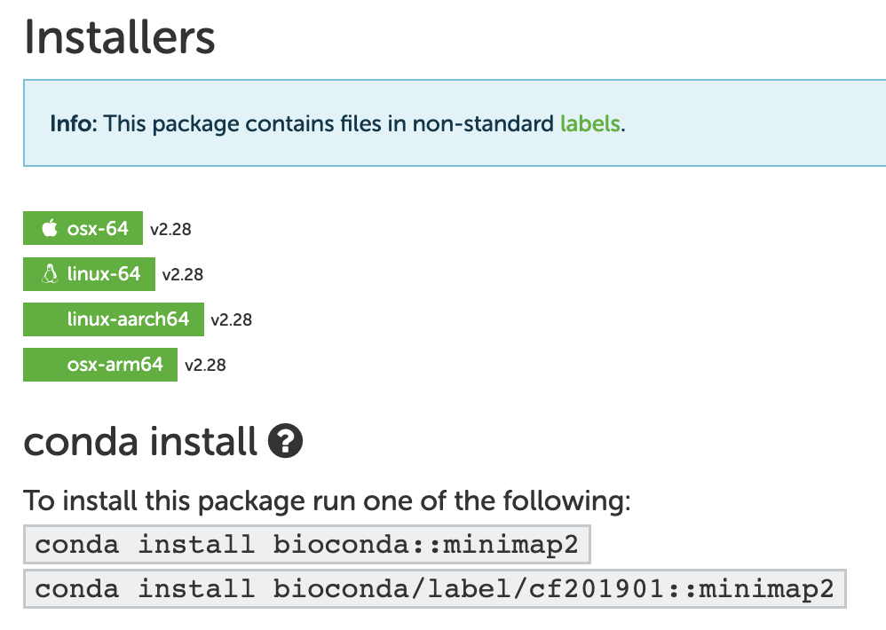
If you search on the internet "Conda + {software}" you will find instructions.
Copy paste into terminal.
Tells you what version is available on which systems.

Slide 14
Installing packages, software, tools, libs
To install packages:
mamba install –c bioconda minimap2
The tells conda to use the channel 'bioconda'
Multiple channels can be specified
If you installed the miniforge distribution, you do not need to specify any channels – the defaults are set for you
Tip: You can install multiple tools at once:
mamba install –c bioconda minimap2 samtools

Slide 16
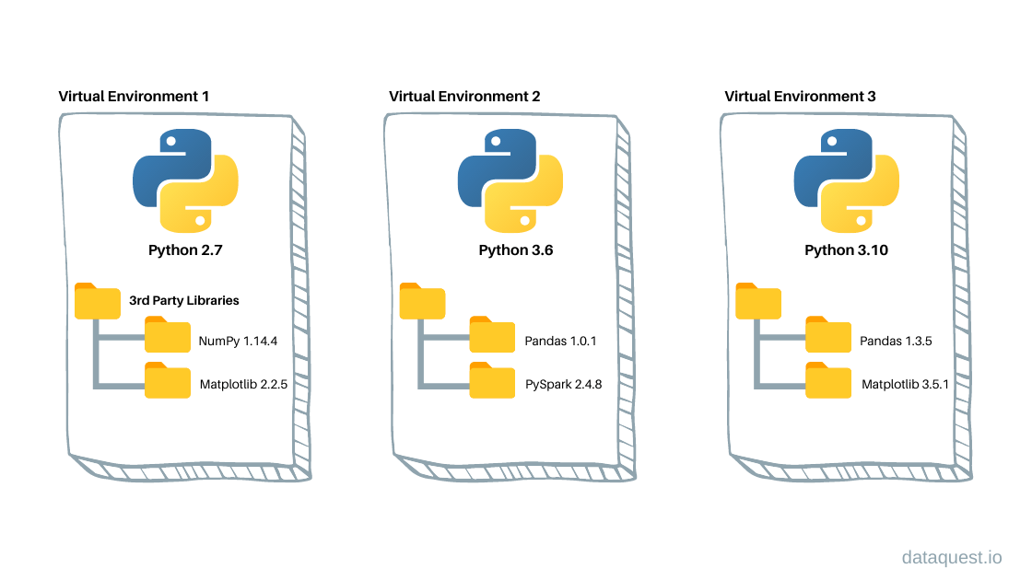
Conda Environments
A Conda environment is a directory that contains a specific collection of Conda packages that you have installed.

Slide 17
Creating New Environments
New environments can be activated:
mamba activate myEnv
To deactivate:
mamba deactivate
Create as many environments as you wish!
Call them whatever you wish – but be descriptive:
'dengue-seq-pipeline' – good
'pipeline' – bad
'myEnv' - bad

Slide 18
Best practices
Do not install software or tools in your (base) environment – keep this clean
Create an environment for each project/tool
Use descriptive but short names
To show your environments:
mamba env list
To export your environment:
mamba list –e > req.txt

Slide 19
Questions? + Resources
Official Documentation:
https://docs.conda.io/projects/conda/en/latest/user-guide/getting-started.html
Software Carpentries:
https://carpentries-incubator.github.io/introduction-to-conda-for-data-scientists
Conda for Bioinformaticians:
https://protocols.hostmicrobe.org/conda

