Slide 1

DengueSeq Analysis Pipeline – pt2
https://github.com/grubaughlab/DENV_pipeline
Ammar Aziz – VIDRL

Slide 2
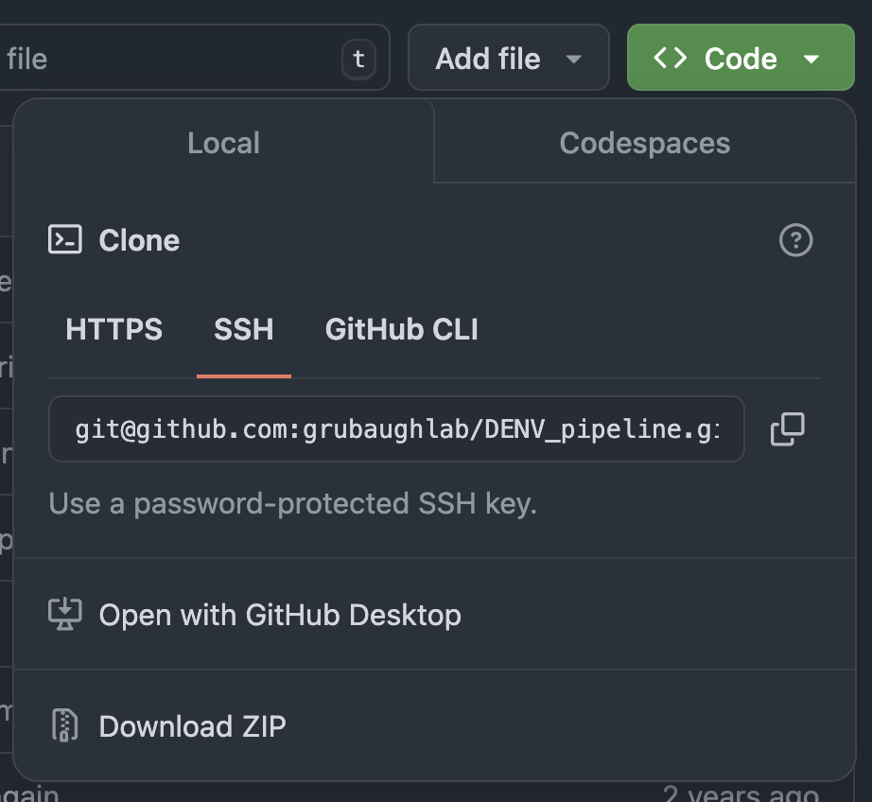
Installing DengueSeq analysis pipeline
Go to the code repository
https://github.com/grubaughlab/DENV_pipeline
Click "Code" button
Click "Download ZIP"
Uncompress

Slide 3
Installing DENV_Analysis code
Navigate to the location where the pipeline was downloaded and uncompressed
Install the dependencies:
mamba env create -f environment.yml
Activate the created environment
mamba activate analysis_env
Install the toolkit
pip install .

Slide 4
Demo

Slide 5
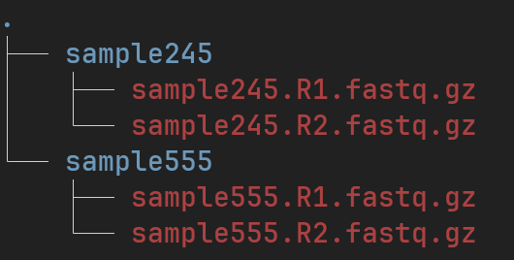
Preparing inputs
Your fastq files must be in the following structure:
Note: R1 and R2 must be contain capital R

Slide 6
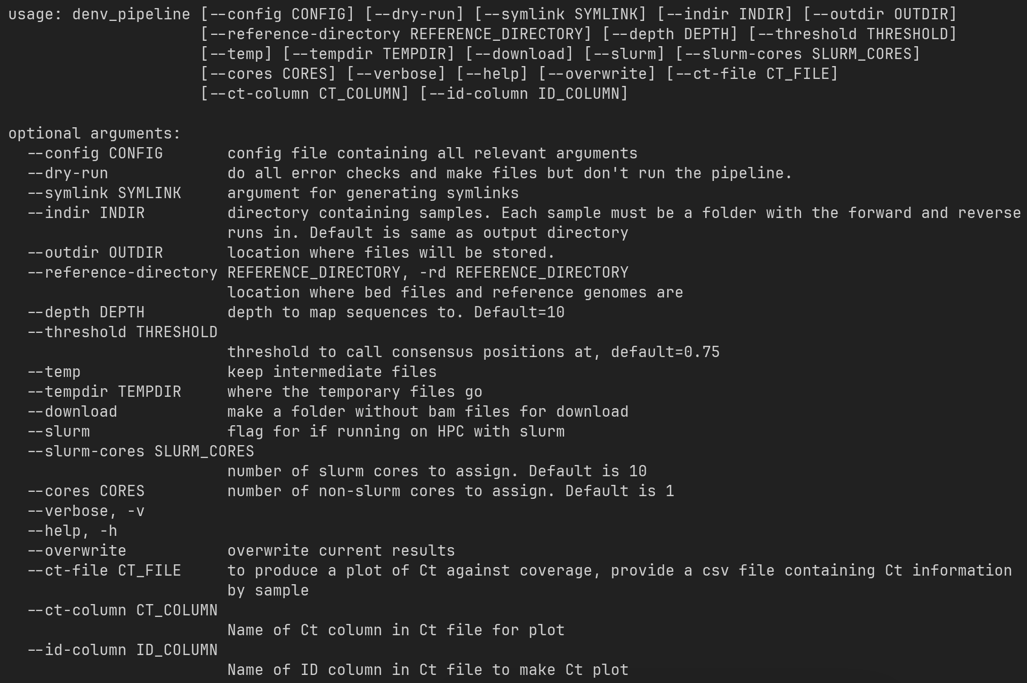
Running the pipeline - Options
Lots of options! Most are optional.
Mandatory:
--indir
--outdir
--cores

Slide 7
Running the pipeline
Parameters we must set for the pipeline:
--indir - the structured input directory with your fastq files
--outdir - the name of the output directory
--cores - cpus to use
Final command:
denv_pipeline --indir input --outdir results --cores 10

Slide 9
Pipeline Output
Lots of outputs. Most important:
virus_calls.tsv: Contains virus calls per sample. I.e. those viruses with which the sample has more than 50% coverage
top_virus_all_samples.tsv: Contains the highest coverage virus per sample, regardless of coverage
consensus folder - consensus sequences of the called virus for each sample

Slide 10
Pipeline Output - understanding
Check "virus_calls.tsv" file – open this in excel
Do the virus calls for each of your samples align with what you were expecting? For example, were you expecting mostly DENV2?
Any oddities, such as sylvatic (rare) detected?
Check "top_virus_calls.tsv" - open in excel
The virus chosen by the pipeline should be clear – that is no other dengue serotype is above the 50% apart from what was shown above
Example:
Check the how much of the genome is covered per sample
Does it match the Ct values?
Good rule: samples with Ct below 29 should provide good (>80%) genome coverage

Slide 11
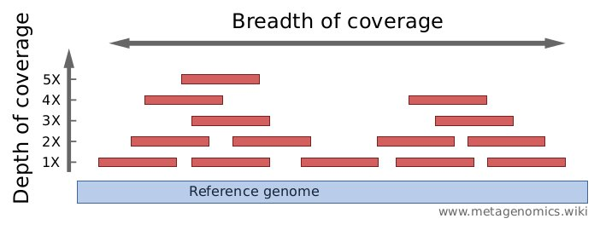
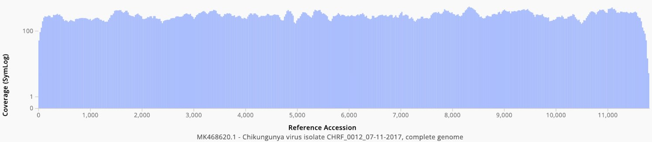
QC Metrics – Coverage plot
Coverage plot – Coverage plots are good for looking at the breadth and depth of the assembled genome

Slide 12
QC Metrics – Coverage plot
Coverage plot – Coverage plots are good for looking at the breadth and depth of the assembled genome
Depth:
Per-base coverage is the average number of times a base of a genome is sequenced. The coverage depth of a genome is calculated as the number of bases of all short reads that match a genome divided by the length of this genome. It is often expressed as 1X, 2X, 3X,... (1, 2, or, 3 times coverage).
Breadth
Breadth of coverage is the percentage of bases of a reference genome that are covered with a certain depth. For example: "90% of a genome is covered at 1X depth; and still 70% is covered at 5X depth."

Slide 13
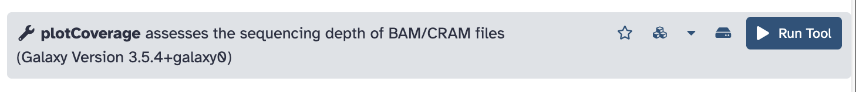
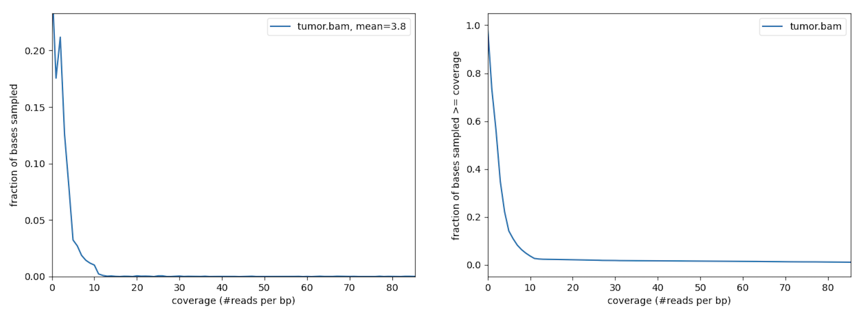
QC Metrics – Coverage plot
Galaxy tool plotCoverage

Slide 14
QC Metrics – Coverage plot
Use different thresholds for different objectives
Speciation – Which dengue serotype?
Genome coverage of >50% + E gene
Phylogenetics – Whole genome/E gene
>80-90% genome coverage
Clade/Lineage analysis
Use Nextclade internal metrics - Next lecture!

Slide 15
OtherQC Metrics
% Genome Called - Refers to the percentage of the genome meeting thresholds for calling consensus bases. The closer this number is to 100%, the better.
SNPs - Indicates the number of single nucleotide polymorphisms. SNPs represent single nucleotide variations between the reference accession and consensus genome.
Ambiguous bases - If multiple sequencing reads support more than one nucleotide at a given site, those sites will be designated with an IUPAC ambiguity code. This metric specifies the number of non-C, T, G, A nucleotides in the consensus genome. The consensus genome pipeline only calls nucleotides that are detected at least at 75% frequency.
Mapped reads - Refers to the total number of reads that mapped to the reference genome.

Slide 16
Questions? + Resources
All the tools in DengueSeq are available in Galaxy, however there isn't a workflow that simplifies the proccess.
If you use Galaxy, run the process for each reference (x6) and select the genome with the height coverage and depth.

