Slide 1


Note: The data and information in this document is reflective of a hypothetical situation and client. This document is to be used for KPMG Virtual Internship purposes only.
Sprocket Central Pty Ltd
Data analytics approach
[Division Name] - [Engagement Manager], [Senior Consultant], [Junior Consultant]

Slide 2
Note: The data and information in this document is reflective of a hypothetical situation and client. This document is to be used for KPMG Virtual Internship purposes only.
Agenda
Introduction
Data Exploration
Model Development
Interpretation

Slide 3
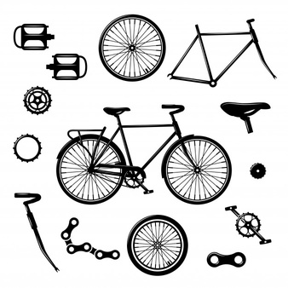
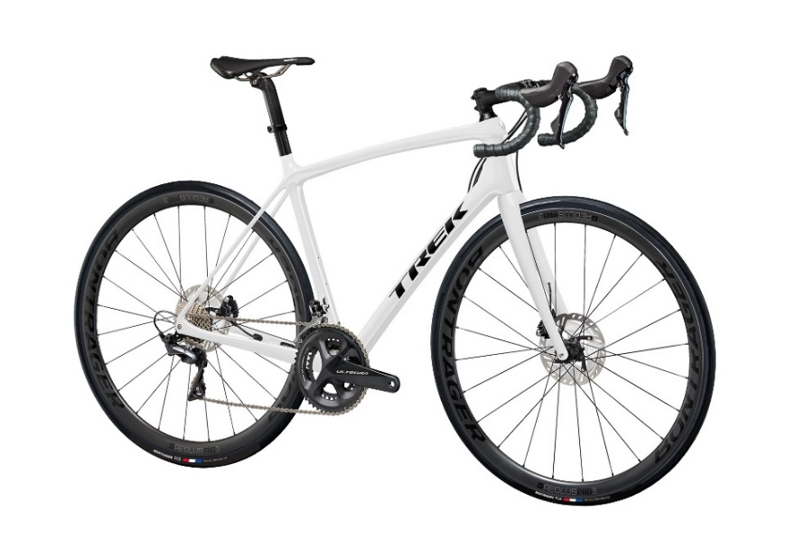
Note: The data and information in this document is reflective of a hypothetical situation and client. This document is to be used for KPMG Virtual Internship purposes only.
Introduction
A champion at providing
Bikes
Cycles
Accessories

Slide 4
Note: The data and information in this document is reflective of a hypothetical situation and client. This document is to be used for KPMG Virtual Internship purposes only.
Data Exploration
Performing data exploration for the datasets provided by Sprocket is to understand the customer base and their purchasing trends and behavior. Example: Find the age-group that tends to purchase the bikes and cycle accessories? The analysis focuses on that age-group for better business.
Try to understand the specifics of the data variables by looking at their data types and the definition. Perform correlation tests (multi-collinearity), similarity matrices, and distributions on the dataset to gain meaningful insights about the data variables. All these tests will ensure the data is appropriate for use and has only relevant variables. Example: Conducting similarity tests will confirm if there are any variables that we can neglect for analysis, reducing the dataset's inconsistencies.
A new dataset will be combined if the existing dataset fails to solve Sprocket's problems. Joining the datasets should have a shared data variable which will ensure in smooth data connection. Data transformation techniques devised to ensure the correct format of the combined data. Verify the target audience by learning about their past trends, which enables them to predict sales in the future.
Determine data assumptions, limitations, and risks for the data that needs to be kept in mind and attempt to minimize in the further analysis.

Slide 5
Note: The data and information in this document is reflective of a hypothetical situation and client. This document is to be used for KPMG Virtual Internship purposes only.
Model Development
The best way to validate our assumptions is to build a hypothesis that revolves around answering the business questions. Hypothesis testing involves making a model for training the sample data and justifying against the testing sample if they are valid or not. A calculated field can be derived from the variable DOB to determine the age of customers that buy the bikes/ cycles. Another computed value that can be extracted from the existing data to assess the customer's purchase in the past three months is the profit variable, which is the difference between the list_price and standard_cost.
Considering the collaboration of two datasets, one question that arises is whether the customer is a professional rider or not? Because if the customer is a professional rider, he is most likely to buy a new bike/cycle or it's accessories, thereby impacting the sales and profit of the company. This information will be used for building up a model and verifying it against a similar customer base.
The results will be formulated in the form of graphs or studying the various model parameters like the R square, AIC, AOC or ROC curves, and accuracy. Document the model's performance, assumptions, and limitations.

Slide 6
Note: The data and information in this document is reflective of a hypothetical situation and client. This document is to be used for KPMG Virtual Internship purposes only.
Interpretation
The model output presents in the form of visualizations. The finding includes interpretations of relevant qualitative and quantitative coefficients that enable solving business problems. Develop a report/ presentation for the client for the entire process undertaken that supports the case of your observations.

Slide 7
Note: The data and information in this document is reflective of a hypothetical situation and client. This document is to be used for KPMG Virtual Internship purposes only.
Thank You

