Slide 1
Speed Calculation Using IP
GROUP ID :-
41
GROUP MEMBERS :-
SEHAB MANKADA - 1414029
VIDHI CHITALIA - 1414074
NIDHI GADA - 1414079
GUIDE :-
PROF.SUNAYANA JADHAV

Slide 2
Problem Definition
Nowadays the accident rate has increased intensely and the major factors contributing towards it are the roadways and the road traffic.
These accidents have been mainly caused due to violation of the speed limits by vehicles on the street.
In this project we estimate the speed using a sequence of video images from an uncalibrated camera (a normal mobile camera) kept in the sideways direction.
We classify the proposed methods named Lucas Kanade and Kalman Filter on the basis of the object detection and tracking while examining their accuracy and error rate with respect to the speed.

Slide 3
Literature Survey
Motion Detection Using Lucas Kanade Algorithm and Application Enhancement
http://ieeexplore.ieee.org/stamp/stamp.jsp?arnumber=5254757
Vehicle speed determination from video streams using image processing
http://ieeexplore.ieee.org/document/7860375/
An Efficient Implementation of Video Based Traffic Analysis System(Kalman Filter Algorithm)
http://ieeexplore.ieee.org/stamp/stamp.jsp?arnumber=7873681
Speed Determination of Moving Vehicles using Lucas Kanade Algorithm
http://ijcat.com/archives/volume2/issue1/ijcatr02011007.pdf

Slide 4
Functional Requirements
The functional requirements are as follows:
Foreground Detection
Vehicle Detection
Vehicle Tracking
Speed calculation
Error Rate
Details:

Slide 5
Non Functional Requirements
Performance requirements(Speed, response time)
Reliability
Manageability and Ease of Use
Extensibility
Scalability

Slide 6
Technologies to be Used
Operating System: Windows 7,8,9
Platform Used: MATLAB 2017b
Database: File System

Slide 7
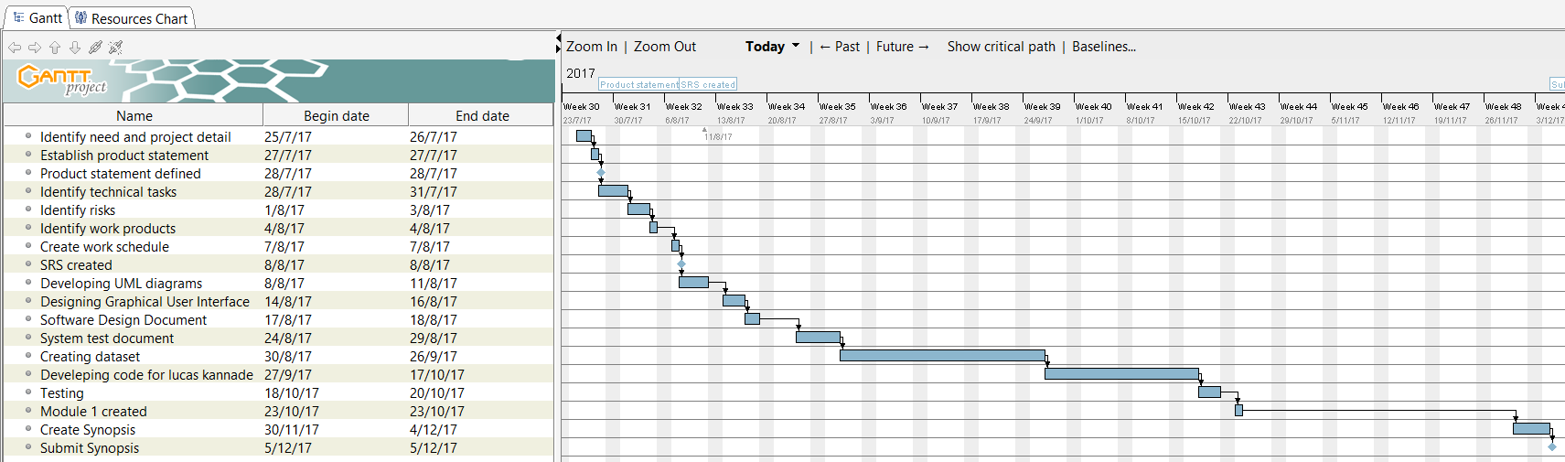
Timeline Chart

Slide 8
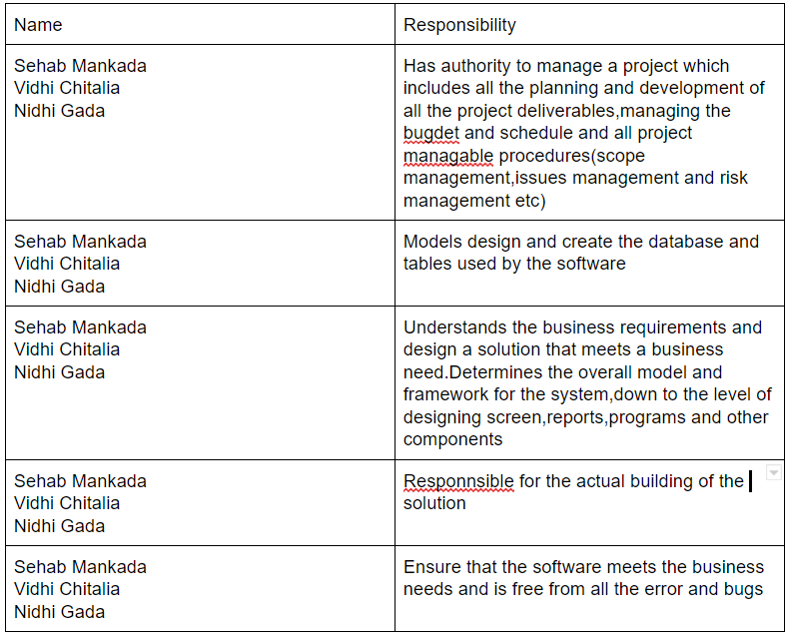
Roles and Responsibilities
Details:

Slide 9
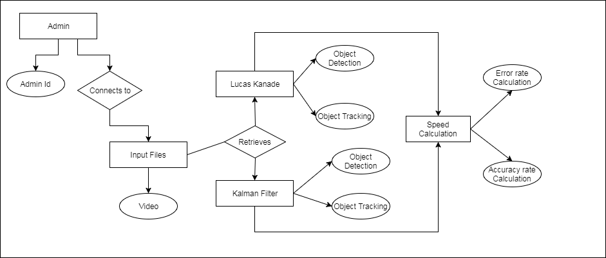
Software Design Document
ER Diagram

Slide 10
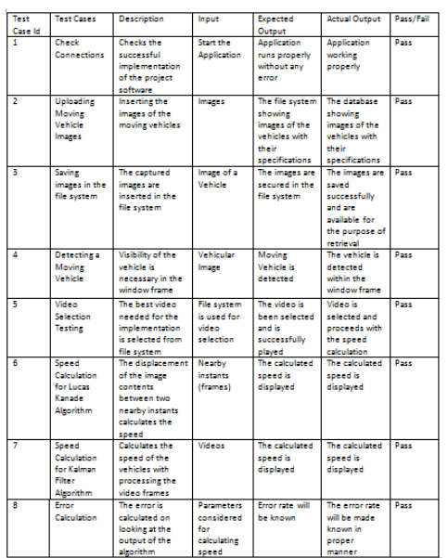
Test Cases
Details.

Slide 11
Implementation
Problem Statement
Dataset Collection
Detection and Tracking of the vehicles
Speed Calculation
Error Estimation

Slide 12
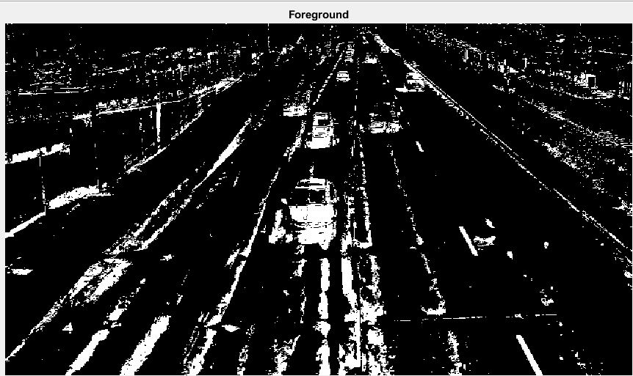
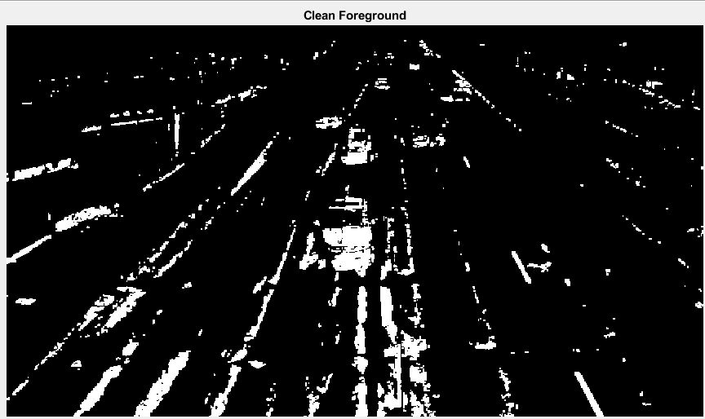
Lucas Kanade Tracking
Foreground
Clean Foreground

Slide 13
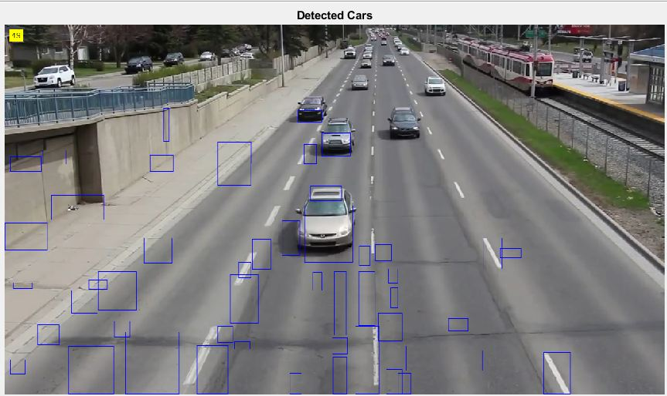
Lucas Kanade Detection

Slide 14
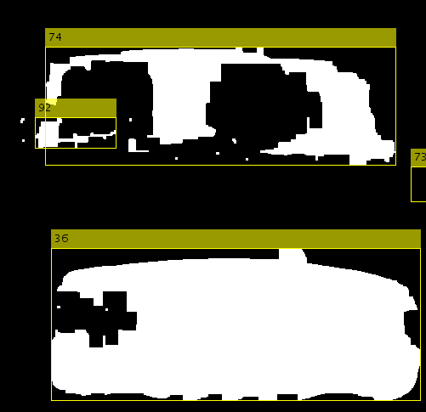
Kalman Filter Tracking
Foreground

Slide 15
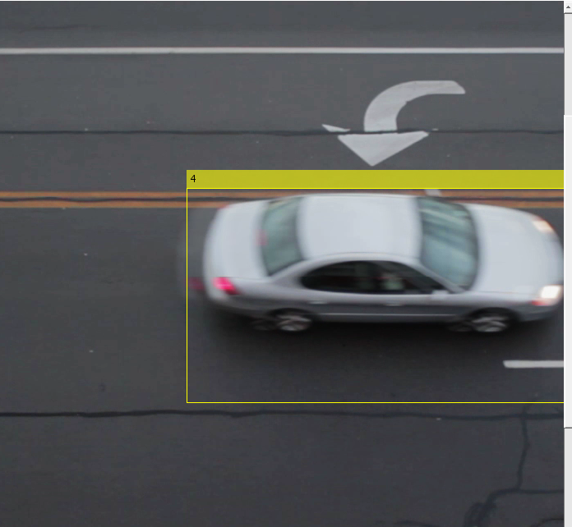
Kalman Filter Detection
Detection

Slide 16
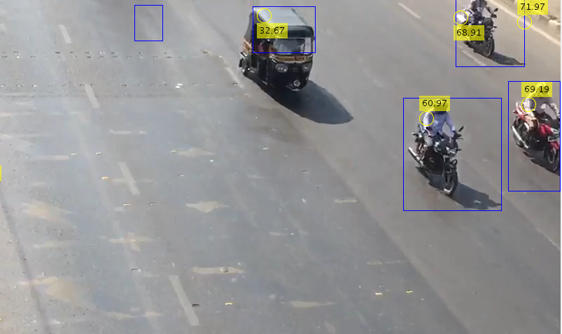
Speed Calculation

Slide 17
Conclusion
From the results that we obtained,combining the computation of partial derivative in lucas kanade algorithm,with smooth filtering,the processing time decreases in a better optical flow.The best parameter to represent each of the algorithm is concluded based on the factors which are segmentation,motion vector of motion and the processing time.In lucas kanade algorithm the optimised window size will be of [25,16].
After executing both the algorithms(Lucas Kanade and Kalman filter),we conclude that Kalman filter algorithm is more accurate on the basis of Speed Calculation than Lucas Kanade on object tracking and detection.

Slide 18
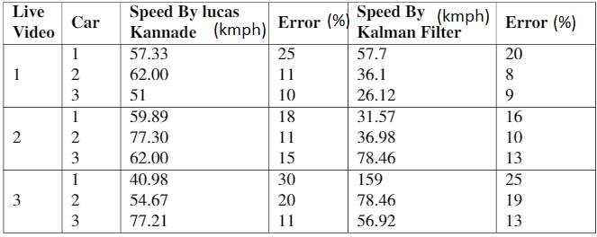
Results

Slide 19
References

Slide 20
Thank You!

