Slide 1
Fetal Health Classification

Slide 2
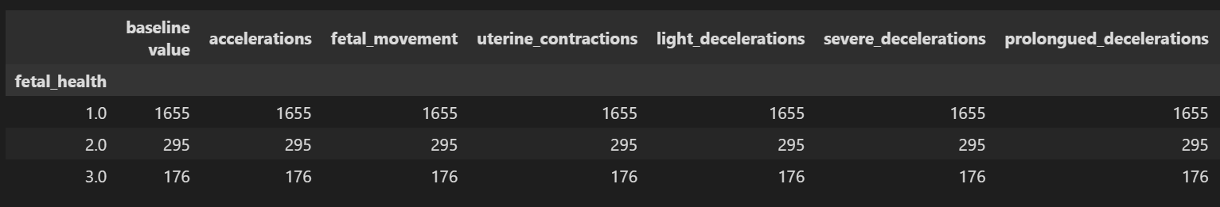
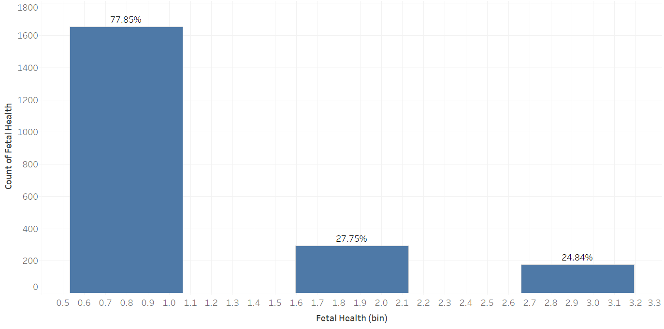
Counting normal, suspected and pathological

Slide 3
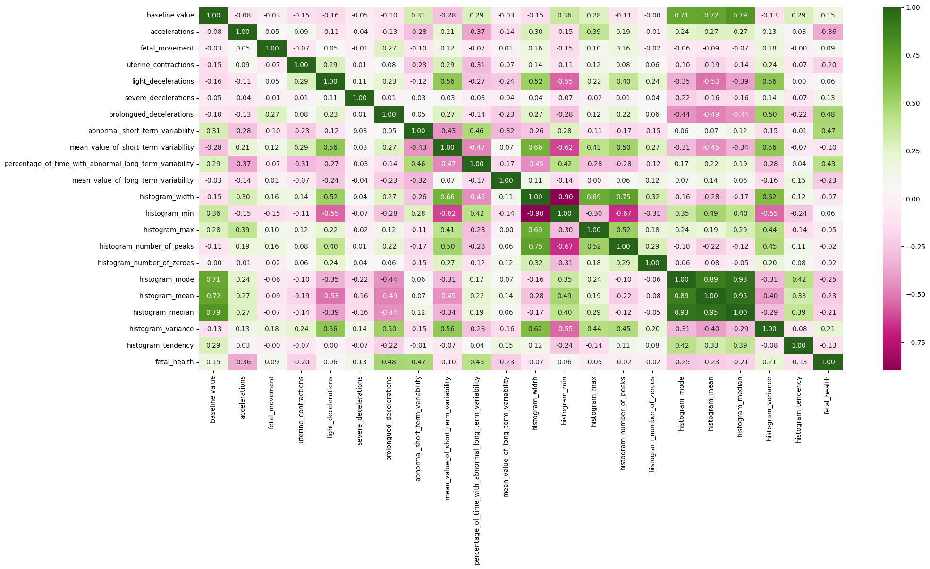
Heatmap of correlation

Slide 4
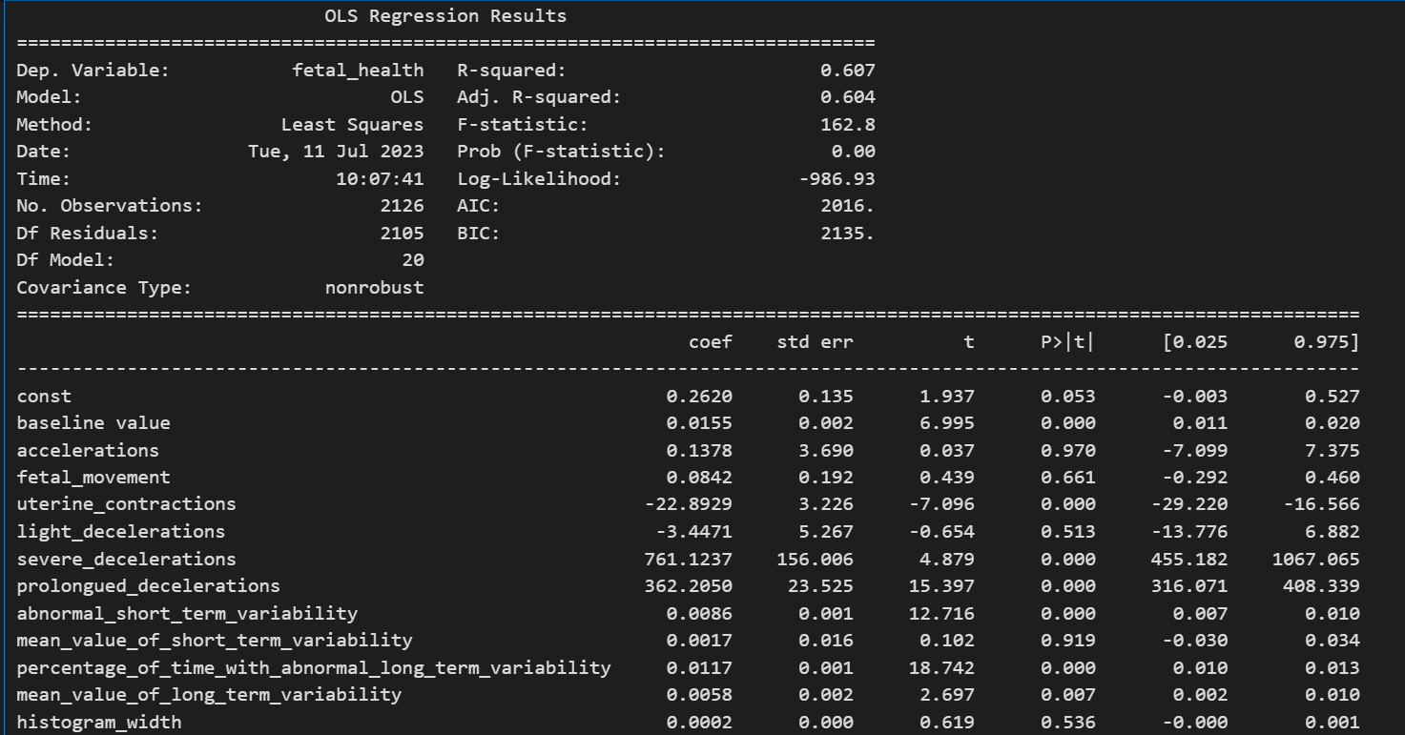
OLS Regression Results

Slide 5
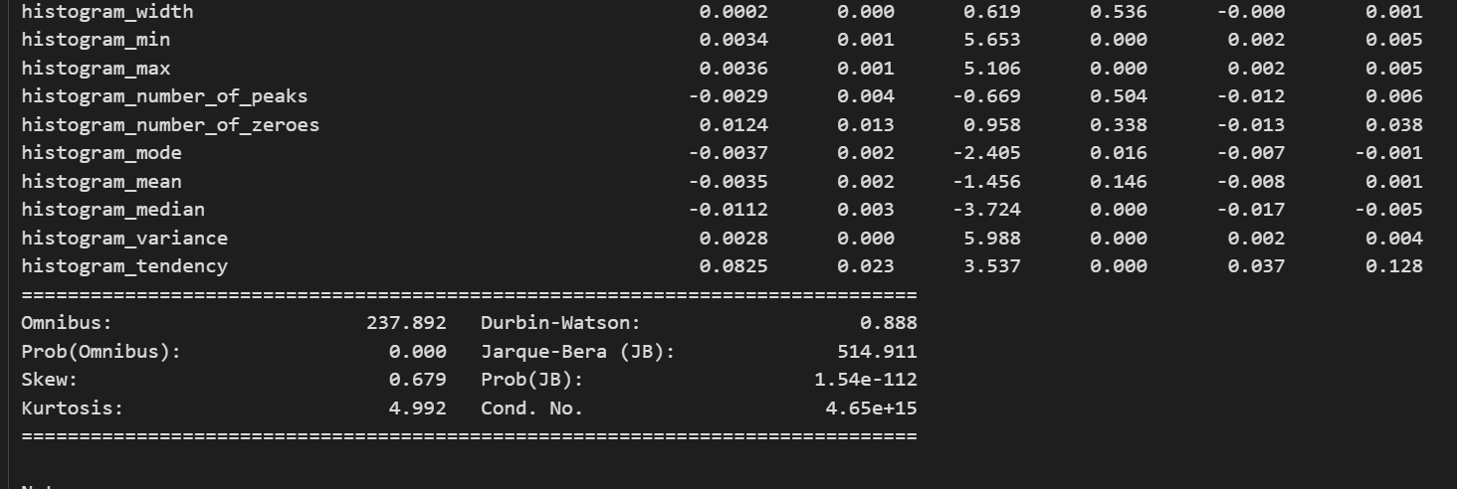

Slide 6
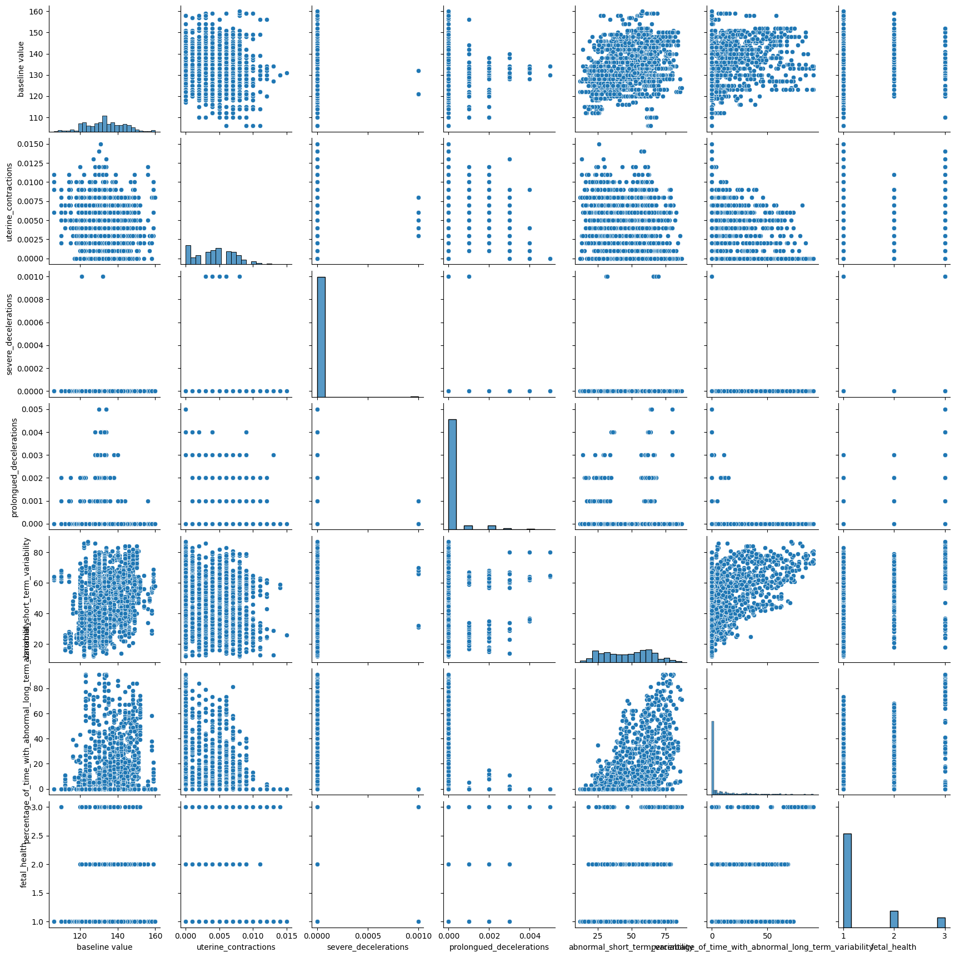
Pairplot for significant features

Slide 7
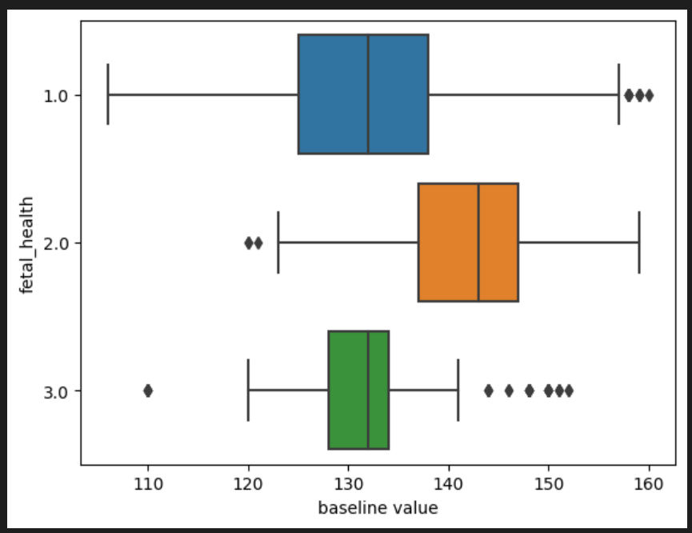
Boxplot of baseline value vs fetal health

Slide 8
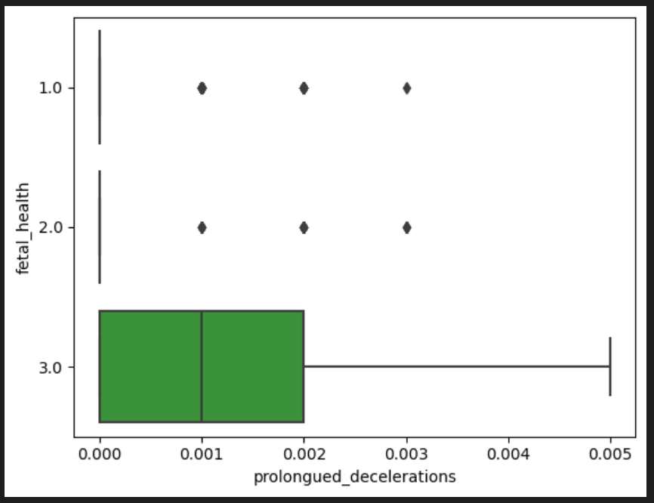
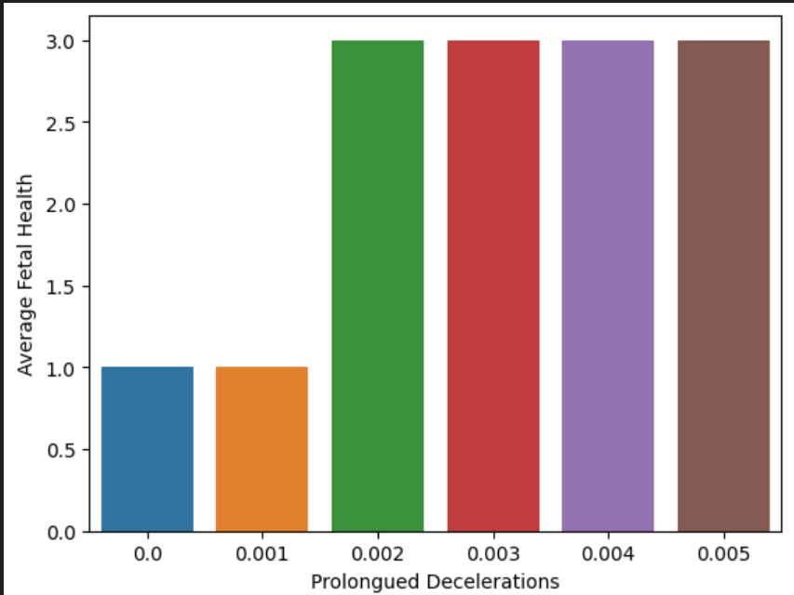
Relationship between prolonged decelerations and fetal health

Slide 9
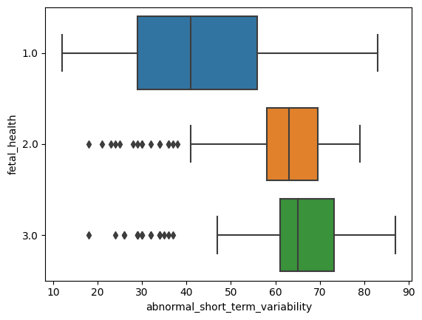
Relationship between abnormal short term variability and fetal health

Slide 10
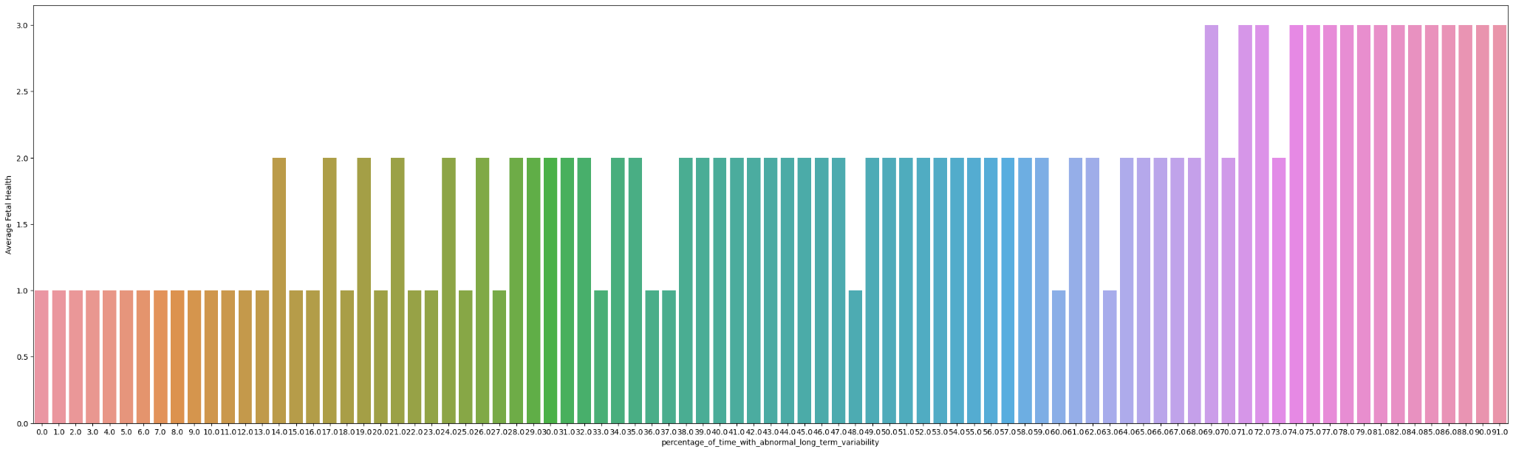
Relationship between percentage of time with abnormal long term variability and fetal health

Slide 11
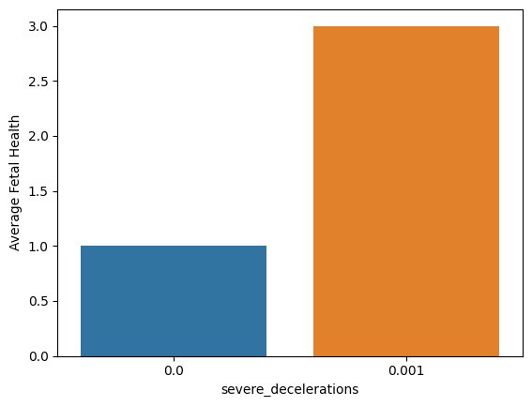
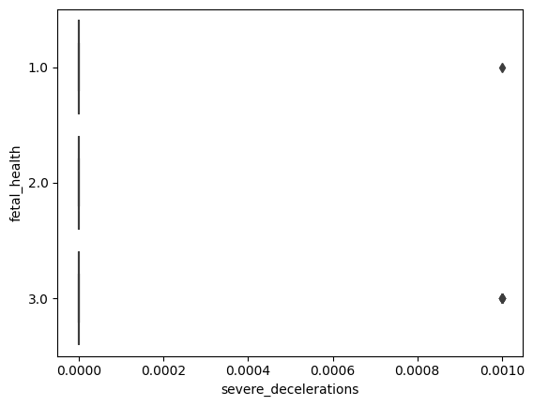
Relationship between severe decelerations and fetal health

Slide 12
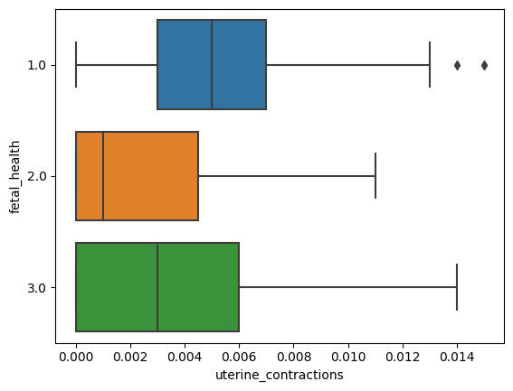
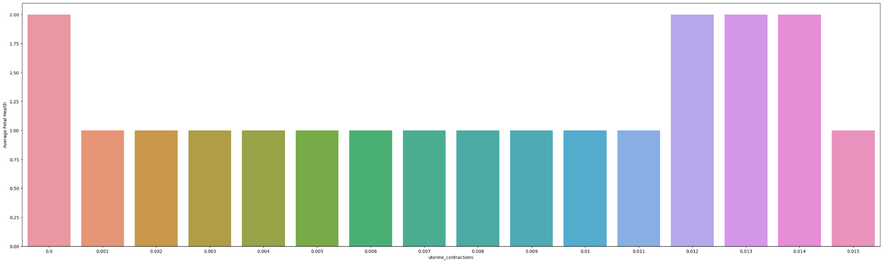
Relationship between uterine contractions and fetal health

