Slide 1

KK-Music Box’s Prediction & Recommendation
By
Anushi Doshi
Mahesh Kumar Badam Venkata
Manideep Kannaiah
Vidushi Mishra

Slide 2
Project analysis slide 3
Project Overview
DATA PREPARATION
VISUALIZATION
MODEL BUILDING
TUNING
RECOMMENDATIONS

Slide 3
Project analysis slide 2
Data Introduction
Data is originally from a Kaggle competition.
It comprises of 4 tables
Members
User Id
Songs
Song id
Song length
SongsExtraInfo
Song Id
ISRC Code
Logs
City
Age
Gender
Registration Channel
Registration date
Expiration date
Genre id
Artist name
Composer
Lyricist
Language
Name
User Id
Song id
Source System tab
Source Screen name
Source type
Target

Slide 4
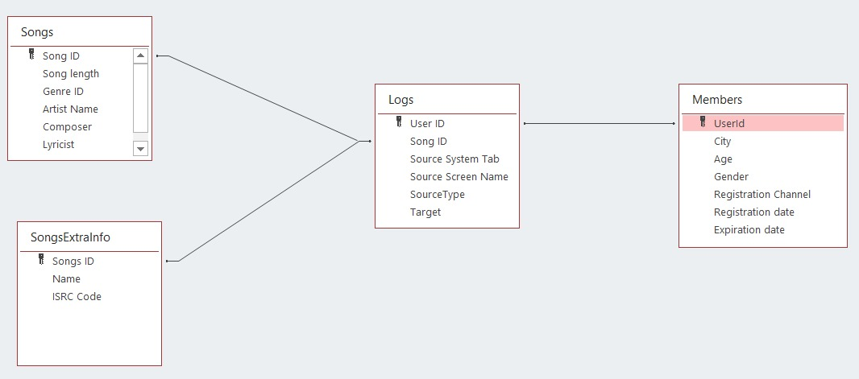
Project analysis slide 4
Relationship Diagram

Slide 5
Project analysis slide 2
Data Preparation
Members: (34403, 7)
Songs: (2296833, 7)
SongsExtraInfo: (2296869, 3)
Logs: (7377418, 6)
Missing Values
Removed Null and NA’s
Dataset is huge
Data types
Members and songs data frames have inappropriate data types for city, registration channel, language to support data abstraction
They are of integer type converted to String type.
Renamed columns to more meaningful names
Adjusted date types.
Merging
Members, Songs, SongExtraInfo, Logs data frames are merged using appropriate join techniques
Filtering
Members are filtered for appropriate age group, city and registration time frame
Members

Slide 6
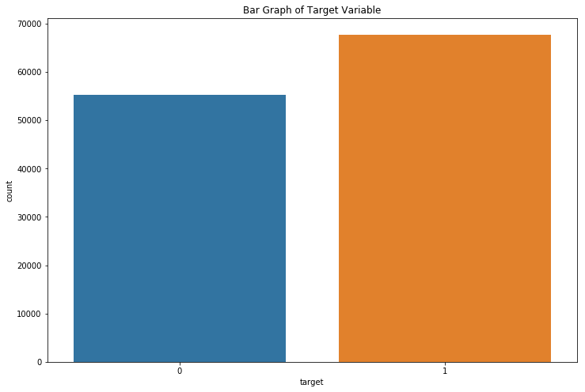
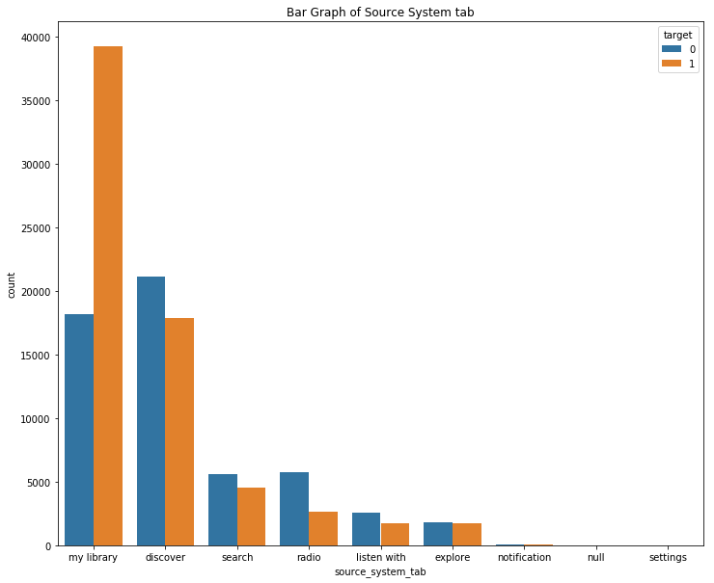
Project analysis slide 4
Visualization

Slide 7
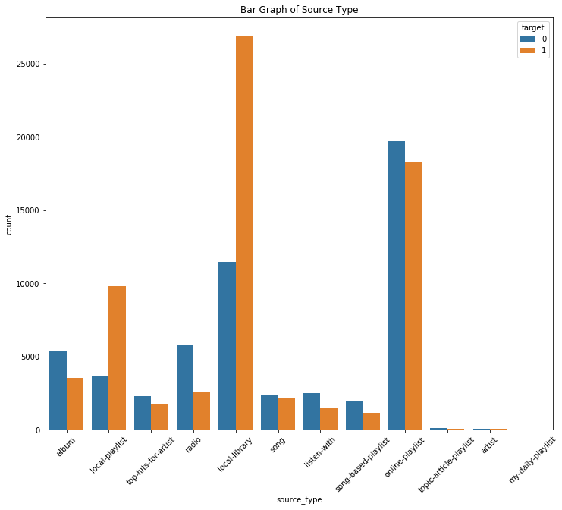
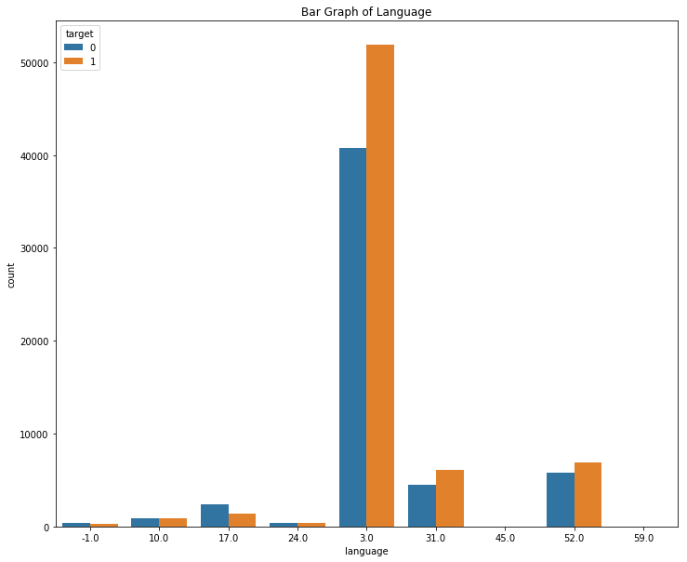
Project analysis slide 4
Visualization

Slide 8
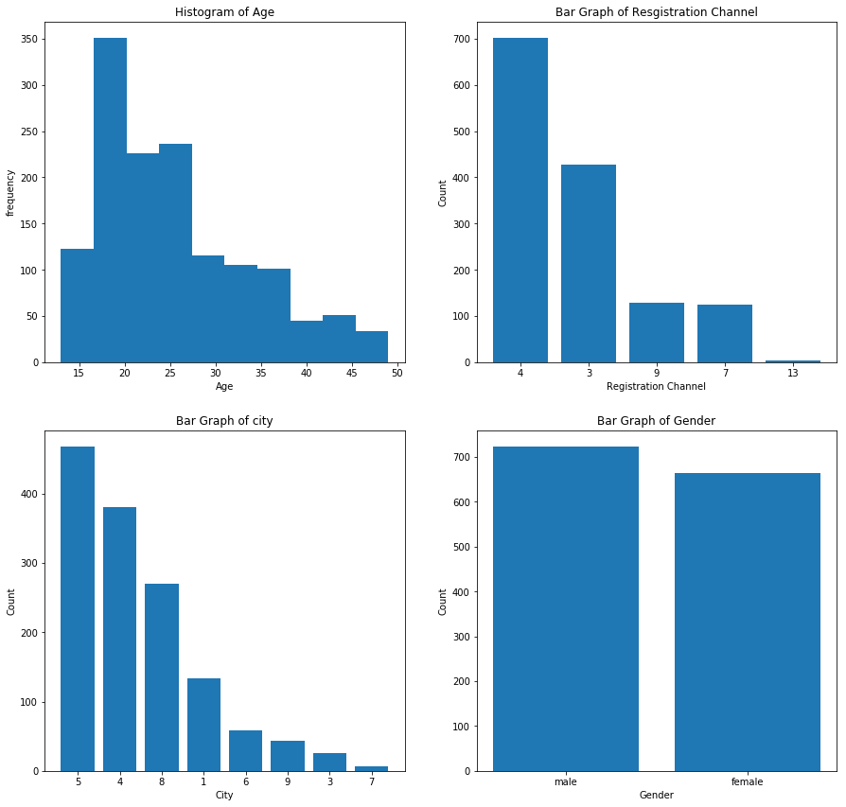
Project analysis slide 2
Visualization

Slide 9
Project analysis slide 4
Feature Selection
Members:
Age
Gender
City
Registration channel
daysLeft = Expiration Date - RegistrationDate
Songs:
Song Length
Language
Genre Id
Logs:
Source System tab
Source Screen name
Source type

Slide 10
Project analysis slide 2
Data Preparation For Model Building
String Indexing
One Hot Encoding
To avoid assigning numerical ordering to categorical nominal variables
Converting categorical columns to numerical
Scaling
All Numerical columns are standardized using standard scaler.

Slide 11
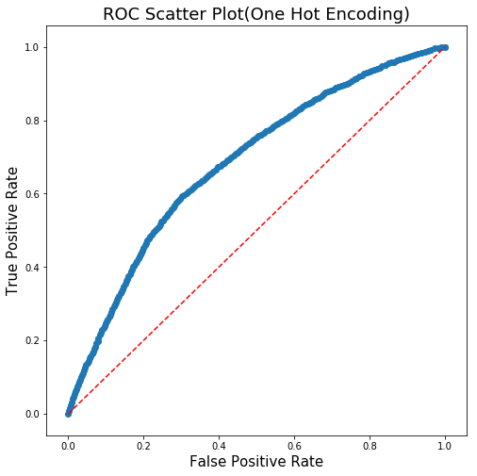
Project analysis slide 2
Logistic Regression
Parameters
Features = One hot encoded
Label column = target
Accuracy
Training data set = 68.41 %
Hold-out data set = 67.90 %
Run time = 17-18 min
Features eliminated by L2 = 5
Drawbacks
Huge runtime
Unable to run cross validation
Unable to use param grid builder

Slide 12
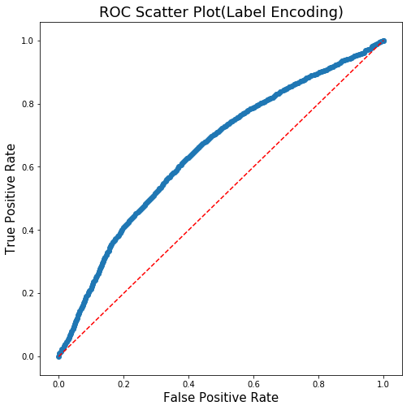
Project analysis slide 2
Logistic Regression
Parameters
Features = String Indexed
Label column = target
Accuracy
Training data set = 64.85 %
Hold-out data set = 64.26 %
Run time = 5-6 min
Features eliminated by L2 = 0
Drawbacks
Conceptually incorrect

Slide 13
Project analysis slide 2
Decision Trees
Algorithm | Decision Trees | Random Forest | Gradient Boosting
Parameters |  | numTrees = 60 maxDepth = 8
Accuracy |  | Training data set = 70.41% HoldOut data set =69.53% | Training data set = HoldOut data set =71.39%
Run time |  | 10 min | 30 min
Drawbacks

Slide 14
Recommendation System (ALS)
ALS : Alternate Least Squares Algorithm
Extending Matrix Factorization(MF) to fill unknown user’s interest, ALS tried to find values of two variables (user, interest) in cost function (C) by fixing value of one variable, optimizing another and vice-versa.
In our case, it fills the blanks in MF of unknown interest of user in an item by considering interests of similar users.
Feature Engineering
ALS modelling
Fine Tuning Recommendations
Used features like userID, song id, genre, artist and language to create a measure of user’s interest on genre, artist and language.
The scale of rating is based on how many songs user listens in each genre, artist and language.
We created 6 separate dataframes which indicate user’s interest, song’s popularity on each attribute.
The input to the model is just the userID and interest in each feature (genre, artist, language) separately.
The output from the model is the top k (10 in our case) or few recommendations of genre, artist and language.
Using these, we compared the popular songs in those criteria and shown to the user tab where he usually checks-in.
The model is trained and tested and finally evaluated under ‘rmse’ , accuracy and the input parameters are adjusted to impute NULL values, add ‘cold start’ feature and adjust to regularization.

Slide 15
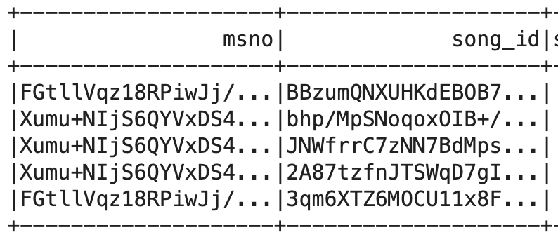
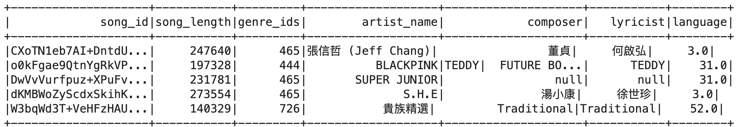
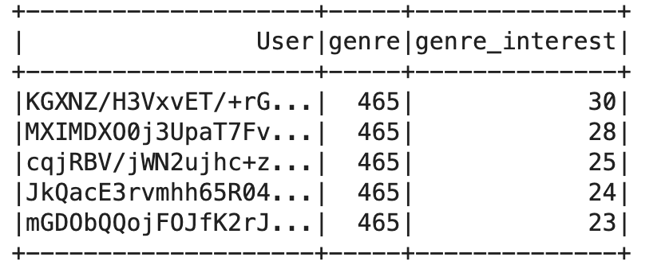
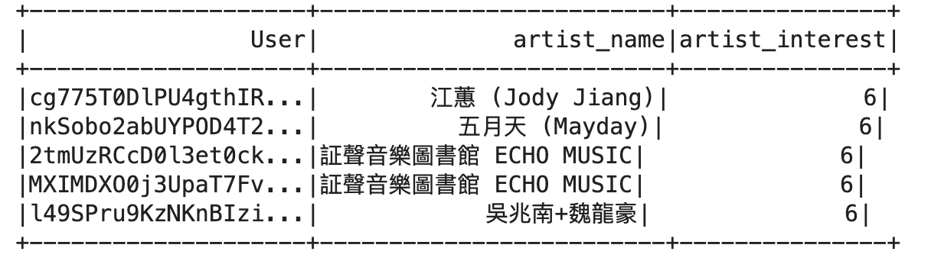
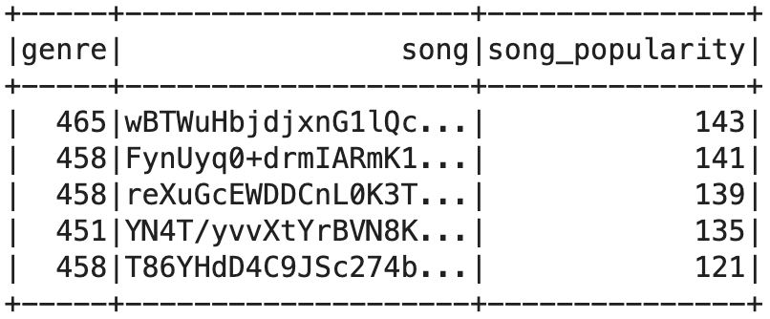
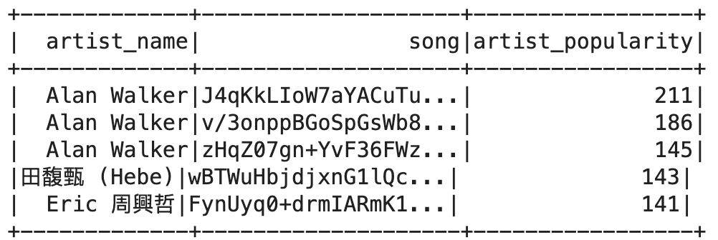
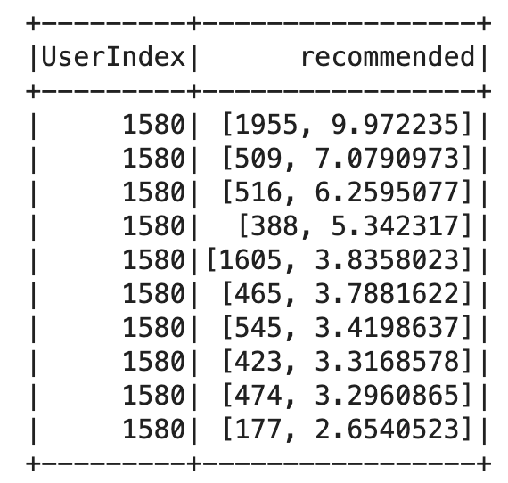
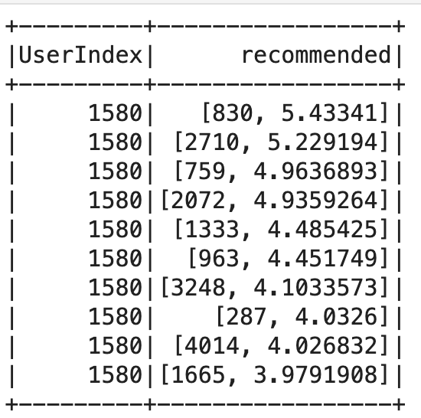
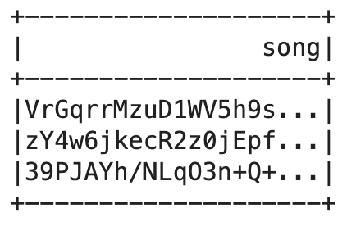
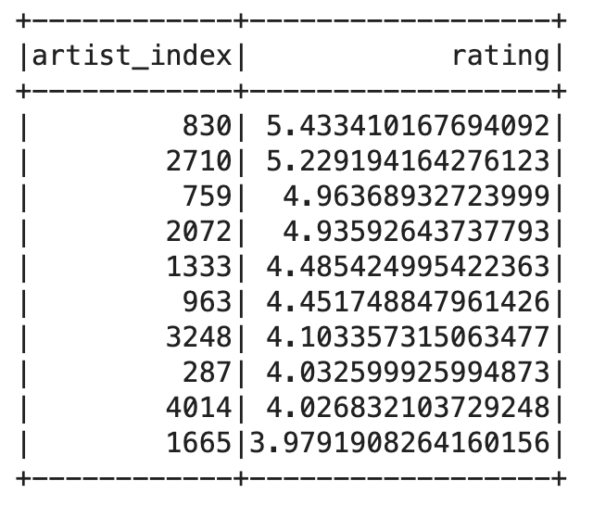
Overview of steps
Raw Data
Feature
Extraction
Recommendations

Slide 16
Project analysis slide 4
Challenges Faced
Run time
175 features and 120,000 observations
Hold-out method to evaluate model performance
Tuning
Using a param grid was time consuming
Resort trail and error method for tuning
Target Encoding
Alternative to label encoding and one hot encoding
Very quick to run but the performance slumped
PCA
Performance Slumped
Weird results

Slide 17
Project analysis slide 4
Credits
Data Preparation, Model Building | Manideep
Feature Extraction, Visualizations | Anushi
Model Building and Evaluation | Vidushi
Recommendation System, Fine tuning tab based customizations. | Mahesh

Slide 18
Thank You

