Slide 1

VIDUSHI MEHTA BTECH 3RD YEAR ELECTRICAL

Slide 2
What is Cloud?

Slide 3
Cloud is a service provider, with options of various kinds of services, including storage computing, backend etc.
In cloud computing, the word cloud (also phrased as "the cloud") is used as a metaphor for "the Internet," so the phrase cloud computing means "a type of Internet-based computing," where different services — such as servers, storage and applications — are delivered to an organization's computers and devices through the Internet.

Slide 4
Why use Cloud?
Universal Access
Automatic Software Updates
Capital Expenditure Free
Security
Flexibility
Environment Friendly

Slide 5
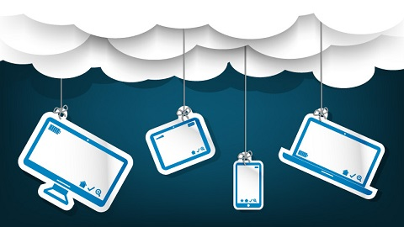
Personal Role of Cloud :
Practically very large backup space.
GB’s of data accessible with one click from anywhere over the web.
Secured data storage
Reduction in duplicity of data(store more information with less space).

Slide 6
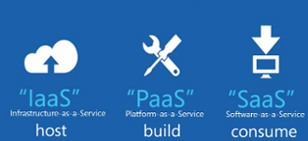
Models of Cloud :
Software As A Service
Example: Google Docs.
Platform As A Service
Example: Microsoft 365, Google App Engine.
Infrastructure As A Service
Example: Google Drive.

Slide 7
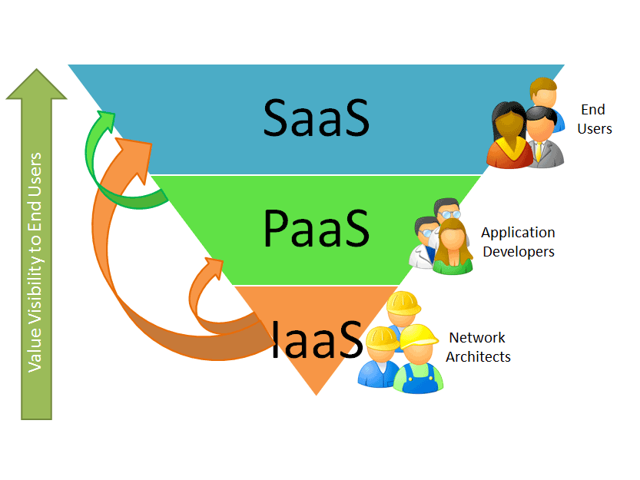
SaaS : Through this service delivery model end users consume the software application services directly over network according to on-demand basis. PaaS : It is a platform where software can be developed, tested and deployed. It means the entire lifecycle of software can be operated on PaaS. It is dedicated to application developers ,testers and administrators. IaaS: The main concept behind this model is where user has virtual desktop and consumes the resources like network , storage, routers and so on, supplied by cloud service provider.

Slide 8
Deployment of Cloud Service
PUBLIC CLOUD
PRIVATE CLOUD
COMMUNITY CLOUD
HYBRID CLOUD

Slide 9
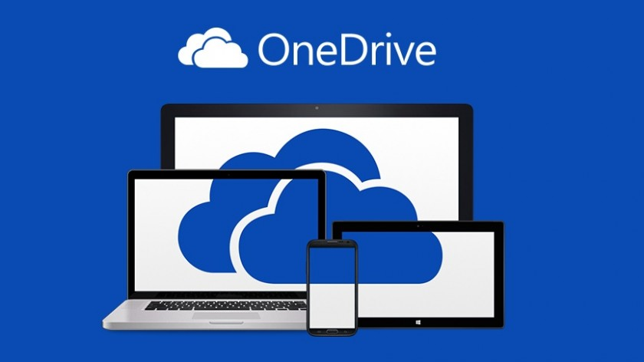
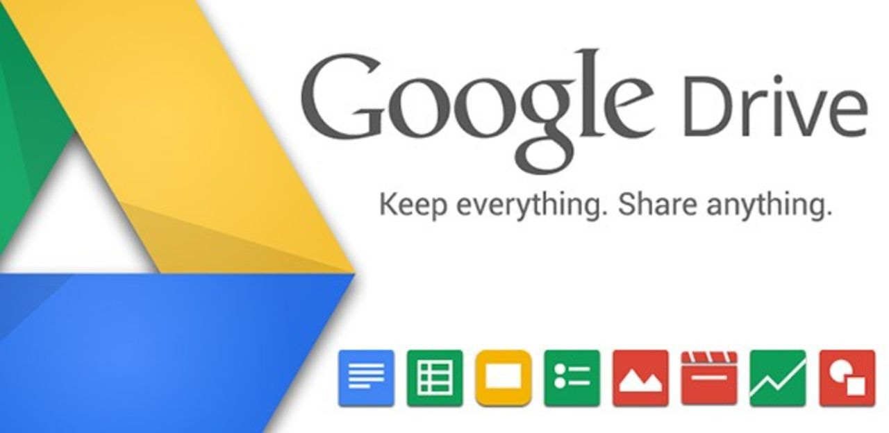
Storage on Demand
With the ongoing trend of increase in storage required and the sustainability of data, cloud has turned on its storage services for people.

Slide 10

Computing on Demand
Cloud gives us benefits of computing anytime we want. Since most of the companies have offices across the world, there is always someone available for your help.

Slide 11
Computing Comparison
Standard comparison by infoworld.com included following Cloud PC’s
 | Virtual CPU’s | RAM | Cost/Hr
Amazon m1.medium | 1 | 3.75GB | 12 cents
Amazon c3.large | 2 | 3.75GB | 15 cents
Amazon m3.2xlarge | 8 | 30.00GB | 90 cents
Google n1-standard1 | 1 | 3.75GB | 10.4 cents
Google n1-highcpu-2 | 2 | 1.80GB | 13.1 cents
Google n1-standard-8 | 8 | 30.00GB | 82.9 cents
Windows Azure Small VM | 1 | 1.75GB | 6 cents
Windows Azure Medium VM | 2 | 3.50GB | 12 cents
Windows Azure X-Large VM | 8 | 14.00GB | 48 cents

Slide 12
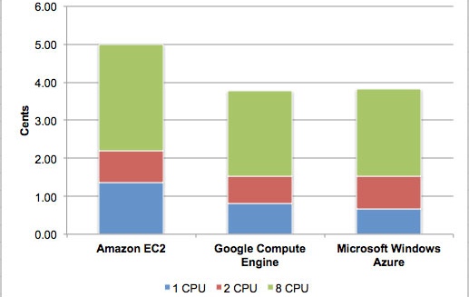
Price Comparison :

Slide 13
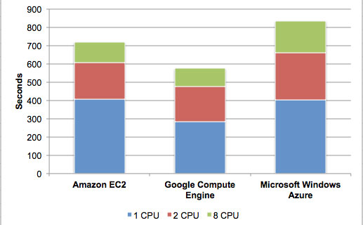
Time Comparison

Slide 14
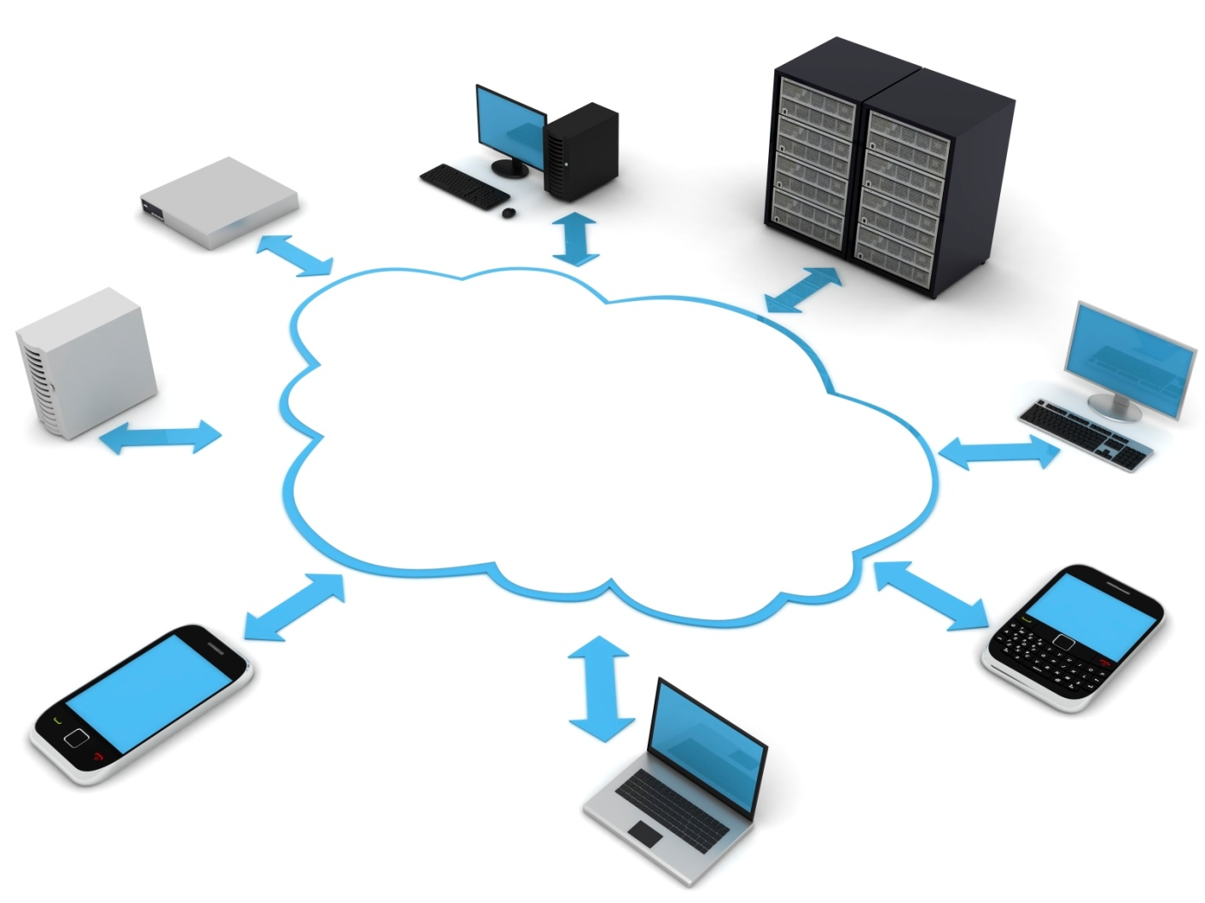
Hosting on Demand
What is hosting??

Slide 15
ODC-- ON DEMAND COMPUTING
On demand computing is also referred to as WEB based services that are procured on pay and use basis. On demand functionality of cloud computing was developed to cater varying demands of computing resources by users. It is not feasible to maintain resources because there can be huge fluctuations in demands.
It marks the foundation of utility based services for cloud computing users.

Slide 16
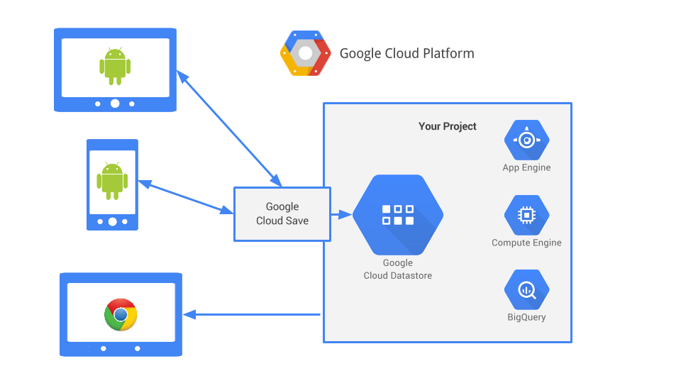
Backend Computing
Is backend server required? What does it do?

Slide 17
Outsourcing??

Slide 18
Outsourcing v/s Cloud-Sourcing
Outsourcing is a recent trend by business personals to reduce costs by transferring portions of work to outside suppliers rather than completing it internally.
Cloud Sourcing involves asking companies over the internet to take hold of specific tasks. Over the cloud, it does not require the company to provide infrastructure to the outsourced company.

Slide 19
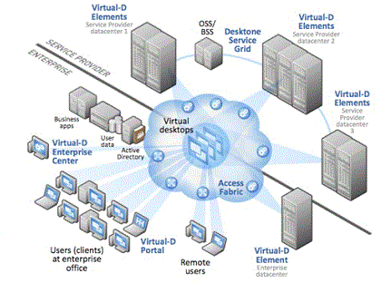
Cloud virtualization….
Virtualization in computing is the creation of a virtual version of something such as hardware platform, operating system, a storage device or network resources.
It allows to share a single physical instance of a resource or an application among multiple customers and organizations.

Slide 20
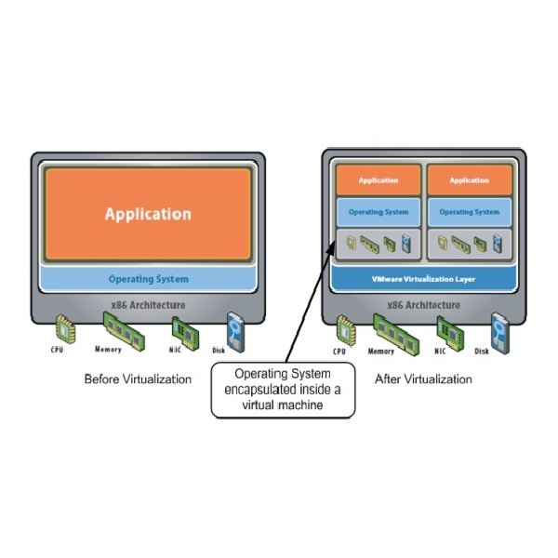
After virtualization
Before virtualization
Single OS per machine
Software and Hardware tightly occupied.
Underutilized resources
Costly infrastructure
Running multiple apps on same machine creates conflicts.
Independent of Hardware
Manages OS and apps as a single unit by encapsulating them.
VM can be provisioned to any machine.

Slide 21
SOA – Service Oriented Architecture
A service-oriented architecture is essentially a collection of services. These services communicate with each other. The communication can involve either simple data passing or it could involve two or more services coordinating some activity.
Cloud has dedicated architecture depending upon the services it has to give to customers.

Slide 22
Storage Size :
Storage size is constantly increasing decade by decade and one of the biggest reason is data duplicity.
Example: We download a movie and then share it with our friends, but it costs a lot of data storages. Cloud can help us sharing data instead of distributing it rather saying duplicating it.

Slide 23
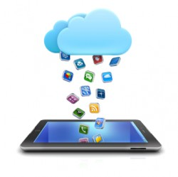
Home Sweet Connected Home : “Personal Cloud allows you to enjoy your everything in a connected home.”
Private Cloud has very vast usability in house .It provides services within an organization for maintaining the security and privacy.
Personal Cloud is a cool, secure place to load and store all of your favourite music and movies along with a lifetime of photos with every media devices(PC,TV). Your everything.

Slide 24
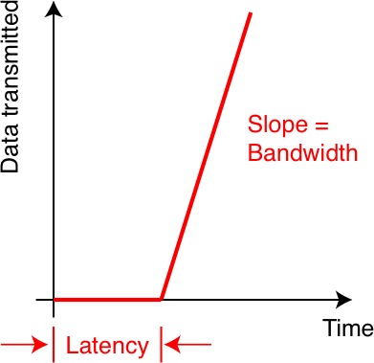
Basic Requirements to Access a Cloud
Internet connection with bandwidth according to the work.
Proper computer devices to stay connected to and configuration to reduce latency.

Slide 25
Computing Examples
Here we go with how the processing becomes efficient with EC2 (Elastic Cloud Computing)...
Storage services with S3...
Mobile HUB...
And much more.

Slide 26
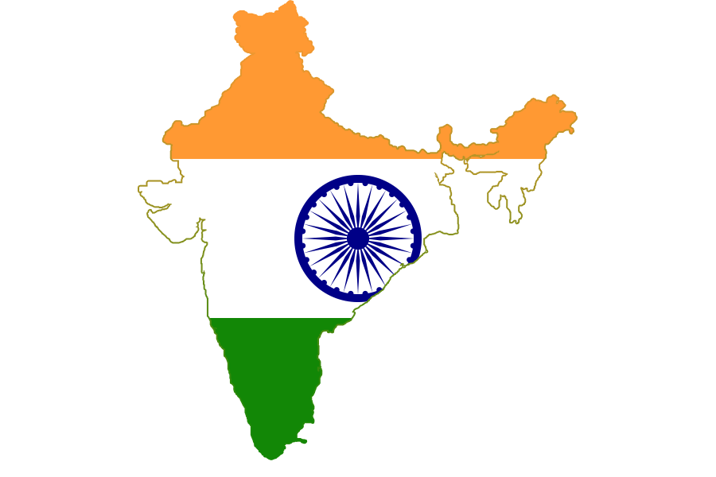



Indian Cloud Service Providers
Infosys – Cloud Services and Solutions
Extentia – Cloud Services
Orange Scape – Platform as a Service Provider

Slide 27


MeghRaj – Cloud by Indian Government
To utilise and harness the benefits of Cloud Computing, Government of India has embarked upon an ambitious initiative - "GI Cloud" which has been named as 'MeghRaj'.
The focus of this initiative is to accelerate delivery of e-services in the country while optimizing ICT spending of the Government. This will ensure optimum utilization of the infrastructure and speed up the development and deployment of eGov applications.

Slide 28
Cloud for Reduced Storage
The cloud has advantages of reduced storage by sharing instead of copying.
Movies and Music gives you best example.
Docs sharing is very effective for authenticity of documents.
Software piracy can also be reduced by keeping data on cloud since cracks and licenses cannot be stored on cloud.

Slide 29
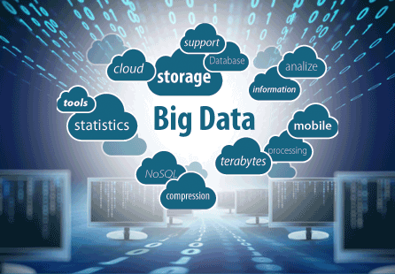
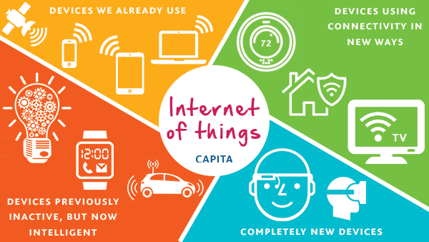
Future Linked Technologies
Big Data Analytics
Internet of Things

Slide 30

Big Data Embedded into Cloud
Data handling and its analysis has become a hectic task.
The rise of cloud computing and cloud data stores have been a precursor and facilitator to the emergence of big data. Cloud computing is the commodification of computing time and data storage by means of standardized technologies.
Unbelievably Facebook handles 300PB of data every day.
Hadoop is an open source, Java-based programming framework that supports the processing and storage of extremely large data sets in a distributed computing environment.

Slide 31
Internet of Things Embedded into Cloud
Handling the data flow over internet for interaction between the devices.
Cloud provides uninterrupted processing of data and communication between the devices.
Cloud computing and the IoT both serve to increase efficiency in our everyday tasks, and the two have a complimentary relationship. The IoT generates massive amounts of data, and cloud computing provides a pathway for that data to travel to its destination.

Slide 32
What you might have missed… RECENT DEVELOPMENTS IN CLOUD COMPUTING
AWS launches free services to get startups on the cloud !
Vending machine uses cloud technology to personalise your purchase !
Improved encryption @
CIPHERCLOUD

Slide 33
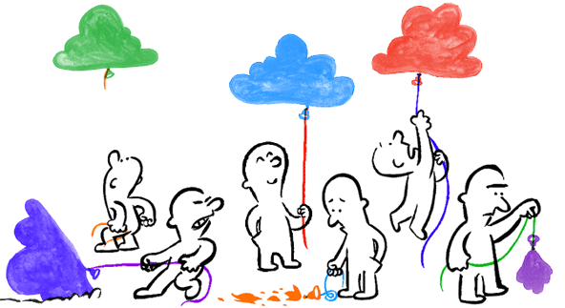
IMPLEMENTATION Comparison of execution times obtained for running simple codes on – 1.) command prompt 2.)cloud

Slide 34
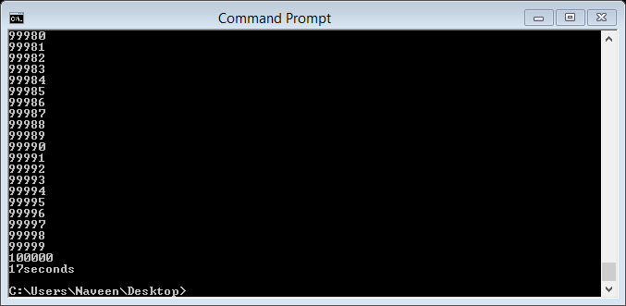
Execution time for running a simple program on command prompt is 17 seconds…

Slide 35
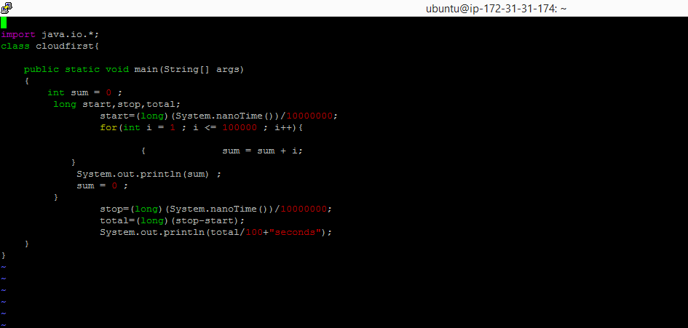
Code-- cloudfirst

Slide 36
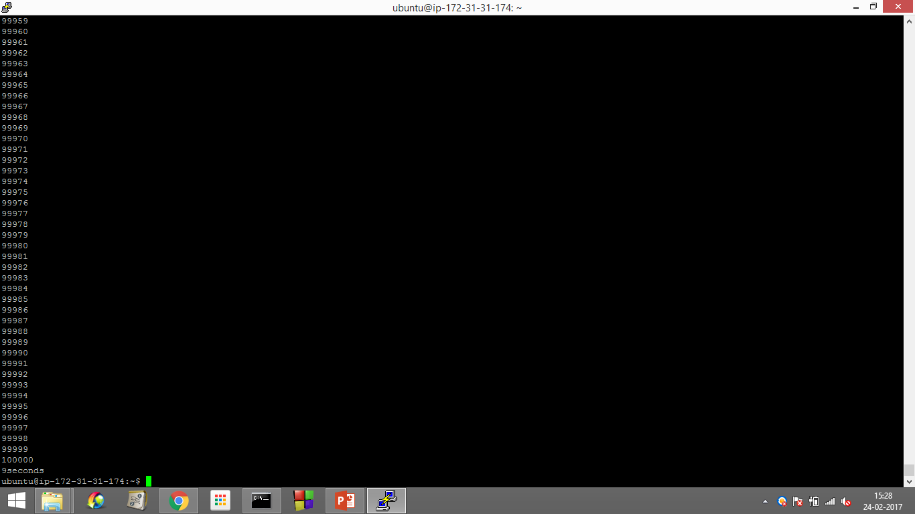
Execution time on the cloud for executing the same code cloudfirst is 9 seconds.

Slide 37


